Slide 1

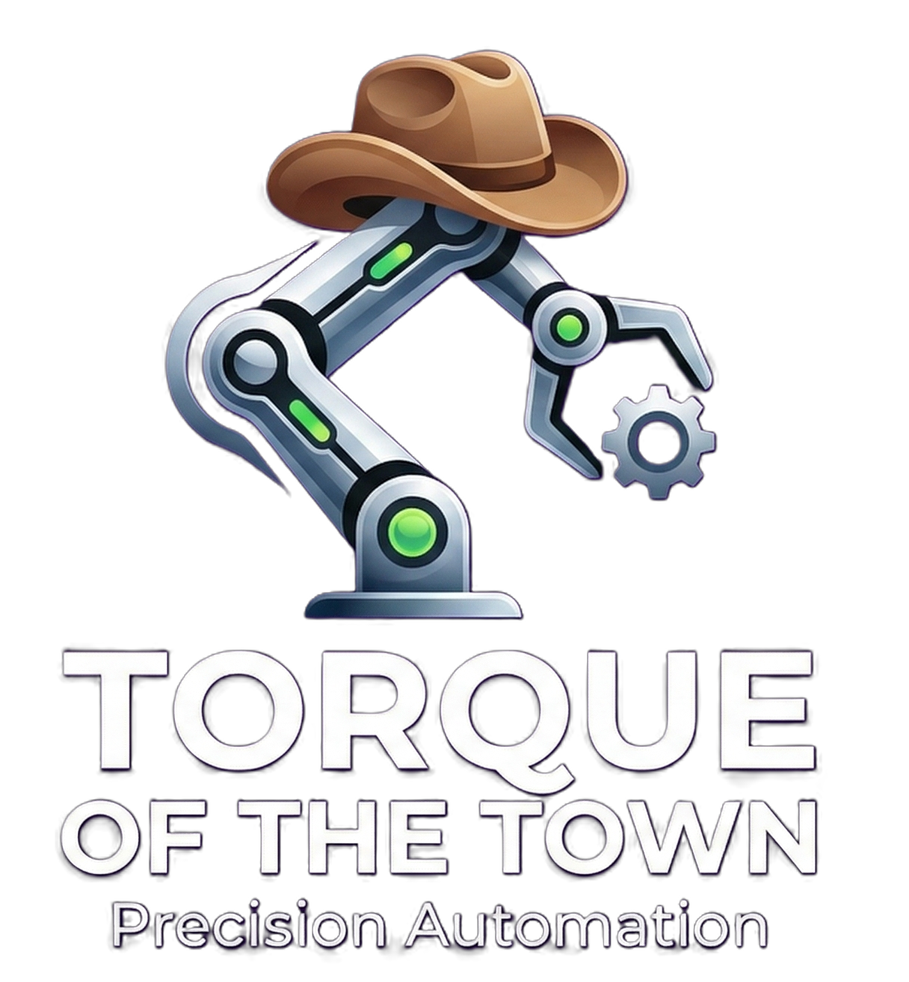

Torque of the Town™ Presents Torquey: a SCARA robot for Specialised Manufacturing Automation Processes
Pol Vallverdu – F321590
Zac Reyes – F319808
Kirushanth Kirushnakopalu – F323744
Kidus Dawit – F221110
Zachary Danzig – F229645
25WSC912

Slide 2
Problem Statement & System Requirements
Kirushanth Kirushnakopalu F323744
Note!
Company is specialised in IGUS APIRO robotic system utilising ESP32 microcontrollers
Brief issues:
Factory transition to remote automation
Original required recorrecting by a person
Had error of 1% in long production hours
Overall objective:
Design, build and test system to detect, pick, reorientate and place disc
Improve upon 1% error
Needs to also be efficient/fast
Needs to be cost efficient

Slide 3
System Architecture
Kirushanth Kirushnakopalu F323744
XIAO Camera (detects Disc Position, using Blob Detection)
ESP32-S3 (main controller) Frame Conversion, Inverse Kinematics and Motion Planning
DM556T Driver
IGUS Stepper motors
SCARA arms (towards set flipping station location)
End Effector (pick up disc)
SCARA arms (towards disc position)
Flipping Station (drops disc into flipping station and flips)

Slide 4
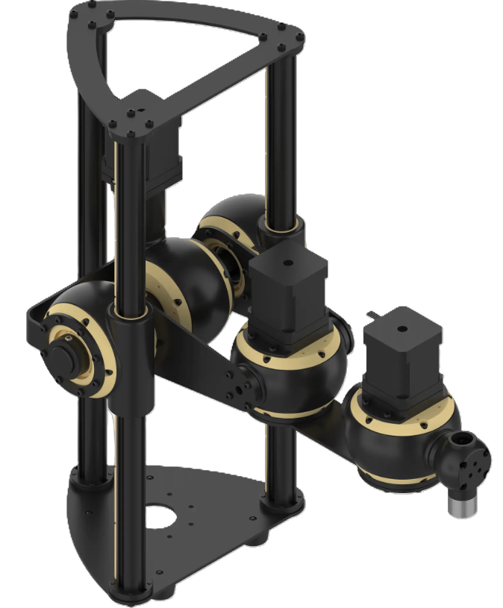
IGUS Apiro – Scara
Zac Reyes F319808
Task dominated by horizontal movement
Scara is optimised for planar motion
Compact design
Ideal horizontal reach
Low moving inertia
Notes:
Most of the movement is horizontal. Vertical movement only needed in one occasion: to pick bring disc to required height.
Two rotary joints provide fast and efficient horizontal positioning.
Well suited to the limited workspace available.
Reach covers entire area perfectly from a small base footprint.
Lightweight rotating links enable faster acceleration, deceleration, and direction changes.
Gantry has higher linear accuracy, but slower, larger, and less efficient for this application.

Slide 5
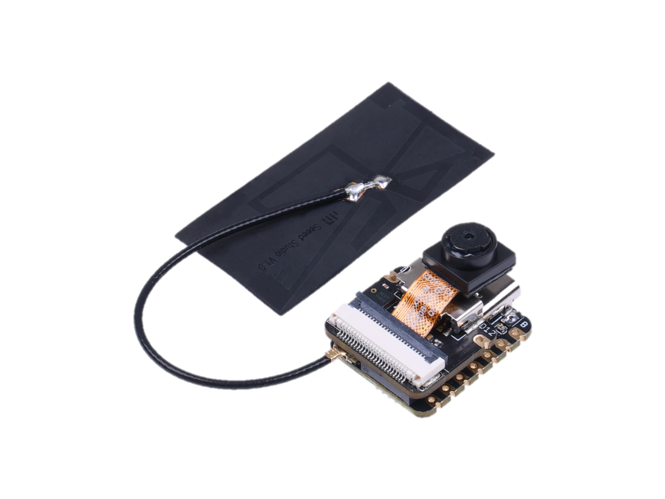
Sensor Selection
Zac Reyes F319808
Camera VS Alternatives
Ultrasonic and IR array sensors too expensive, affordable options only read single points
Lidar sensor exceeds budgetary limits
Camera provides all necessary information in one image
Limit Switches
Simple way to assign a home position for robot
Budget friendly
Why the Xiao ESP32S3?
Designed for Machine vision Applications
ESP32 compatible
Very cheap < £12
Notes:
Why camera over other sensor types – considerations for how this solution could be solved (i.e. an ultrasonic or IR sensor could have been used but they read only single points, Lidar would work but is probably out of budget), limit switches
Camera model is XIAO ESP32S3 – very cheap at ~£12 and perfect for this solution

Slide 6
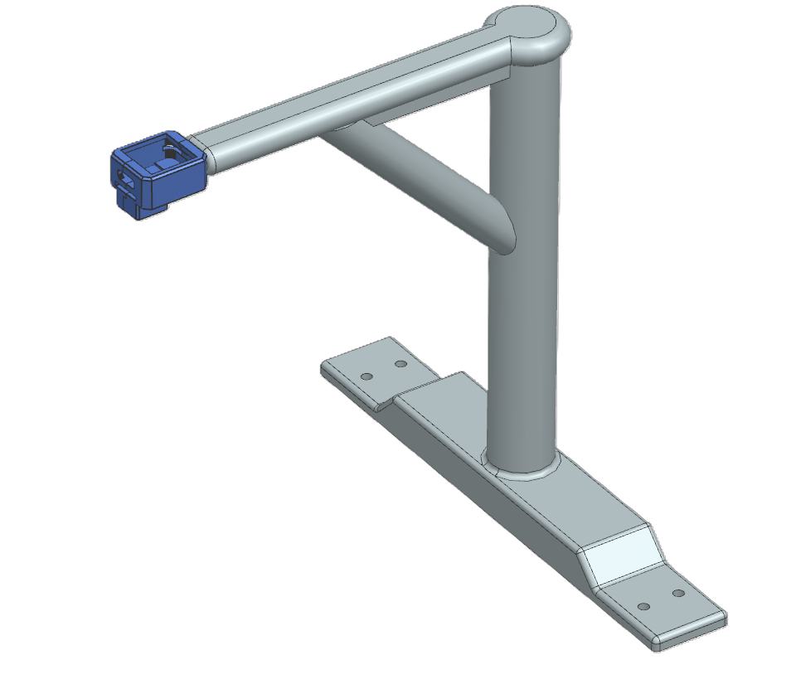
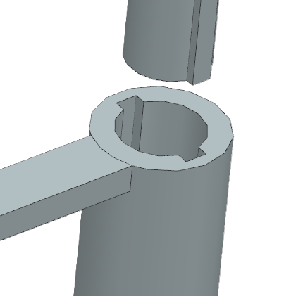
Camera Stand
Zac Reyes F319808
Stand-alone camera stand to ensure stability
Top and bottom piece slot together to avoid lateral movement
Angled beam guarantees camera is parallel with base plate – crucial for disk location accuracy
Open-source case specifically designed for XIAO ESP32S3 Camera

Slide 7
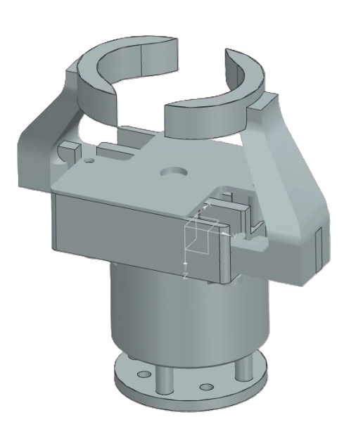
End Effector
Pol
F321590
Disc-shaped fingers reduce dependence on disc localization.
Stepper motor has increased precision but requires an additional driver and increases control complexity.
DC motor is cheaper and faster but lacks inherent positional feedback.
Servo actuator selected due to best balance of simplicity, cost, and weight.
Notes:
Disc-shaped fingers ensure disc is picked up even if the sensing mechanism is slightly off, which reduces dependence on exact disc localisation.
Servo motor was chosen to open and close the gripper due to its low mass, which reduces load on the arm and improves dynamic performance.

Slide 8
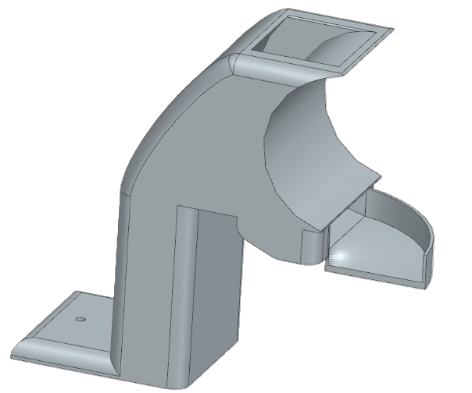
Flipping Mechanism
Pol
F321590
No active control required.
Curvature profile optimised through iterative testing.
Sensitive to release position and orientation.
94% success rate with inconsistent release positions.
Expected near 100% success rate under consistent release conditions
Notes:
No dedicated actuator or additional programming required.
Multiple curvature profiles were evaluated to achieve consistent flipping behaviour
Single component reduces manufacturing cost and allows for easy replacement if broken
50 tests done from different drop positions, 3 failures: 1 from dropping too high causing too much momentum and flip back after bouncing on box wall and 2 from dropping it near an edge causing it to bounce from the edge into the channel so lack of momentum and flipping back as leaving the flipper before touching the box.
Concluded that as long as the position the disc is dropped from is consistent the flip should remain successful

Slide 9
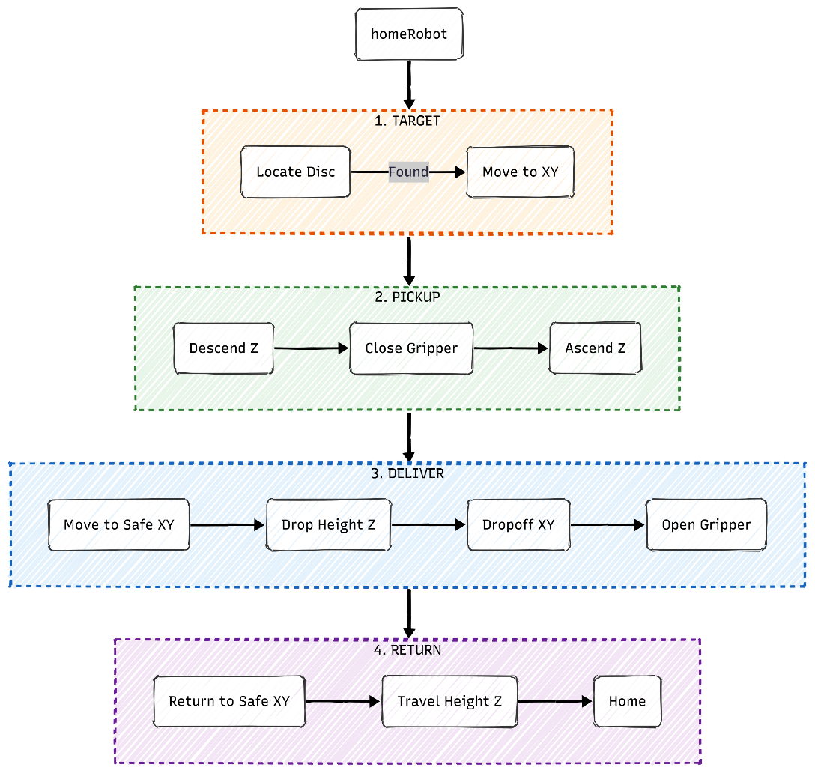

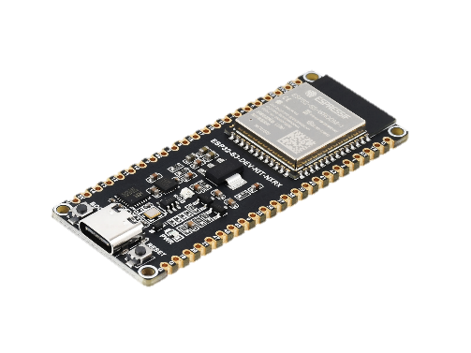
The State Machine
Zachary Danzig
F229645
Software Integration
loop
Central disc (x,y) pixel
coordinates
Notes:
First robot is homed using the limit switches then we enter the state machine.
The main esp32 awaits pixel coords for the disc which is converted into a world frame location.
Inverse kinematics is then performed to move to XY.
The next stage in the state machine is the pickup, and then the payload delivery.
First, we move to a safe location to avoid collisions with the camera stand, then we rise to the drop height above the flipping station.
Once dropped we return home via the same path and then the whole process is looped.

Slide 10
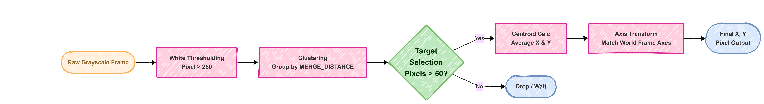
Blob Detection
Zachary Danzig
F229645
Algorithms – Machine Vision
y
Primary Target
x
X,Y centroid found
Notes:
For the MV we use Blob detection to identify disc pixel coordinates.
Greyscale then white threshold.
“Clustering” groups nearby white pixels into blobs, creating boundary boxes for each of these blobs.
Any boundary box with less than 50 pixels is dropped, then a primary target is selected and the central point is found. (Cameras BR corner is 0,0)
The point then undergoes an axis transform to match the world frame axes and the final location is sent to the main ESP32.

Slide 11
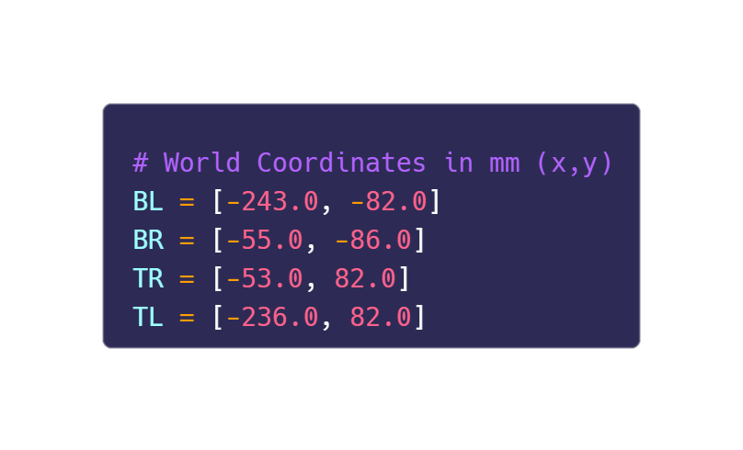
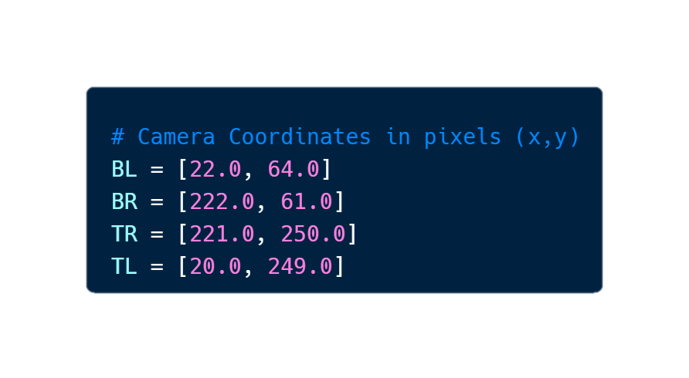
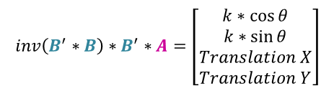
Camera Frame to World Frame
Zachary Danzig
F229645
Algorithms – 2D Similarity Transform
Global World Frame
Form matrix
A
(0,0) mm
TL
TR
y
x
Form matrix
B
BL
BR
$$inv\left(B^{′}∗B\right)∗B^{′}∗A=\left[\begin{matrix}k∗\cos{θ} \\ k∗\sin{θ} \\ Translation X \\ Translation Y\end{matrix}\right]$$
(x,y) mm
(x,y) pixels
Location Found relative to the world Frame
Notes:
How is the disc located?
We use the 2D ST to convert from the camera frame to world frame.
First, we define a Global WF in our rig (this is intercepting with the z-axis of the 1st rotary motor)
We measure the X,Y coordinates of the pickup region in the world frame and camera frame, these form our A and B matrices.
We can then determine our rotation, translation and scaling from this equation to convert our cameras pixel location into a location relative to the world frame (in mm).
(k = scale factor)

Slide 12
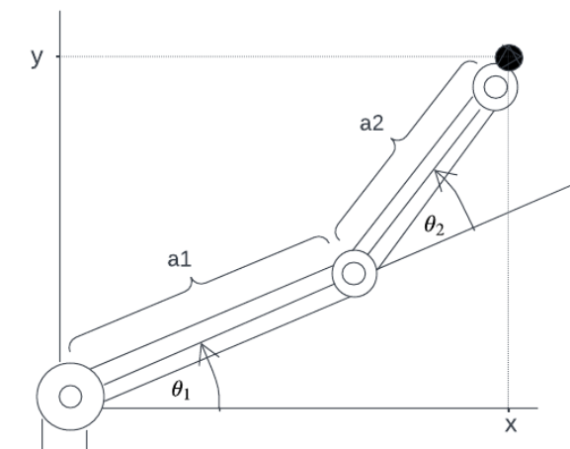




(2-Link Planar Robot Arm)
Kidus Dawit – F221110
Algorithms – Inverse Kinematics
Inverse kinematics maps the detected disc position (x,y) (x,y) to the shoulder and elbow joint angles required to reach it. The algorithm first checks whether the target lies inside the robot workspace, then computes two possible 2-link arm configurations using trigonometry. The valid solution is chosen based on joint limits, and the final angles are converted into stepper motor commands.
Input: target disc position in world frame
Method:
1. Compute radial distance to target:
2. Check if the point is reachable using link lengths
3. Solve elbow angle using the law of cosines:
4. Solve shoulder angle geometrically:
5. Generate two possible arm configurations, then select the one that satisfies THE Joint limits
6. Convert final joint angles into stepper motor steps for actuation
Notes:
Disc position known in world frame
Convert target (x,y) into shoulder + elbow angles
Check if point is reachable
Use 2-link geometry / law of cosines
Calculate both possible arm configurations
Choose solution within joint limits
Convert final angles into stepper steps

Slide 13
Limitations & Improvements
Kidus Dawit – F221110
Limitation | Improvement
Z-axis stepper missing steps at higher speed | Redesign or replace Z-axis drive
Homing not fully reliable from all start positions | Separate limit switches for each joint, include an independent one per joint Or include encoders for each joint
Encoder feedback could improve positioning Safety move required before drop-off to avoid collisions | Improve layout for a more direct, collision-free path
Despite high 94% success rate, all errors would accumulate downstream | Continue to make slight adjustments to the flipping station, while testing for more edge cases Include failsafe to check for failed runs that would halt further action
Notes:
Main issue was the Z-axis missing steps at speed
Homing was also unreliable in some starting positions
A better design would use one limit switch per joint
Encoders would further improve accuracy
We also needed a safety move to avoid collisions
Future layout changes could allow a more direct path
94% success rate is good but errors accumulate
To counter this, improve as well as add failsafe to stop production line in the case of failed attempts

Slide 14
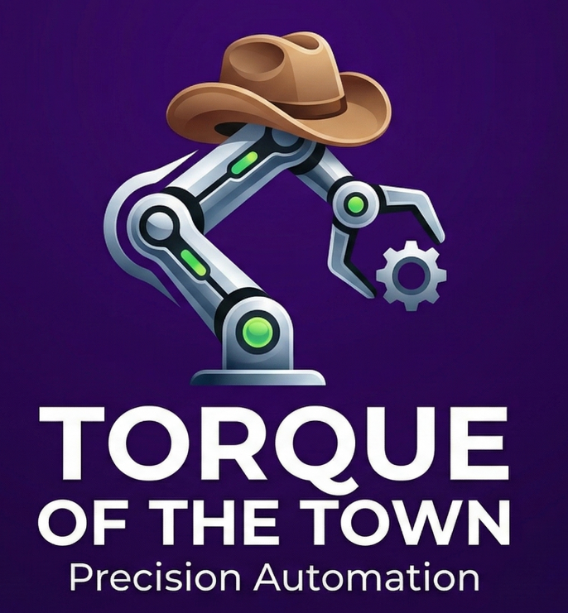
Final Outcomes & Conclusion
Kidus Dawit – F221110
Automated detect, flip, and place process
Replaced inconsistent manual handling with a repeatable system
SCARA design suited the task through fast planar motion
94% flipping success showed strong proof of concept
Future deployment needs more precise placement or a more tolerant flipping/pickup stage
Modular, low-cost, and scalable for wider factory use
(Google Gemini, 2026)
Notes:
System completed locate, flip, and place task
Combined vision, transforms, IK, and actuation
SCARA design suited fast horizontal motion
Passive flipping kept system simple and cheap
Proof of concept was successful despite limitations
Strong potential for wider industrial pick-and-place use
Clear routes for future improvement and scaling

Slide 15
