Slide 1
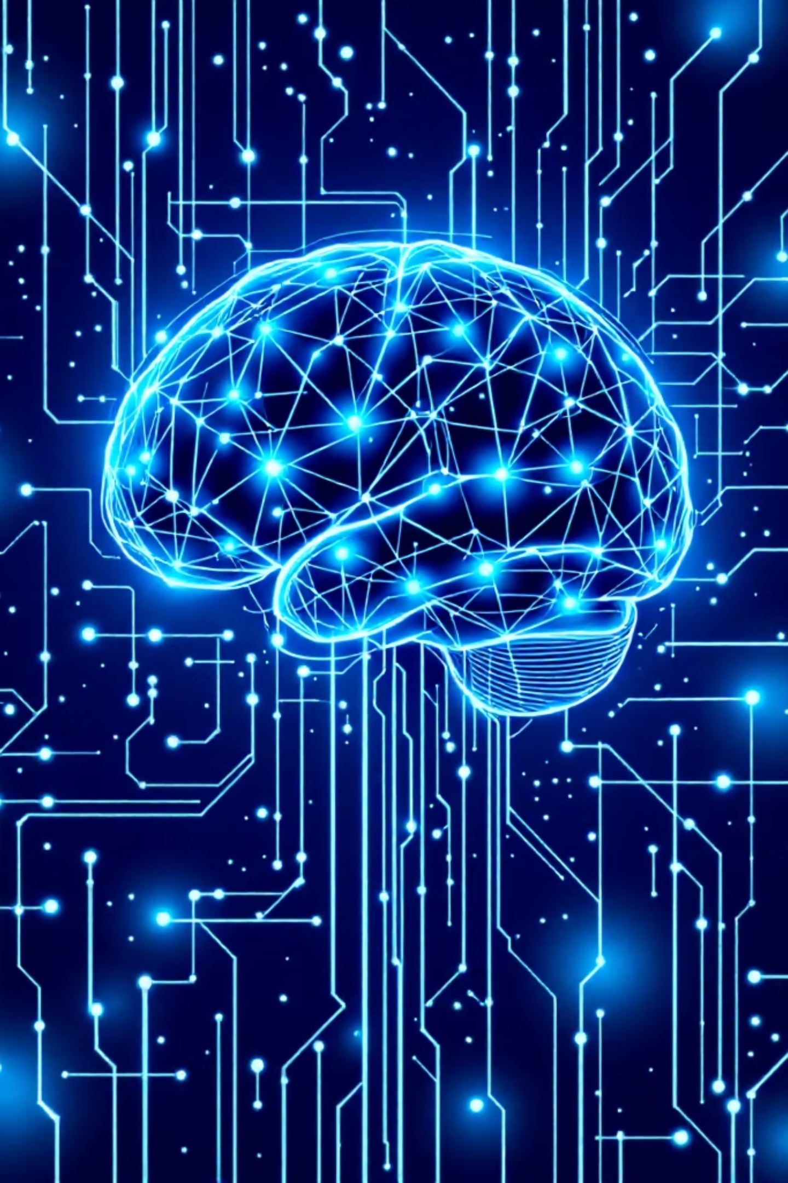
Real-Time Deep Learning Classifier for Multiclass Motor Imagery BCIs
Presenter: Giacomo Albergo | Advisor: Dr. Abhishek Prasad | Course: BME 707

Slide 2

Background and Significance
Motor imagery Brain-Computer Interfaces show significant promise in neurorehabilitation and assistive technology. However, a critical challenge stands still: achieving high decoding accuracy in multiclass scenarios.
While binary classifications (e.g., left vs. right hand movements) show success, transitioning to complex functional tasks remains highly difficult. This research bridges the gap between theoretical deep learning capacity and practical, high-accuracy BCI control.

Slide 3




Project Goals
Primary Objective
Classification Model
Develop a robust deep learning classifier for real-time decoding of nine distinct hand movements using EEG signals.
Establish high-accuracy multiclass classification by overcoming overfitting issues in standard neural network architectures.
Signal Analysis
Analyze relationships between non-invasive EEG and invasive ECoG to inform feature extraction strategies.

Slide 4
Proposed Plan
Implementing a comprehensive neural network pipeline within a Python-based environment using BIDS standard for reproducibility.
01
02
Environment Setup
Data Organization
Fork and clone repository, create isolated Conda environment for dependency management.
Organize datasets using BIDS standard for consistent formatting and reproducibility.
03
04
Experimental Testing
Model Development
Test full 9-class multiclass dataset and simplified binary subset (Finger vs. Wrist movements).
Write custom classifier with advanced preprocessing and regularization techniques to enhance generalization.

Slide 5

Expected Outcomes and Deliverables
Optimized Decoder
Fully optimized multiclass model ready for real-time application with high classification accuracy.
Overcoming Baseline Issues
Resolved overfitting issues and improved multiclass separation capabilities with limited data.
Robust Method
Reliable deep learning method that translates complex motor imagery into actionable BCI commands.

