Slide 1

Project Ideas

Slide 2
Offensive Pattern Recognition
Trajectory Prediction Model:
Generative models.
Start with Social LSTM model, to get some results.
Develop to GNNs and LSTMs or Graph Variational RNNs
Pattern Recognition:
Player use case or team use case .
Select specific game plays, predict trajectories.
Use clustering to group trajectories then analyze these game plays to find patterns.
Use visualization.

Slide 3
Offensive Pattern Recognition
Articles with methods:
Diverse Generation for Multi-agent Sports Games (Graph Variational RNNs)
https://openaccess.thecvf.com/content_CVPR_2019/papers/Yeh_Diverse_Generation_for_Multi-Agent_Sports_Games_CVPR_2019_paper.pdf
Multiagent off-screen behaviour prediction in football (GNNs & LSTM)
https://www.nature.com/articles/s41598-022-12547-0
Searching for a Strategy: Modelling Player Trajectories in Soccer Games (Social-LSTM)
https://github.com/jagjeet-singh/Social-lstm-for-predicting-player-trajectories-in-soccer/blob/master/Report.pdf

Slide 4
Social LSTM - code
Model init:
LSTMcell, InputEmbedding, TensorEmbedding, OutputLayer.
SocialTensor: matrix multiplication between player grid (player surrounding) and hidden state (LSTM output).
Model forward:
For each frame in the sequence:
Get nodes present in the frame and the corresponding grids.
Get current hidden and cell states.
Get Social Tensor then push current nodes through Input Embedding layer and push social tensor through TensorEmbedding. Then concatenate.
Push concateneted tensor through LSTM. Use hidden nodes to calculate the output.

Slide 5
Social LSTM - code
Training:
Generate sequences, generate grid sequence matrix
Represent the sequence as the graph, get nodes.
Generate hidden and cell states with zero tensor.
Do the forward propagation use Gaussian2DLikelihood loss function (created by author)
Backpropagation with a Gradient clipping to prevent exploding gradients.

Slide 6
Player Performance Analysis
Model for Decision Evaluation:
Offline DRL.
Focus on a specific player not the one who has a ball.
Actions: on-ball:pass, carry, dribble, clear | off-ball: destination to move, speed etc.
Reward: on-ball: reward from paper | off-ball: xReceiver
Develop with GNNs.
Performance Analysis:
Analyze clutch game-plays by comparing possible actions with chosen one.
Generate heatmaps with difference with decision value to evaluate
Add recommendations for game plays where player performed badly.

Slide 7
Player Performance Analysis
Articles :
Reinforcement Learning for Football Player Decision Making Analysis
https://statsbomb.com/wp-content/uploads/2022/09/Michael-Pulis-and-Josef-Bajada-–-Reinforcement-Learning-For-Football-Player-Decision-Making-Analysis-1.pdf
Deep soccer analytics: learning an action-value function for evaluating soccer players
https://link.springer.com/article/10.1007/s10618-020-00705-9
Deep Reinforcement Learning meets Graph Neural Networks: exploring a routing optimization use case
https://arxiv.org/abs/1910.07421
Making Offensive Play Predictable - Using a Graph Convolutional Network to Understand Defensive Performance in Soccer
https://www.statsperform.com/wp-content/uploads/2021/04/Making-Offensive-Play-Predictable.pdf
Identifying Soccer Players’ Playing Styles: A Systematic Review
https://www.mdpi.com/2411-5142/8/3/104

Slide 8
Event Detection with Temporal GNNs
Event Detection Model:
Use Convolutional GNNs
Test different pooling methods,
Develop model with RNNs.
Potential Use Cases:
Collect useful statisctics for analysis,
Generate heatmaps for each phase.
Generate passing networks for specific phases.

Slide 9
Event Detection with Temporal GNNs
Articles:
Goal!! Event detection in sports video
https://www.researchgate.net/publication/313228631_Goal_Event_detection_in_sports_video
Spotting Football Events Using Two-Stream Convolutional Neural Network and Dilated Recurrent Neural Network
https://ieeexplore.ieee.org/document/9410263
Event Detection in Football using Graph Convolutional Networks
https://arxiv.org/abs/2301.10052

Slide 10
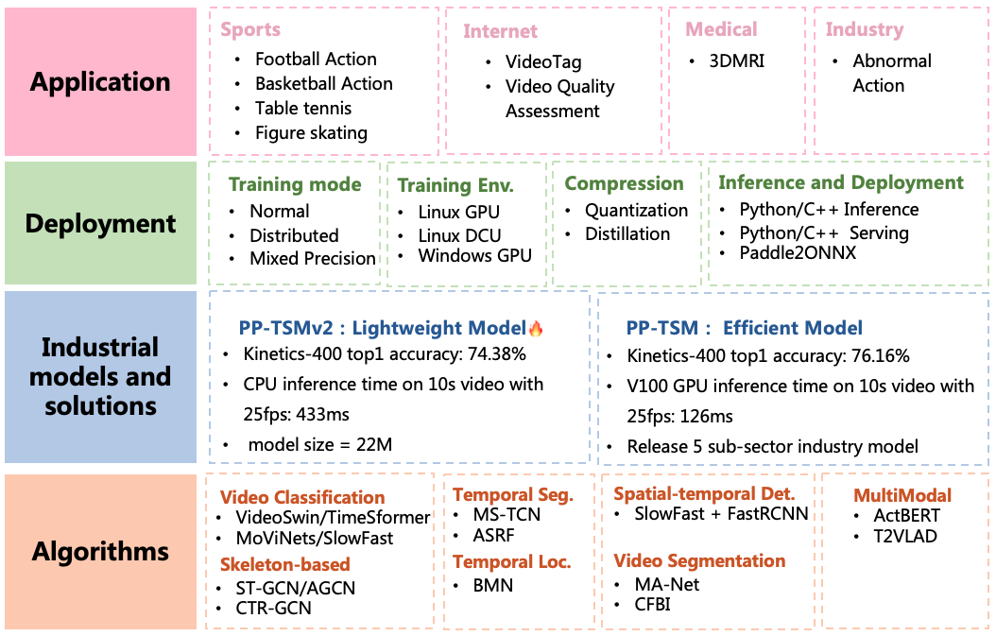
SoccerNet Features - Code
PaddleVideo Model:
Package for video tasks.
Generates features used for classification.
Different modelling frameworks: ["Recognizer1D", "Recognizer2D", "Recognizer3D", "BMNLocalizer"].
Different backbone networks and head for classification layer.

Slide 11
Football Events – positional data
Article: Slicing and dicing soccer: automatic detection of complex events from spatio-temporal data
Formalizing events based on principled ITL.
An open source soccer simulation engine to release the synthetic Soccer Event Recognition dataset.
Repository consists:
a) EventDetector Atomic (with Genetic Optimizer and Evaluation code)
b) EventDetector Complex
c) Visualization System (to visualize annotated and detected events super-imposed on the video)

Slide 12
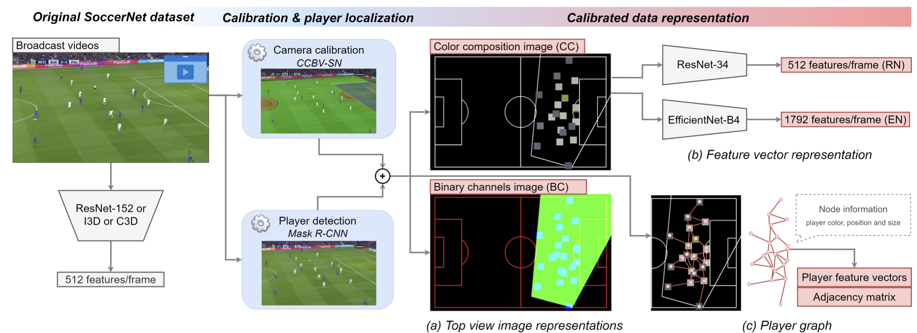
Soccer Action Spotting
Article: Camera Calibration and Player Localization in SoccerNet-v2 and Investigation of their Representations for Action Spotting
https://arxiv.org/pdf/2104.09333.pdf

Slide 13
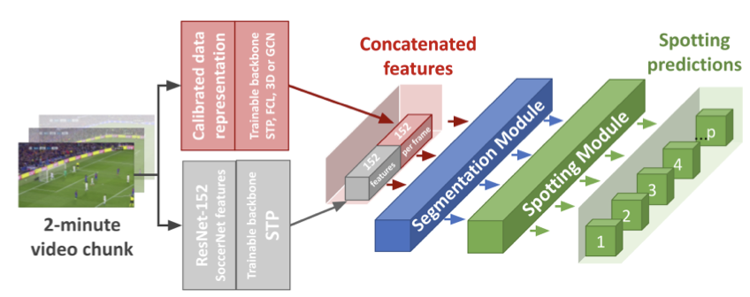
Soccer Action Spotting

Slide 14
Ghosting to analyze tactics
Goal: predict the actions of soccer players, which are defined as their positions at future time steps.
Imitation Learning Model
- Use RNNs to capture temporality. - Phase 1: focuses on training individual player models for various roles.
- Phase2: joint training of these pre-trained player models for collaborative multi-agent learning.
- Develop with GNNs.
Tactical Analysis: - Analyse specific game plays from the game: corners, ball on the wings, ball played at middle.
- Use for teams comparisons.

Slide 15
Ghosting to analyze tactics
Data-Driven Ghosting using Deep Imitation Learning http://www.yisongyue.com/publications/ssac2017_ghosting.pdf

Slide 16
Data-Driven Ghosting using Deep Imitation Learning - Code
Dynamic Raw RNN: takes a cell (LSTM cell), input, batch size, sequence length, horizon, output dimension, dropout rate, and policy number as input. Inside the function, a loop function (loop_fn) is defined to control the RNN's behavior at each time step.
SinglePolicy: module representing an LSTM-based model for predicting sequences, designed for a single policy in a multi-policy setting.
ImportGraph Class: facilitates the loading and forward-pass execution of a pre-trained neural network graph, including its input and output tensors, from a saved model checkpoint.

Slide 17
Team Off-Ball Movement Analysis
Model for Decision Evaluation:
Use Offline-RL to learn optimal movements.
Phase 1: focuses on training individual player models for various roles.
Phase 2: joint training of these pre-trained player models for collaborative multi-agent learning.
Actions: desired coordinates x, y.
Performance Analysis:
Analyze clutch game-plays by comparing possible movements with chosen one.

