Slide 1
Matched-Filter Chirp Ranging
with CFAR Detection
Finding echoes in noise by pattern matching, in simulation and live on a laptop
Student name: [Student name] Roll no: [Roll no]
Guide name: [Guide name]
Department: [Department] Institute: [Institute]
Academic year: [Academic year]

Slide 2
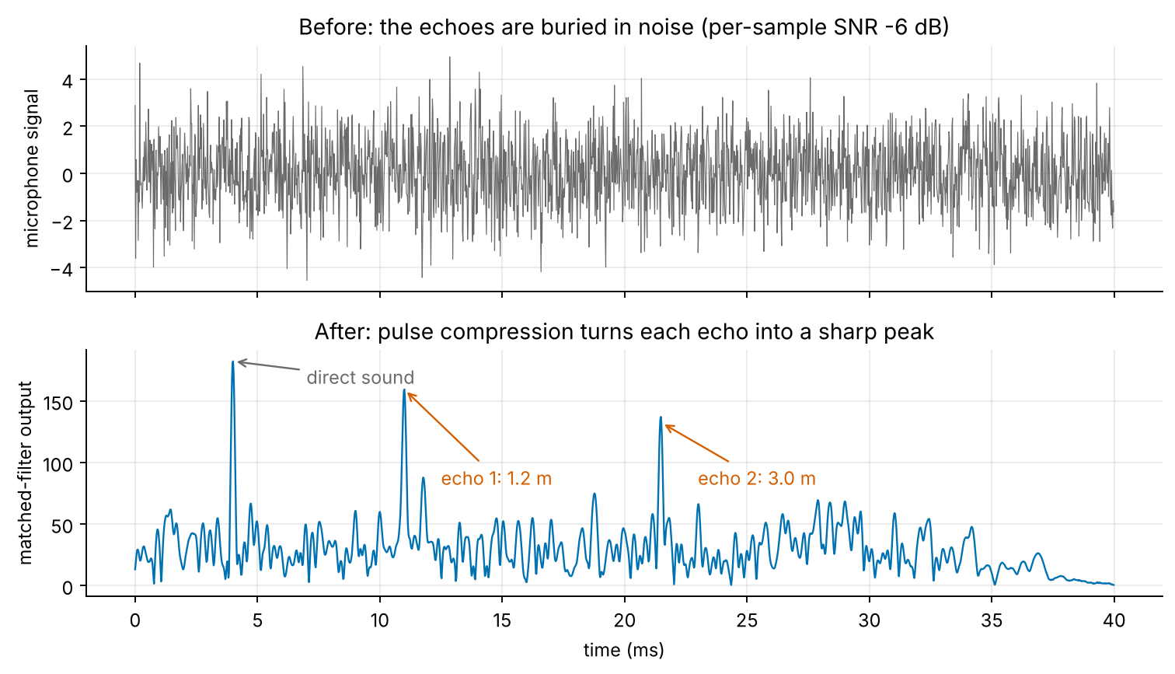
1 Introduction
• Distance from an echo: R = c·t / 2
• Long chirp = lots of energy; matched filter squeezes it into a peak ≈ 1/B wide [7]
• Range resolution c/(2B) = 2.14 cm for B = 8 kHz; SNR gain ≈ 26.8 dB
• Problem 1: sidelobes (−13 dB) hide weak targets [1], [2]
• Problem 2: a fixed threshold gives false alarms → CFAR [3], [4]
• One laptop: speaker + mic only cm apart, so targets < 10–20 cm merge with the direct sound
Before (top): echoes invisible at −6 dB SNR. After the matched filter (bottom): clear peaks.
2

Slide 3
2 Comparative Study of Literature
Paper | Year | Takeaway for this project
Azouz et al., enhanced matched filter, Sensors [1] (base) | 2021 | Shape the receive filter to cut LFM sidelobes
Tan & Wang, two-step windowing [2] (abstract only) | 2025 | Sidelobes vs SNR trade-off; not implemented
SonicPACT ultrasonic ranging [5] | 2020 | Acoustic ranging on commodity devices
Pyroomacoustics [11] | 2018 | Room simulation cross-check
Weinberg, sliding-window detectors [4] | 2017 | CA / OS CFAR family
Richards [7], Richards et al. [8], Skolnik [9] | 2008–14 | Formulas: resolution, gain, detection
Rohling, CFAR in clutter [3] | 1983 | CA-CFAR baseline, multiple targets
Allen & Berkley, image method [6] | 1979 | Room echo simulator
Base paper first, then latest to oldest. Summaries are title/abstract level.
3

Slide 4
3 Objective
• Build an LFM chirp generator and FFT matched filter from scratch in NumPy
• Convert delay to range (R = c·t/2); report resolution c/(2B) and unambiguous range
• Control sidelobes with rectangular / Hamming / Taylor windows; measure PSLR
• Implement CA-CFAR and OS-CFAR with threshold set by a false-alarm probability; test two close targets
• Measure Pd, false alarms and range error vs SNR by Monte Carlo
• Interactive Streamlit app: Simulation and Live one-device mode on the same code
• Optional: estimate room length and breadth, with honest limits
4

Slide 5
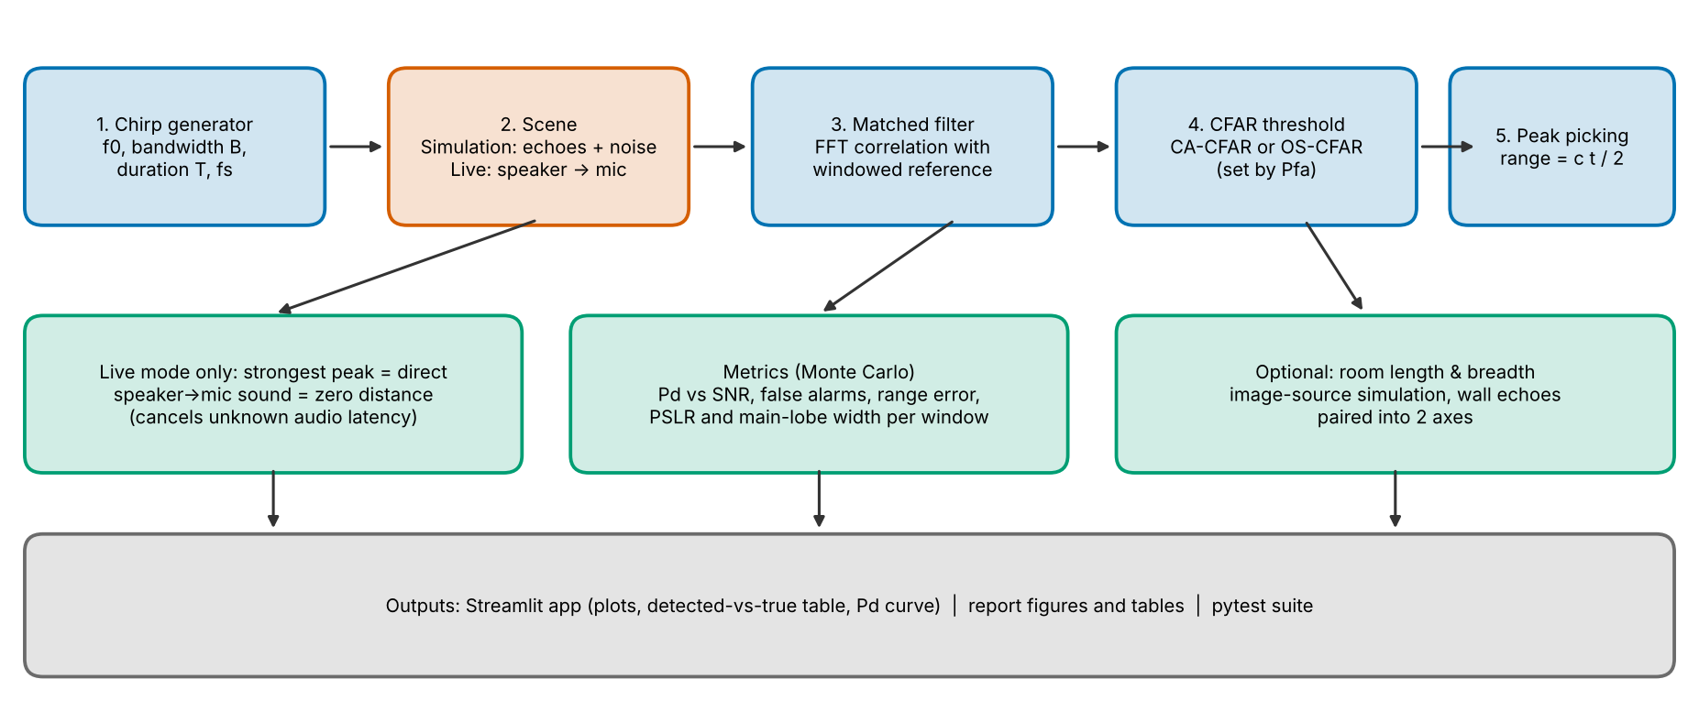
4 Methodology
• Chirp: f0 → f0+B in T
• Matched filter: IFFT(FFT(rx)·conj(FFT(ref)))
• Window on the replica
• CFAR: threshold = α · noise level of training cells
• CA: mean, α = N(Pfa^(−1/N) − 1) [3]
• OS: k-th smallest, k = 0.75 N [3], [4]
• Live: direct sound = zero distance → latency cancels
5

Slide 6
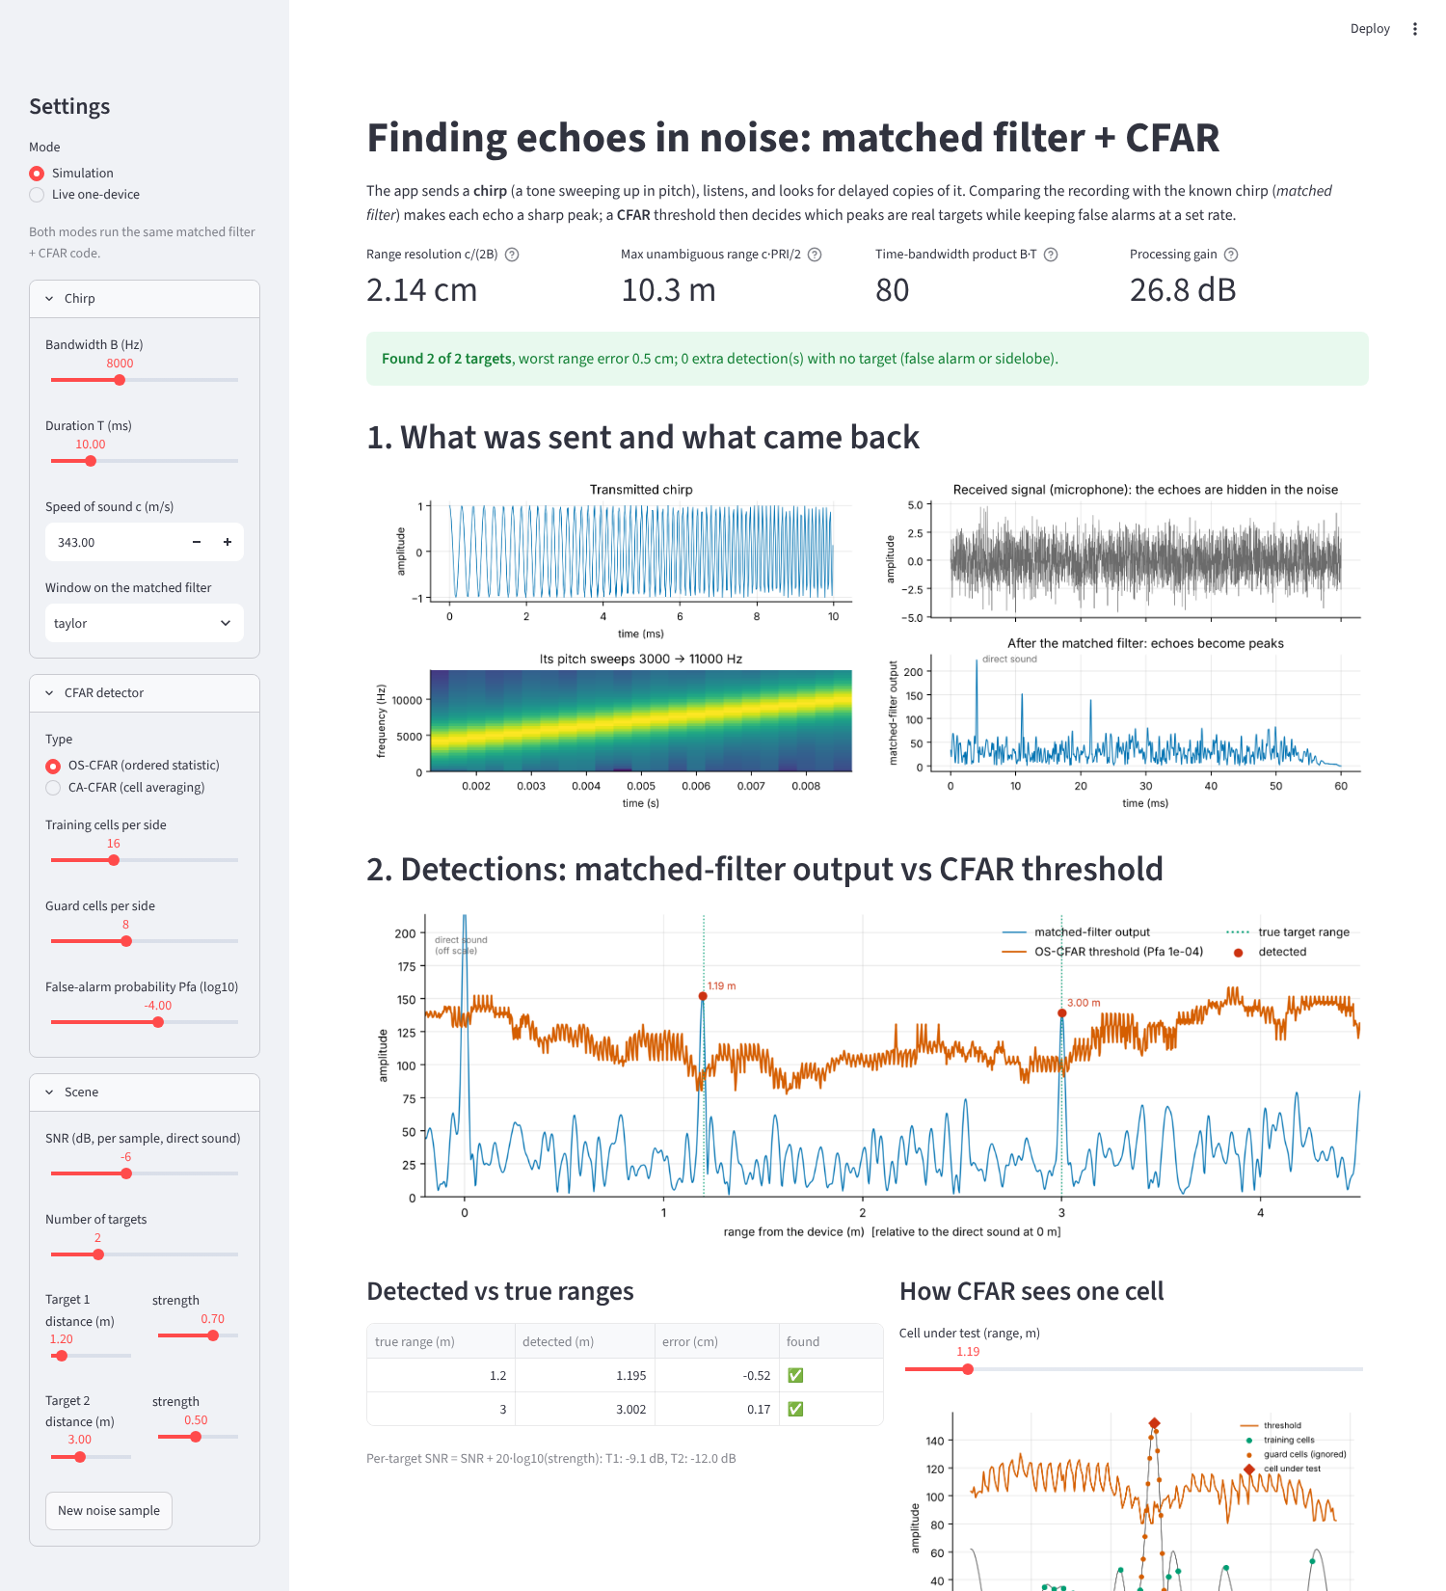
5 Work Done
• Tools: Python, NumPy [12], SciPy (Taylor window only) [13], Matplotlib [14], Streamlit [15], sounddevice [16], pytest [17]
• src/: chirp, matched filter, windows, CA/OS-CFAR, metrics, audio I/O, room estimation
• 32 pytest tests, all passing
• experiments/: one script per figure and table
• Fallback to simulation if no audio device
6

Slide 7
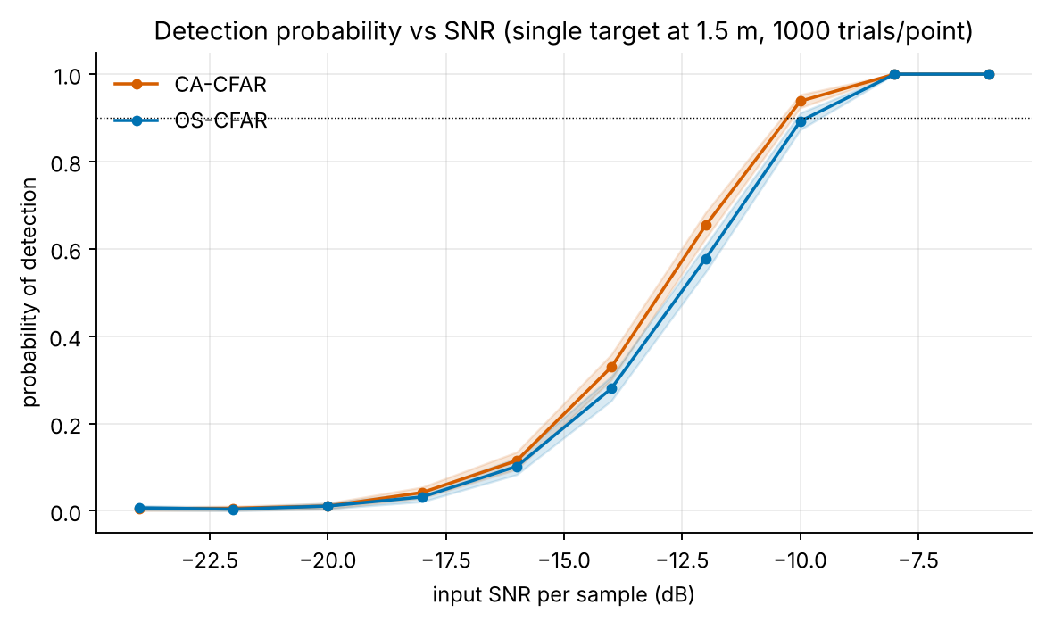
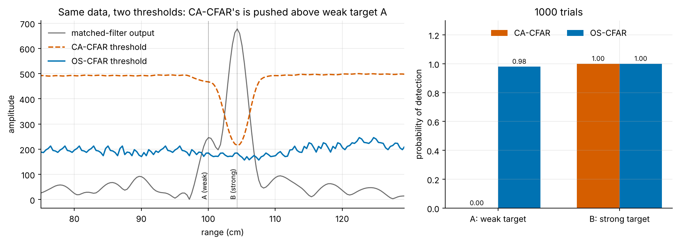
6 Results
• PSLR: rectangular -13.4 dB, Hamming -38.3, Taylor -36.6; main lobe 1.86 → 2.65 cm (Taylor), SNR loss 1.14 dB
• Pd at −10 dB input SNR: CA 0.938, OS 0.892; measured Pfa 1.6e-04 / 1.6e-04 vs design 1e-4
• Range error std 2.2 mm at −10 dB (one cell = 21.4 mm)
• Masking (2 close targets): weak target found CA 0.00 vs OS 0.98
• Room size (simulation): 79/100 random rooms within 5 cm at 50 dB; 0/36 at 20 dB
• Live run and real-room check: NOT done (no audio device here) – placeholders
7

Slide 8
7 References
[1] M. Azouz, M. Abosekeen, M. Nassar and A. Hanafy, "Design and Implementation of an Enhanced Matched Filter for Sidelobe Reduction of Pulsed Linear Frequency Modulation Radar", Sensors, vol. 21, no. 11, art. 3835, 2021, doi:10.3390/s21113835 (open access).
[2] Y. Tan and Z. Wang, "Two-step windowing for both sidelobe suppression and SNR maximization of radar range profiles", Signal, Image and Video Processing, vol. 19, no. 2, 2025, doi:10.1007/s11760-024-03748-3 (paywalled; only the abstract was checked).
[3] H. Rohling, "Radar CFAR Thresholding in Clutter and Multiple Target Situations", IEEE Trans. Aerospace and Electronic Systems, vol. AES-19, no. 4, pp. 608-621, 1983.
[4] G. V. Weinberg, "An Introduction to Radar Sliding Window Detectors", arXiv:1709.09786, 2017.
[5] Meklenburg et al., "SonicPACT: An Ultrasonic Ranging Method for the PACT Protocol", arXiv:2012.04770, 2020.
[6] J. B. Allen and D. A. Berkley, "Image method for efficiently simulating small-room acoustics", J. Acoust. Soc. Am., vol. 65, no. 4, pp. 943-950, 1979, doi:10.1121/1.382599.
[7] M. A. Richards, Fundamentals of Radar Signal Processing, 2nd ed., McGraw-Hill, 2014.
[10] TU Berlin, "Matched Filter and Pulse Compression", chapter of the Scientific Python course, platform.commit.tu-berlin.de/en/book/sci-python/chapter/ch25/section/s01.
Full list of 19 references in the report. [2] cited from its abstract only.
8

