Slide 1
Template Matching of Environmental Sounds
using Normalised Cross-Correlation
Finding where a known sound occurs in a longer recording (ESC-50)
Student name: [Student name] Roll no: [Roll no]
Guide name: [Guide name]
Department: [Department] Institute: [Institute]
Academic year: [Academic year]

Slide 2
Index
01
Title
02
Index
03
Comparative Study of Literature
04
Objective
05
Methodology (Flow Chart)
06
Work Done
07
Results
08
References
Template matching of environmental sounds with normalised cross-correlation (ESC-50)
2

Slide 3
Comparative Study of Literature
Paper | Year | Takeaway
BASE PAPER: Nolasco et al., Learning to detect an animal sound from five examples, Ecological Informatics [17] | 2023 | Detect a sound from few examples; template matching is the classic baseline
Tutul, Buchem, Pinkwart, cross-correlation vs CNN sound detection (arXiv preprint) [18] | 2026 | NCC with a fixed threshold detects a stored sound
Piczak, ESC dataset [1], [2] | 2015 | Labelled clips, 50 classes; data used here
Richards, Fundamentals of Radar Signal Processing [4] | 2014 | Matched filter and correlation detection
Richards, Scheer, Holm, Principles of Modern Radar [5] | 2010 | Correlation detection and thresholds
Skolnik, Radar Handbook [6] | 2008 | Matched filtering reference
TU Berlin, Matched Filter and Pulse Compression [7] | n.d. | FFT correlation in Python
Base paper: title, authors, journal and DOI checked against repository records; summarised from its abstract (full text not read). Latest-to-oldest after the base paper.
3

Slide 4
Objective
• Load ESC-50, convert to mono 16 kHz, normalise
• Join clips with 1 s silences; record exact spans as ground truth
• FFT-based normalised cross-correlation in NumPy; threshold + non-maximum suppression
• Detection correct if its centre lies inside a true clip; precision, recall, F1
• Streamlit app with a threshold slider and plots
• Experiment: P/R/F1 vs threshold, 5 classes, 30 recordings each; best threshold per class
Background
Template matching = slide a known sound along a recording and score every position (NCC [4], [7])
Test data: ESC-50 [1], [2] clips joined with 1 s silences, so true positions are known
CC BY-NC 3.0 [3]; 5 classes, 16 kHz
4

Slide 5
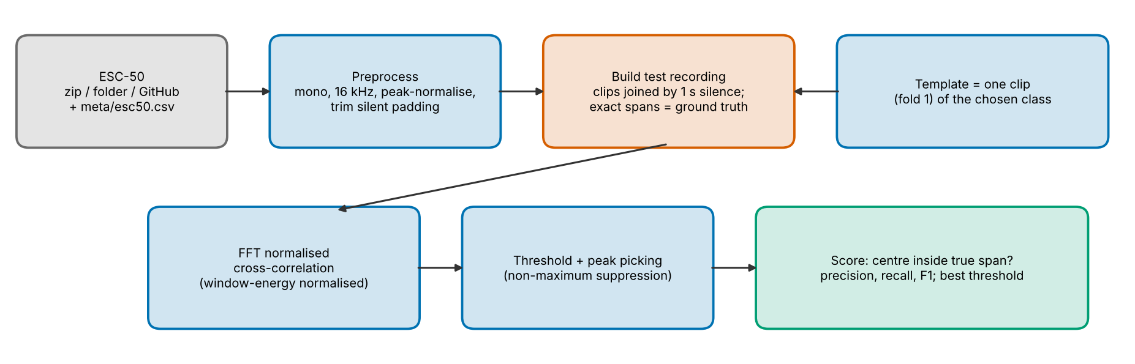
Methodology (Flow Chart)
• score[k] = sum x[k+n]·t[n] / ( sqrt(sum x[k+n]²) · sqrt(sum t²) ) (numerator by FFT, window energy by running sum)
• Two test conditions: other clips of the class | the template itself (gain 0.5–1.5, 20 dB noise)
5

Slide 6
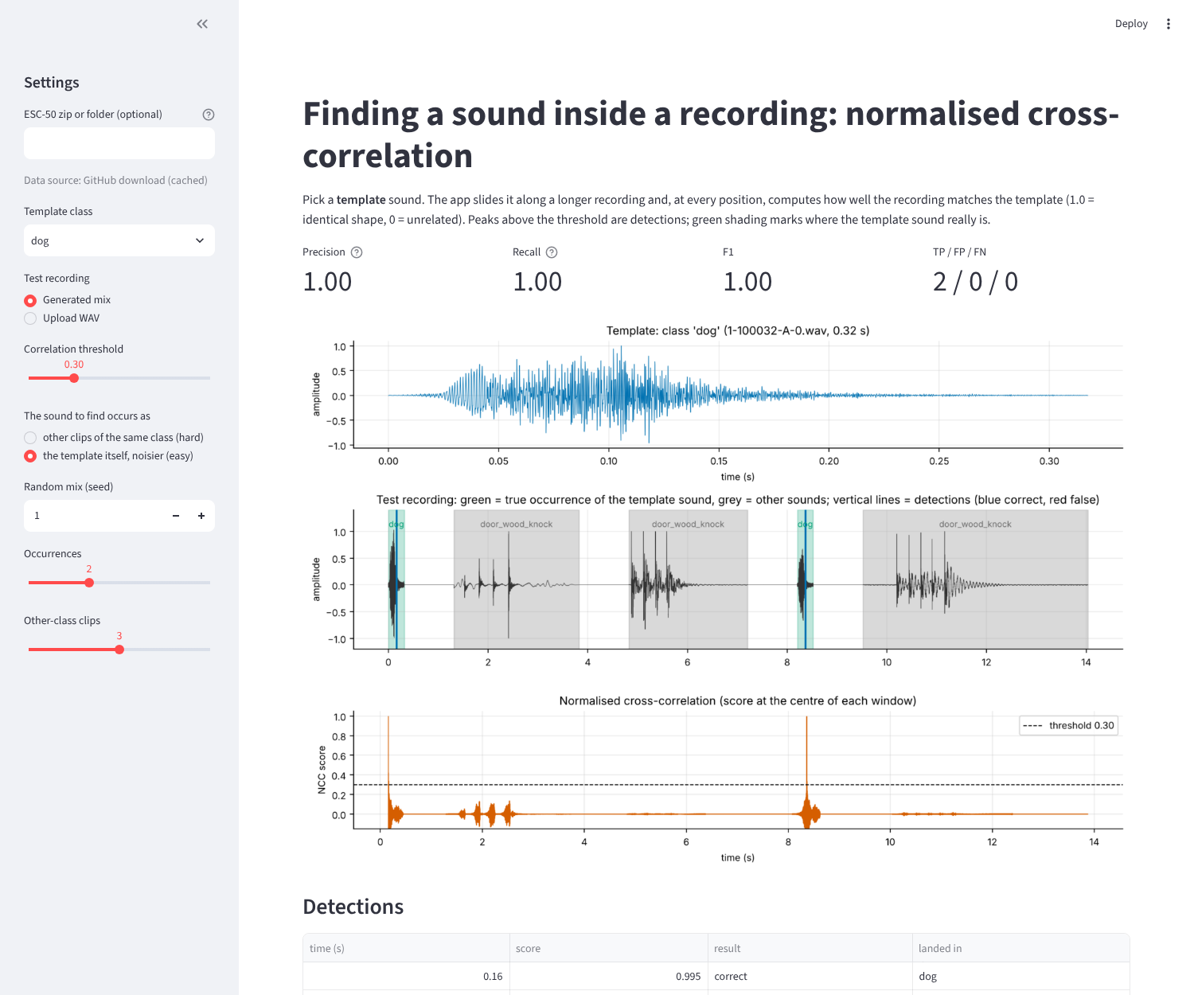
Work Done
• NumPy [8] for all matching; SciPy [9] only for WAV reading and resampling
• Data from your ESC-50 zip, a folder, or single-file GitHub download
• Streamlit app [11]; Matplotlib [10]
• pytest [12]: 6 tests, all pass
• Chance baseline added to judge the results honestly
6

Slide 7
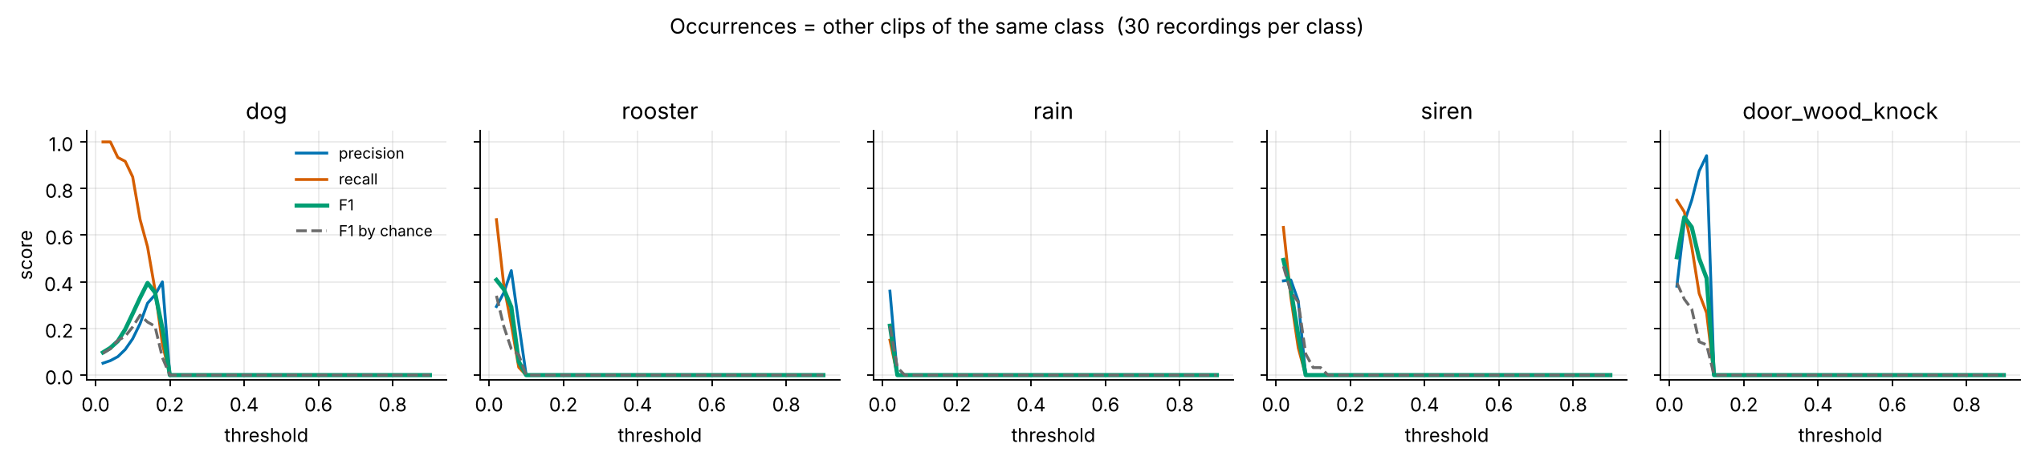
Results
• Same sound repeated (gain 0.5–1.5, 20 dB noise): F1 = dog 1.00, rooster 1.00, rain 1.00, siren 1.00, door_wood_knock 1.00 (no false detections)
• Other clips of the class (figure): best F1 dog 0.40 (chance 0.23), rooster 0.41 (chance 0.34), rain 0.21 (chance 0.21), siren 0.49 (chance 0.47), door_wood_knock 0.68 (chance 0.33)
• Only dog and door_wood_knock clearly beat chance; rain and siren are at chance level
• Best thresholds are very low (0.02–0.14): raw-waveform NCC does not generalise across different recordings
7

Slide 8
References
[17] I. Nolasco, S. Singh, V. Morfi, V. Lostanlen, A. Strandburg-Peshkin, E. Vidana-Vila, L. Gill, H. Pamula, H. Whitehead, I. Kiskin, F. H. Jensen, J. Morford, M. G. Emmerson, E. Versace, E. Grout, H. Liu, B. Ghani and D. Stowell, "Learning to detect an animal sound from five examples", Ecological Informatics, vol. 77, art. 102258, 2023, doi:10.1016/j.ecoinf.2023.102258 (BASE PAPER; also on arXiv:2305.13210).
[18] R. Tutul, I. Buchem and N. Pinkwart, "Algorithmic Accuracy as a Motivational Driver in Robot-Mediated Learning: A Comparative Study of Cross-Correlation and CNN-Based Sound Detection in an Interactive Quiz Game", arXiv:2607.16299, July 2026 (preprint).
[1] K. J. Piczak, "ESC: Dataset for Environmental Sound Classification", Proc. 23rd ACM International Conference on Multimedia (ACM Multimedia), 2015.
[2] K. J. Piczak, ESC-50: Dataset for Environmental Sound Classification (2,000 clips, 50 classes), github.com/karolpiczak/ESC-50.
[3] Creative Commons Attribution-NonCommercial 3.0 licence (CC BY-NC 3.0), creativecommons.org/licenses/by-nc/3.0/.
[4] M. A. Richards, Fundamentals of Radar Signal Processing, 2nd ed., McGraw-Hill, 2014.
[7] TU Berlin, "Matched Filter and Pulse Compression", chapter of the Scientific Python course, platform.commit.tu-berlin.de/en/book/sci-python/chapter/ch25/section/s01.
Full list of 18 references in the report. [17] is the base paper.
8

