Slide 1
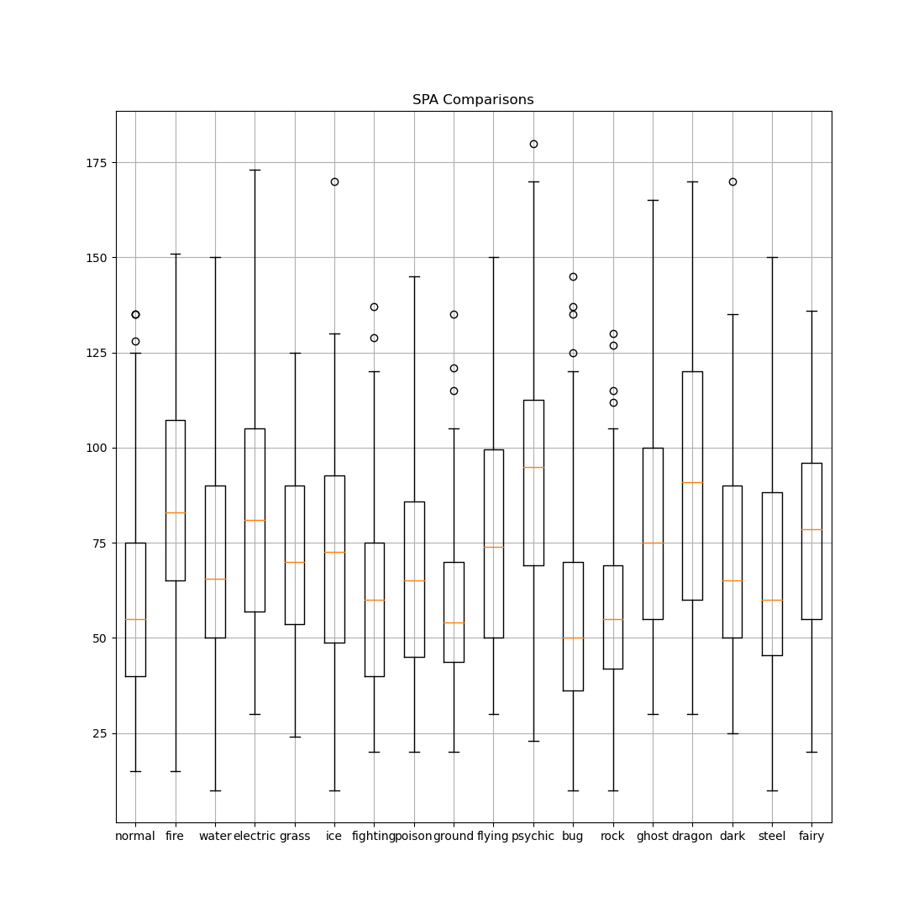
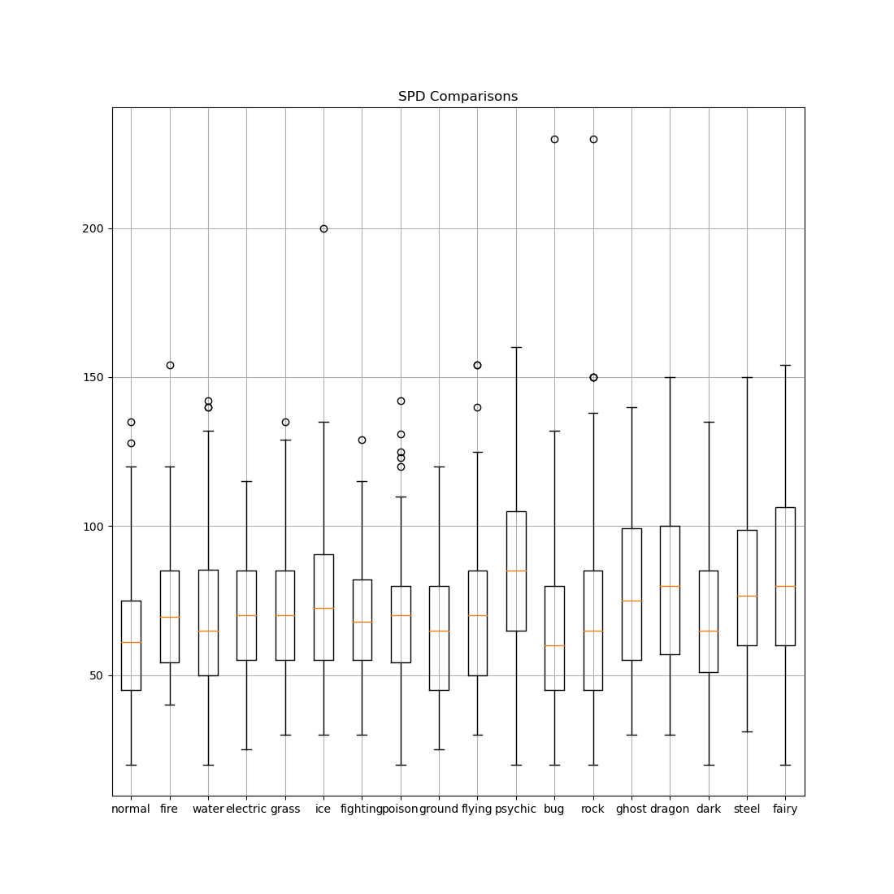
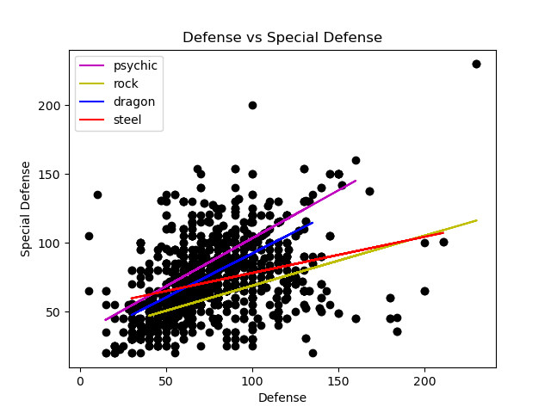
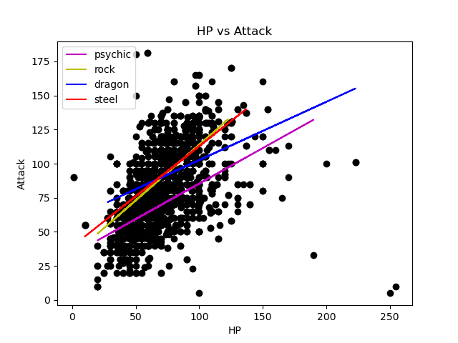
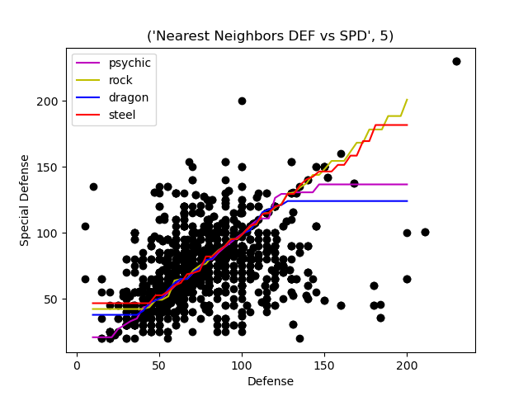
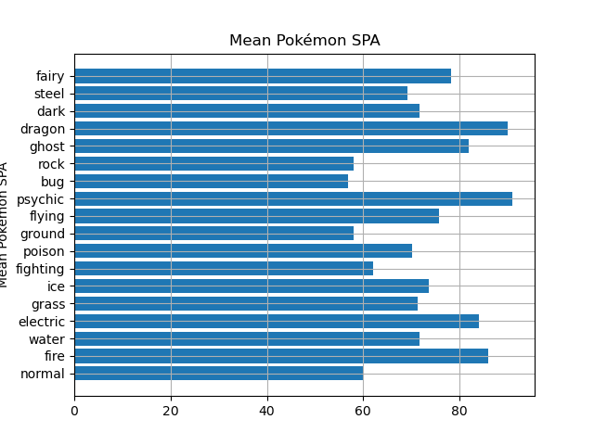
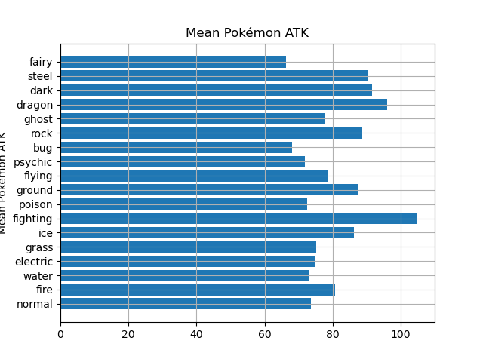
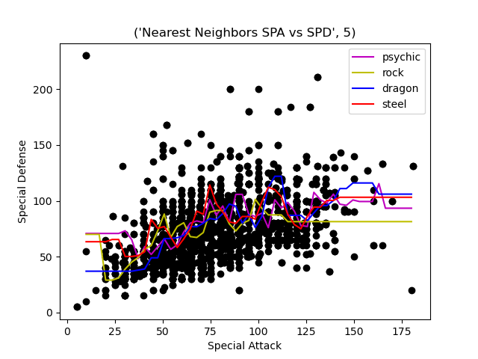
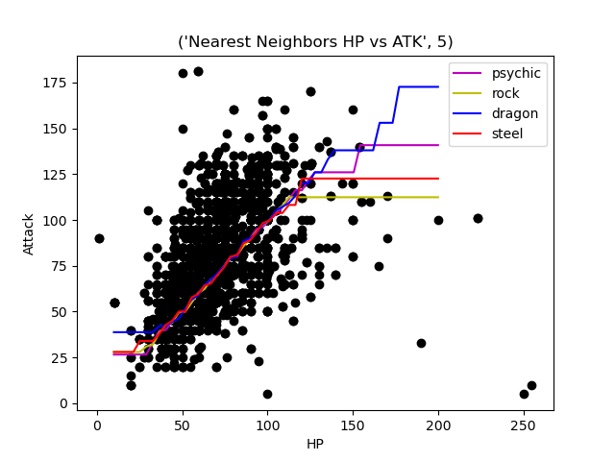
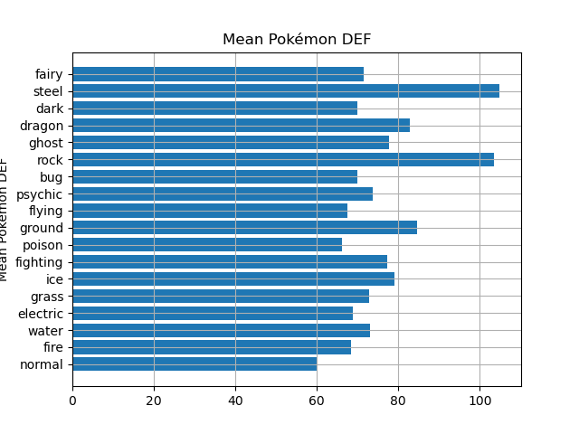
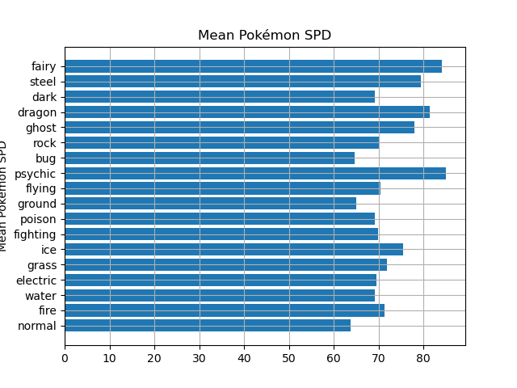
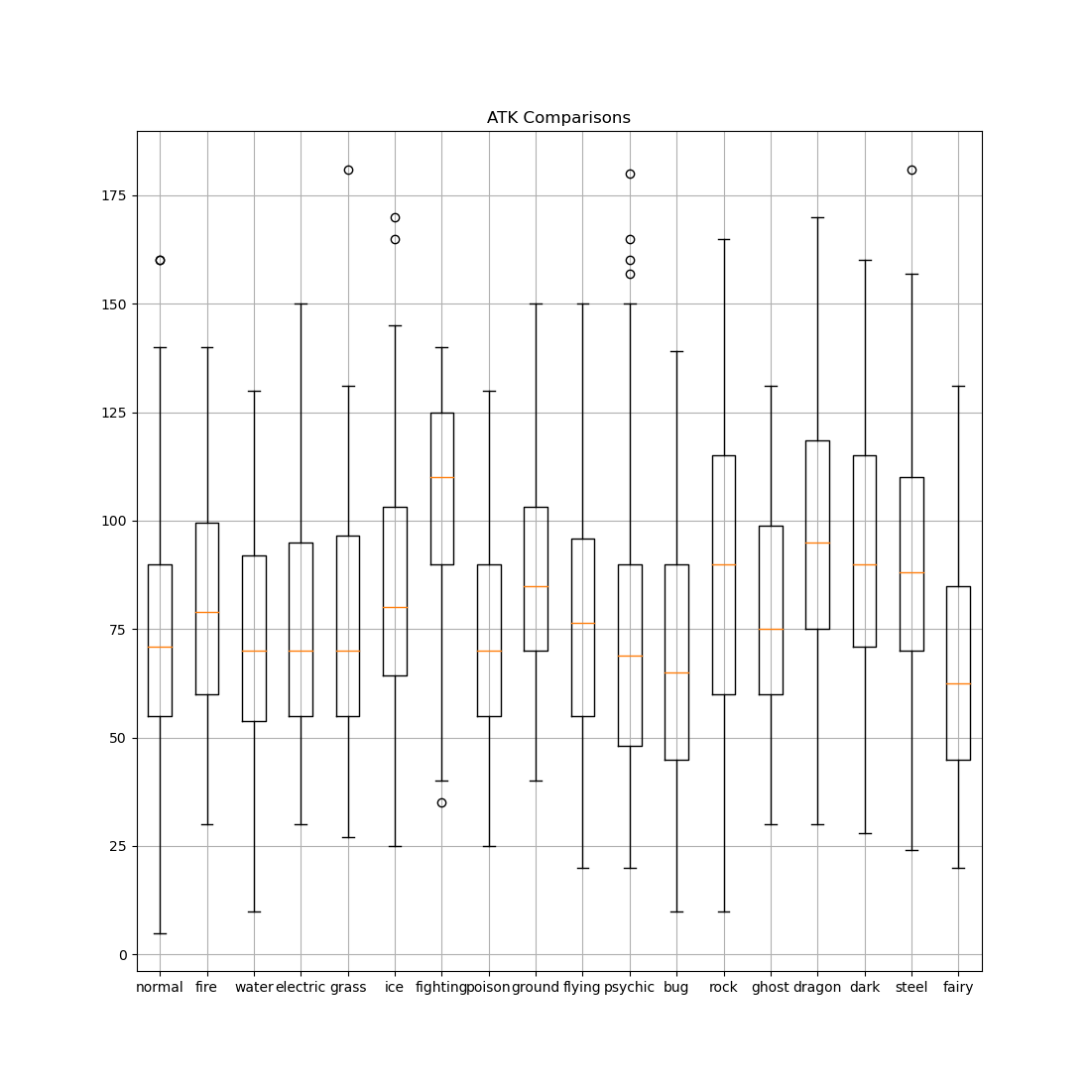
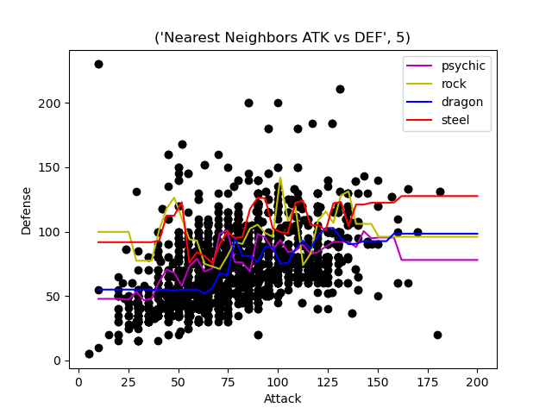
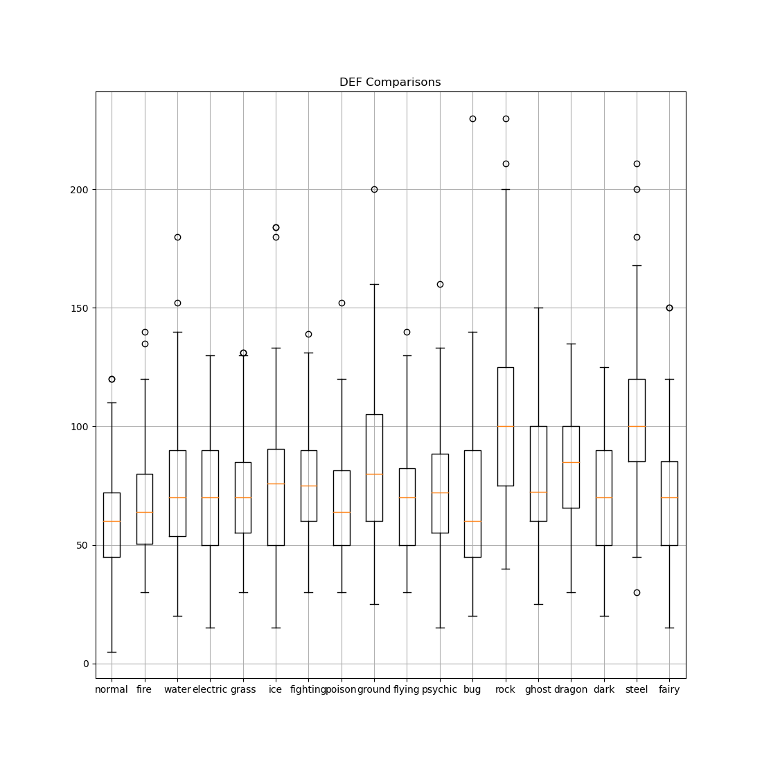
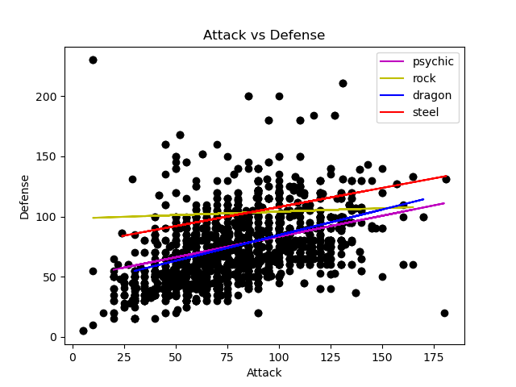
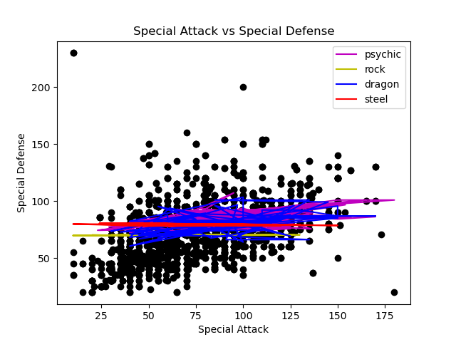
Exploring Pokémon Types vs Stats using ML
Machine Learning Final Project
Zachary East, New College of Florida
Abstract
Box and Bar Plots
Linear Regression and Nearest Neighbors
Linear Regression and Nearest Neighbors
Pokémon is a series of video games where you catch various creatures called Pokémon and use them in battle. Each Pokémon has six stats and 1-2 elemental types that are affiliated with that determine how they’re used in battle. I’ve been a fan of the series for a long time, and I’ve always wondered what design decisions go into designing each individual Pokémon. With six stats and 18 possible types, there are likely many patterns or relationships. What I wanted to see was if there was any possibility of predicting the stats or elemental typing of Pokémon.
The three main questions I wanted to answer were this:
Can you predict stats based on other stats?
Can you predict type based on stats?
Can you predict stats based on type?
I decided that I could use machine learning algorithms of Linear Regression and Nearest Neighbor Regression along with various data visualization techniques in order to potentially answer these questions
From these specific box plots we can see some various types having higher or lower ranges as well as different averages
A lot of the types have distinct but similar linear relationships between stats. For some reason Special Attack and Special Defense were all over the place when trying to do a linear regression, so I felt I couldn’t draw anything from it.
Data/Methodology
Before doing anything, a dataset was needed. I obtained a set of all main Pokémon from https://www.kaggle.com/datasets/hamzacyberpatcher/data-of-1010-pokemons/, however it did not contain all the data required. It was missing the data for various regional or alternate forms of Pokémon, which often have different typing and stats. I manually added any missing data from https://pokemondb.net and trimmed the entire file down to only the main features I needed.
The code and visualizations were done in a jupyter notebook using python’s matplotlib and pandas library.
Box Plots
Conclusions?
By looking at the means for each stat as well as the stats with the most covariance, I ended up picking four types
Psychic
Rock
Dragon
Steel
to do the regression with as well as four combinations of features :
Attack vs Defense
Special Attack vs Special Defense
Defense vs Special Defense
HP vs Attack
So, after taking several of the most stand out Pokémon types and stat spreads with the most covariance, I wanted to see if I could see patterns/relationships. Looking at this, I think that it's possible to predict certain aspects of a Pokémon's stats from other stats. I think there is a relationship between the stats of Pokémon, but I think they mostly correspond to each other.
It seems that you may be able to predict certain aspects of a Pokémon from one or more stats. For example, a Pokémon with high special attack may often have high special defense (specially focused), or a Pokémon with high defense may also have strong special defense (overall tanky). I think each elemental type of Pokémon has patterns or tendencies that may differ from other types, but it may be impossible to fully predict a Pokémon's stats from its type. I believe the opposite holds true as well: that you can't predict a Pokémon's type from its stats. I think there may be more of specific archetypes of stats depending on type, but that every type has enough of each archetype that it makes prediction messy?
Linear Regression
Points of possible improvement?
- I think trying different models and taking into account every type and stat combination may reveal more information, but I mainly wanted to stick to the stats with the highest covariance for prediction.
- Perhaps k-clustering based on multiple stats could help with prediction?
- Perhaps more normalized or pruned data could make things less clear? I didn't do much in terms of normalizing the data, and I left a lot of strong outlier Pokémon as part of the data set.

