Slide 1
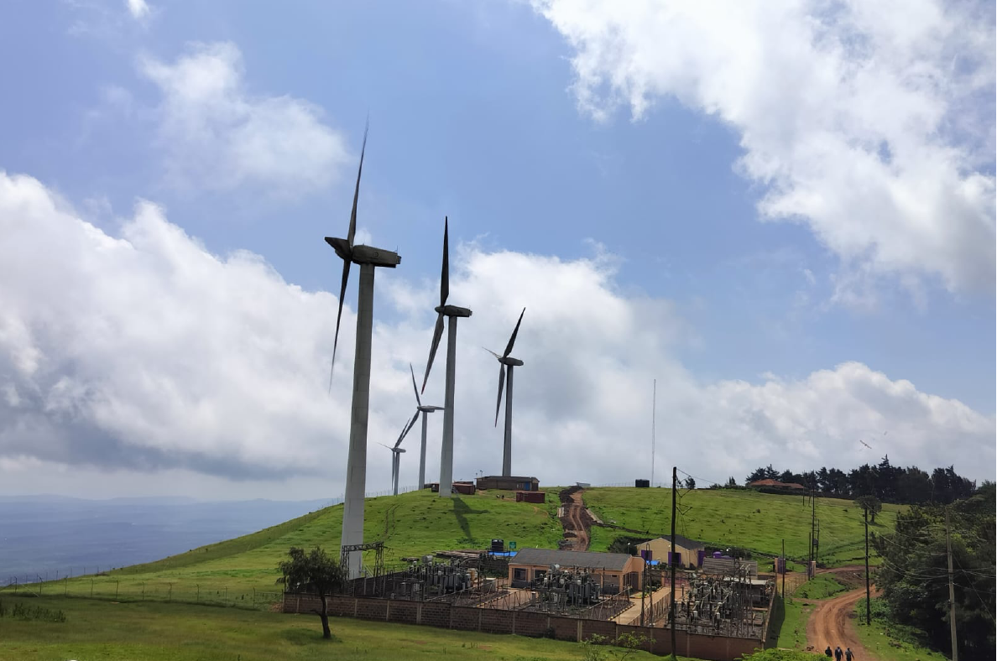
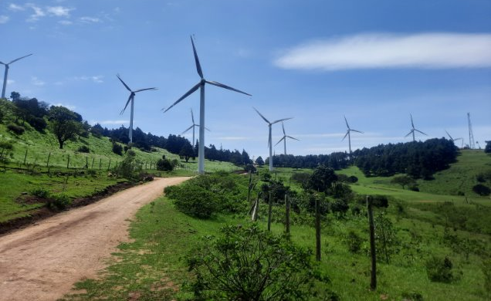
Interactive Data Analysis for Ngong Wind Turbines
By Zipporah Cheruiyot

Slide 2
Overview
Problem Statement and Data Overview
Data Loading and Preprocessing
Interactive Dashboard with Visualizations
Machine Learning for Outage Classification
Results, Predictions, and Visual Insights
Conclusion and Recommendations

Slide 3
Problem Statement
Challenges: Frequent outages, long durations affecting plant availability & revenue generation
Goal: Analyze patterns, visualize trends, predict high-risk units, and minimize downtime
Dataset: Operational events from Vestas SCADA system in KenGen's Ngong Wind Farm.
Notes:
The dataset has different events, such as warnings, system logs and alarms bur we shall focus only on alarms The dataset comes from Vestas SCADA alarm logs from July 2020 to June 2025, with over [66 ., thousands] records. Key columns include Unit (like WTG01), Code, Description, Detected and Reset timestamps, Duration, Event Type, Severity, and Remarks

Slide 4
Data Loading & Preprocessing
Load
Load dataset from Excel file.
Convert
Convert date columns to datetime format.
Calculate
Calculate alarm durations in hours.
Extract
Extract short descriptions from alarm text.
Prepare
Prepare aggregated datasets for charts:
Alarm
- Daily alarm count
Total
- Total duration by description
Top
- Top alarms by frequency
Notes:
Handled missing values by dropping completely null columns and replacing with mean

Slide 5
Dashboard Overview
The dashboard is built using Dash & Plotly and includes:
- Unit selection dropdown
- Severity selection dropdown
- Date range picker
- Interactive charts (line, bar, pie)
- Detailed alarm data table with filtering and sorting

Slide 6
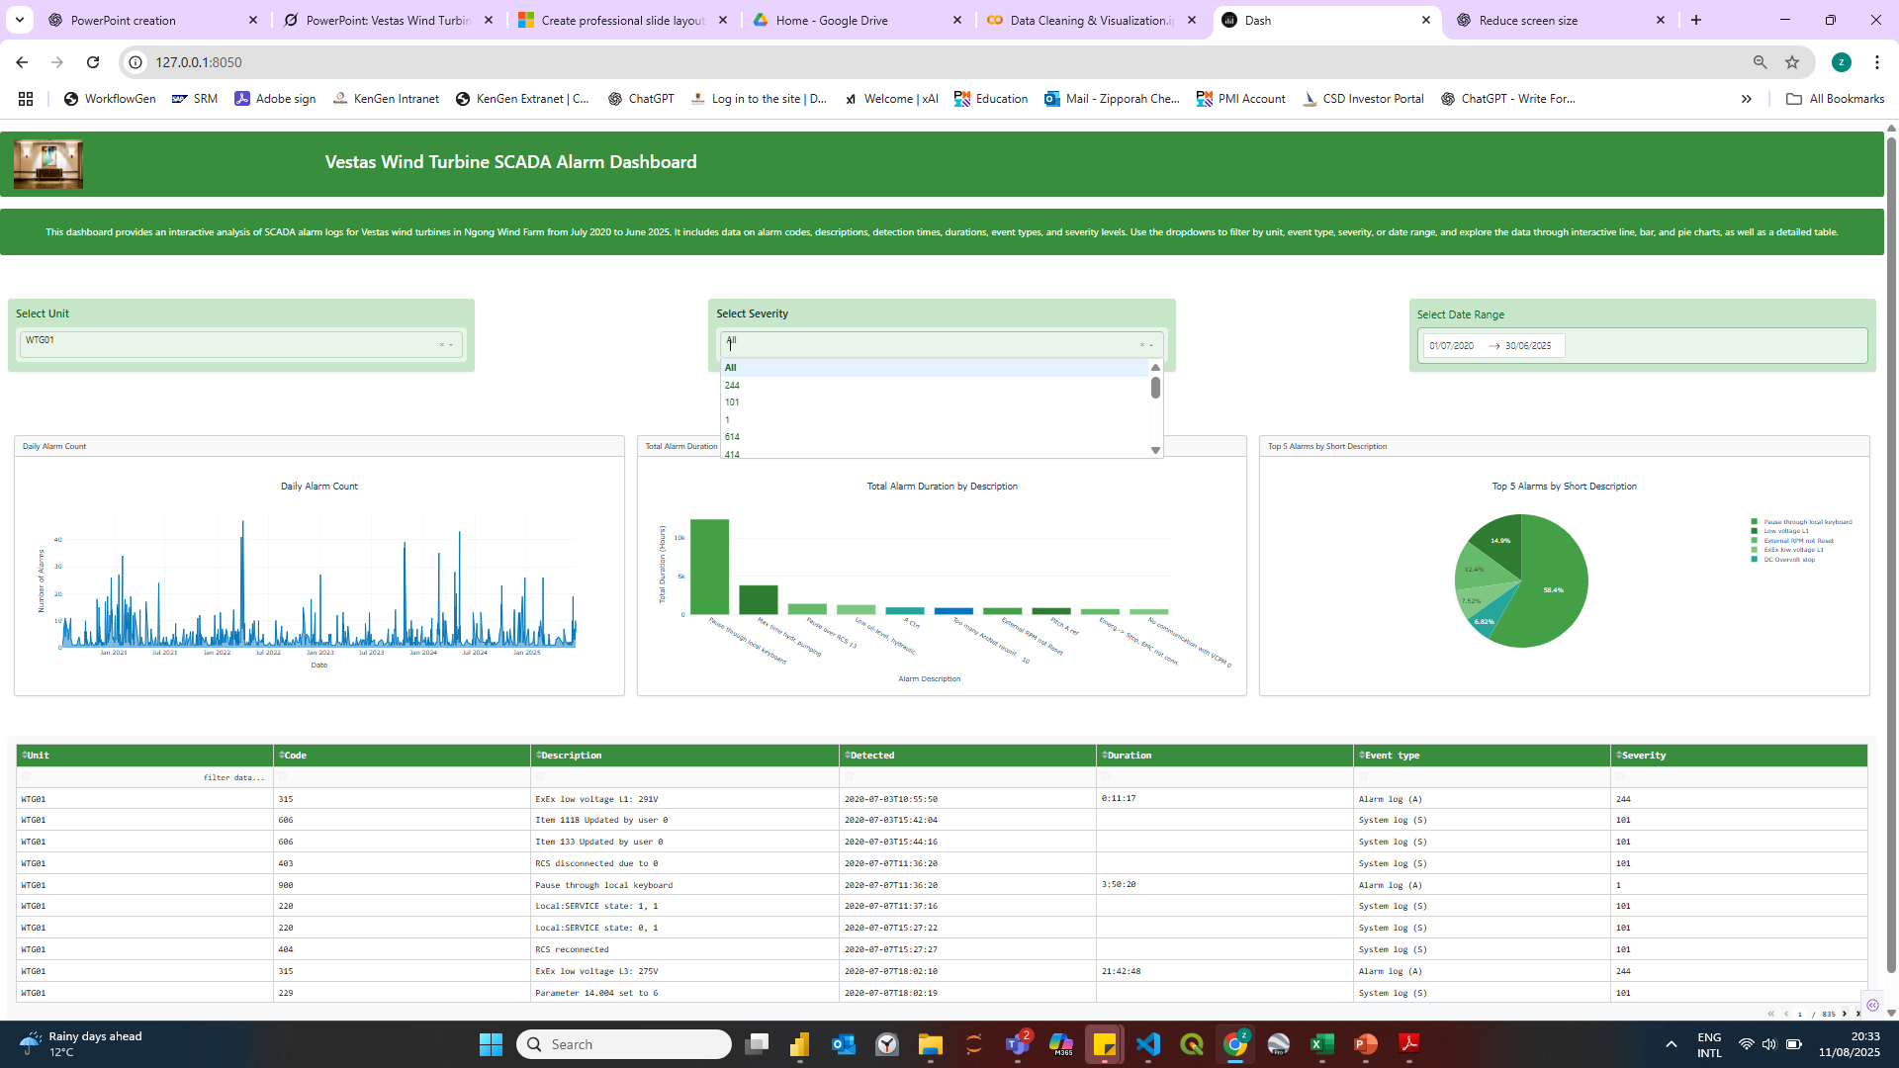
Dashboard Overview
Notes:
Daily Alarm count= identify peaks & patterns, Total alarm duration= prioritize alarms to aadress, top alarms – most frequent alarms recurring operational issues

Slide 7
Outage Classification with ML
Tasks: High-frequency and long-duration outages.
Models: Logistic Regression, Random Forest, XGBoost, SVM, Neural Networks
Process: Feature extraction, train/test, evaluate..

Slide 8
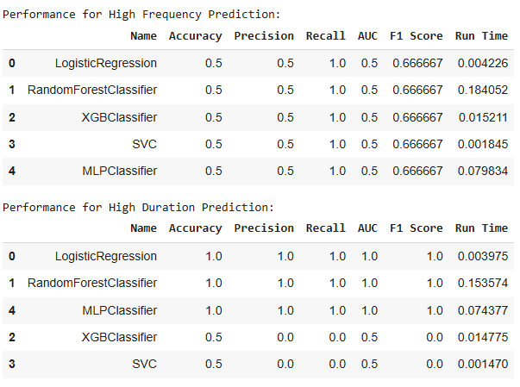
Models Evaluation: High Frequency Outages

Slide 9
Model Evaluation : Long Duration Outages

Slide 10
Findings
Select Logistic Regression model
Train on the full dataset,
Calculate Probabilities for each unit being high-risk (probability > 0.5 threshold).
Flag the units exceeding this threshold as high risk
Notes:
The high risk units that experience frequent prolonged outages are WTG01, WTG02, WTG04 and WTG07

Slide 11
Conclusion & Recommendation
The Alarm Dashboard & ML models enables data-driven decision-making for wind turbine maintenance.
- Deploy Dash app for real-time alarm monitoring.
- Add predictive analytics for alarm prevention.
- Integrate with maintenance scheduling systems.
Next Steps:
Notes:
Feeding of live data to models and dashboard through API subject to KenGen data protection guidelines

