Slide 1
Executive Summary slide
SpaceX advertises Falcon 9 rocket launches on its website with a cost of 62 million dollars; other providers cost upward of 165 million dollars each, much of the savings is because SpaceX can reuse the first stage. Therefore if we can determine if the first stage will land, we can determine the cost of a launch.
We first collect the data using python web scraping method then use sql to manipulate the data and using python to do the EDA and visualization, including folium map and dash interactive visualization and at last, we will train machine learning model to predict the successful landing rate.
What we find is that the Flight number has positive correlation with the success rate, payload usually negative correlation. And all four machine learning classification methods we use give similar accuracy on the test data.

Slide 2
Introduction :
I am Ziqin He and in this project, we will predict if the Falcon 9 rocket first stage will land successfully. SpaceX advertises Falcon 9 rocket launches on its website with a cost of 62 million dollars; other providers cost upward of 165 million dollars each, much of the savings is because SpaceX can reuse the first stage. Therefore if we can determine if the first stage will land, we can determine the cost of a launch.

Slide 3
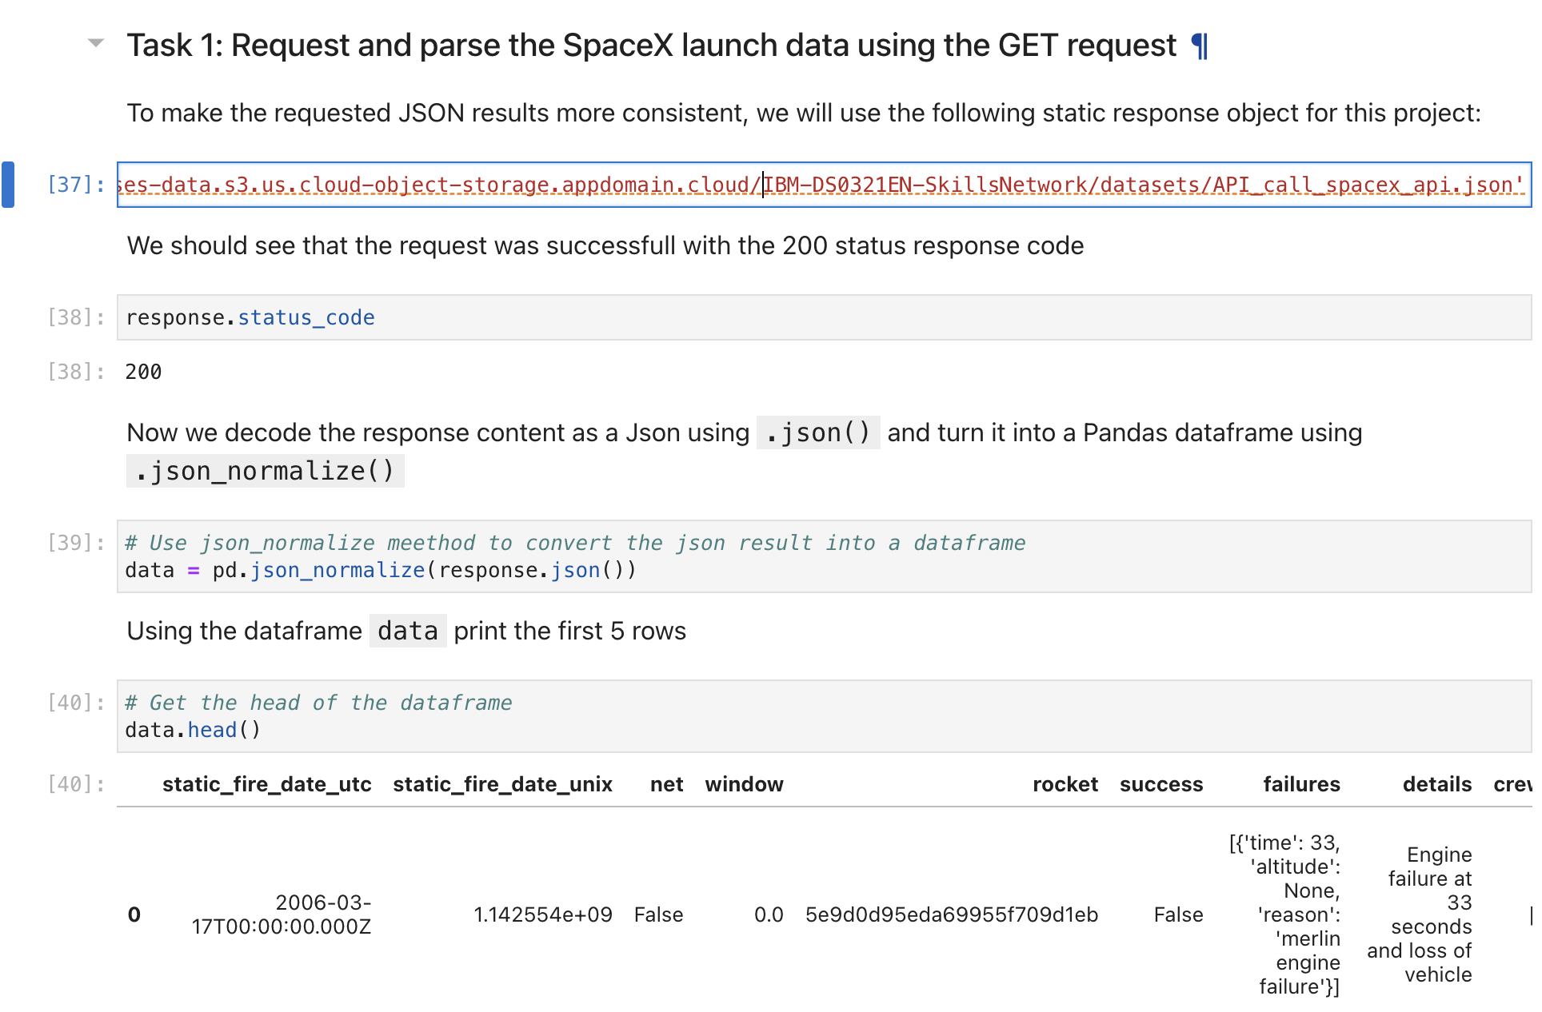
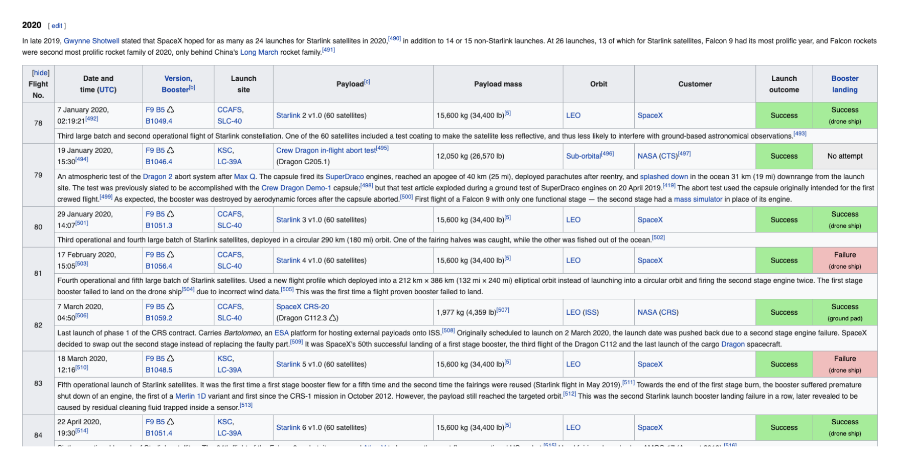
Use get request to do data collection and beautiful soup to do web scraping

Slide 4
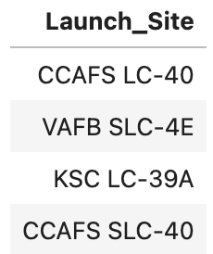
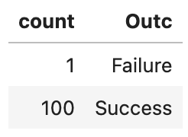
Using sql to do EDA, we find there are 4 launch sites. 101 trials and completed the mission 100 times. And we did other anaylsis such as which boosters carry more than 4000kg payloads and the success rate of landing during a period of time.

Slide 5
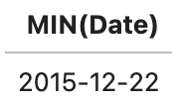
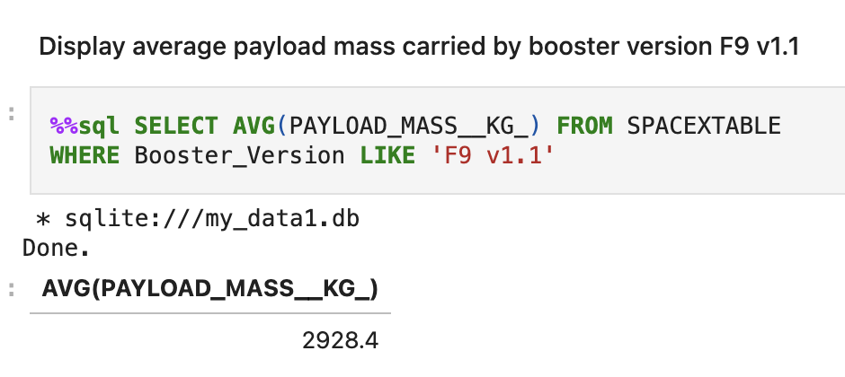
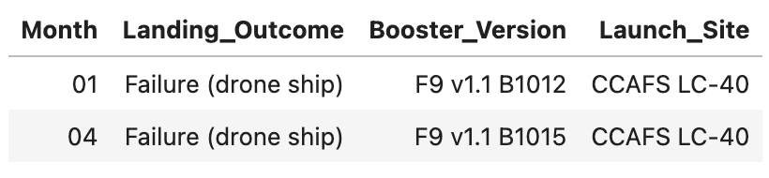
Sql : First time landing successfully. Average payload mass carried by booster version F9 v1.1 And the data analysis in a particular year for example the failure landing (drone ship) records in year 2015.

Slide 6
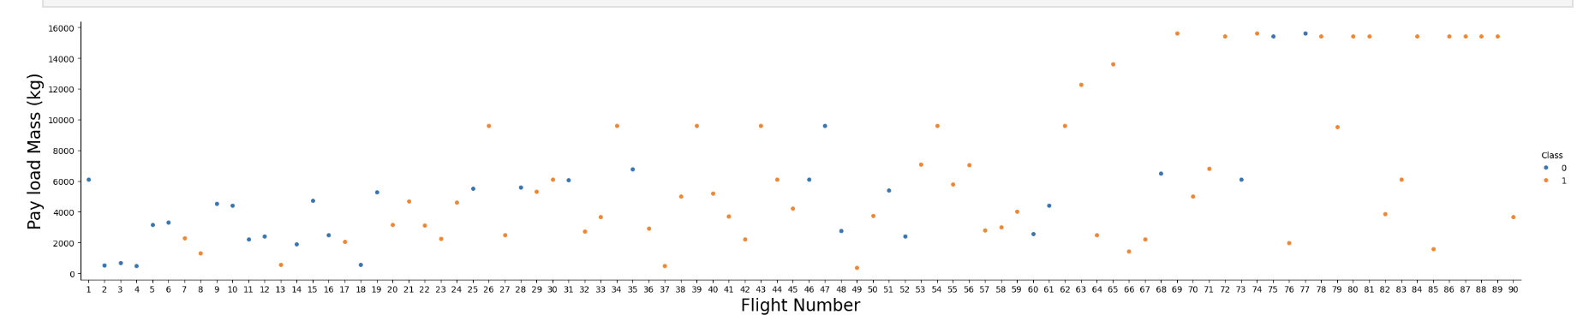
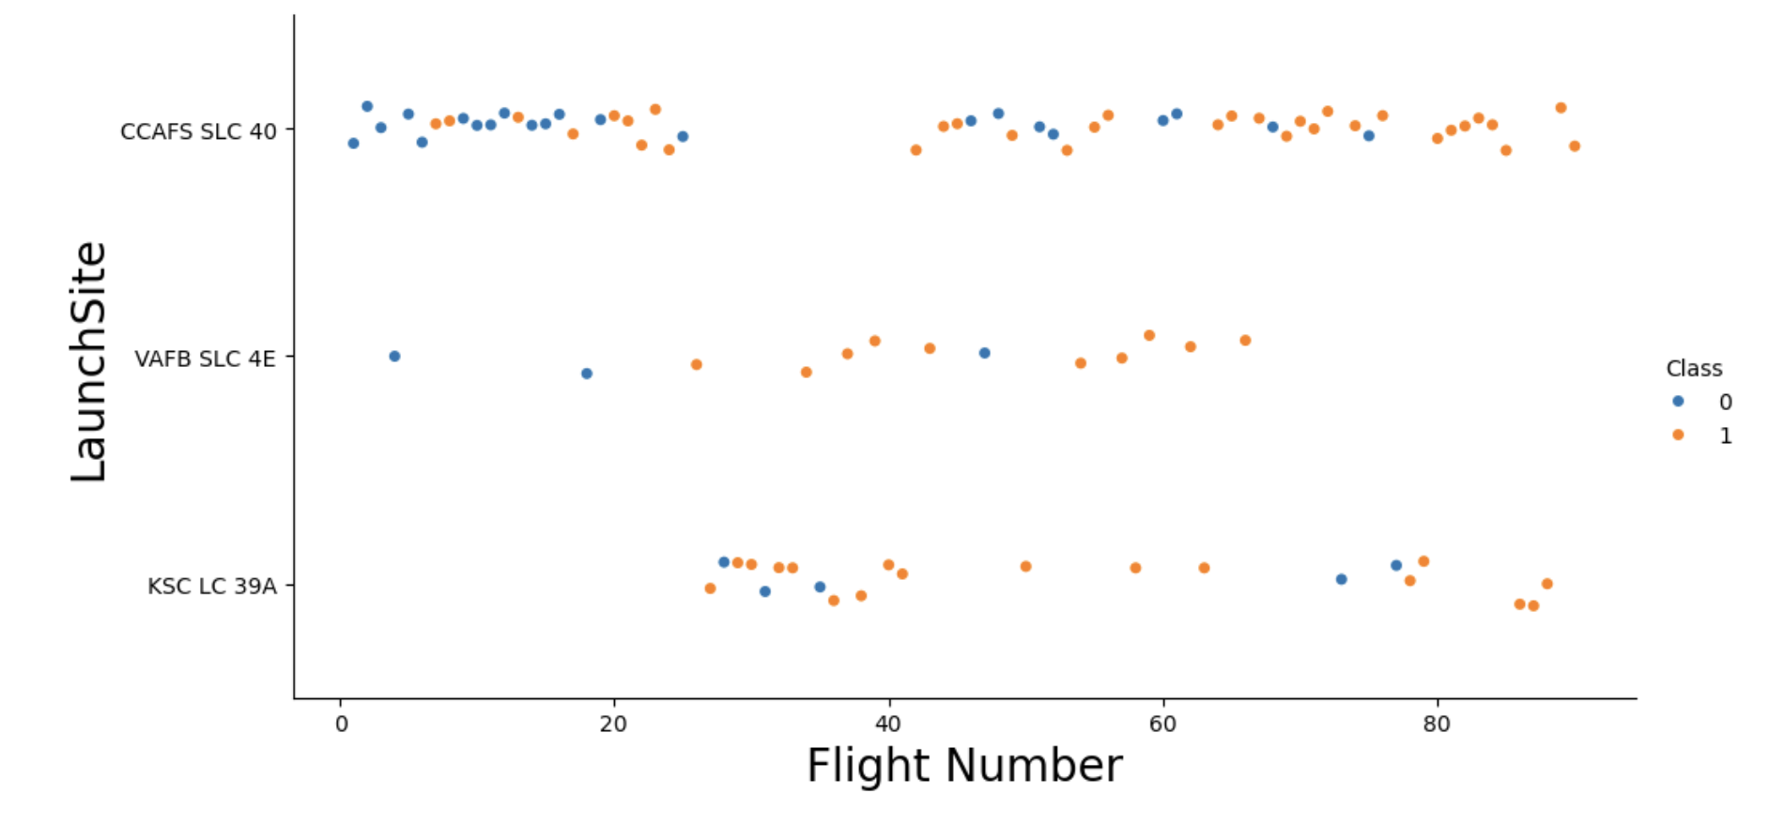
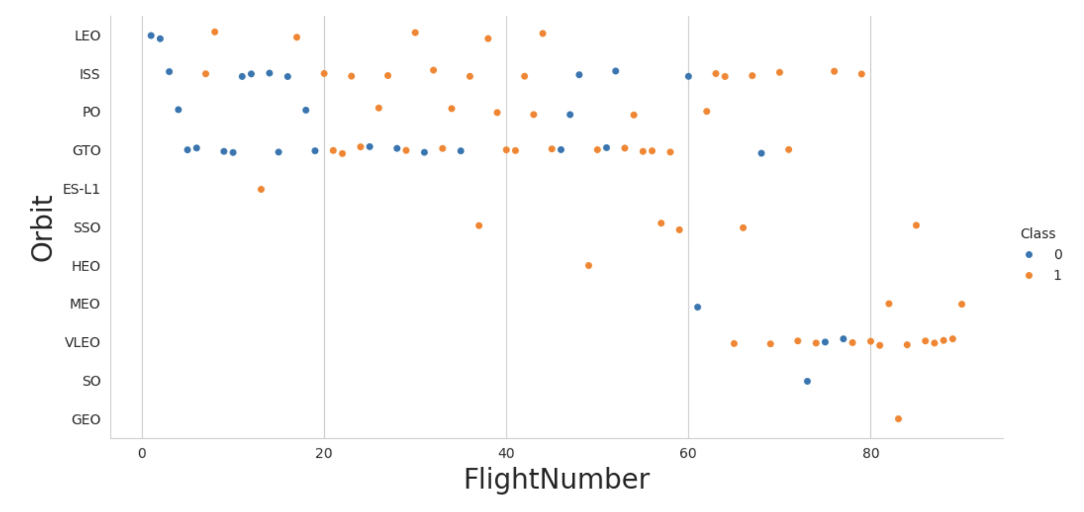
Python visualization EDA:
With larger Flight Number, the first stage seems to land with higher successful rate. And even with large pay load, high flight number still shows good landing result trend.
For different launch sites and orbits, larger flight number also shows better landing results.

Slide 7
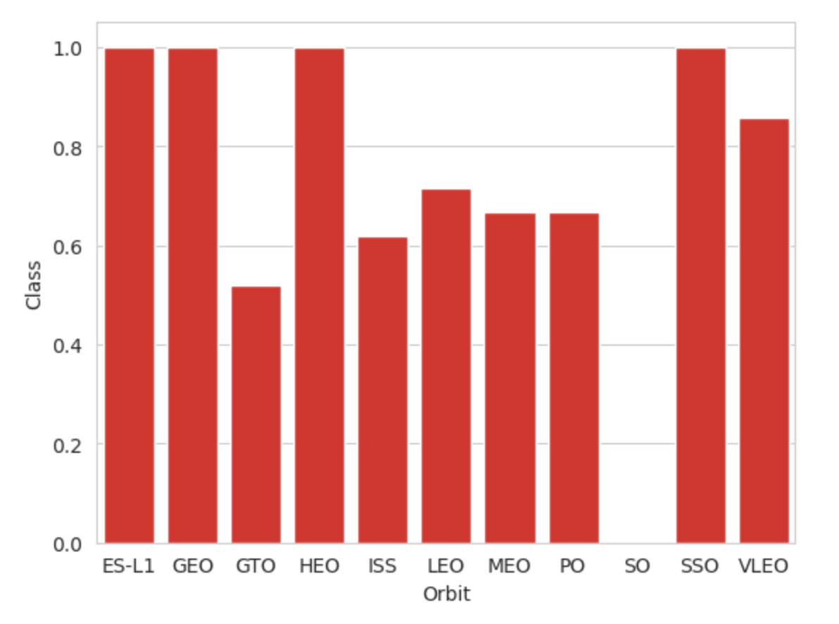
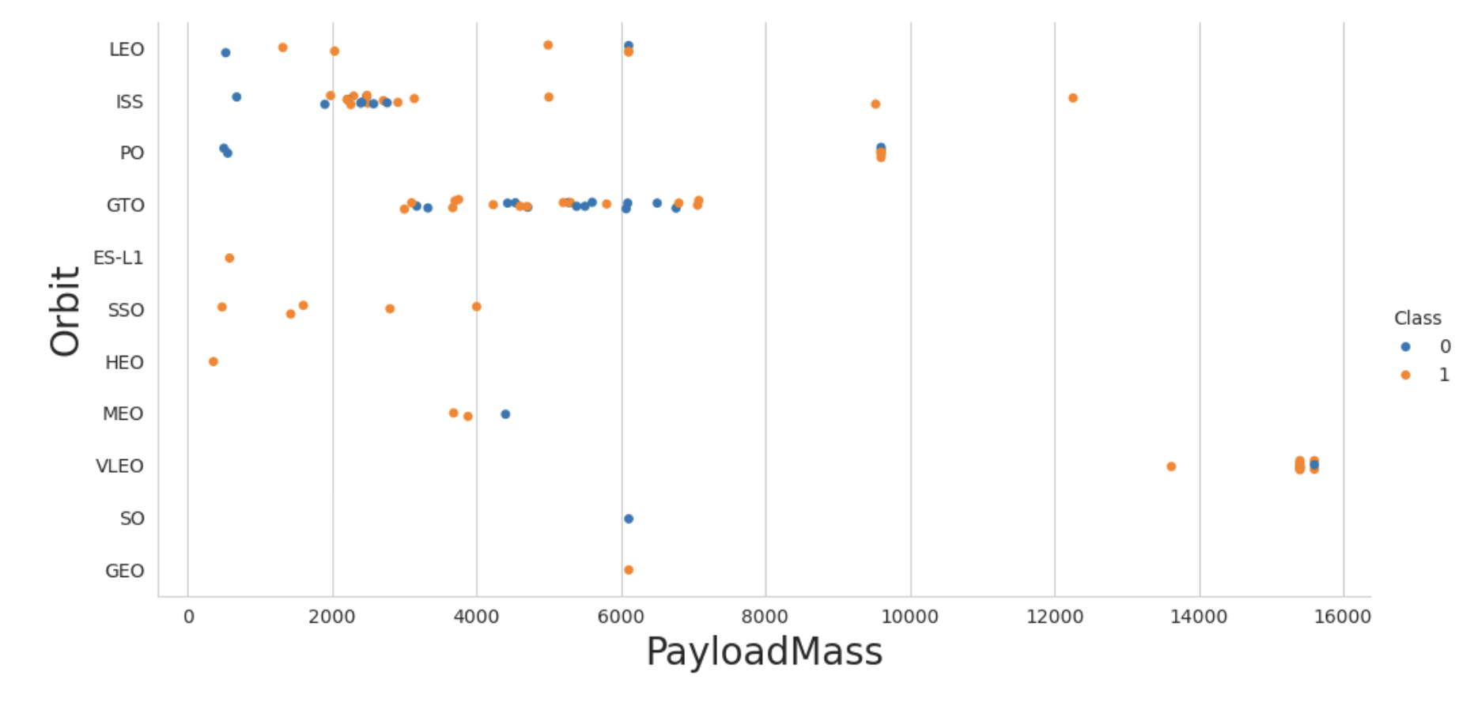
We plot the success rate with respect to different orbit. We see that with orbit ES-L1, GEO, HEO and SSO, the landings are all successful.
With heavy payloads the successful landing or positive landing rate are more for Polar,LEO and ISS.
However, for GTO, it's difficult to distinguish between successful and unsuccessful landings as both outcomes are present.

Slide 8
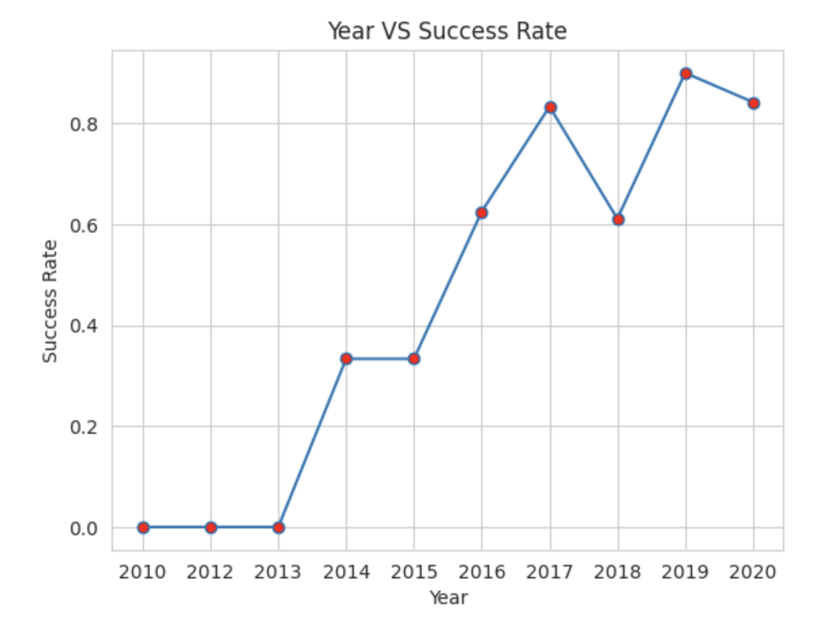
you can observe that the sucess rate since 2013 kept increasing till 2020

Slide 9
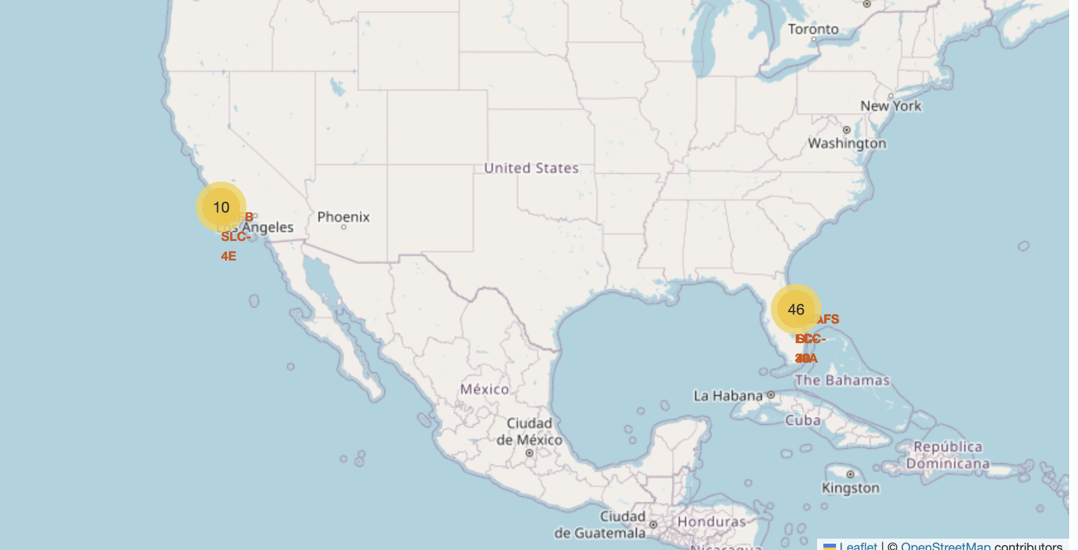
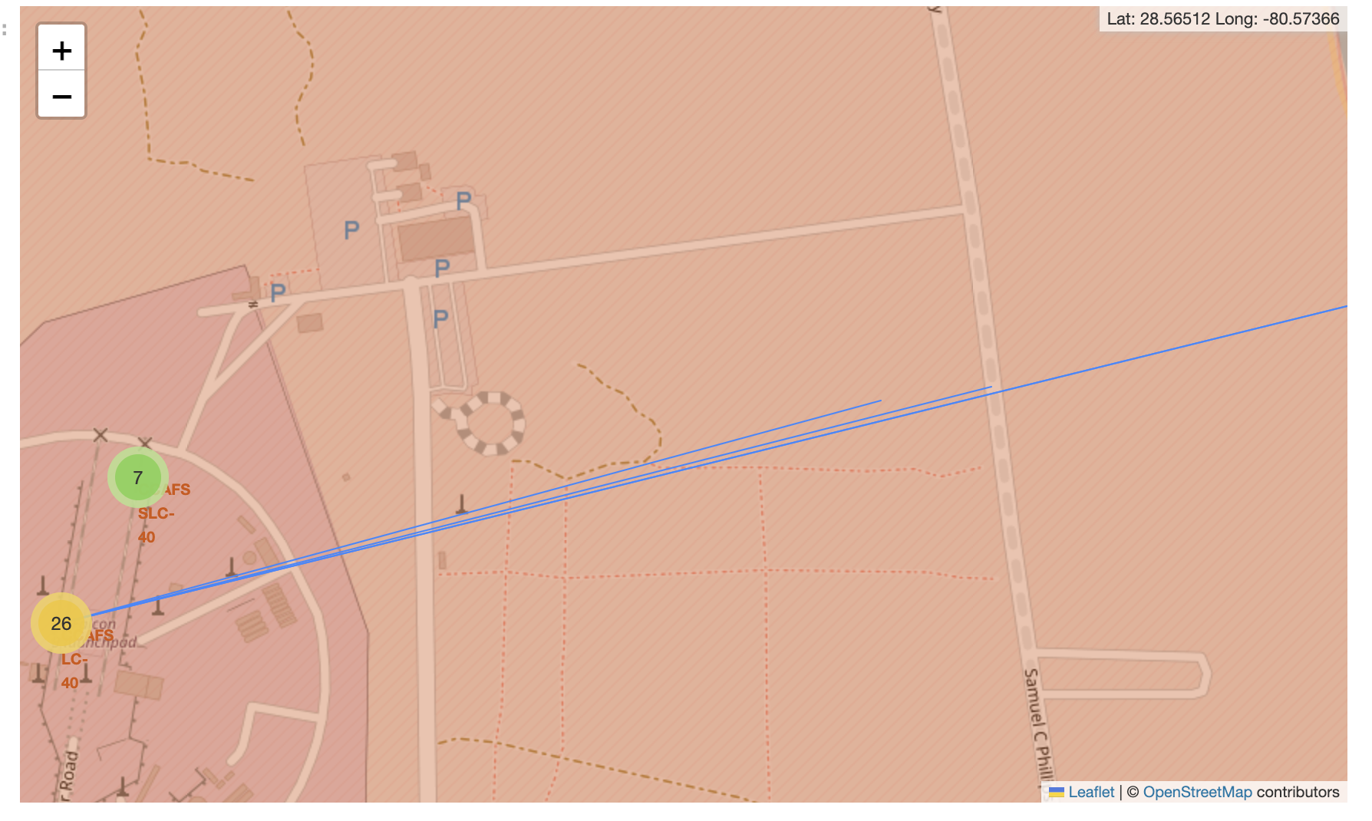
We use python folium to do the map visualization and we can see the launch sites are all close to the coastline. And we can check out how many landings at each launch sites with the line connecting the launch sites with nearest railway, highway, coastline and city.

Slide 10
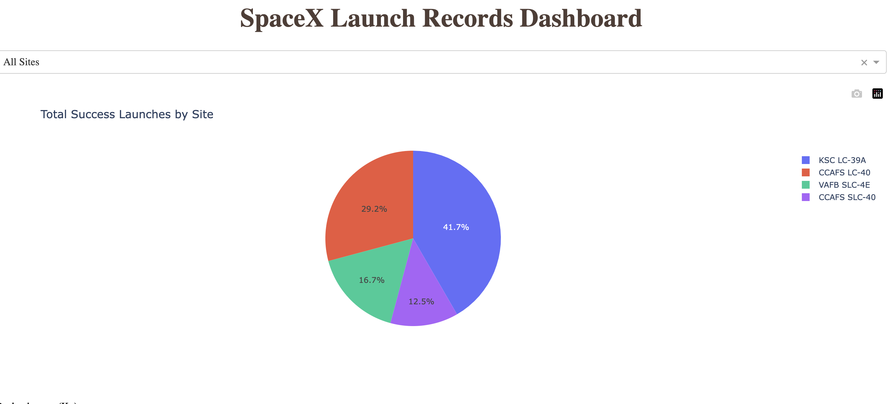
Using python dash, we can see the percentage of the total success lauches by each site

Slide 11
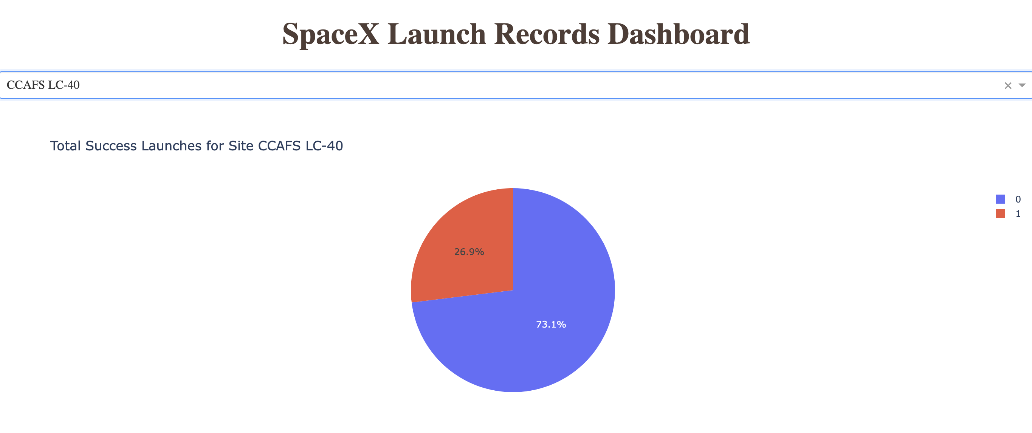
And we can pick a particular launch site to see the successful rate

Slide 12
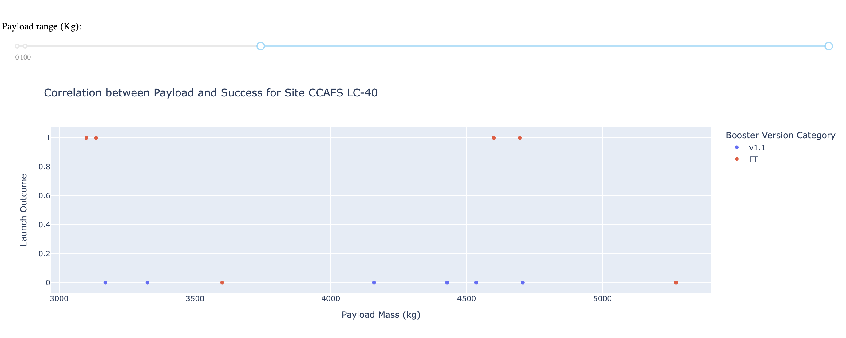
We can pick different Payload Mass an visualize the success rate

Slide 13
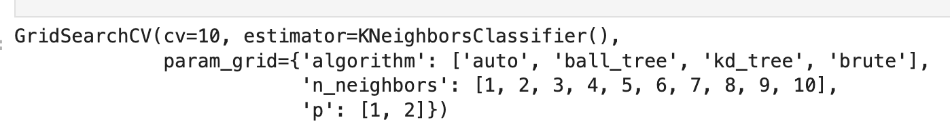
Classification ML using Logistic Regression, SVM, Decision Tree and KNN

Slide 14

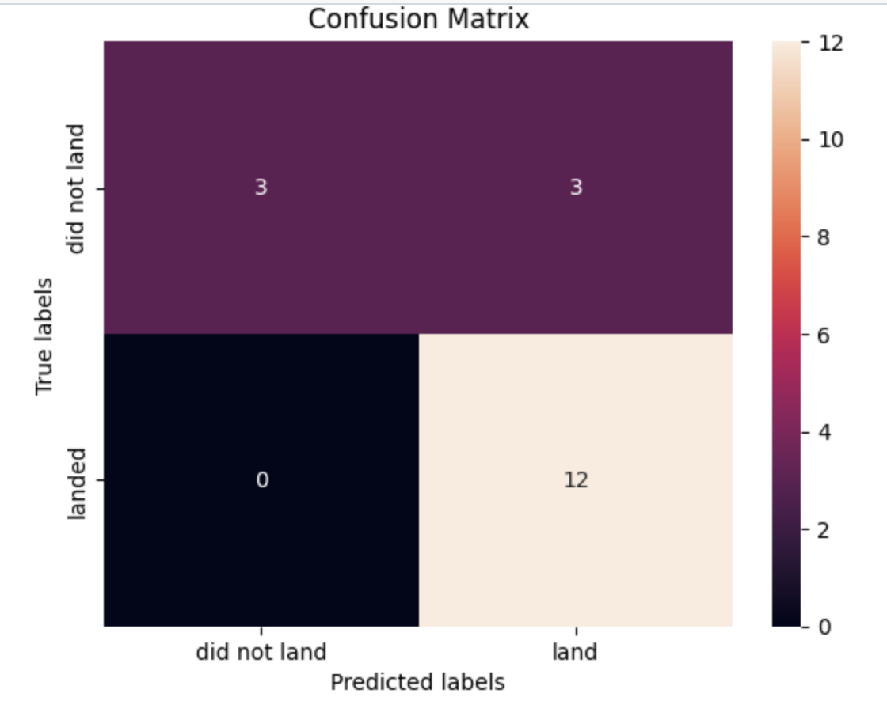
The accuracy rate in training set of different classification method is relatively close to each other and the test accuracy and confusion matrix is the same for all 4 methods. So we cannot tell which method is better for this classification problem. We may need to use a larger set of data so we can have a larger test data set.

Slide 15
Summary : With high Flight number, the landing is more likely to success. And the successful rate is increasing since 2013 to 2020.(Our data ends at 2020). The orbit will higher successful rate usually combines with high Flight number and low payload.

