Slide 1

OPEC Supply and Oil Price Volatility EC681: Final Presentation Ziqiu Zhu, 205199990 Wilfrid Laurier University Supervisor: Professsor Snudden April 9, 2021

Slide 2
1. Background

Slide 3
Motivation
CRUDE OIL
Makes up 8% of Global GDP
Significant influence on economic aggregates
Price derived from shifts in global supply and demand.
Global commodity
OPEC
Intergovernmental organization of 13 countries.
Produces 40% of the world’s crude oil (EIA, 2021).
Unifying goal to reduce oil price fluctuations (OPEC 2021).
Episodes of OPEC contributing to oil price volatility
Notes:
(see for example Hamilton 1983, Cuñado and Gracia 2003, Bodenstein et al. 2012 and Nyangarika et al. 2018).
Missing episodes in OPEC historyyank wars, oil embargo, iran Iraq war etc. Mention that people have thought of OPEC as the main source of oil price volatility, which contradicts their mandate. Make sure to mention that OPEC has been a source of volatility and make a bullet
First bullet point 8% of global GDP. Get across it’s really important, big cost of production
Second, important for economic aggregates. Give an example volatility in headline inflation comes from gasoline prices. At this point there’s a consensus in the literature that variations in oil prices have big macro effects.
Last point is that ti’s a global commodity par excellence. Expect global shiftsto supply and demand to effect prices.

Slide 4
Has OPEC been meeting its mandate on reducing oil price volatility?
Hypothesis: OPEC has on net contributed positively to oil price volatility.

Slide 5
2. Literature Review
Notes:
Literature review can mostly be words it doesn’t have to be written down.
First thing: Related literature
Bunch of papers that have treated oil price changes as exogenous. Then I talk about the seminal paper of Kilian and spinoff versions of that. Kilian kickstarted this literature on distangling supply and demand shocks and that’s important. Third thing is how other papers have extended Kilian’s framework and looked at OPEC

Slide 6
Relevant Literature
OPEC Behavior
No consensus in the literature (Griffin 1985*; Alhiji and Heuttner 2000; Smith 2005*)
OPEC behaves less than a frictionless Cartel
Modeling Oil Price Changes
Historically thought to be caused by exogenous political events (Hamilton 1985; Jones and Kaul 1996; Hamilton 2003*)
Now thought of as endogenously determined in global markets (Kilian 2008; Killian 2009*)
However, Kilian (2009) understates the role of supply (Kodozeij and Kaufmann 2014*; Ratti and Vespignani 2015*; Álvarez and Venditti 2020)
*These papers did not have meaningful quantifiable results
Notes:
Make a note to talk about the sample
Literatures are in one slide. Talk about what the literature says and how this paper contributes to the understanding.
Related literature: list them and the ntalk about one.

Slide 7
3. Empirical Specification
Notes:
Literature review can mostly be words it doesn’t have to be written down.
First thing: Related literature
Bunch of papers that have treated oil price changes as exogenous. Then I talk about the seminal paper of Kilian and spinoff versions of that. Kilian kickstarted this literature on distangling supply and demand shocks and that’s important. Third thing is how other papers have extended Kilian’s framework and looked at OPEC

Slide 8
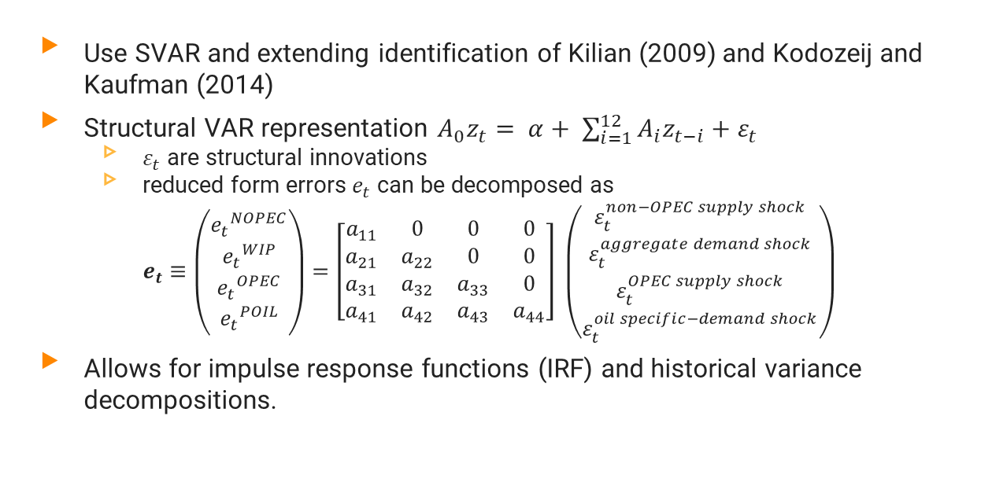
Model Specification
Use SVAR and extending identification of Kilian (2009) and Kodozeij and Kaufman (2014)
Structural VAR representation $A_{0}z_{t}= α+ \sum_{i=1}^{12}{A_{i}z_{t−i}+ε_{t}}$
$ε_{t}$ are structural innovations
reduced form errors $e_{t}$ can be decomposed as $e_{t}≡\left(\begin{matrix}{e_{t}}^{NOPEC} \\ {e_{t}}^{WIP} \\ {e_{t}}^{OPEC} \\ {e_{t}}^{POIL}\end{matrix}\right)=\left[\begin{matrix}a_{11} & 0 & 0 & 0 \\ a_{21} & a_{22} & 0 & 0 \\ a_{31} & a_{32} & a_{33} & 0 \\ a_{41} & a_{42} & a_{43} & a_{44}\end{matrix}\right] \left(\begin{matrix}ε_{t}^{non−OPEC supply shock} \\ ε_{t}^{aggregate demand shock} \\ ε_{t}^{OPEC supply shock} \\ ε_{t}^{oil specific−demand shock}\end{matrix}\right)$
Allows for impulse response functions (IRF) and historical variance decompositions.
Notes:
First bullet point USING SVAR and extending identification of Kilian (2009)
Kilian assumes that OPEC can not respond in the samem onth. I am relaxing this assumption and if we can assume OPEc can respond in the same month, we have to allow it to respond to btoth supply and demand. And that’s not what the 2014 paper did.
Say that this is a causal model, these are economic shocks… to get to that point, I need to carefully motivate the identification restrictions. Kilian said that supply does not respond contemporaneously, inelastic in the short run
Price can respond contemporaneously , perfect market. Just like Kaufmann we are relaxing OPEC assumption.
Kilian introduced his identification restrictions it’s good. Kaufmann assumes… if OPEC has excess capacity it should respond to asupply and demand shocks. This let mets disentangle OPEC and non-OPEC production. To answer if OPEC has been contributing to oil price volaatilty, I look at structural estimate impulse responses…

Slide 9
4. Data
Notes:
Literature review can mostly be words it doesn’t have to be written down.
First thing: Related literature
Bunch of papers that have treated oil price changes as exogenous. Then I talk about the seminal paper of Kilian and spinoff versions of that. Kilian kickstarted this literature on distangling supply and demand shocks and that’s important. Third thing is how other papers have extended Kilian’s framework and looked at OPEC

Slide 10
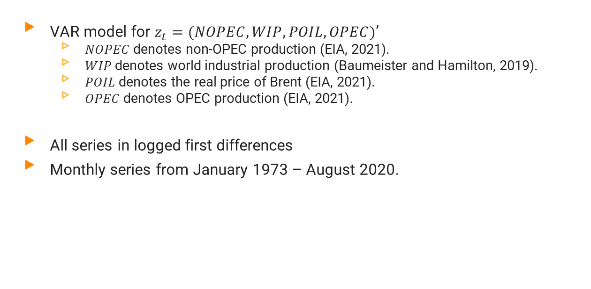
Variables
VAR model for $z_{t}=(NOPEC, WIP, POIL, OPEC)$’
$NOPEC$ denotes non-OPEC production (EIA, 2021).
$WIP$ denotes world industrial production (Baumeister and Hamilton, 2019).
$POIL$ denotes the real price of Brent (EIA, 2021).
$OPEC$ denotes OPEC production (EIA, 2021).
All series in logged first differences
Monthly series from January 1973 – August 2020.

Slide 11
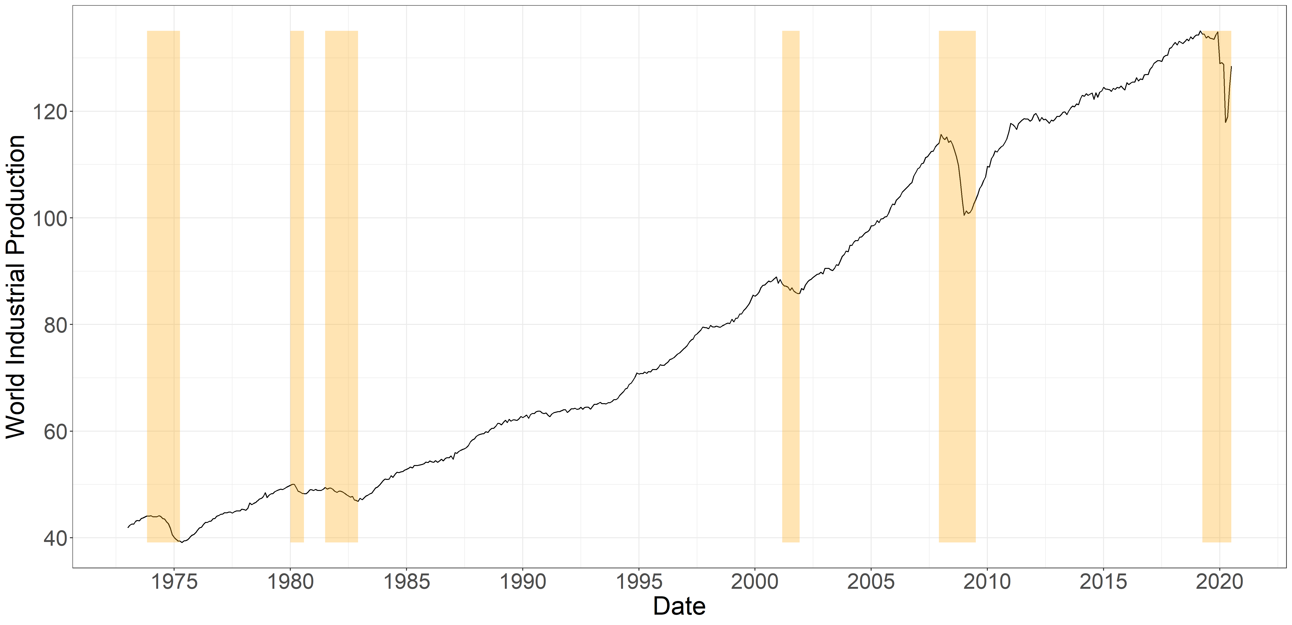
Variable | Min. | Median | Mean | Max. | S.D.
WIP | -8.84 | 0.29 | 0.20 | 4.47 | 0.77
Activity Index: World Industrial Production

Slide 12
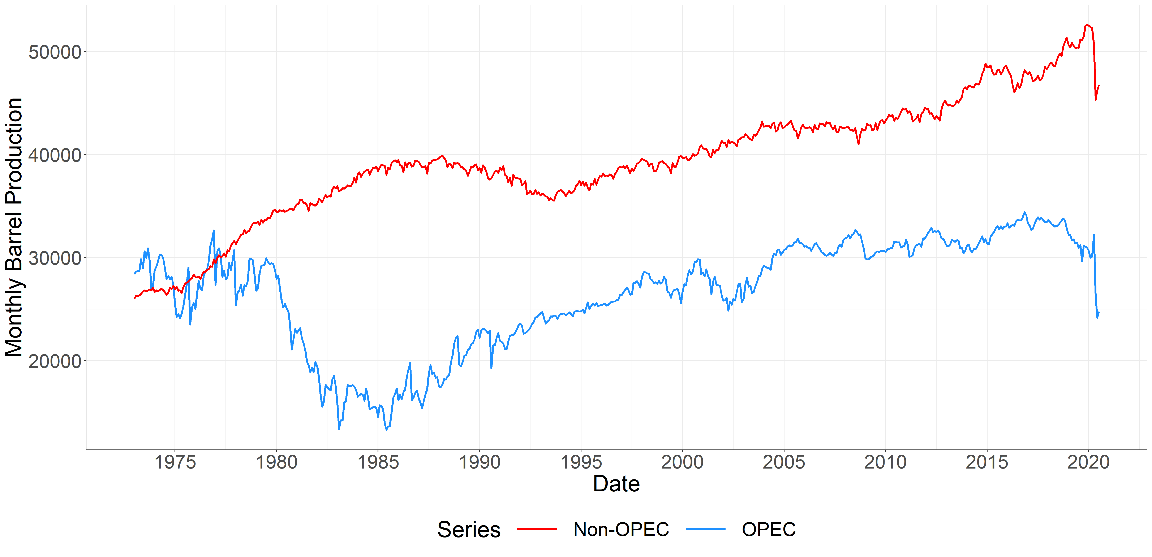
‘73 Oil Embargo
‘08 Recession
‘00 Dot-com
‘90 Gulf war
’80 Iran-Iraq War
’98 East Asian Crisis
‘20 Covid-19
’14 OPEC Collapse
Variable | Min. | Median | Mean | Max. | S.D.
NOPEC | -11.07 | 0.12 | 0.11 | 2.85 | 1.01
OPEC | -21.09 | 0.22 | -0.02 | 11.42 | 3.53
Global Crude Oil Production

Slide 13
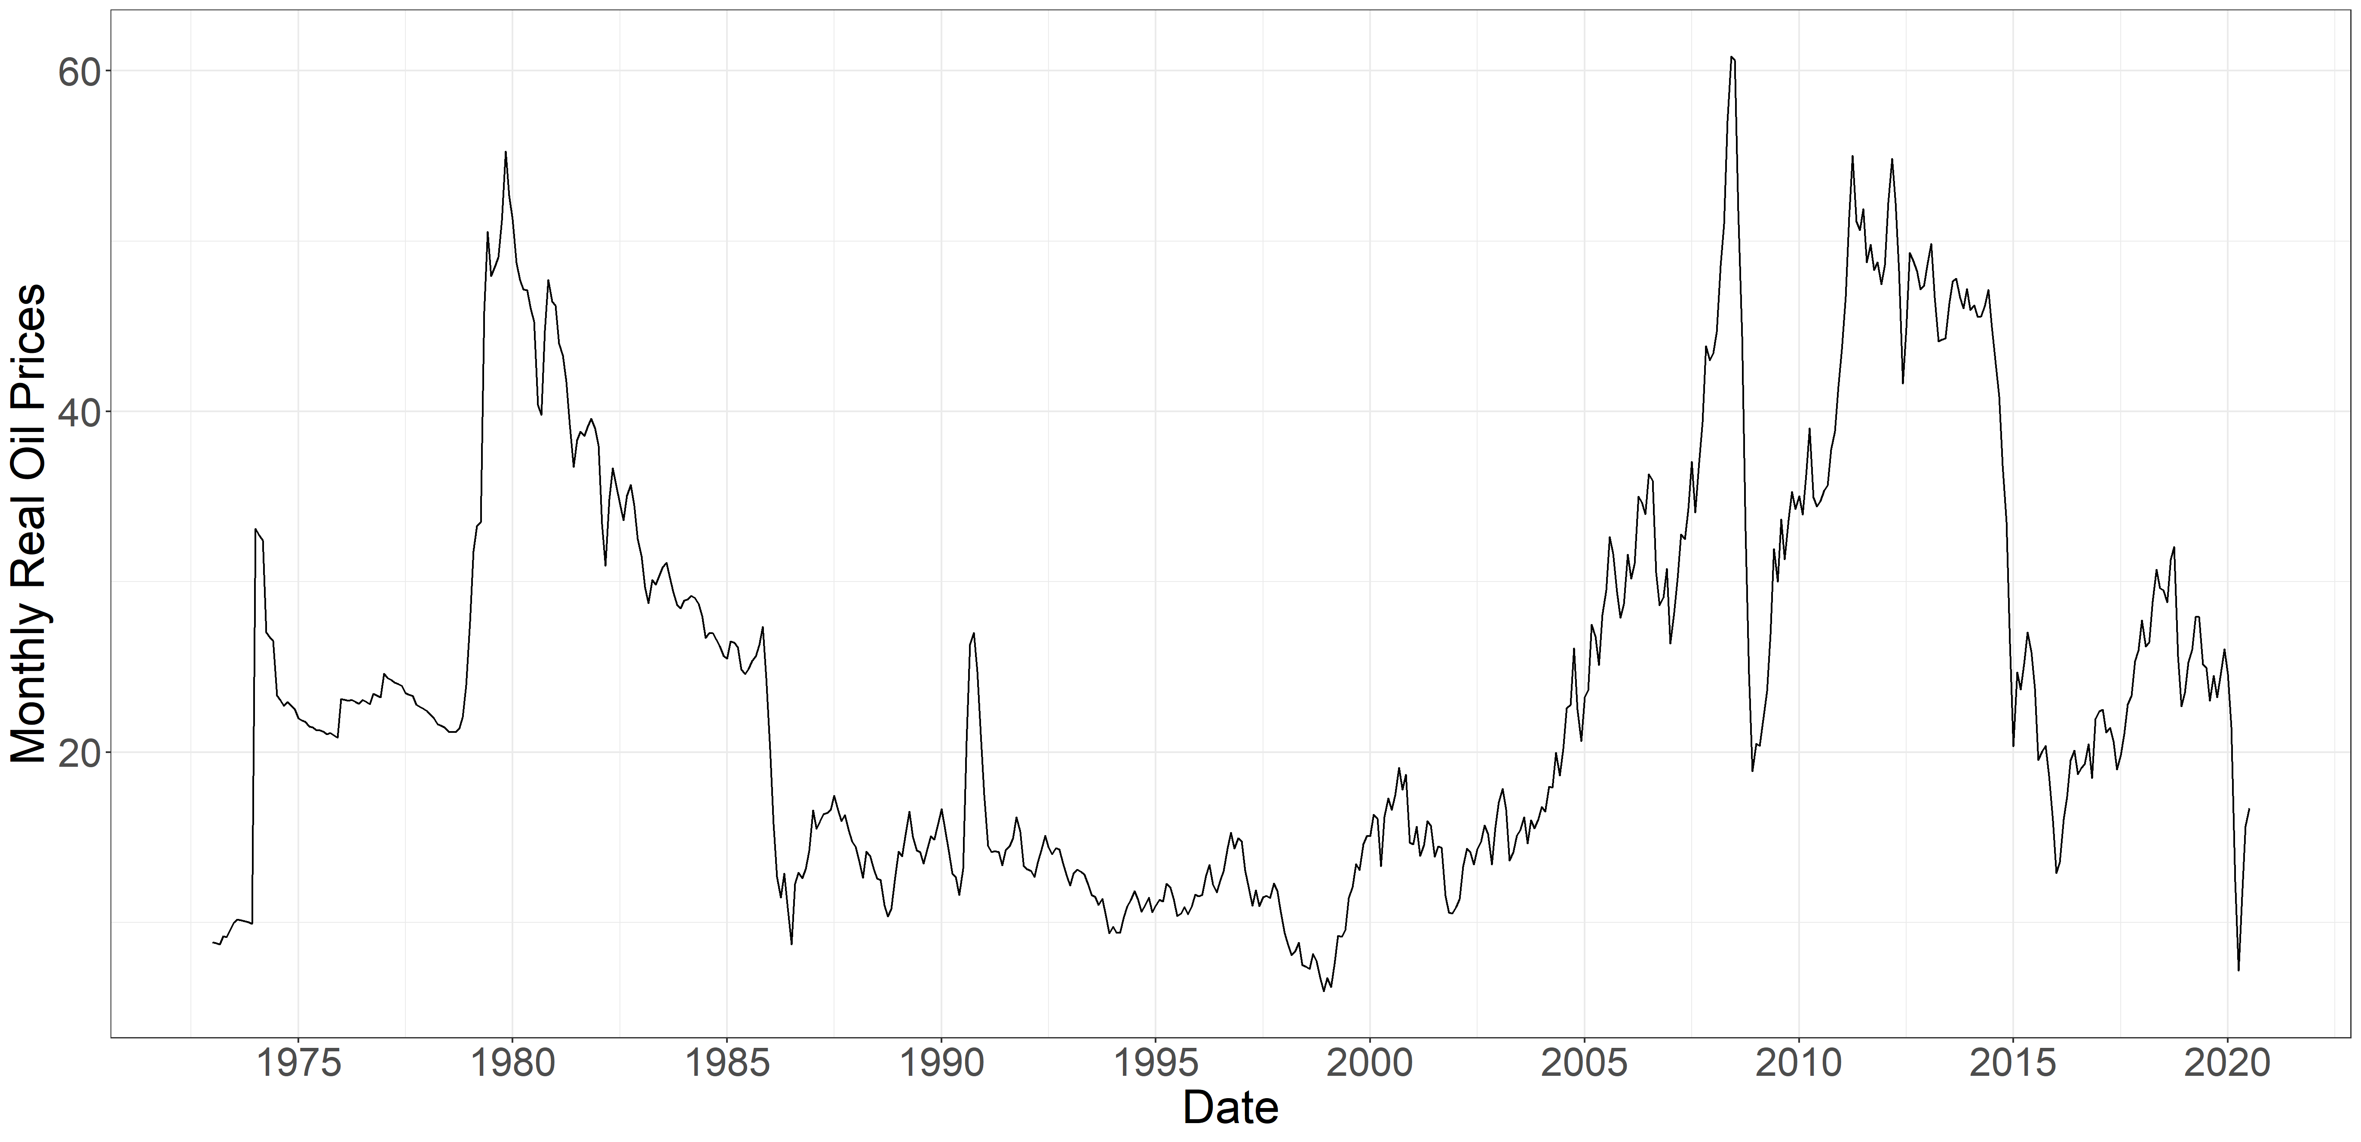
’80 Iran-Iraq War
‘08 Recession
‘73 Oil Embargo
‘90 Gulf war
‘00 Dot-com
’14 OPEC Collapse
’98 East Asian Crisis
‘20 Covid-19
Variable | Min. | Median | Mean | Max. | S.D.
POIL | -54.90 | -0.38 | 0.11 | 120.40 | 10.39
Real Brent Oil Price

Slide 14
5. Empirical Results
Notes:
Literature review can mostly be words it doesn’t have to be written down.
First thing: Related literature
Bunch of papers that have treated oil price changes as exogenous. Then I talk about the seminal paper of Kilian and spinoff versions of that. Kilian kickstarted this literature on distangling supply and demand shocks and that’s important. Third thing is how other papers have extended Kilian’s framework and looked at OPEC

Slide 15
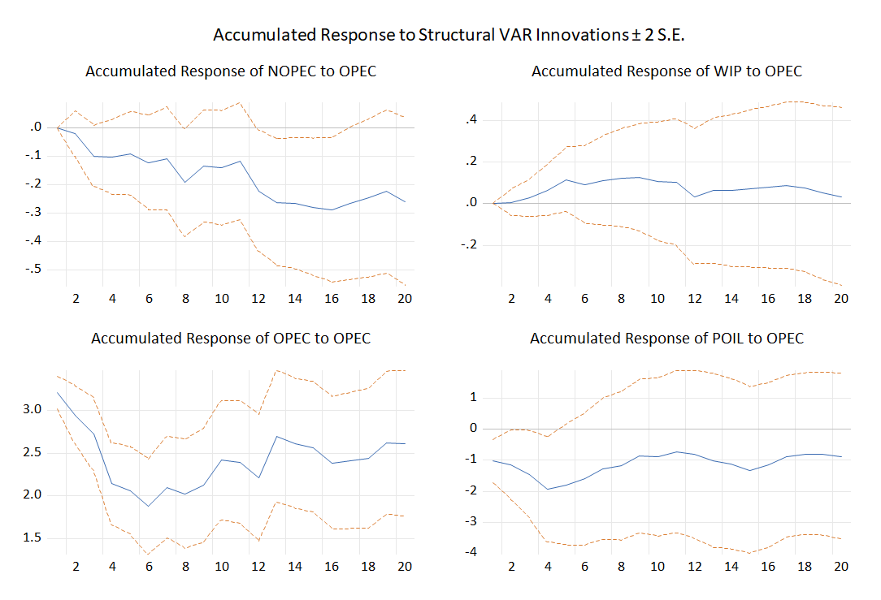
Impulse Response Functions, OPEC production

Slide 16
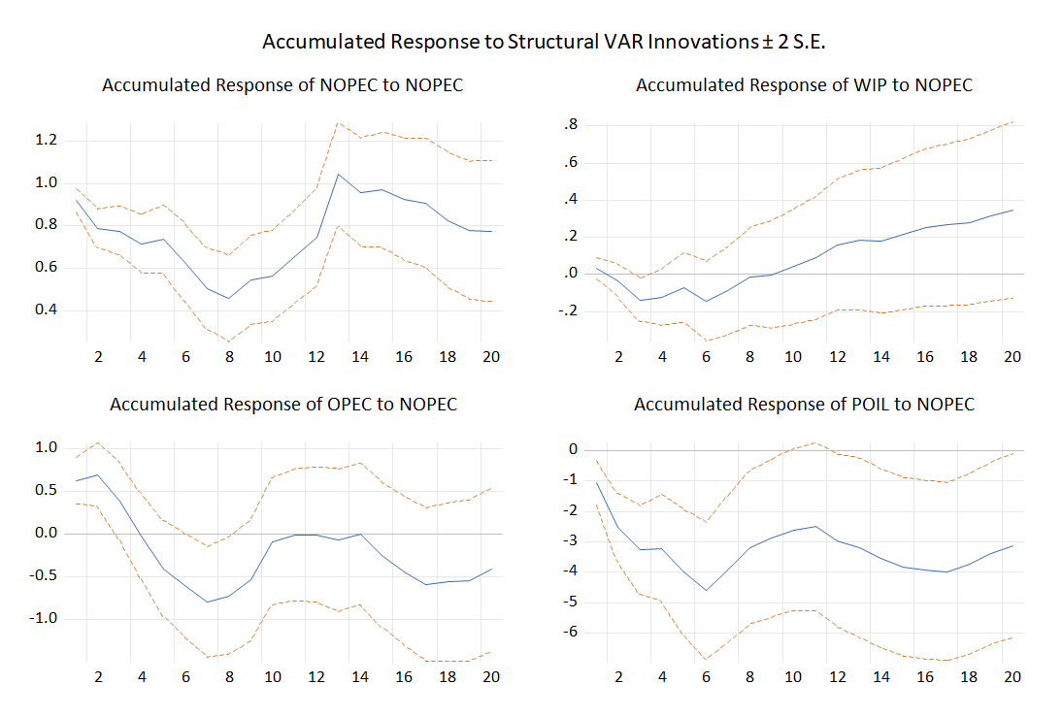
Impulse Response Functions, Non-OPEC production

Slide 17
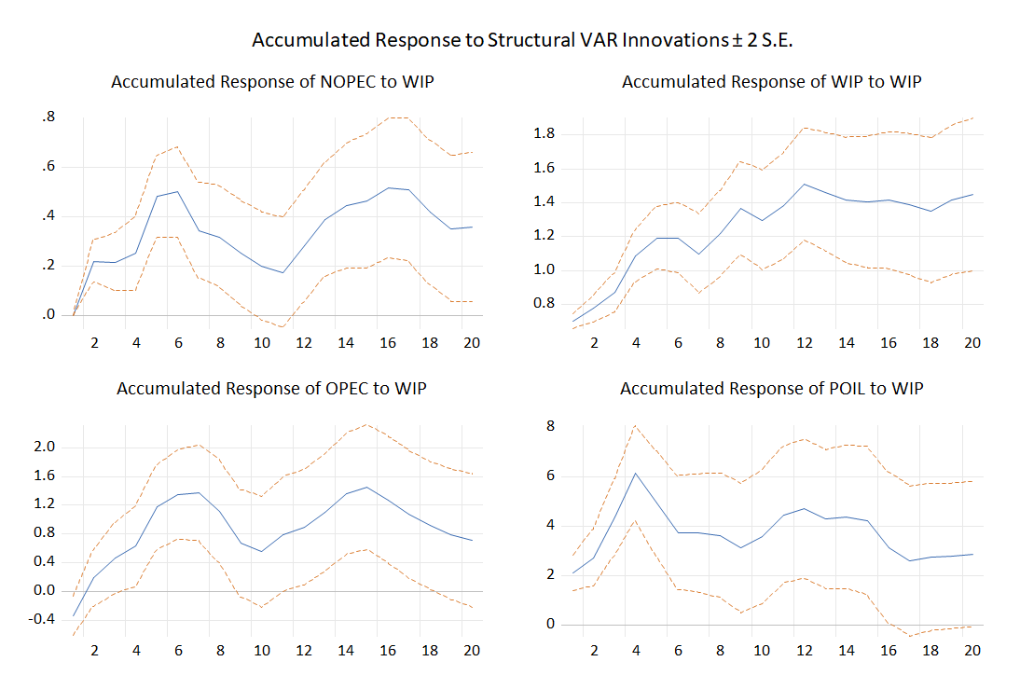
Impulse Response Functions, Demand
Notes:
Let’s look at the x shock.
One standard deviation shock increases WIP by 1.2. It’s a permanent shock and is very persistnet. Demand increases presenetantly for 1 year and remainds high.
An example of this is China’s boom. Permanent demand increases.
In response, prices are increasing. Increases in global demand increases prices. This is consistent with our priors. We’re interested in the elasticity of this.
Increases prices persistently by 4%. Little overshooting in the short run.
How does supply respond? Start with OPEC. If OPEC was trying to reduce oil price volatility, they would increase production. On net, OPEC increases production by 1%.
Care about elasticity.
Last thing is dynamics. Our demand shocks is a level shift. Oil prices overshoot and then is permanently higher. OPEC dynamics track the growth rate shock, take abit but they also increase. Non-OPEC responds similarly to OPEC, but responds half of that of OPEC.

Slide 18
Historical Variance Decompositions, Price of Oil
Notes:
Calculate standard devation of oil prices, subtract each component and recalculate standard deviations. With all the numbers calculate the percent.
Calculate standard deviation of each component to the oil price, Four percentages each add to 100 in the end.

Slide 19
Sensitivity Analysis
Lag selection
AIC reports lag length of 6
Kilian (2009) uses lag length of 24
Robust to 6 and 24 lag specifications
Structural Break in 1996
Post-1996:
Robust to estimates
Notes:
Instead of impulses write about contribution to opec variability. Check historical decompositions.

Slide 20
6. Conclusion
Notes:
Literature review can mostly be words it doesn’t have to be written down.
First thing: Related literature
Bunch of papers that have treated oil price changes as exogenous. Then I talk about the seminal paper of Kilian and spinoff versions of that. Kilian kickstarted this literature on distangling supply and demand shocks and that’s important. Third thing is how other papers have extended Kilian’s framework and looked at OPEC

Slide 21
Final Remarks
OPEC behavior consistent with a market-sharing cartel
Results consistent with Kilian (2009) on the importance of demand
Future studies
Relax restrictions with Bayesian SVARs

Slide 22
Thank you for listening!
Any questions?

Slide 23
References
Alhajjia, A., & Huettner, D. (2000). OPEC and other commodity cartels: a comparison. Energy Policy 28:15, 1151-1164.
Álvarez, I. A., Di Nino, V., & Venditti, F. (2020). Strategic interactions and price dynamics in the global oil market. Working Paper Series 2368, European Central Bank.
Baumeister, C., & Hamilton, J. D. (2019). Structural Interpretation of Vector Autoregressions with Incomplete Identification: Revisiting the Role of Oil Supply and Demand Shocks. American Economic Review, 109, 1873-1910.
Baumeister, C., Korobilis, D., & Lee, T. K. (2020). Energy Markets and Global Economic Conditions. Review of Economics and Statistics, forthcoming.
Behar, A., & Ritz, R. A. (2014). OPEC vs US shale: Analyzing the shift to a market-share strategy. Energy Economics, 63, 185-198.
Hamilton, J. D. (2003). What is an Oil Shock? Journal of Econometrics, 113: 363-398.
Hamilton, J. D. (2019). Measuring global economic activity. Journal of Applied Econometrics.

Slide 24
References
Jones, C. M., & Kaul, G. (1996). Oil and the Stock Markets. The Journal of Finance, 51:2, 463-491.
Kilian, L. (2008). Exogenous Oil Supply Shocks: How Big Are They and How Much Do They Matter for the U.S. Economy? The Review of Economics and Statistics, 90:2, 216-240.
Kilian, L. (2009). Not All Oil Price Shocks Are Alike: Disentangling Demand and. American Economic Review, 99:3, 1053–1069.
Kolodzeij, M., & Kaufmann, R. (2014). Oil demand shocks reconsidered: A cointegrated vector autoregression. Energy Economics, 41(C), 33-40.
Leblanc, M., & Chinn, M. D. (2004). Do High Oil Prices Presage Inflation? The Evidence from G-5 Countries. UC Santa Cruz Economics Working Paper No. 561.
OPEC. (2021). About Us. Retrieved from Organization of the Petroleum Exporting Countries: https://www.opec.org/opec_web/en/about_us/23.htm#:~:text=In%20accordance%20with%20its%20Statute,of%20petroleum%20to%20consumers%2C%20a

Slide 25
References
Ratti, R. A., & Vespignani, J. L. (2015). OPEC and non-OPEC oil production and the global economy. Energy Economics, 50, 364-378.
Smith, J. L. (2005). Inscrutable OPEC? Behavioral Tests of the Cartel Hypothesis. The Energy Journal, 26:1, 51-82.
U.S. Energy Information Administration. (2020, January). International. Retrieved from EIA: https://www.eia.gov/international/data/world

