Slide 1


Foreach Loop Enumerators in SSIS
Reza Rad
SQL Server MVP, Author, DW / BI Architect

Slide 2
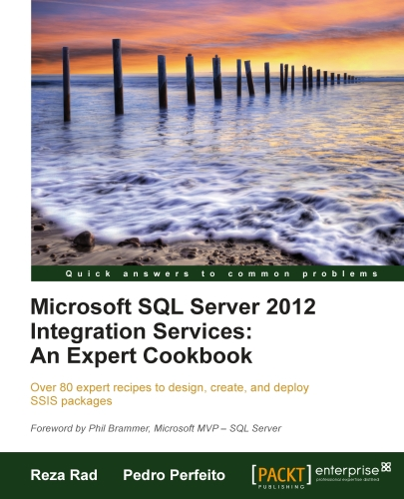



About Me: Reza Rad
SQL Server MVP
Author of some SQL Server BI books
DW / BI Architect
Trainer
Author of SSIS Webcast Series

Slide 3
Containers in SSIS
Sequence Container
For Loop Container
Foreach Loop Container

Slide 4
Foreach Loop Container
Loop through items of an array, data table, object collection, xml content, files, SQL Server objects, metadata objects.
Benefits;
Reducing number of packages and tasks >> Lower maintenance cost

Slide 5
Seven Types of Enumerators
From Variable Enumerator
Item Enumerator
ADO Enumerator
ADO.NET Schema Rowset Enumerator
Nodelist Enumerator
SMO Enumerator
File Enumerator

Slide 6
Dynamism in SSIS
Variables
Expression Language
Data Flow -> Derived Column, Conditional Split Transformation
Control Flow -> Expression Task, Precedence Constraint
Expression Property
Setting property values dynamically

Slide 7
Foreach File Enumerator

Slide 8
Foreach File Enumerator
Looping through files of a directory
File mask can be used, such as “Customers?.csv”
Fully qualified file path, or file name only (with or without extension) can be fetched
Ability to traverse subfolders

Slide 9
File Enumerator: DEMO
Customer records exists in multiple CSV files in a source folder
A loop structure will loops through CSV files, and;
Extract data from each file, and load it into the Customer database table
Move CSV files to Archive folder
Log an entry with file name and datetime into SourceFileLog table

Slide 10
Foreach From Variable Enumerator

Slide 11
Foreach From Variable Enumerator
Looping through arrays of objects
Array can be loaded with .NET scripts through Array or ArrayList or similar collection structures
Array should be loaded into an OBJECT type variable in the package

Slide 12
From Variable Enumerator: Sample
SalesData CSV files coming from a source directory
A loop structure should only pick those files that does not exists in the Archive folder. Load them with file name and date time into a database table, and move them to archive
We use Script Task to find new files and then we fill them into an ArrayList, the ArrayList will be used in the Foreach Loop.

Slide 13
Considerations
Best practice to use From Variable is; where you can fetch an array (much easier) in a .NET script, and then use that array in the Foreach Loop.
There are many situations that few lines of .NET script do same thing that more than dozens of SSIS tasks do. This enumerator impressively helps in those scenarios.

Slide 14
Foreach ADO.NET Schema Rowset Enumerator

Slide 15
ADO.NET Schema Rowset Enumerator
Looping through schema and metadata of the data source
Examples;
All tables under specific database
Views of Sales schema under the database
All system objects
List of items can be filtered
INFORMATION_SCHEMA views in SQL Server

Slide 16
ADO.NET Schema Rowset Enumerator: Sample
Loop through all tables under AdventureWorks2012 database, with Sales Schema.
Export the data of each table into a csv file with name of same table
Structure of tables are different (Data flow cannot be used)
BCP for export from SQL Server to CSV

Slide 17
Considerations
Best for scenarios that looping through schema and metadata is required.
Output for each schema view differs based on the information provided.
Loop can be narrowed using filters in schema view’s columns.

Slide 18
Foreach Nodelist Enumerator

Slide 19
Foreach Nodelist Enumerator
Looping through elements and attributes of an xml data
XML can be
DirectInput -> Static loop
File Connection -> Configurable loop
Variable -> Dynamic loop

Slide 20
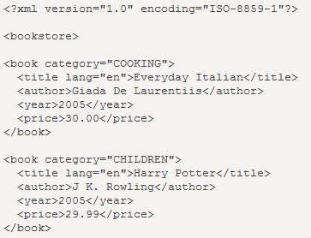
XPath
Standard query language for XML content
Examples:
List of all books:
/bookstore/book
Title of the specific book
/bookstore/book[1]/title
Author of books with price greater than 30:
/bookstore/book[price>=30]/author
More here:
http://www.w3schools.com/xpath/default.asp

Slide 21
Xpath enumeration types
Navigagor: Looping based on .NET XPathNavigator
Node: Looping based on Xpath provided and returns Nodes
NodeText: Looping based on Xpath provided and returns Node Texts
ElementCollection: looping through elements provided through OuterXpath, and fetch data based on InnerXpath

Slide 22
Considerations
Using Nodelist enumerator with Web Service Task empowers the ETL scenario
XPATH; more profession you gain in this query language, more power you’ll have in Nodelist enumerators

Slide 23
Nodelist Enumerator : DEMO
List of teams that played in FIFA 2010 fetched from a web service
A loop structure required to loop through team names, and call another web service to get full details of each team based on another web service.
The second web service accepts team name as an input parameter
Results of inner web services should be written into xml files named based on each time, such as Brazil.xml

Slide 24
Foreach Item Enumerator

Slide 25
Foreach Item Enumerator
Loops through Static data table defined in the enumerator configuration.
Column data types can be different, but not names.
Useful for defining loop structure for multi column arrays in the packages

Slide 26
Foreach Item Enumerator: Sample
There are two database servers for Employee info, one for each department; Sales, and Production. Name of databases, and name of tables are different.
Loop structure required to loop through two different servers with different db name and table names, and load data into a single destination database table on a third server.

Slide 27
Considerations
Good for looping through arrays with multiple columns (each column can have different data type).

Slide 28
Foreach ADO Enumerator

Slide 29
Foreach ADO Enumerator
The most useful type of enumerator
Loops through a data table that loaded into an object type variable
Data table can be loaded from Execute SQL Task with Full Result Set
Data table can be loaded from Data Flow Task with RecordSet Destination

Slide 30
Advantages of ADO Enumerator
Data Table can be loaded from any source through the Data Flow (Excel, Oracle, DB2, Flat File…)
Data Table can be transformed through any transformation through the Data Flow
Loop structure will be dynamic, because the source table that the data table comes from can be changed

Slide 31
ADO Enumerator: DEMO
Using ADO Enumerator to implement a simple package execution framework.
Packages with their execution order entered into a database table, there is also an enable/disable tag.
Loop structure will iterates through packages in the execution order and execute them one by one
A log entry will be written back into a log table

Slide 32
SMO Enumerator

Slide 33
Foreach SMO Enumerator
SMO = SQL Server Management Objects
List of .NET libraries for managing SQL Server objects.
Examples;
Looping through SQL Server jobs, Logins
Linked Servers

Slide 34
Foreach SMO Enumerator: Sample
There are two database servers for customer info; North Island, and South Island. Two Linked Server created to connect to each of these servers.
Loop structure required to loop through these linked servers (and any future linked servers with customer info), and load Customer data from CustomerInfo table into an integrated database.

Slide 35
For Loop Container

Slide 36
For Loop Container
Simple Loop structure, such as For in programming languages
For (int i=0; i<=20; i++)
Init Expression @i=0
Eval Expression @i<=20
Assign Expression @i=@i+1

Slide 37
For Loop: DEMO
Loop through numbers from 2 to the specified number.
Find all dividers of the number.
Create a string of all dividers with comma delimiter
Use this for BANDING time dimension for Hour column

Slide 38
Summary
Foreach Loop empowers ETL design
Reduces redundant work
Reduces maintenance and support costs
Improves consistency and standardization
Empower Foreach Loop with Expressions and Variables

Slide 39
Time for Action!
Find where in your SSIS packages you can use the power of Foreach Loop Container to reduce number of redundant tasks and packages

Slide 40
References to Study More
ADO Enumerator
Item Enumerator
SMO Enumerator
ADO.NET Schema Rowset Enumerator
From Variable Enumerator
Nodelist Enumerator
File Enumerator
For Loop Container

Slide 41
Thank you.. Stick Around for Q&A

