Slide 1
Voice-To-Text Analysis Web User Guide

Slide 2
Versions
Version | Change Date | Change By | Description
0 | 2022.06.09 | Tongtong | Initial

Slide 3
Contents
Login
Main
Upload
History
Report
About

Slide 4
Login
User can login with his/her username and password.

Slide 5
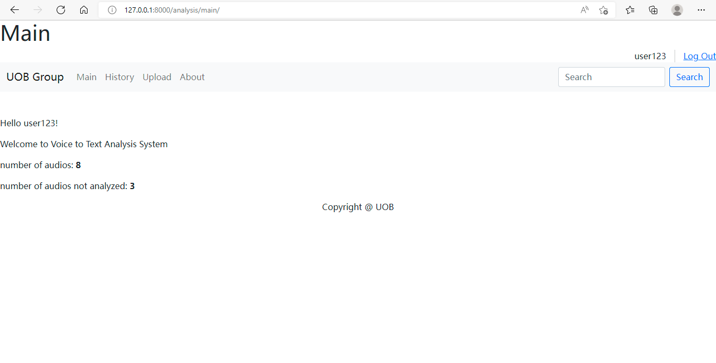
Main
This is designed as a dashboard to show summary information of current user.

Slide 6
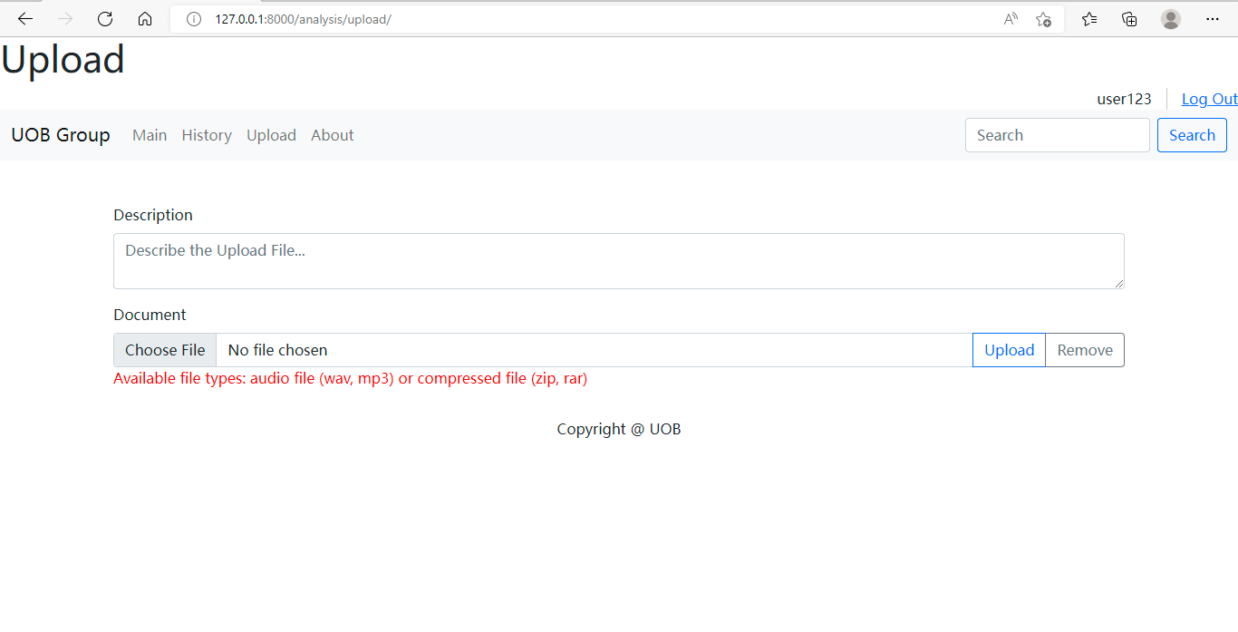
Web Portal

Slide 7
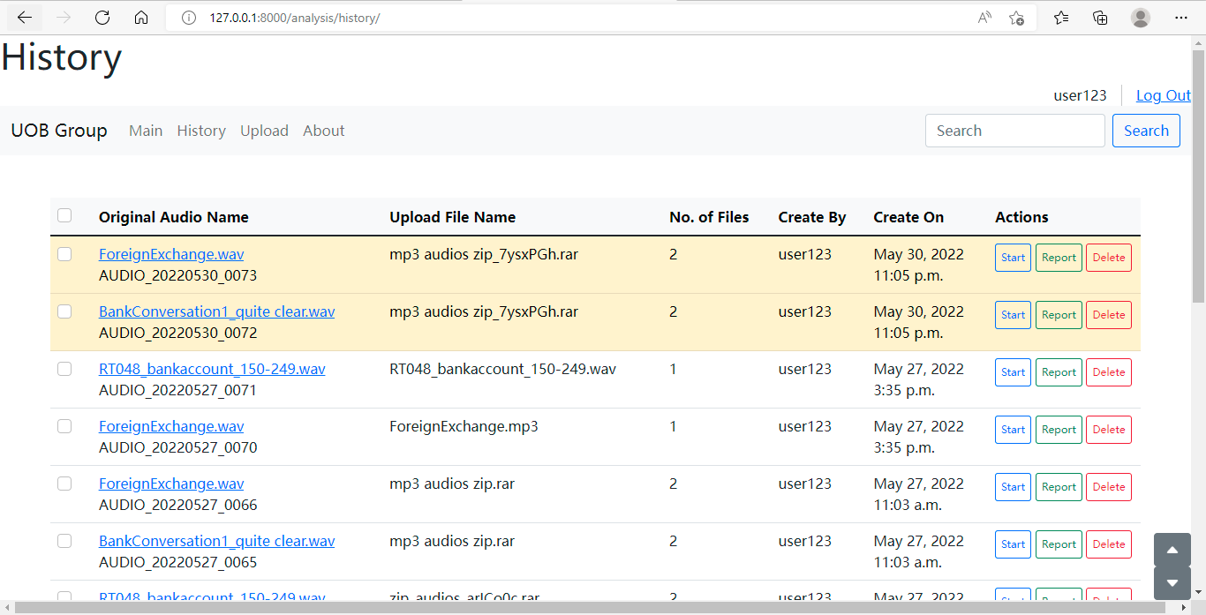
Web Portal

Slide 8
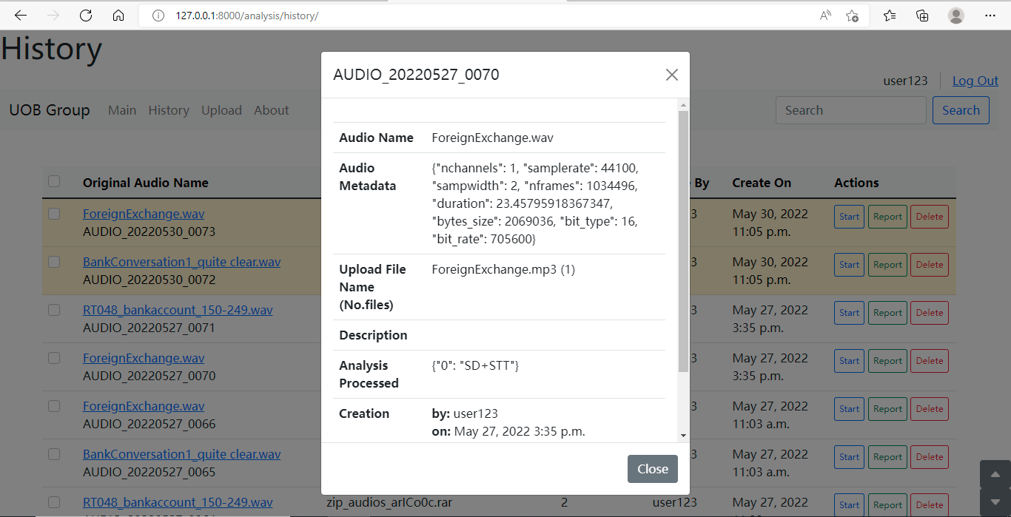
Web Portal

Slide 9
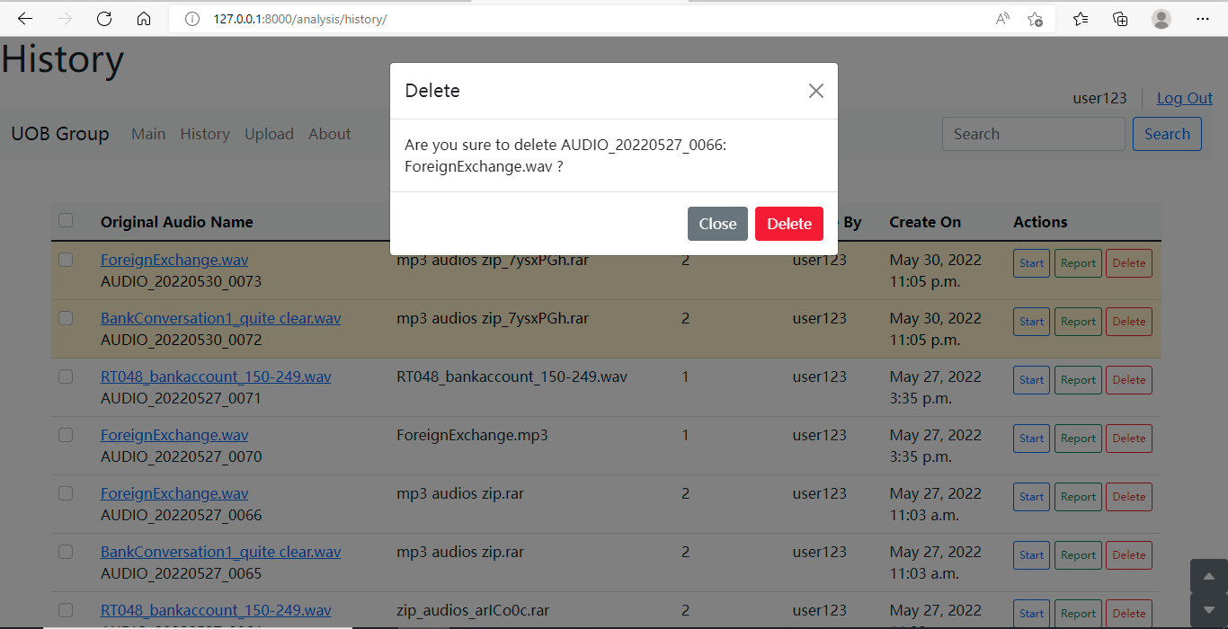
Web Portal

Slide 10
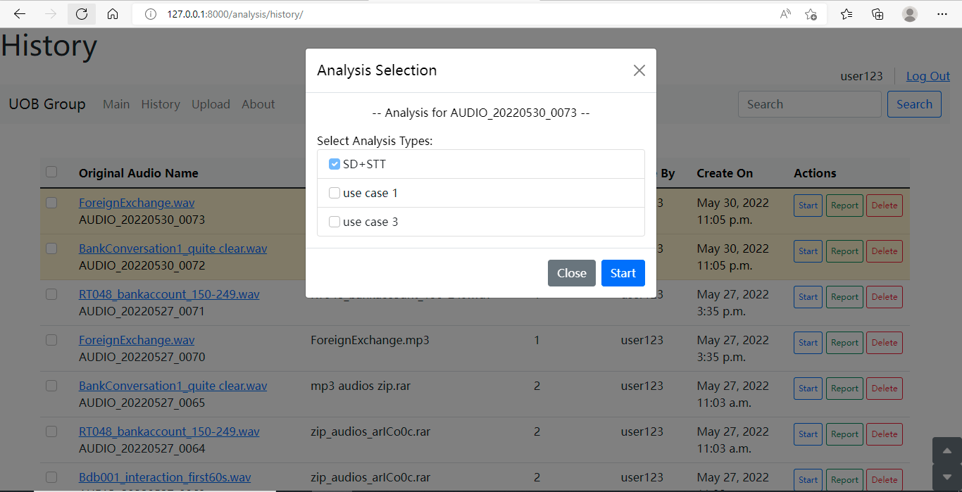
Web Portal

Slide 11
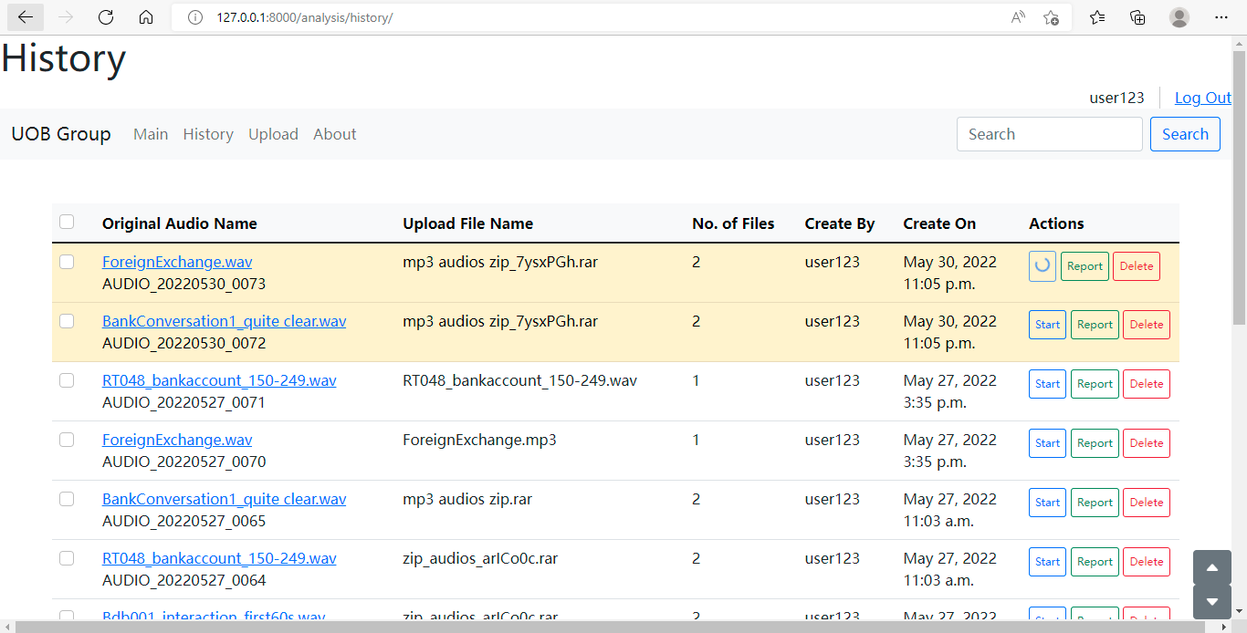
Web Portal

Slide 12
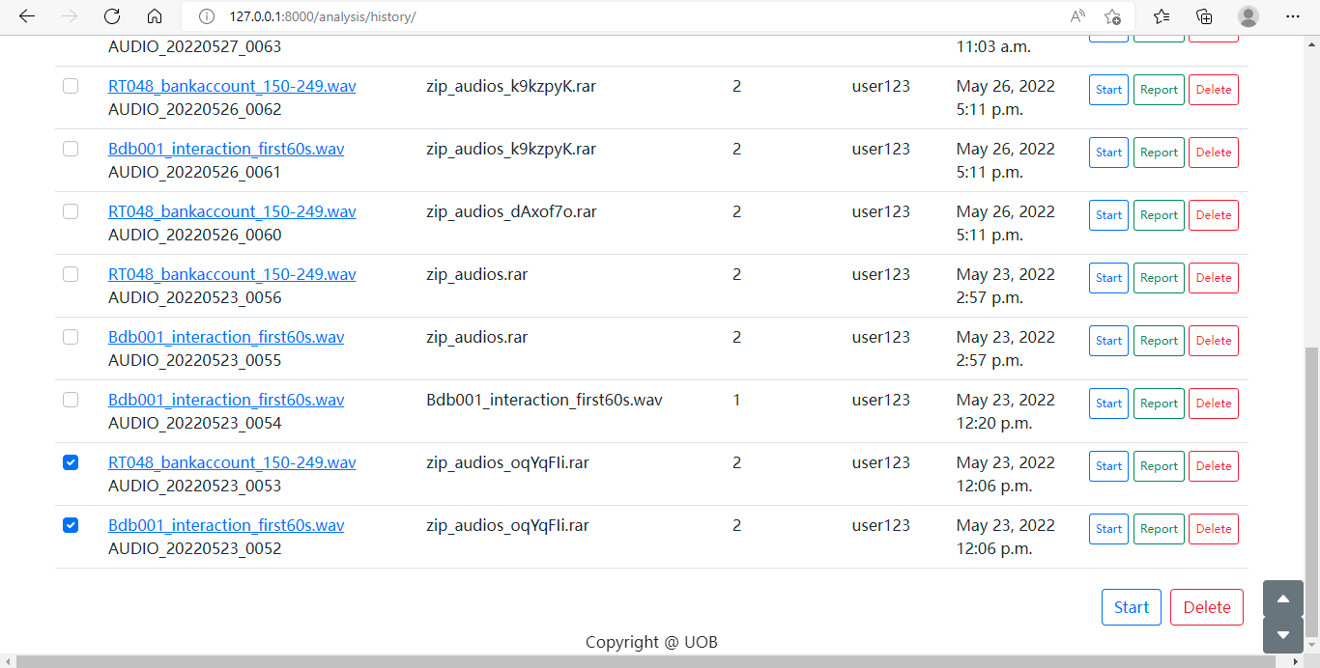
Web Portal

Slide 13
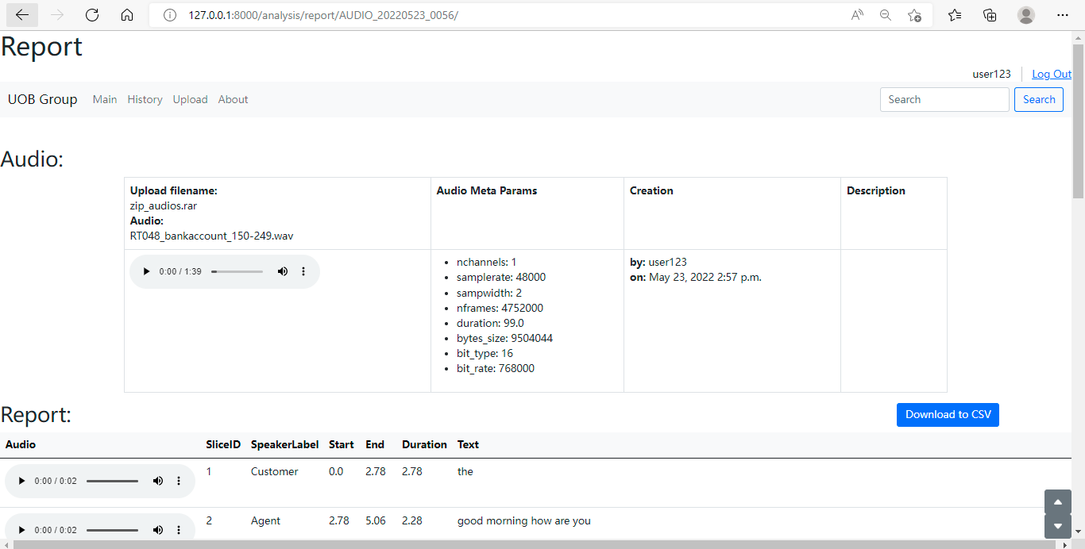
Web Portal

Slide 14
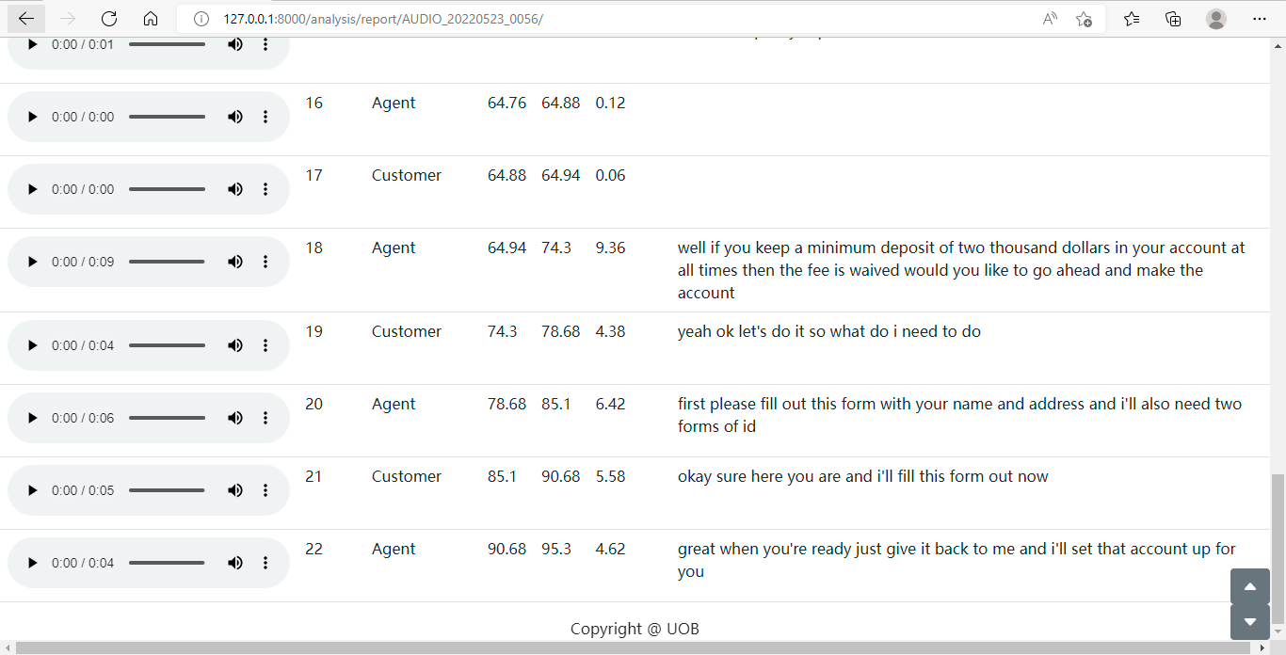
Web Portal

Slide 15
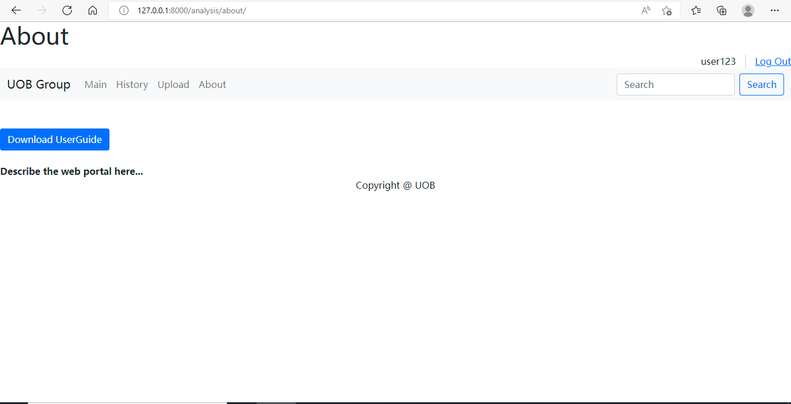
Web Portal

