Slide 1




Understanding Customer Churn : Comprehensive Analysis
By: Purity Kibaki

Slide 2

Background
Business Problem Data
Outline
METHODOLOGY
FINDINGS CONCLUSIONS

Slide 3

Background
Customer churn impacts every organization. In the case of this telecommunications company, the root causes are initially identified.
Machine learning techniques are then employed to determine which models yield the most precise forecasts for future predictions.

Slide 4
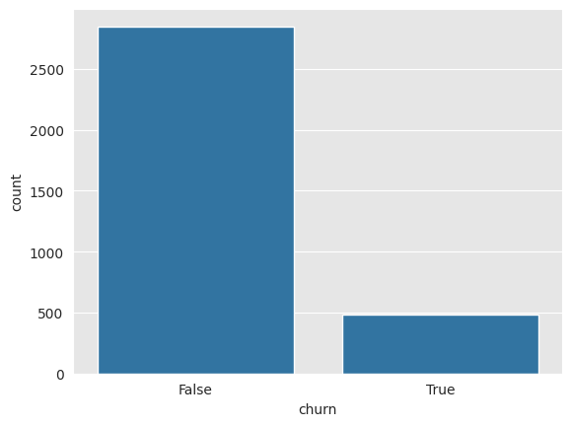
Maximize customer retention
Minimize customer turnover
Identify causes
Develop models that will help predict customer turnover
Business Problem

Slide 5
Using Telecom data set available on Kaggle with 3,333 customers.
Contains data including
daytime data
night time data
International data
Customer service calls
International plan
Churn/turnover
Data

Slide 6
Identify variables with statistical significance
Address class imbalance
Remove non-necessary variables
Split data into Train and Test set
Employ Feature selection
Implement Machine Learning models
Methodology

Slide 7
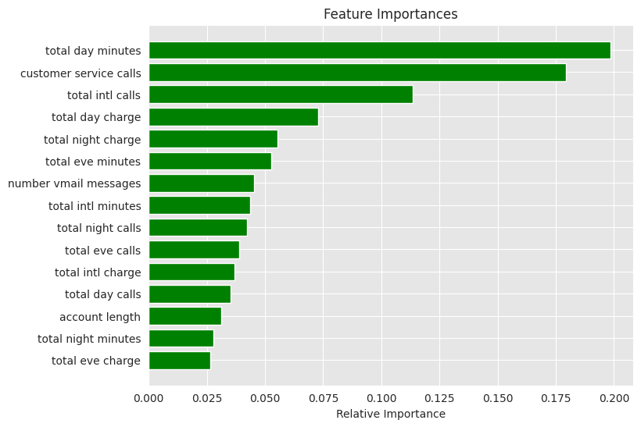
Feature Importance results
Results
Customer service calls and International Plans top two features for turnover.

Slide 8
Customers with an International Plan are 7 times more likely to leave compared to those without.
Each additional customer service call increases the likelihood of churn by a factor of 1.55.
Customers making international calls are less likely to churn, with an odds ratio of 0.92.
Having a Voicemail Plan decreases the likelihood of churn significantly, with an odds ratio of 0.16.
F1 score, deciding factor. Random Forests best model.
Summary of Findings

Slide 9
Models findings
Model Performances:
Logistic Regression: Accuracy score of 0.70.
Decision Trees, and Random Forests: Accuracy score of 0.87.
Results
F1 Scores:
Decision Trees: F1 score of 0.42.
Random Forests: F1 score of 0.55.
Best Model:
Random Forests emerged as the best model based on accuracy and F1 score.

Slide 10
THANK YOU

