Slide 1
User Group MeetUp on Amplify

Slide 2
Agenda
What’s new on AWS?
Usecase: Collecting Notes App
Architectural Design
Implementation via the Cloud Development Kit (CDK)
Implementation via the Amplify CLI
Open Space

Slide 3
Whats new on AWS
My personal highlights from 240 features launched since 01-01-2020
AWS Step Functions now supports CloudWatch Logs for standard workflows
AWS Lambda participates in Compute Savings Plans
Announcing Microsoft Azure Active Directory support for Amazon Redshift
AWS CloudFormation StackSets introduces automatic deployments across accounts and regions through AWS Organizations
Amazon Cognito User Pools service now supports case insensitivity for user aliases
Configure fine-grained data access with Amazon Elasticsearch Service
Amazon Elastic Container Service has added support for canary deployments
Amazon Redshift now supports per-second billing
AWS Compute Optimizer Available In 11 Additional Regions
Amazon RDS for MySQL Supports Authentication with Microsoft Active Directory

Slide 4
Usecase: Collecting Notes App I
Why: Comittment of all parents to work free charge for son’s kindergarten.
Who: 75 kids with round about 2 parents
Why:
The comittment forces parents to spend four hours per month for the kindergarten.
Every missed hour comes up with 20 €
75 (Families) x 4 (hours) x 12 (months) x 20 (€) = 72.000 in total

Slide 5
Usecase: Collecting Notes App II
User Management
Autom. Reporting
User Seperation
Maybe: IDP, like Google
GDPR compliant
Fast Solution
Simple Management
Maybe: Multi platform support

Slide 6
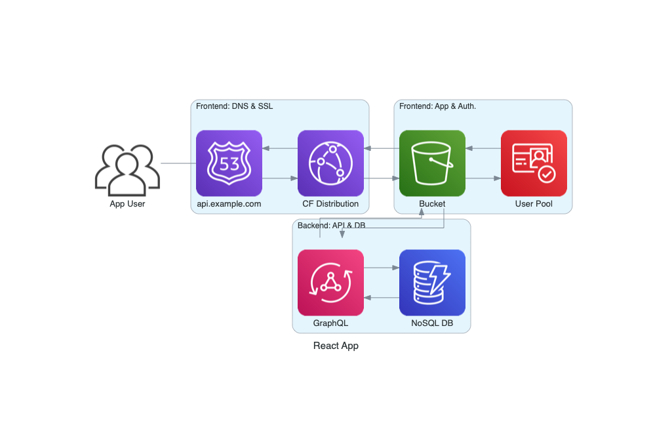
Architectural Design
Architecture

Slide 7
Architectural Design - Frontend
DNS: some nice URL - Route53
SSL: https everywhere - CloudFront
ReactApp: For fun and simplicity - S3 with a dedicated Bucket
Authentication: Using an Userpool - Cognito
Notes:
Route53: DNS Service, Registrat, Routing Policies, Private and Public Hosted Zones
CloudFront: Content Delivery Network, DDoS protection, CNAME capability, S3 Protection
S3: Object storage, server capability without server-side language support
Cognito: User- and indentity pool, supports SAML, OpenID and JWT

Slide 8
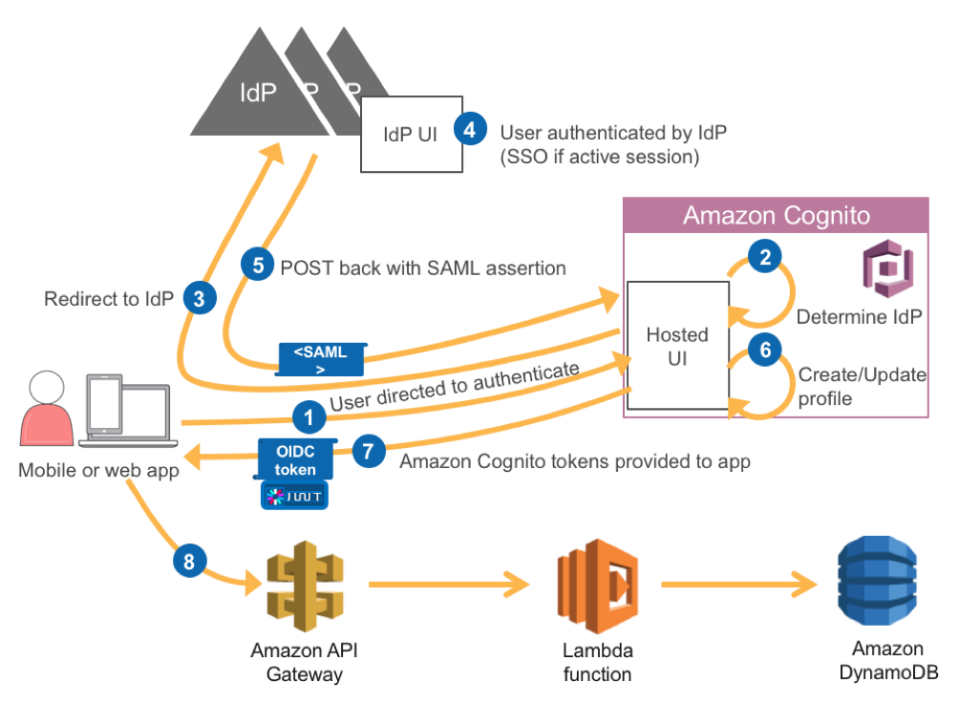
Architectural Design - Frontend - Cognito
Cognito: JWT

Slide 9
Architectural Design - Backend
API: GraphQL for Fun and Simplicity (no Lambda Developing) - AppSync
Serverless DB: No Network or Security Discussions - DynamoDB
Notes:
AppSync: flexible API design for real-time apps with GrapQL
DynamoDB: NoSQL DB, no limit towards size, API based calls

Slide 10
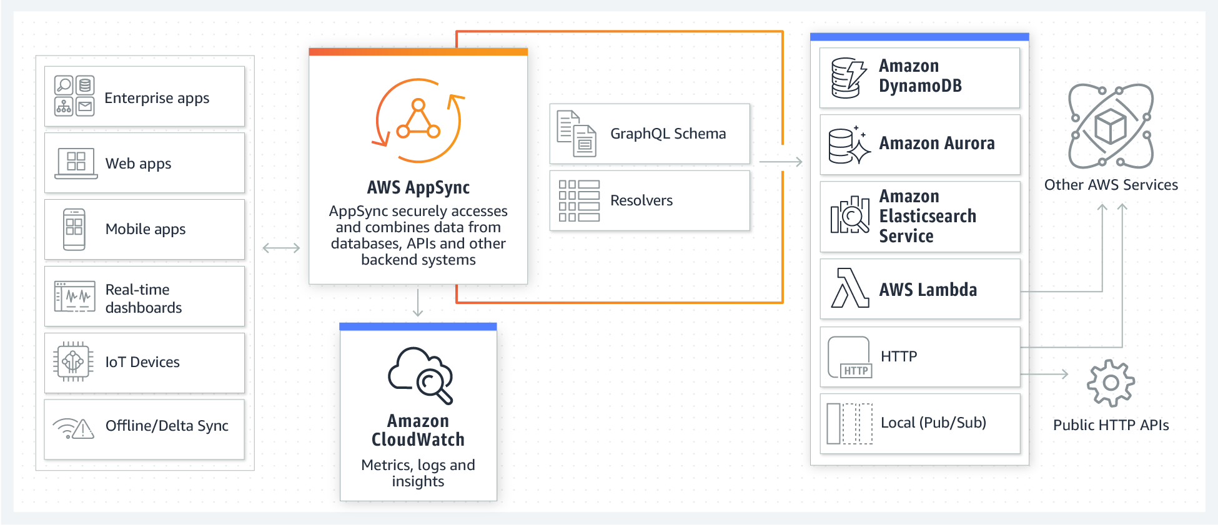
Architectural Design - Backend - Appsync
Appsync

Slide 11
Implementation via the Cloud Development Kit (CDK)
375 lines of code …

Slide 12
Implementation via the Amplify CLI I
Let’s us the Amplify CLI instead!
$ npm install -g @aws-amplify/cli $ amplify configure # You need a functional user
Notes:
https://dev.to/aws/10-minute-tutorial-creating-a-serverless-express-web-server-api-29j7 https://github.com/dabit3/awesome-aws-amplify

Slide 13
Implementation via the Amplify CLI II
Let’s us the Amplify CLI instead!
$ npx create-react-app amplify-version $ cd amplify-version $ npm install aws-amplify $ amplify init

Slide 14
Implementation via the Amplify CLI III
Lets’ add the Database
Let’s add the API
Let’s add the Authentication
Let’s build the App itself

Slide 15
Implementation via the Amplify CLI IV
Architecture
Notes:
Amplify is not able to deal with Rout53 and CNAMEs of CF distributions.

Slide 16
Open Space
Let’s connect ;-)! Thanks for listening!

