Slide 1
Perfect Subset Privacy in Polynomial Computation IEEE International Symposium on Information Theory Athens, Greece, July 2024 Ken Deng, Vinayak Ramkumar, Netanel Raviv
1

Slide 2
Motivation
Assigning large-scale computations to service providers raises privacy problems.
Coded computing: application of error-correcting codes in distributed computations.
Used to address stragglers, adversaries, and privacy issues.
Some level of restricted collusion is usually assumed among workers in the system.
The system administrator is trusted.
2

Slide 3
Motivation
What about the setting where a user relies on a single untrusted service provider that introduces a privacy risk?
Very common nowadays (Amazon Web Services, Google Cloud, etc.)
We seek to extend the scope of coded computation settings to protect privacy against the service provider as a whole.
The service provider has access to all of the data, which means assuming restricted collusion is not relevant.
3

Slide 4






Shifting the “Privacy Barrier”
Worker $1$
User
$$\tilde{x}$$
Admin
Worker $2$
Worker $3$
$$k$$
$$x$$
4
Notes:
The user encodes x with key
The user wishes to discard x and only keep k
F is not known a priori. Make that come later.
Thicker lines on the barrier. Move barriers using animation. 3 workers? What is A? say results or something

Slide 5


Shifting the “Privacy Barrier”
Service provider
Worker $1$
User
$$\tilde{x}$$
Admin
$$f$$
Worker $2$
Results
Worker $3$
$$k$$
Results
$$f(x)$$
Proposed barrier
Existing barrier
5
Notes:
The user encodes x with key
The user wishes to discard x and only keep k
F is not known a priori. Make that come later.
Thicker lines on the barrier. Move barriers using animation. 3 workers? What is A? say results or something

Slide 6



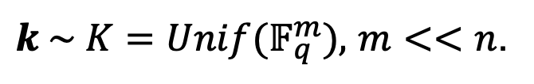






Computation Model: Storage
$$x \sim Unif{(𝔽}_{q}^{n})$$
$$\hat{x}=\hat{E}(\tilde{x})$$
Worker $1$
$${\hat{x}}_{1}$$
$$\tilde{x}≜\tilde{E}(x,k)$$
$${\hat{x}}_{2}$$
Worker $2$
$${\hat{x}}_{3}$$
Worker $3$
User
Admin
$k \sim K=Unif{(𝔽}_{q}^{m}),$ $m<<n$.
6

Slide 7



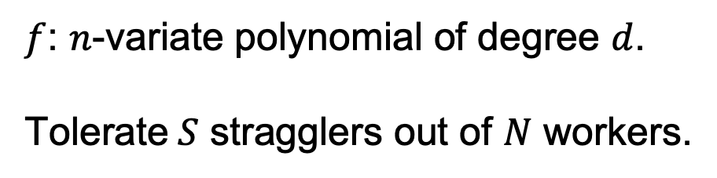





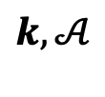
Computation Model: Computation
User
Admin
$$f$$
Worker $1$
$$f:𝔽_{q}^{n}→𝔽_{q}$$
$$f({\hat{x}}_{1})$$
$$f$$
Worker $2$
$$𝒜$$
$$f({\hat{x}}_{2})$$
$$f$$
Worker $3$
$$f({\hat{x}}_{3})$$
$$k,𝒜$$
$f$: $n$-variate polynomial of degree $d$.
Tolerate$S$ stragglers out of $N$ workers.
$$f(x)$$
7
Notes:
F is not known during storage

Slide 8
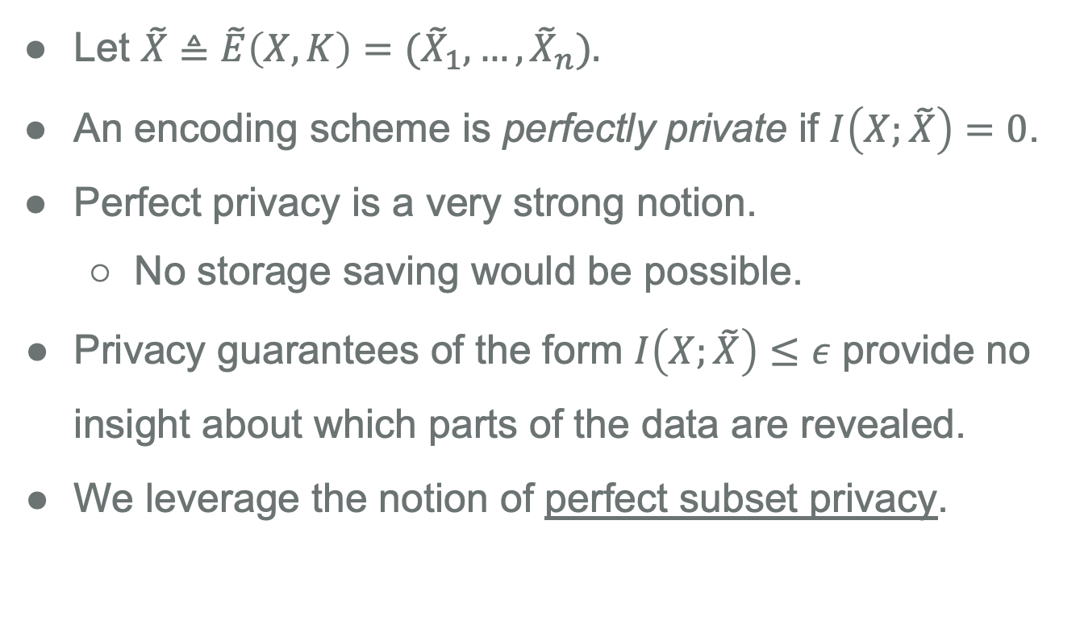
Perfect Subset Privacy
Let $\tilde{X}≜\tilde{E}\left(X,K\right)=({\tilde{X}}_{1},…,{\tilde{X}}_{n}).$
An encoding scheme is perfectly private if $I\left(X;\tilde{X}\right)=0$.
Perfect privacy is a very strong notion.
No storage saving would be possible.
Privacy guarantees of the form $I\left(X;\tilde{X}\right)≤ε$ provide no insight about which parts of the data are revealed.
We leverage the notion of perfect subset privacy.
8
Notes:
Perfect privacy requires a key as big as the data itself, which means…

Slide 9
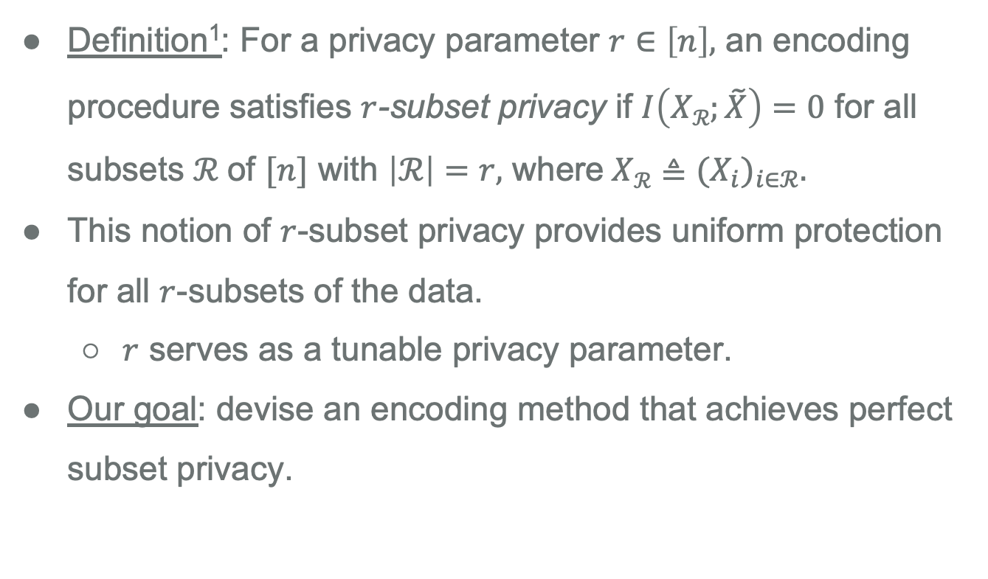
Perfect Subset Privacy
Definition¹: For a privacy parameter $r∈\left[n\right],$ an encoding procedure satisfies $r$-subset privacy if $I\left(Xℛ;\tilde{X}\right)=0$ for all subsets $ℛ$of $[n]$ with $\left|ℛ\right|=r,$ where$Xℛ$ $≜$ ${{(X}_{i})}_{i∈ℛ}.$
This notion of $r$-subset privacy provides uniform protection for all $r$-subsets of the data.
$r$ serves as a tunable privacy parameter.
Our goal: devise an encoding method that achieves perfect subset privacy.
¹N. Raviv and Z. Goldfeld, “Perfect subset privacy for data sharing and learning,” in 2022 IEEE International Symposium on Information Theory (ISIT), IEEE, 2022, pp. 1850–1855.
9
Notes:
Don’t use the binomial notation. Emphasize last bullet

Slide 10
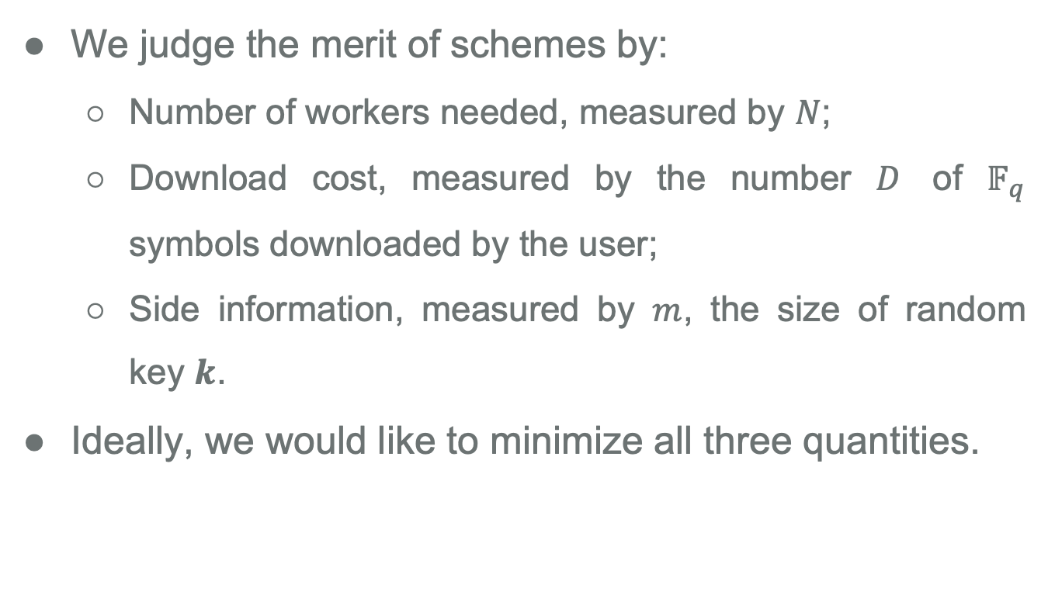
Performance Metrics
We judge the merit of schemes by:
Number of workers needed, measured by $N$;
Download cost, measured by the number $D$ of $𝔽_{q}$ symbols downloaded by the user;
Side information, measured by $m$, the size of random key $k$.
Ideally, we would like to minimize all three quantities.
10

Slide 11
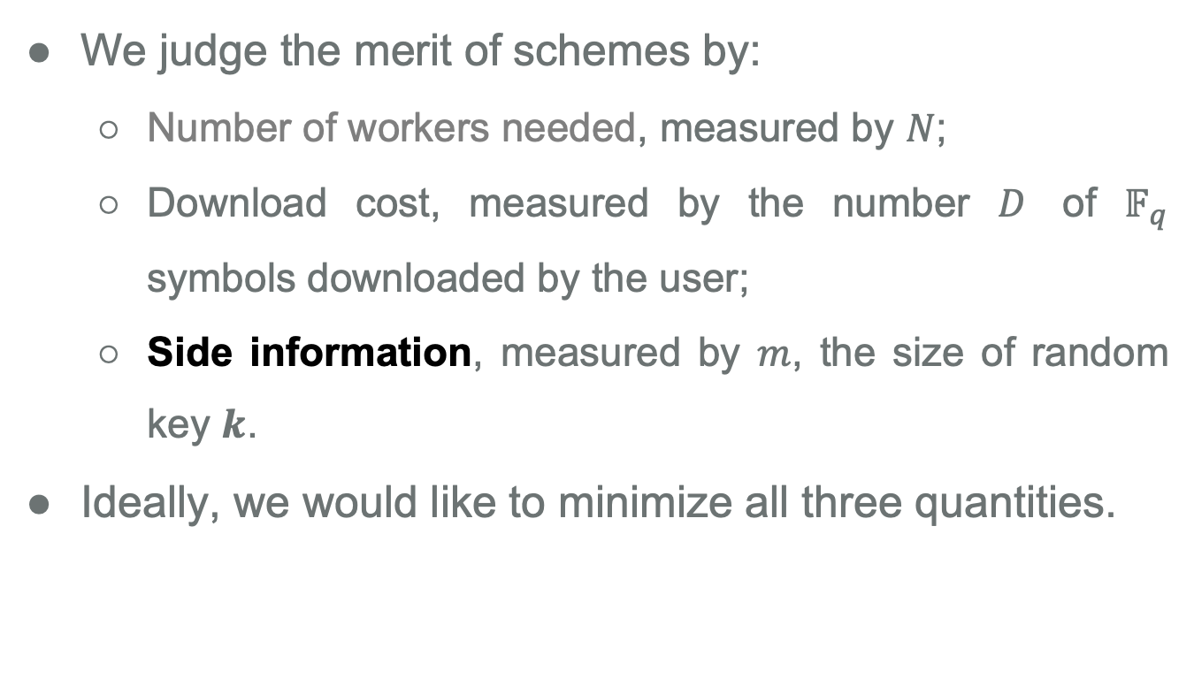
Performance Metrics
We judge the merit of schemes by:
Number of workers needed, measured by $N$;
Download cost, measured by the number $D$ of $𝔽_{q}$ symbols downloaded by the user;
Side information, measured by $m$, the size of random key $k$.
Ideally, we would like to minimize all three quantities.
11

Slide 12

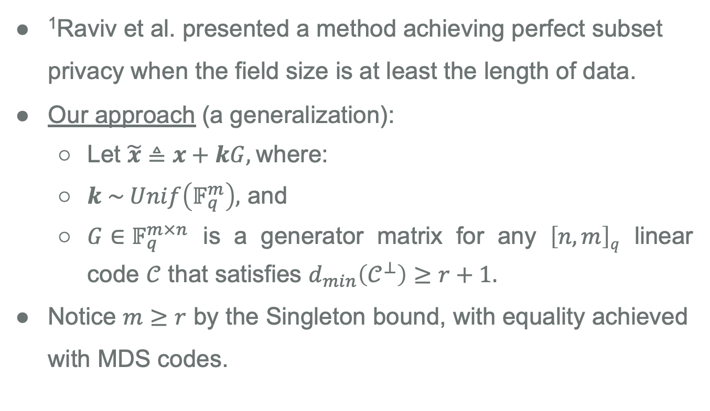
Achieving $r$-subset Privacy
¹Raviv et al. presented a method achieving perfect subset privacy when the field size is at least the length of data.
Our approach (a generalization):
Let $\tilde{x}≜x+kG,$where:
$k \sim Unif\left(𝔽_{q}^{m}\right),$ and
$G∈𝔽_{q}^{m×n}$ is a generator matrix for any $\left[n,m\right]q$ linear code $𝒞$ that satisfies $d_{min}\left(𝒞^{⊥}\right)≥r+1.$
Notice $m≥r$ by the Singleton bound, with equality achieved with MDS codes.
¹N. Raviv and Z. Goldfeld, “Perfect subset privacy for data sharing and learning,” in 2022 IEEE International Symposium on Information Theory (ISIT), IEEE, 2022, pp. 1850–1855.
12

Slide 13
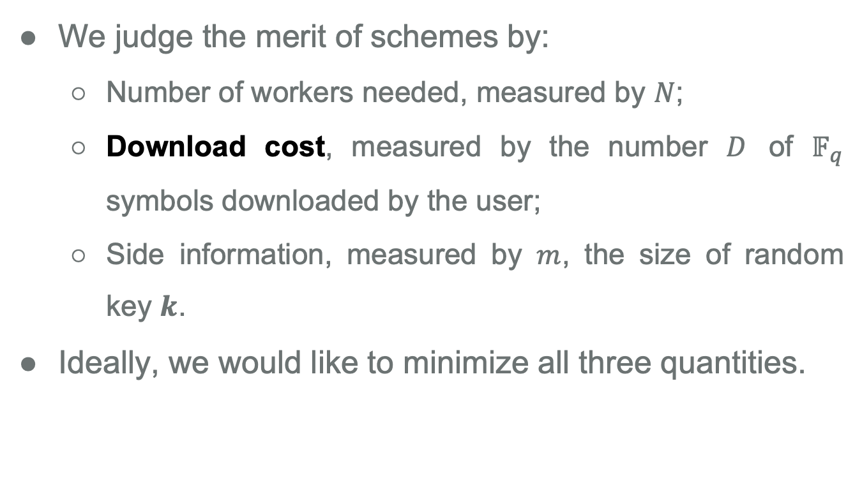
Performance Metrics
We judge the merit of schemes by:
Number of workers needed, measured by $N$;
Download cost, measured by the number $D$ of $𝔽_{q}$ symbols downloaded by the user;
Side information, measured by $m$, the size of random key $k$.
Ideally, we would like to minimize all three quantities.
13
Notes:
Mention reed-muller code here

Slide 14
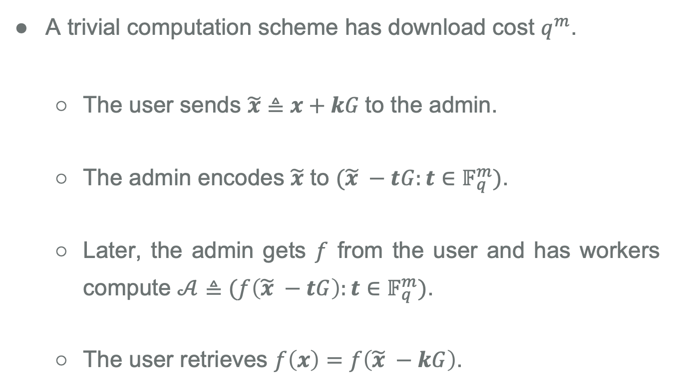
Trivial Scheme
A trivial computation scheme has download cost $q^{m}$.
The user sends $\tilde{x}≜x+kG$to the admin.
The admin encodes $\tilde{x}$ to $(\tilde{x} −tG:t∈𝔽_{q}^{m})$.
Later, the admin gets $f$ from the user and has workers compute $𝒜≜(f\left(\tilde{x} −tG\right):t∈𝔽_{q}^{m})$.
The user retrieves $f\left(x\right)=f\left(\tilde{x} −kG\right)$.
14
Notes:
Informal def. explain trivial scheme briefly.

Slide 15
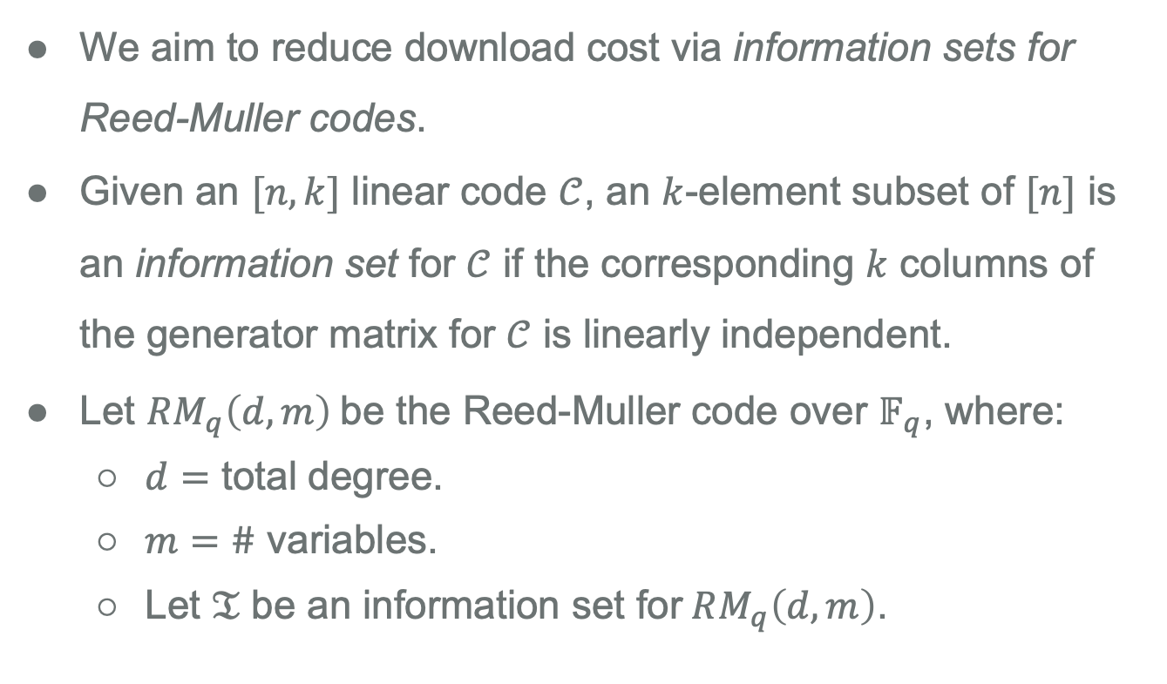
Information Sets for Reed-Muller Codes
We aim to reduce download cost via information sets for Reed-Muller codes.
Given an $[n,k]$ linear code $𝒞$, an $k$-element subset of $[n]$ is an information set for $𝒞$ if the corresponding $k$ columns of the generator matrix for $𝒞$ is linearly independent.
Let $RM_{q}\left(d,m\right)$be the Reed-Muller code over $𝔽_{q}$, where:
$d=$ total degree.
$m=$ $\#$ variables.
Let $𝔗$ be an information set for$RM_{q}\left(d,m\right)$.
15
Notes:
Break monotonicity. Define I.

Slide 16
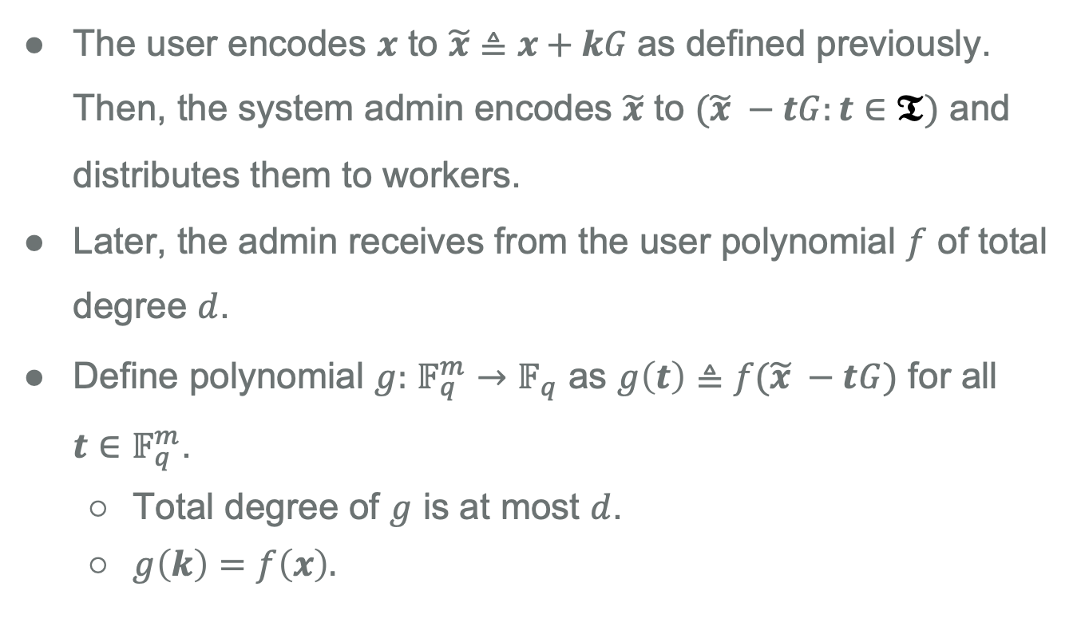
Lowering Download Cost
The user encodes $x$ to $\tilde{x}≜x+kG$as defined previously. Then, the system admin encodes $\tilde{x}$ to $(\tilde{x} −tG:t∈𝕿)$ and distributes them to workers.
Later, the admin receives from the user polynomial $f$ of total degree $d$.
Define polynomial $g:$ $𝔽_{q}^{m}→𝔽_{q}$ as $g\left(t\right)≜f(\tilde{x} −tG)$ for all $t∈𝔽_{q}^{m}$.
Total degree of $g$ is at most $d$.
$g\left(k\right)=f\left(x\right).$
16

Slide 17
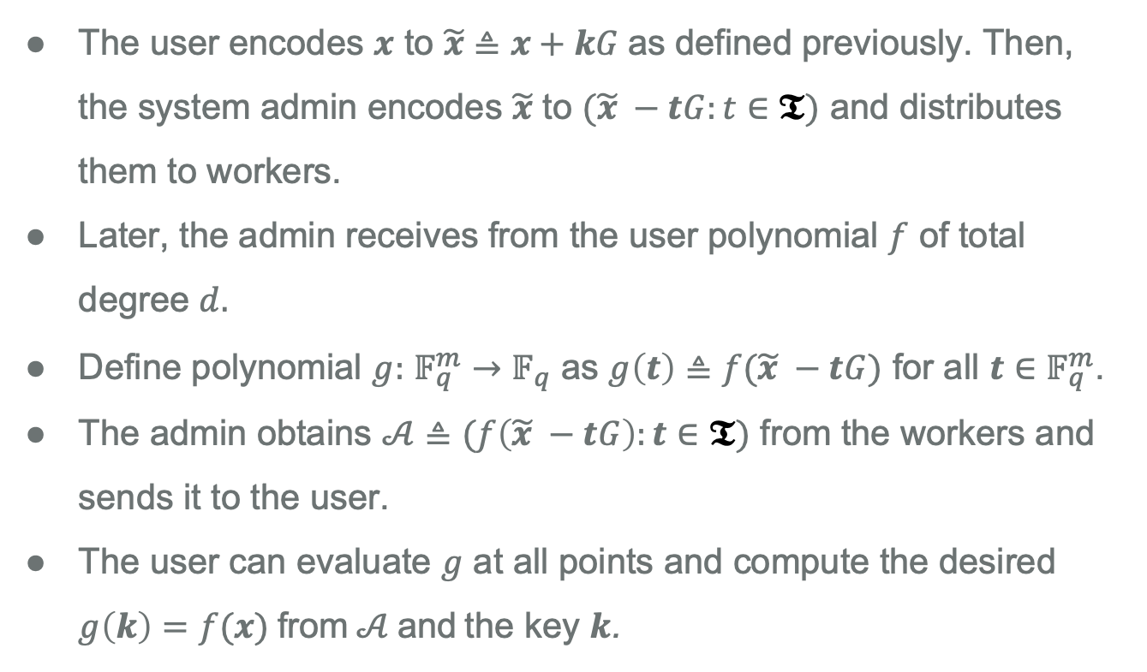
Lowering Download Cost
The user encodes $x$ to $\tilde{x}≜x+kG$as defined previously. Then, the system admin encodes $\tilde{x}$ to $(\tilde{x} −tG:t∈𝕿)$ and distributes them to workers.
Later, the admin receives from the user polynomial $f$ of total degree $d.$
Define polynomial $g:$ $𝔽_{q}^{m}→𝔽_{q}$ as $g\left(t\right)≜f(\tilde{x} −tG)$ for all $t∈𝔽_{q}^{m}$.
The admin obtains $𝒜≜(f\left(\tilde{x} −tG\right):t∈𝕿)$ from the workers and sends it to the user.
The user can evaluate $g$ at all points and compute the desired $g\left(k\right)=f(x)$ from $𝒜$ and the key $k$.
17

Slide 18
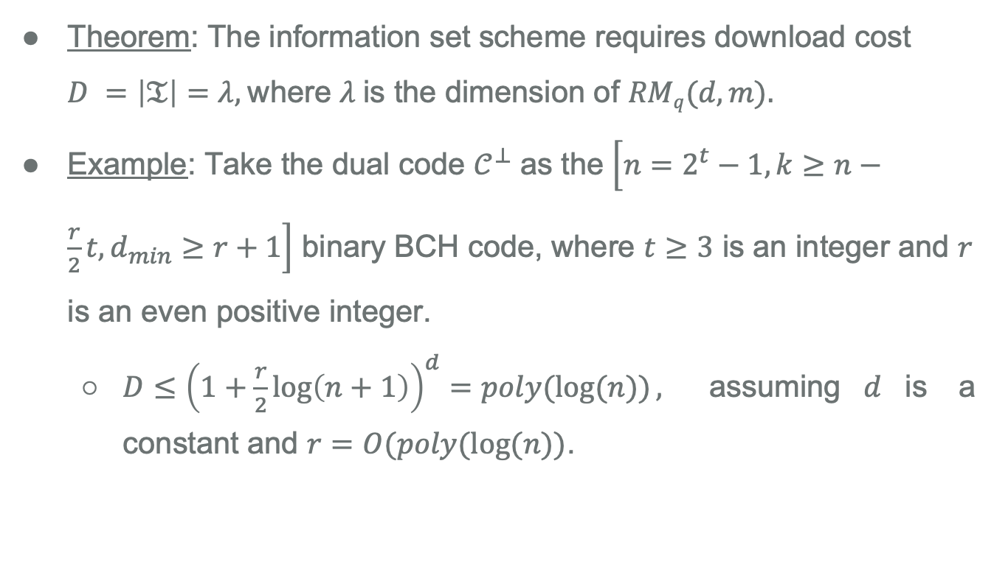
Lowered Download Cost
Theorem: The information set scheme requires download cost $D =\left|𝔗\right|=λ,$where $λ$is the dimension of $RMq(d, m).$
Example: Take the dual code $𝒞^{⊥}$ as the $\left[n=2^{t}−1,k≥n−\frac{r}{2}t,d_{min}≥r+1\right]$ binary BCH code, where $t≥3$ is an integer and $r$ is an even positive integer.
$D≤{\left(1+\frac{r}{2}\log\left(n+1\right)\right)}^{d}=poly(\log{(n))},$ assuming$d$is a constant and $r=O(poly(\log{(n))}$.
18

Slide 19
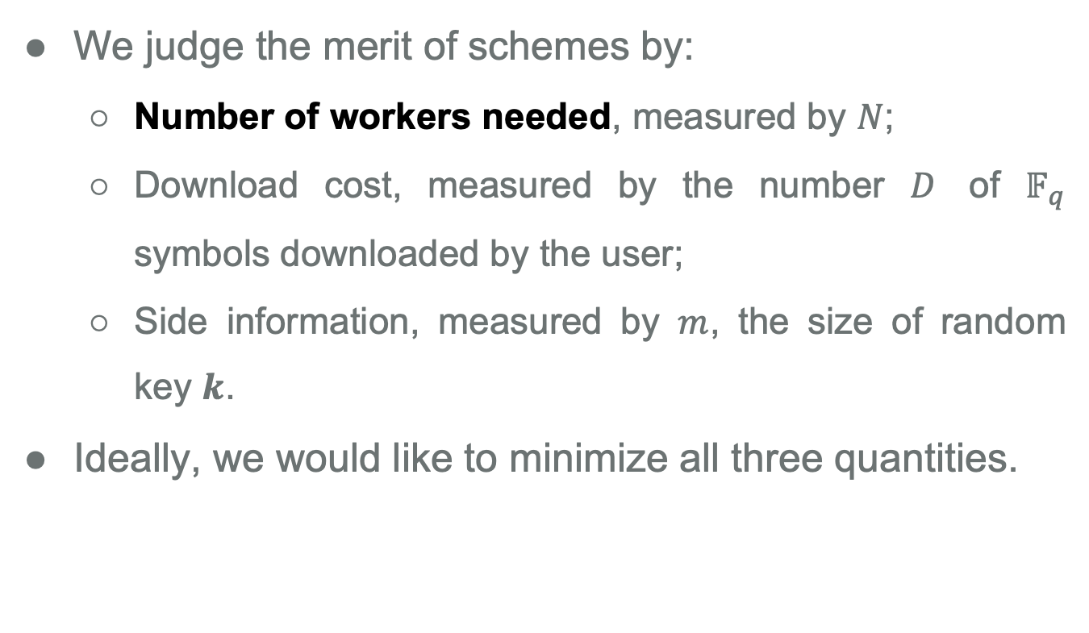
Performance Metrics
We judge the merit of schemes by:
Number of workers needed, measured by $N$;
Download cost, measured by the number $D$ of $𝔽_{q}$ symbols downloaded by the user;
Side information, measured by $m$, the size of random key $k$.
Ideally, we would like to minimize all three quantities.
19

Slide 20
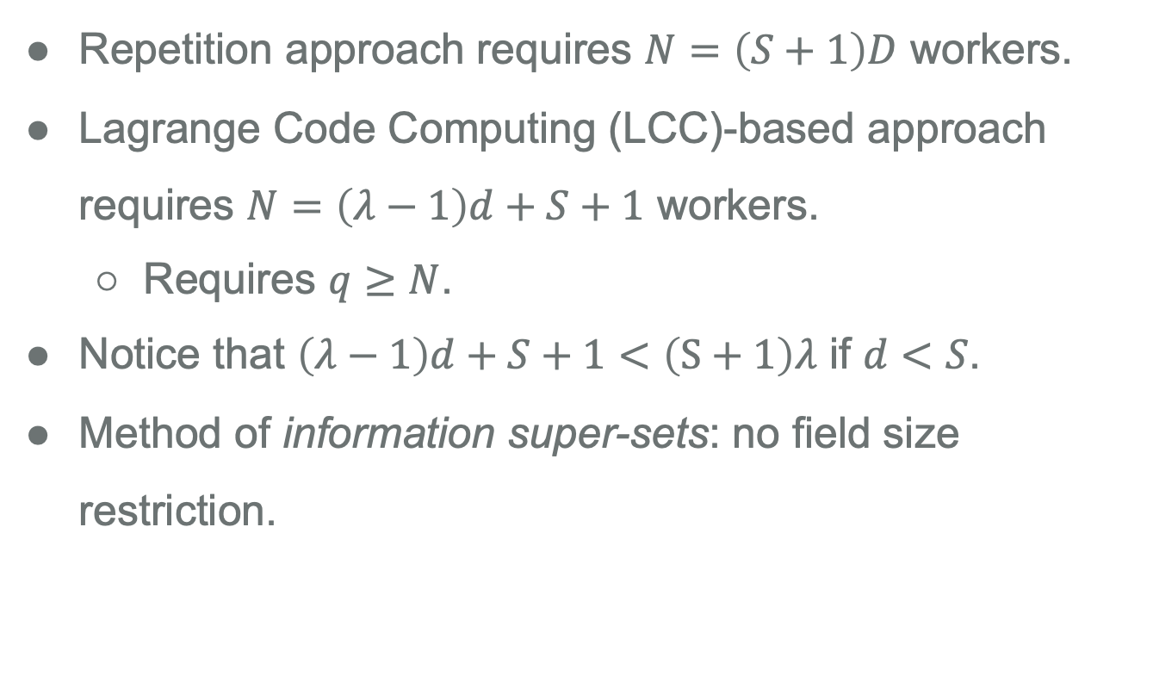
Straggler Resilience
Repetition approach requires $N=\left(S+1\right)D$ workers.
Lagrange Code Computing (LCC)-based approach requires $N=\left(λ−1\right)d+S+1$ workers.
Requires $q≥N$.
Notice that $\left(λ−1\right)d+S+1<\left(S+1\right)λ$ if $d<S$.
Method of information super-sets: no field size restriction.
20

Slide 21
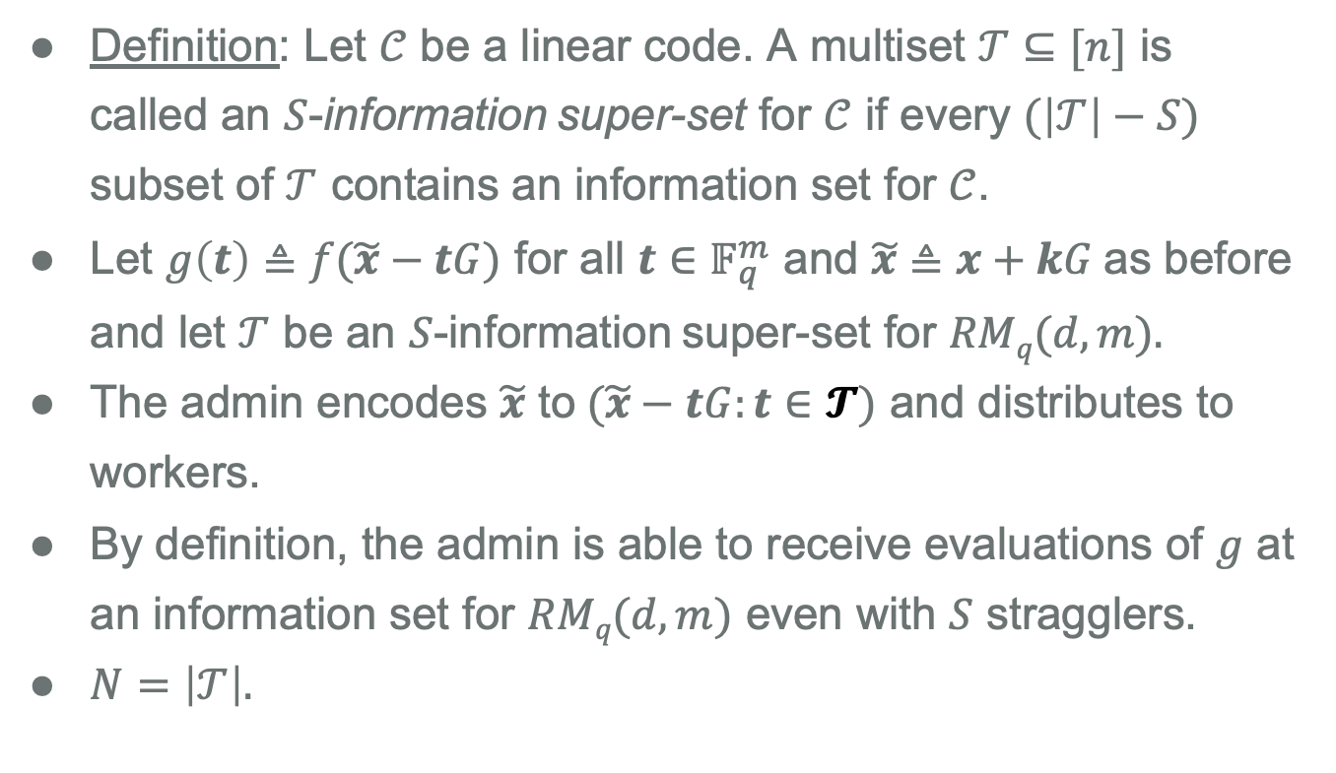
Straggler Resilience via Information Super-sets
Definition: Let $𝒞$ be a linear code. A multiset $𝒯⊆[n]$ is called an $S$-information super-set for $𝒞$ if every $(\left|𝒯\right|−S)$ subset of $𝒯$ contains an information set for $𝒞$.
Let $g\left(t\right)≜f(\tilde{x}−tG)$ for all $t∈𝔽_{q}^{m}$ and $\tilde{x}≜x+kG$as before and let $𝒯$ be an $S$-information super-set for $RMq(d, m).$
The admin encodes $\tilde{x}$ to$(\tilde{x}−tG:t∈𝓣)$ and distributes to workers.
By definition, the admin is able to receive evaluations of $g$ at an information set for $RMq(d, m)$ even with $S$ stragglers.
$N=\left|𝒯\right|.$
21

Slide 22
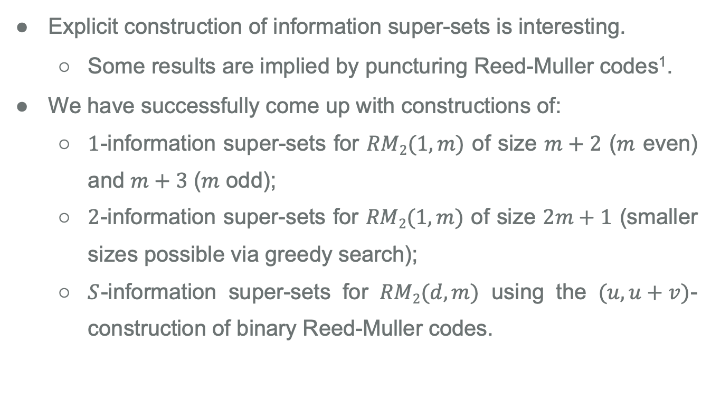
Explicit Information Super-sets
Explicit construction of information super-sets is interesting.
Some results are implied by puncturing Reed-Muller codes¹.
We have successfully come up with constructions of:
$1$-information super-sets for $RM2(1, m)$ of size $m+2$ ($m$ even) and $m+3$ ($m$ odd);
$2$-information super-sets for $RM2(1, m)$ of size $2m+1$ (smaller sizes possible via greedy search);
$S$-information super-sets for $RM2(d, m)$ using the $(u,u+v)$-construction of binary Reed-Muller codes.
¹V. Guruswami, L. Jin, and C. Xing, “Efficiently list-decodable punctured reed-muller codes,” IEEE Transactions on Information Theory, vol. 63, no. 7, pp. 4317–4324, 2017.
22

Slide 23
Summary
This work shifts the focus of privacy in coded computing to safeguarding the privacy of the user against the service provider as a whole.
We leverage perfect subset privacy, which guarantees zero information leakage from all subsets of the data up to a certain size.
Using techniques from Reed-Muller decoding, we provide schemes which enable polynomial computation with perfect subset privacy in straggler-resilient systems.
23

Slide 24
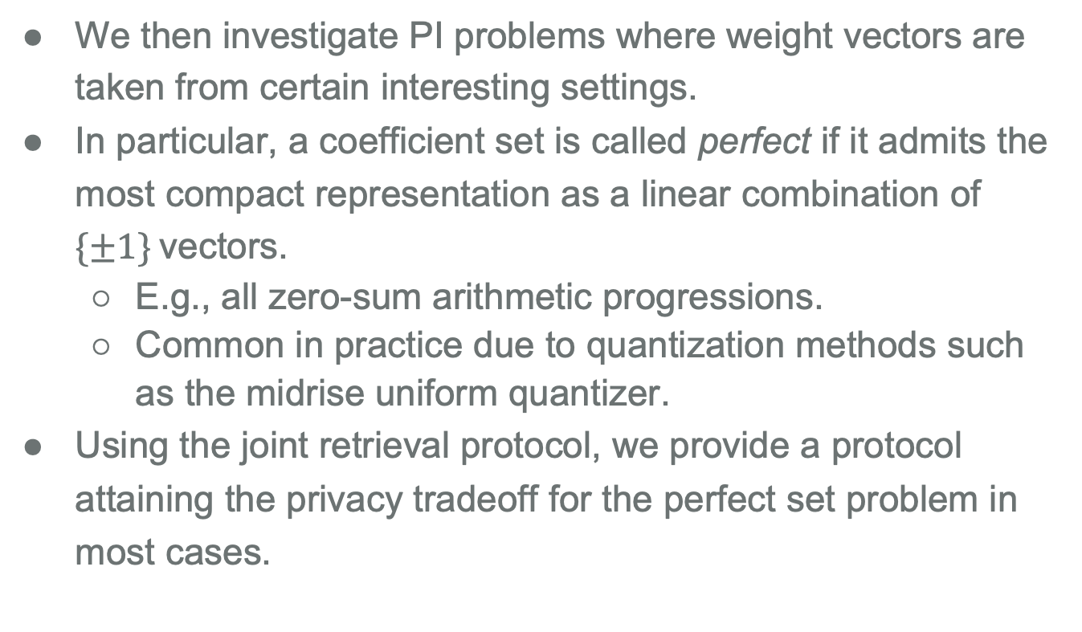
Main Results
We then investigate PI problems where weight vectors are taken from certain interesting settings.
In particular, a coefficient set is called perfect if it admits the most compact representation as a linear combination of $\{±1\}$vectors.
E.g., all zero-sum arithmetic progressions.
Common in practice due to quantization methods such as the midrise uniform quantizer.
Using the joint retrieval protocol, we provide a protocol attaining the privacy tradeoff for the perfect set problem in most cases.
24
Notes:
commonplace in communication and signal processing systems

Slide 25
Thank you!
25

