Slide 1
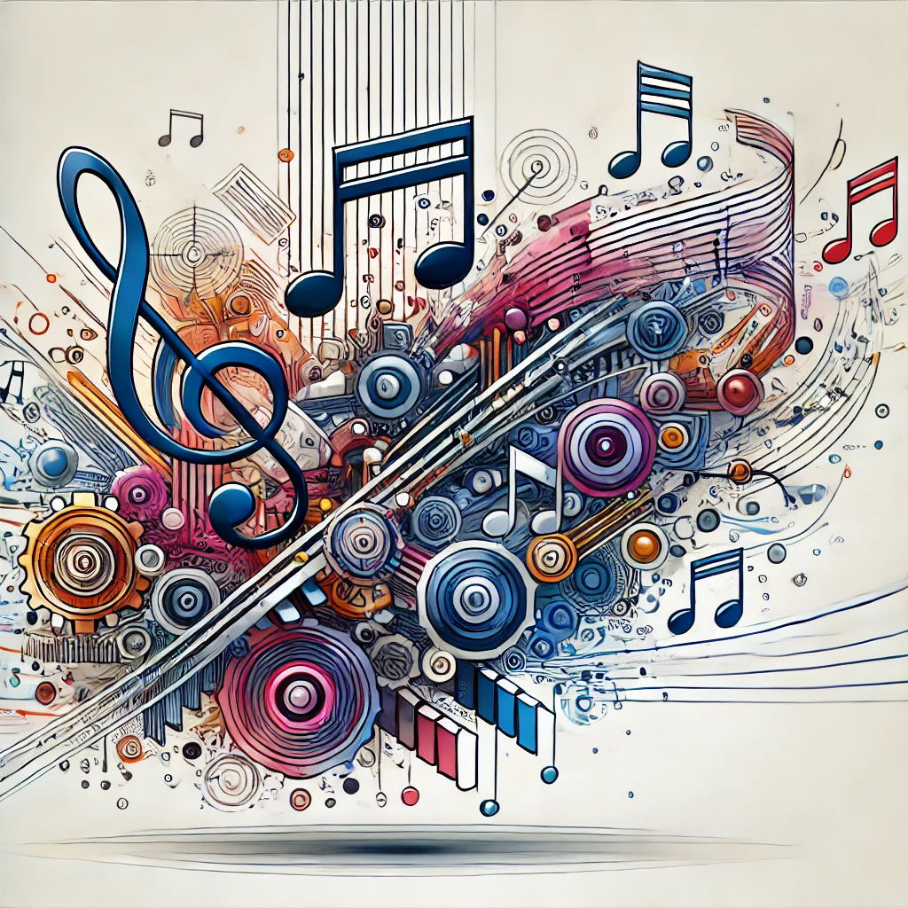
Music World - AI-Driven Harmony from Text, Images, and Audio
Team 17

Slide 2
CONTENTS
01
Problem Statement
04
The Tech
02
Background
05
Project Time Line
03
User Needs
06
Expected prototype

Slide 3
Project Timeline
In this part, we will focus on Division of project tasks

Slide 4
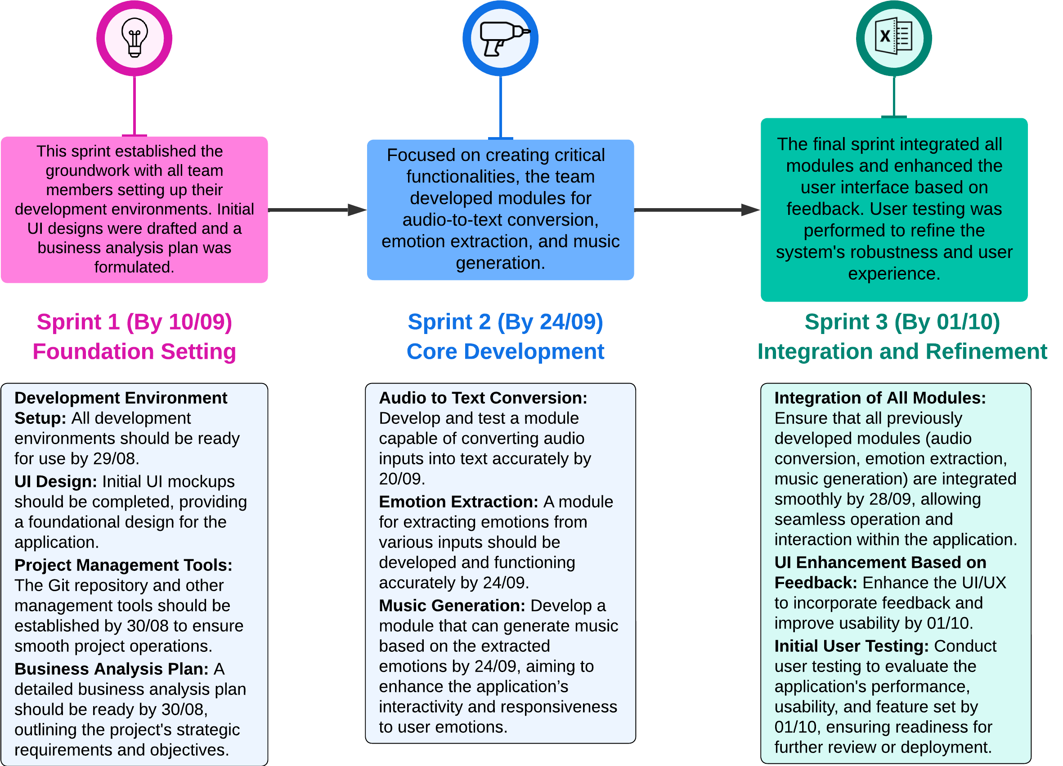
Timeline

Slide 5
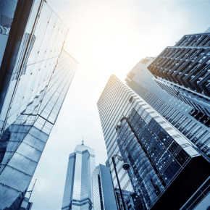
LOGO
合 作
cooperation
THANKS
创 新
innovate
Please add your text content here, or copy your text, paste it here, and select only the text.
共 赢
win-win

