Slide 1
FlashSVD: System-level Benchmark & Kernel-tier Analysis
Low-rank compression × fused attention kernel
Focus: inference memory & throughput
8 GLUE tasks · seq/batch/dtype scaling
Wenhao Wu
Notes:
这次我主要汇报 FlashSVD 在系统层面的 benchmark，以及我完善的测试 pipeline。

Slide 2
Motivation: Why Backend Matters
1️⃣ Compression ≠ Memory Solution 2️⃣ Activation dominates 3️⃣ Activation complexity determined by kernel
Compression reduces parameter memory (−37%)
But peak inference memory is activation-dominated
At seq=512: Activation ≈ 6.6× parameter memory
Therefore: backend implementation determines true memory complexity
Notes:
参数压缩只改变 model size，真正决定峰值显存的是 attention activation。

Slide 3
Fairness & Baseline Clarification
Identical compressed weights across backends
Same rank, same parameters ≈ 69.3M
Difference = kernel implementation only
Dense baseline uses PyTorch SDPA (no logits materialization)
No recompression between backends (identical weights).
Notes:
这里对比是完全公平的，只改变 backend。

Slide 4
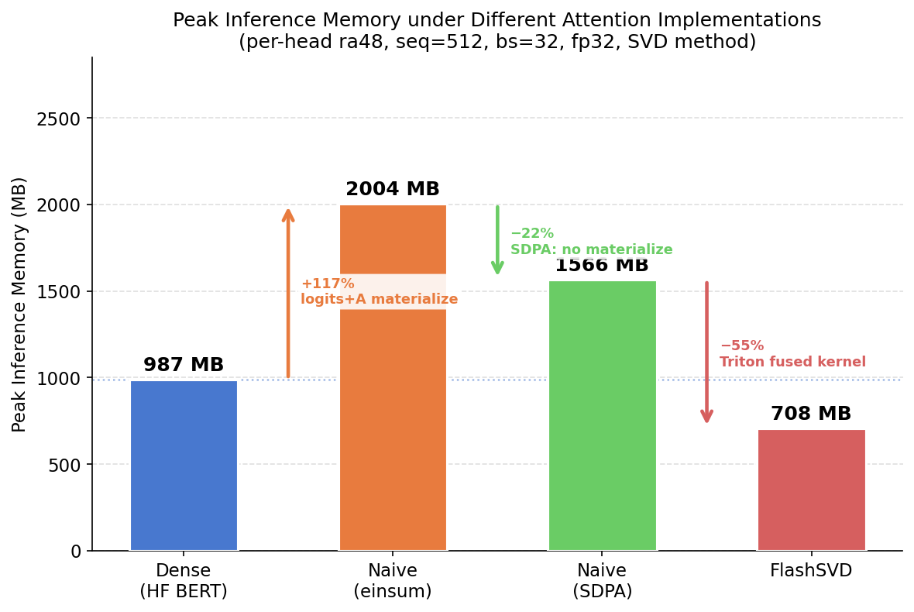
kernel-tier Memory (Single Config)
seq=512 · bs=32 · fp32
Naive (einsum): 2004 MB
Naive (SDPA): 1566 MB
FlashSVD: 708 MB
−65% vs einsum
−55% vs SDPA
FlashSVD reduces activation overhead below dense baseline.
FlashSVD eliminates O(N²) attention matrix materialization.
Notes:
三档 kernel 消除不同来源的 activation 开销。FlashSVD 低于 dense baseline。FlashSVD eliminates O(N²) attention matrix materialization.

Slide 5
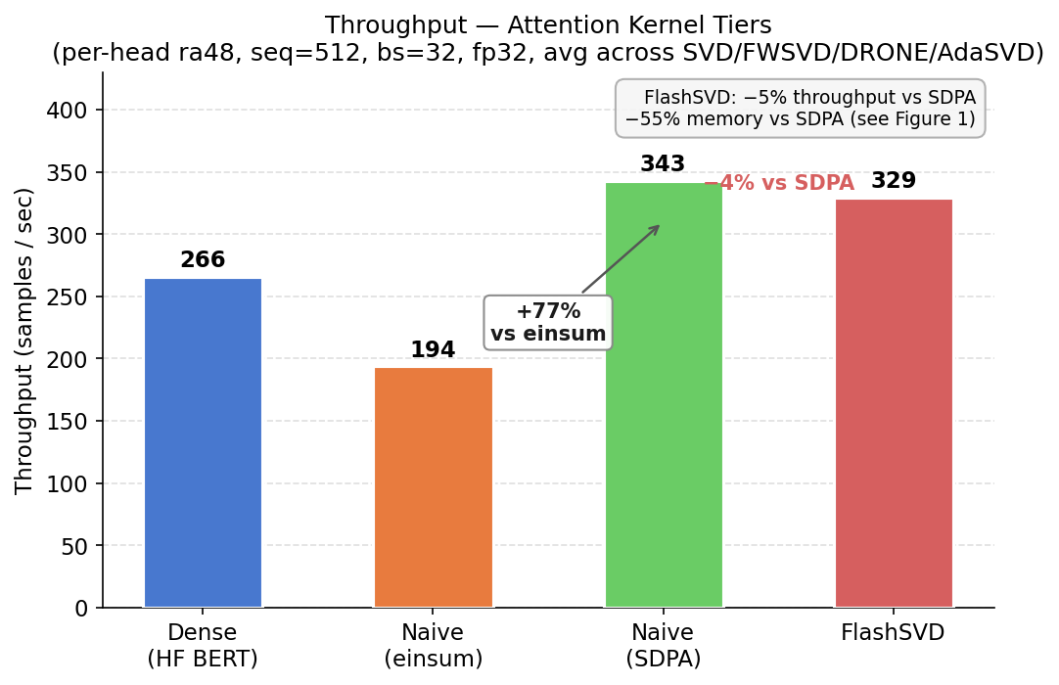
Kernel-tier Throughput
SDPA: +77% vs einsum
FlashSVD: −5% vs SDPA
Memory saving without throughput loss
Flash ≈ SDPA speed, but far lower memory
Flash avoids memory-bound regime by eliminating logits materialization.
Flash shifts memory–throughput Pareto frontier.
Notes:
FlashSVD 基本保持 SDPA 吞吐，但显存再降 55%。Flash shifts memory–throughput Pareto frontier.

Slide 6
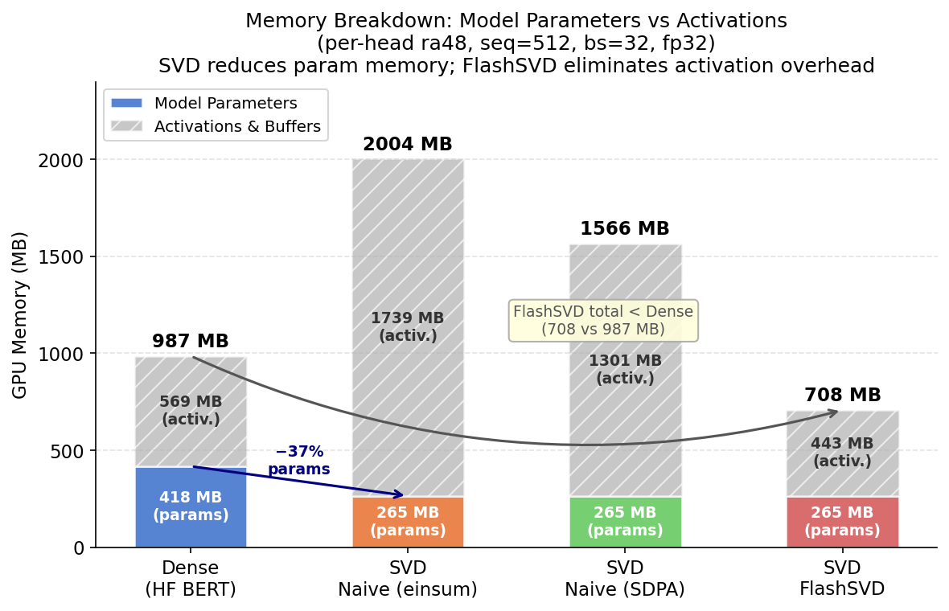
Memory Breakdown
Param memory: 418 → 265 MB (−37%)
Activation memory: 1739 MB (Naive)
Flash activation: 443 MB
−1296 MB from activation reduction
Activation / Param ≈ 6.6×
Kernel-level optimization contributes substantially more memory reduction than parameter compression alone.
Notes:
Backend change contributes 8× more memory saving than parameter compression.

Slide 7
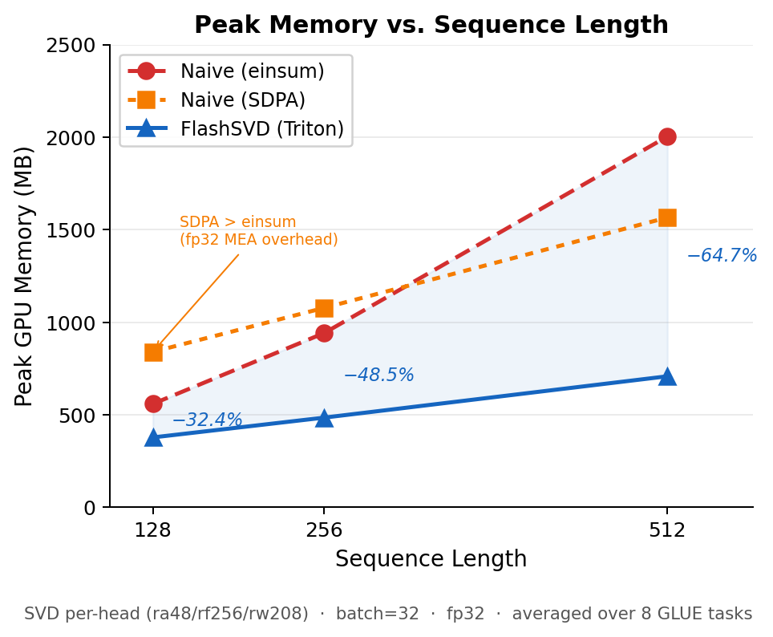
Sequence Length Scaling
seq=128: −32%
seq=256: −49%
seq=512: −65%
Absolute saving: 181 → 1296 MB
Memory gap widens super-linearly with N
Advantage grows as N increases (attacks O(N²) term).
Reduction grows with sequence length, consistent with removing O(N²) term.

Slide 8
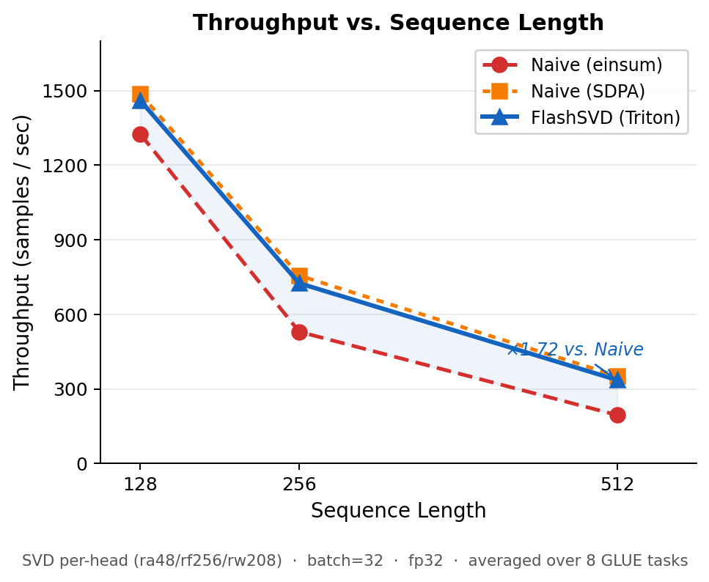
Throughput Scaling
Speedup ×1.10 → ×1.72
Einsum degrades quadratically
Flash ≈ SDPA speed
Scaling consistent with theory
Flash remains compute-bound while einsum becomes memory-bound.

Slide 9
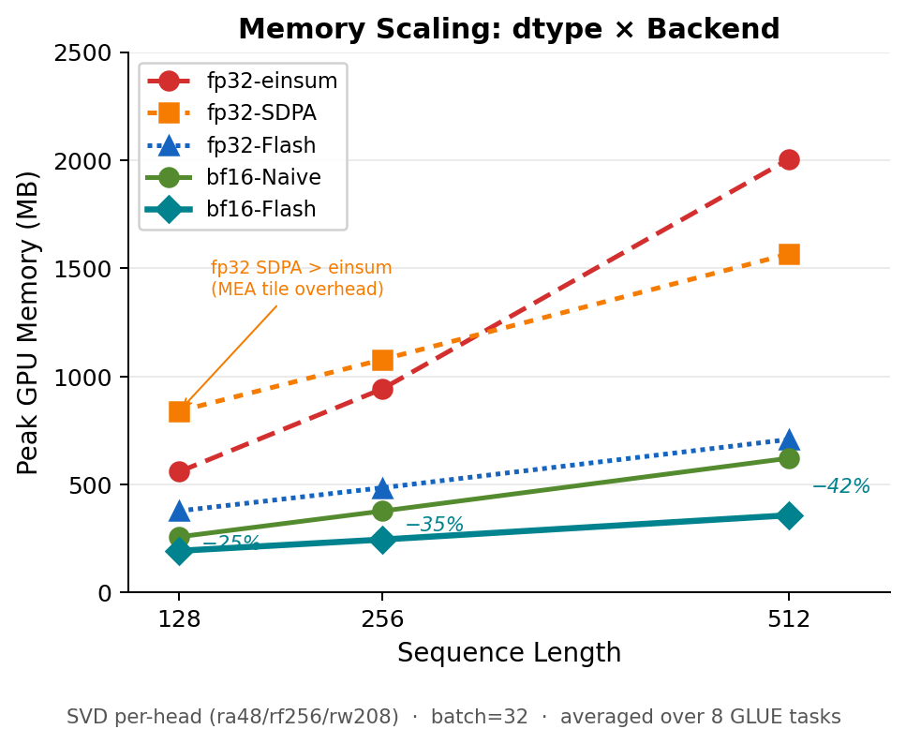
dtype × Backend Scaling
fp32 vs bf16
bf16 halves memory (linear scaling)
Flash structural advantage preserved
FlashSVD + bf16 = deployment-optimal configuration
dtype is multiplicative factor; backend is structural factor.

Slide 10
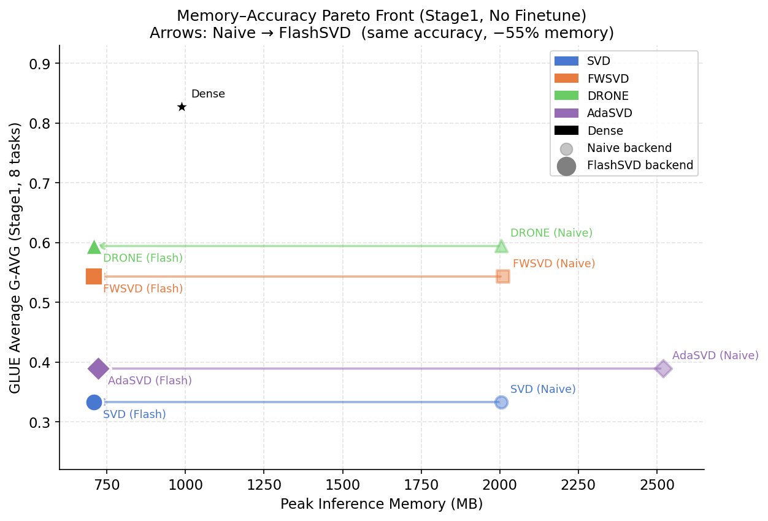
Accuracy–Memory Pareto
Same accuracy across backend (Δ = 0)
Flash shifts all methods left
Backend strictly dominates naive in memory
Backend = free dimension
Backend strictly dominates naive across all compression methods.

Slide 11
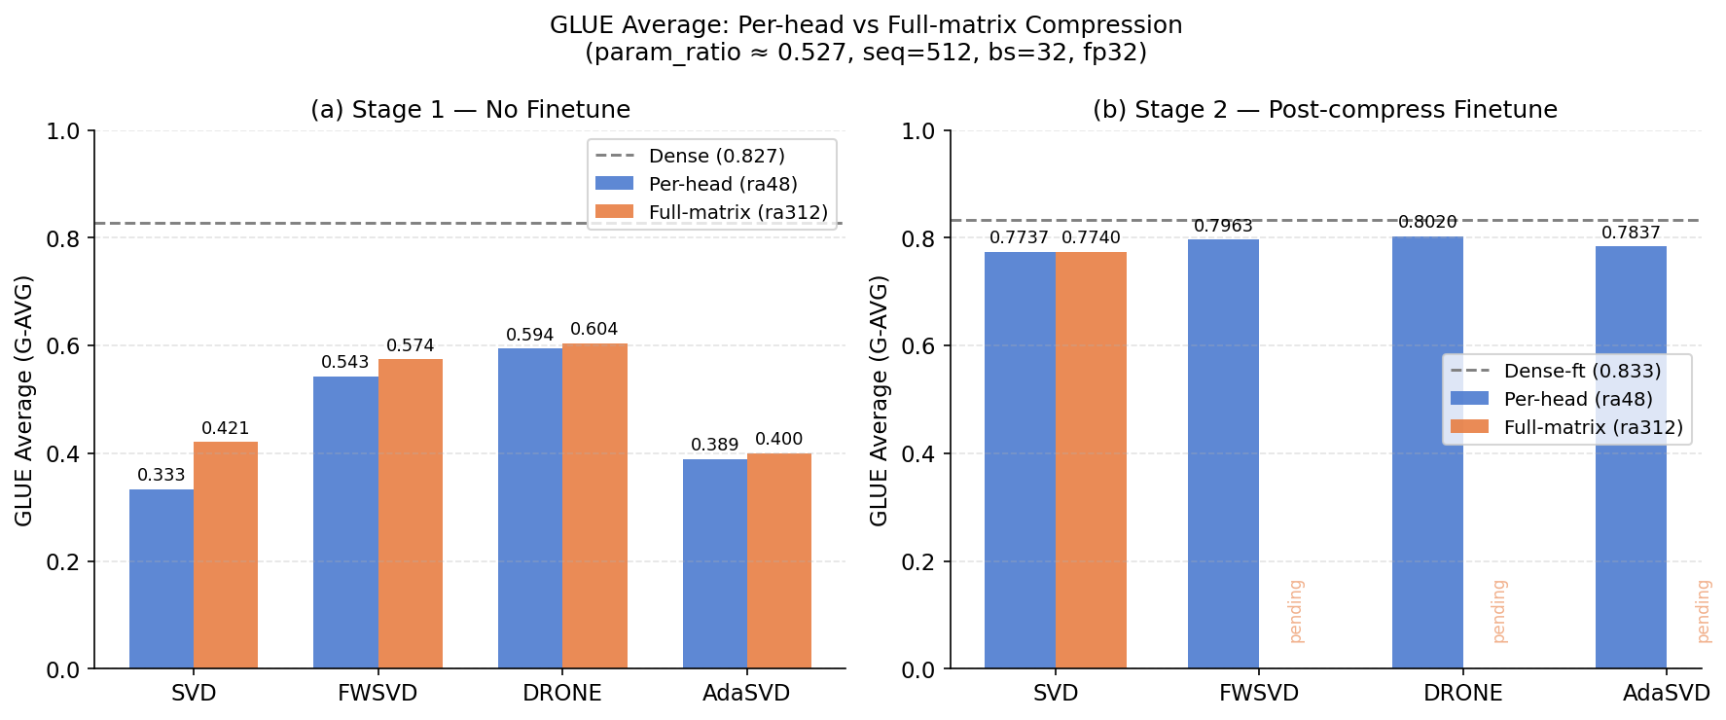
Per-head vs Full-matrix
Equal parameter ratio (~0.527)
Full-matrix consistently better
Per-head breaks cross-head semantic interaction
MRPC collapse illustrates structural bottleneck

Slide 12
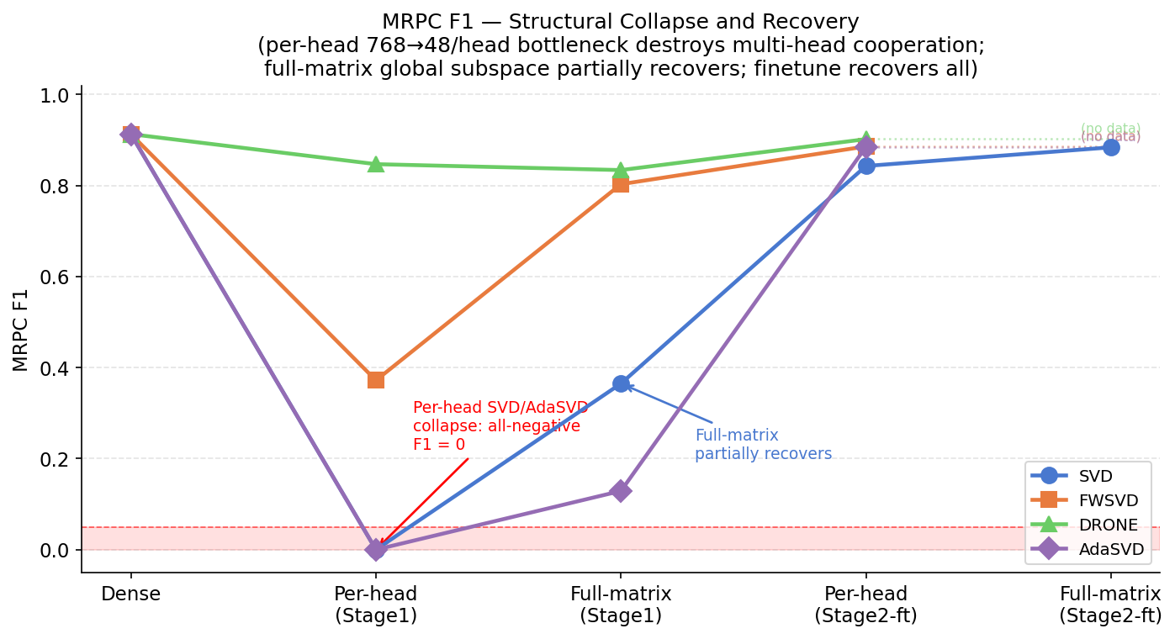
MRPC Structural Collapse
Per-head SVD/AdaSVD F1 ≈ 0
Full-matrix partially restores
Collapse caused by structural information bottleneck
Naive and Flash produce identical task metrics
Independent of backend; identical metrics across kernels.

Slide 13
System Design Space
Deployment space:
Compression Method × Rank × Backend × Dtype
Backend orthogonal to compression method
FlashSVD is plug-and-play
Any naive model can be shifted to Flash without retraining
Flash + bf16 = Pareto-dominant

Slide 14
Benchmark Pipeline Contribution
1️⃣ Isolation
Synthetic microbenchmark removes data pipeline noise
Kernel-level measurement
2️⃣ Measurement correctness
Warmup stabilization
torch.cuda.reset_peak_memory_stats()
Peak inference memory isolation
3️⃣ Automation
Backend toggle without recompression
Seq / batch / dtype sweep
4️⃣ Safety
OOM-safe batch scaling

Slide 15
