Slide 1
CSE-707 Group 12
23273008 || Minar Mahmud Rafi
23266031 || Mohammad Zishan Tareque
23366009 || Ripa Sarkar
20201225 || Md. Ashiq Ul Islam Sajid
ST : Farah
RA : Sabbir

Slide 2
Enhanced Calorie Estimation of Solid Foods using Federated Learning and YOLO Models: A Distributed Approach for Collaborative Caloric Data Analysis

Slide 3
Introduction
Smartphones with high-resolution cameras has transformed food photography into a popular social media trend [1]
The global awareness of unfamiliar foods, facilitated by social media, parallels an escalating consciousness regarding health concerns tied to dietary habits [2]
Harnessing YOLO models for detecting and differentiating various daily encountered solid food items to estimate their calorie content.
Implement Federated Learning with the model for greater privacy, reduced latency and greater diversity
Implement Federated Average Algorithm for Federated Learning

Slide 4
Why Yolo?
Real-Time Detection
Enhanced Accuracy
Efficient Training
Multi-Object Tracking
Practical Application
Leveraging Existing Technology

Slide 5
Federated Learning
Machine learning approach where models are trained across multiple decentralized devices or edge devices without centrally aggregating data
From moving data to computation to moving computation to data
Training occurs on distributed devices instead of a central
Focuses on preserving user data privacy by keeping data local
Combines local model updates to create a global model
The process iterates to refine the global model using decentralized updates

Slide 6
Existing Research
Several studies have utilized YOLOv2 for food detection, primarily focusing on the categorization of Japanese cuisine [3]
Previously YOLO has been used with Federated Learning to enable Autonomous Vehicles (AVs) to achieve reliable safe driving in snow weather [4]
For IoT applications, FL can provide several significant advantages such as data privacy enhancement, low-latency network communication, enhanced learning quality, etc [5]
Another paper explores the use of federated learning, a distributed on-device learning framework, for training a recurrent neural network language model for next-word prediction in virtual keyboards for smartphones [6]

Slide 7
Challenges
Prior research has highlighted the scarcity of diverse datasets specifically focused on solid food items from various cultural backgrounds.
Existing studies have encountered challenges in achieving high accuracy due to the intricate nature of solid food detection and varying dataset sizes.
Ensuring high accuracy while maintaining efficiency in processing large and diverse datasets poses a challenge, especially when multiple food objects coexist in images.
Increased communication overhead when implementing federated learning on YOLO
Data distribution might be inconsistent in reality due to different types of devices with different computing powers

Slide 8
Methodology
Gather diverse images portraying multiple food items from various sources
Label and sort manually, ensuring suitability for model integration
Randomly split into training and validation sets (80-20% ratio)
Implement federated learning using an algorithm (federated average) to train models on subsequent devices simultaneously
Implement federated average using a framework (Flower)
Compare the accuracy of the models

Slide 9
Methodology (Continued)
Initiate calorie estimation by counting the food item instances.
Train the model with nine food item classes, each with specific calorie values assigned.
Implement a calculator to get total calorie count based on the total instances of detected food items.

Slide 10
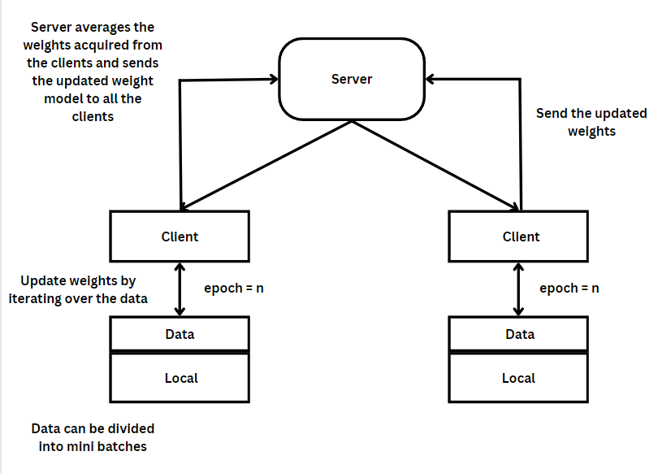
Federated Average Algorithm

Slide 11
Some Federated Learning Frameworks
FATE - One of the earliest open-source frameworks for FL that is ready for commercial use in February 2019
Flower - Originated from a research project at the University of Oxford
TensorFlow Federated TFF - Well-suited for TensorFlow/Keras

Slide 12
Federated Learning Framework (Flower)
Ease of use
Privacy Preserving
Compatible with TensorFlow, PyTorch, framework agnostic
Open source

Slide 13
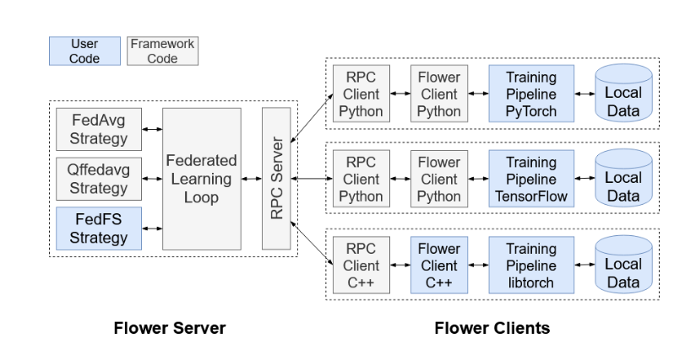
Federated Learning Framework (Flower)

Slide 14
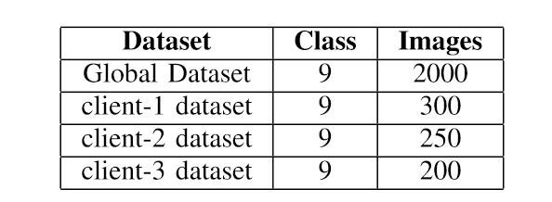
Federated Learning Dataset

Slide 15
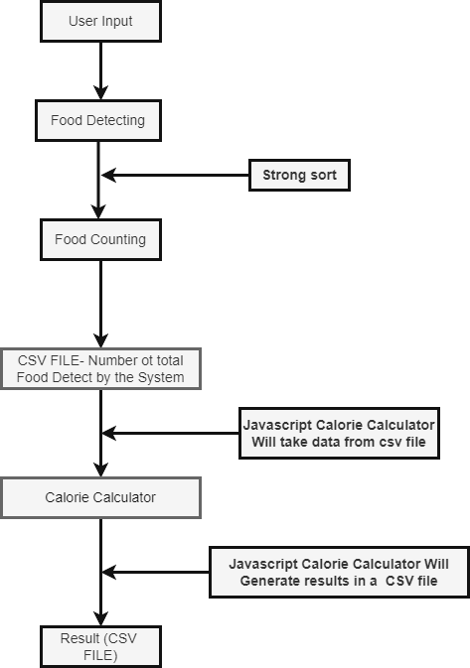
System Flow

Slide 16
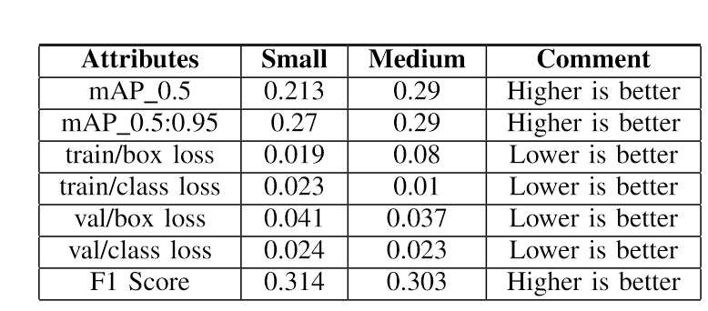
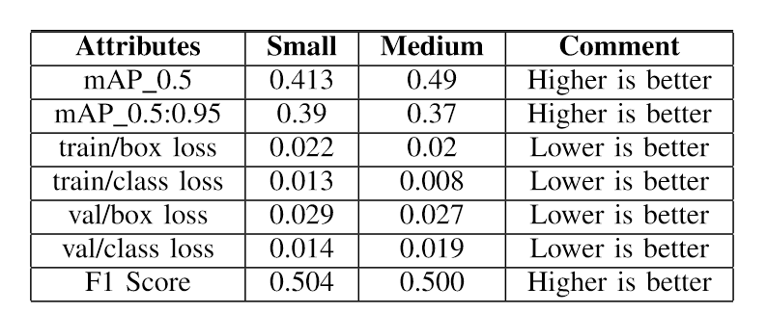
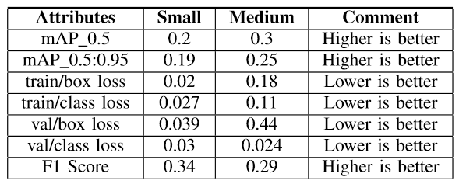
Federated Learning
Client-1
Global
Client -2

Slide 17
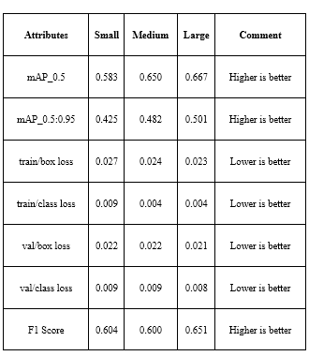
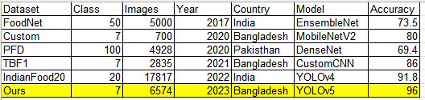
Result With Traditional Machine Learning

Slide 18
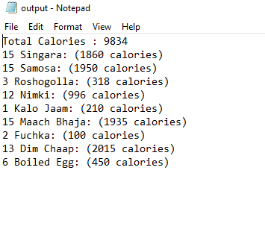
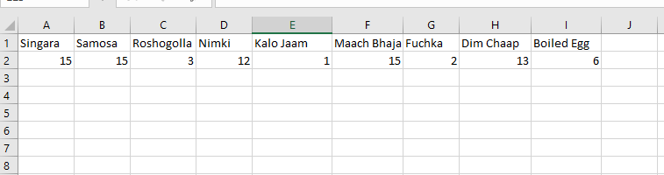
Calorie Calculator Result
Output Sample
Input Sample

Slide 19
Limitations
Centralized learning communication overheads
Different types of client devices not considered
Heterogeneous Data Distribution - Lack of diverse Data
Resource Limitations
Taking pictures in low light areas might affect result

Slide 20
Future Work & Conclusion
Test federated learning on actual clients and figure out the optimum device config
Finding a solution to estimate the calorie content for all kinds of foods.
Find a new technique to overcome issues related to food quantity and shape.
Opens avenues for further exploration in enhancing food recognition technologies and calorie estimation, potentially impacting broader applications in dietary assessment and health monitoring.

Slide 21
References
1. J. Sun, K. Radecka and Z. Zilic, “FoodTracker: A Real-time Food Detection Mobile Application by Deep Convolutional Neural Networks,” The 16th International Conference on Machine Vision Applications, 2019.
2. S. Banerjee, and A.C. Mondal, “Nutrient food prediction through deep learning,” 2021 Asian Conference on Innovation in Technology (ASIANCON). (2021)
3. J. Sun, K. Radecka and Z. Zilic, “FoodTracker: A Real-time Food Detection Mobile Application by Deep Convolutional Neural Networks,” The 16th International Conference on Machine Vision Applications, 2019.
4. Smith, J., Johnson, A. "Improving Autonomous Vehicles Safety in Snow Weather Using Federated YOLO CNN Learning." International Journal of Artificial Intelligence, 10(3), 2022, 123-135
5. Nguyen D.C., Ding M., Pathirana P.N., Seneviratne A., Li J., Poor H.V. Federated learning for internet of things: A comprehensive survey IEEE Commun. Surv. Tutor. (2021), p. 1, 10.1109/COMST.2021.3075439
6. Andrew, Straiton, Hard., Chloe, Kiddon., Daniel, Ramage., Francoise, Beaufays., Hubert, Eichner., Kanishka, Rao., Rajiv, Mathews., Sean, Augenstein. (2018). Federated Learning for Mobile Keyboard Prediction. arXiv: Computation and Language

Slide 22
THANK YOU

