Slide 1
CSE-718 - Group 12
Minar Mahmud Rafi - 23273008 William Ankan Sarkar - 23266034
Mohammad Zishan Tareque - 23266031
Marium Khan Momo - 23273010
ST : Farah
RA : Sabbir

Slide 2
Calorie estimation of solid food using machine learning with YOLO models

Slide 3
Introduction
Smartphones with high-resolution cameras has transformed food photography into a popular social media trend [1]
The global awareness of unfamiliar foods, facilitated by social media, parallels an escalating consciousness regarding health concerns tied to dietary habits [2]
Harnessing YOLO models for detecting and differentiating various daily encountered solid food items to estimate their calorie content.

Slide 4
Why YOLO - (You Only Look Once)
Real-Time Detection
Enhanced Accuracy
Efficient Training
Multi-Object Tracking
Practical Application
Leveraging Existing Technology

Slide 5
Existing Research
Several studies have utilized YOLOv2 for food detection, primarily focusing on the categorization of Japanese cuisine [3].
Gave rise to applications like Food Tracer.
Researchers have explored diverse methodologies, including CNN-based models, SVM, ensemble methods, and transfer learning, to enhance accuracy in food recognition and calorie estimation.
Comparative analyses between different models (such as YOLOv2, YOLOv3, GoogleNet, ResNet, etc.) have been conducted to assess their performance in food recognition tasks.

Slide 6
Challenges
Prior research has highlighted the scarcity of diverse datasets specifically focused on solid food items from various cultural backgrounds.
Existing studies have encountered challenges in achieving high accuracy due to the intricate nature of solid food detection and varying dataset sizes.
Ensuring high accuracy while maintaining efficiency in processing large and diverse datasets poses a challenge, especially when multiple food objects coexist in images.

Slide 7
Methodology
Gather diverse images portraying multiple food items from various sources (approx. 6000 images)
Label and sort manually, ensuring suitability for model integration (Using labelimg software)
Randomly split into training and validation sets (80-20% ratio)
Employ YOLO v5 architectures (small, medium, large) on the curated dataset.
Model train for 640 x 640 resolution
Optimum GPU configuration 12GB and RAM 16GB

Slide 8
Methodology (Continued)
Train the model with nine food item classes, each with specific calorie values assigned.
Train the model for 100 epochs in each training session.
Provide CSV file to the calculator
Initiate calorie estimation by counting the food item instances.
Implement a calculator to get total calorie count based on the total instances of detected food items.

Slide 9
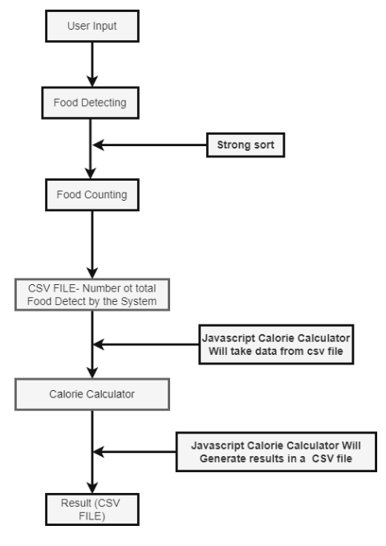
System Flow

Slide 10
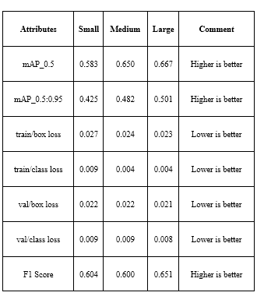
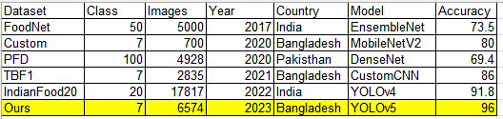
Result

Slide 11
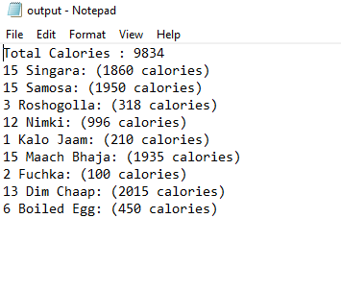
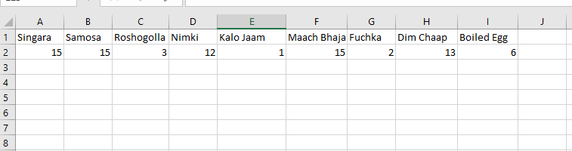
Calorie Calculator Result
Output Sample
Input Sample

Slide 12
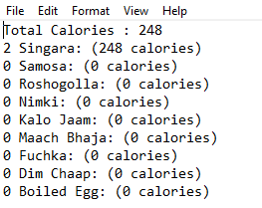
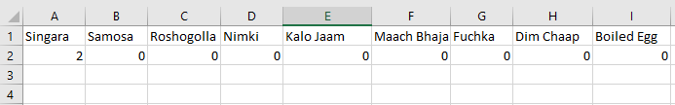
Calorie Calculator Result (2)
Output Sample
Input Sample

Slide 13
Future Work & Conclusion
Connect YOLO detection with the calorie calculator directly
Finding a solution to estimate the calorie content for all kinds of foods.
Find a new technique to overcome issues related to food quantity and shape.
Opens avenues for further exploration in enhancing food recognition technologies and calorie estimation, potentially impacting broader applications in dietary assessment and health monitoring.

Slide 14
References
1. J. Sun, K. Radecka and Z. Zilic, “FoodTracker: A Real-time Food Detection Mobile Application by Deep Convolutional Neural Networks,” The 16th International Conference on Machine Vision Applications, 2019.
2. S. Banerjee, and A.C. Mondal, “Nutrient food prediction through deep learning,” 2021 Asian Conference on Innovation in Technology (ASIANCON). (2021)
3. J. Sun, K. Radecka and Z. Zilic, “FoodTracker: A Real-time Food Detection Mobile Application by Deep Convolutional Neural Networks,” The 16th International Conference on Machine Vision Applications, 2019.

