Slide 1
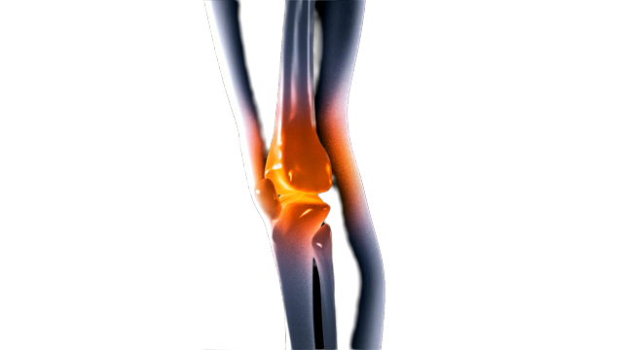

AI-Assisted Discovery of Novel Small-Molecule Modulators of GPR68 for Cartilage Protection in Osteoarthritis
人工智能辅助发现新型 GPR68 小分子调节剂用于骨关节炎软骨保护
本科生组
赛道三：离子通道、GPCR等药靶的小分子药物虚拟筛选

Slide 2

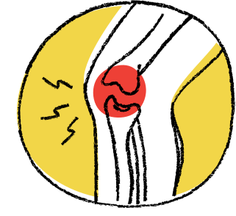

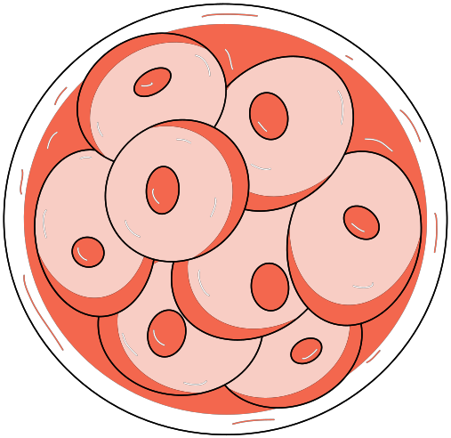





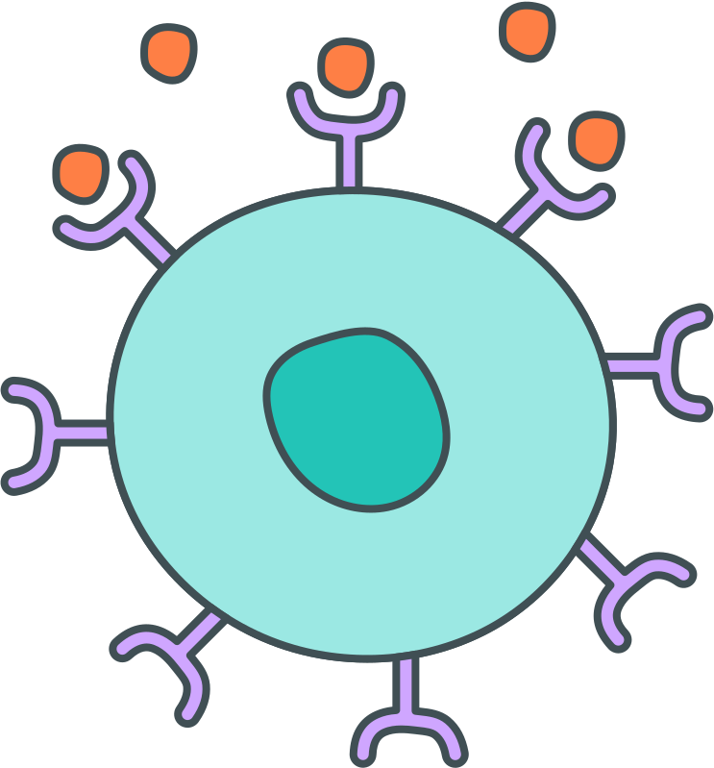






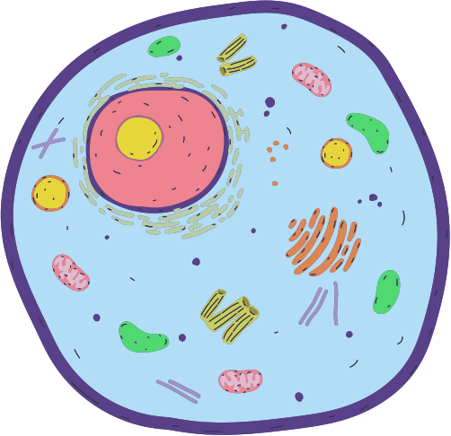

Why Target the OA Microenvironment?
OA is more than just cartilage wear
Central Hypothesis
Inflammation
Oxidative stress
ECM degradation
Local pH changes
GPR68 can sense acidity
AI-Assisted
Screening
Structure-Based
Analysis
proton-sensing
GPCR
extracellular acidification
cell signalling
Identify GPR68 Modulators
Therapeutic Question
Improve
Cartilage Outcomes
Experimental Validation
Can small molecules modulate GPR68 to protect chondrocytes?

Slide 3

A Complete Prediction ⟶ Validation ⟶ Mechanism Pipeline
Known Ligands
Build a GPR68 reference set
Molecular Features
Descriptors + fingerprints
AI / ML
Prioritise promising chemistry
Docking
Test structural plausibility
6-10 Compounds
Select diverse, purchasable candidates
GPR68 Assay
Confirm receptor-level modulation
OA Cells
Test cartilage-protective effect
Mechanism
GPR68 knockdown / target dependence

Slide 4





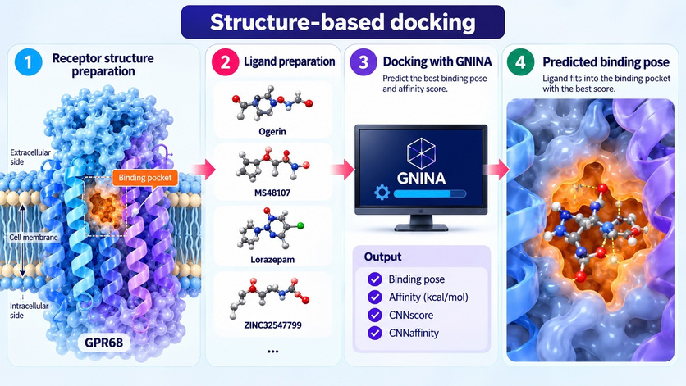


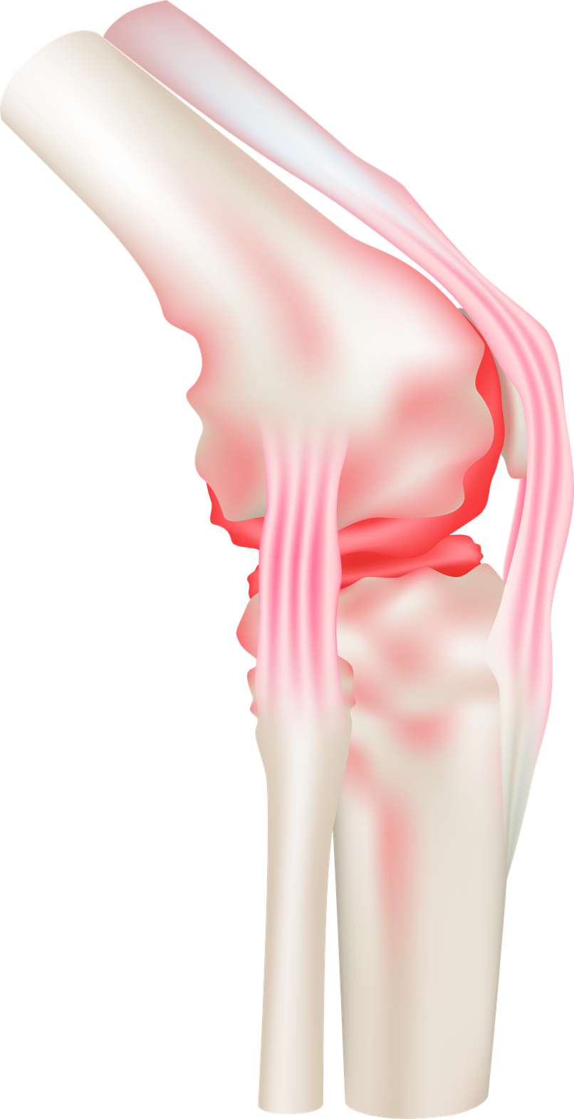

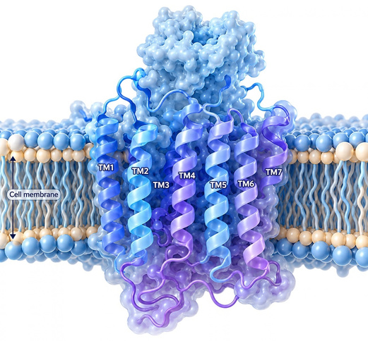

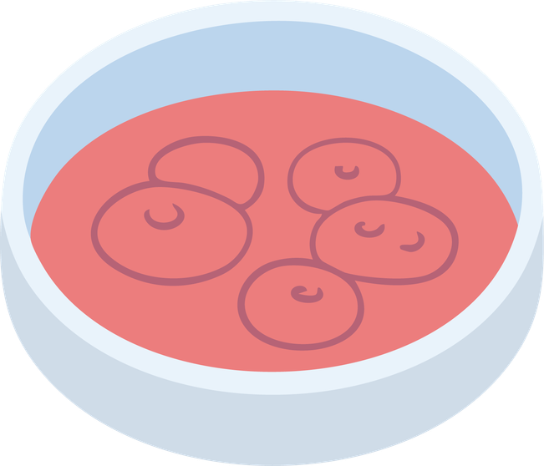
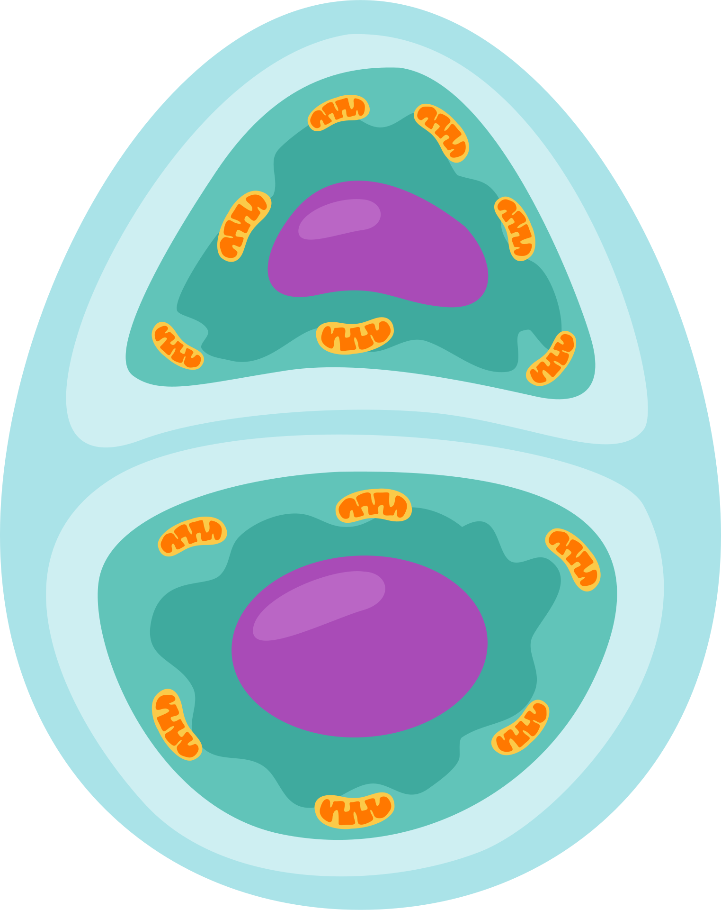





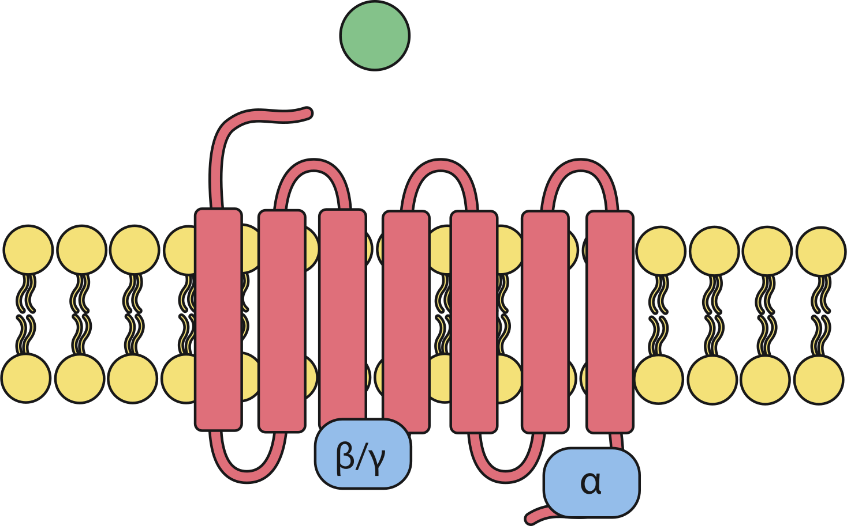
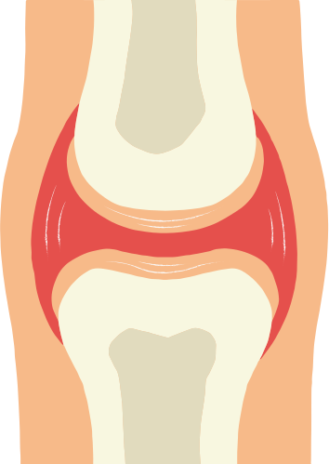
Innovation: More Than A Docking Exercise
Disease-Informed Target
Two Computational Layers
Experimental Closure
Link OA-associated extracellular acidity with a proton-sensing receptor (GPR68).
Hits must pass:
GPR68 Assay
(Receptor-Level Testing)
Ligand-Based ML Prioritization
Structural-Based GNINA Docking
OA Chondrocyte Validation
Provide complementary evidence before purchase.
GPR68 Knockdown
(Target-Dependence Testing)
Success Indicator
A Rational Target
Predicted Molecule
Real GPR68 Response
Cartilage Protection

Slide 5



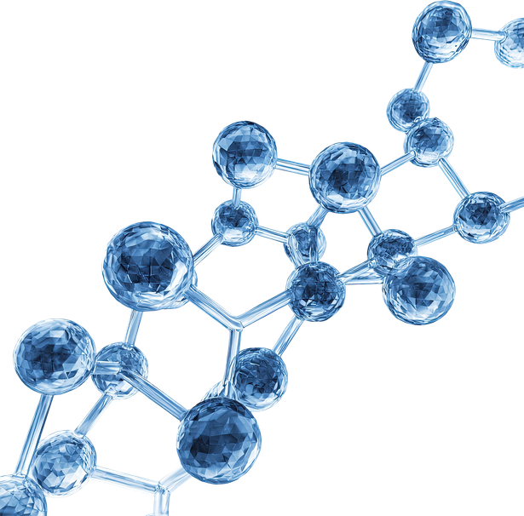
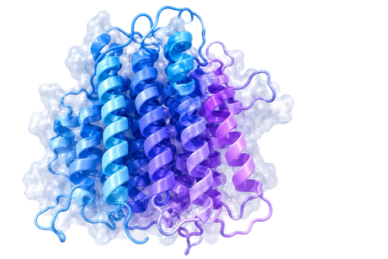
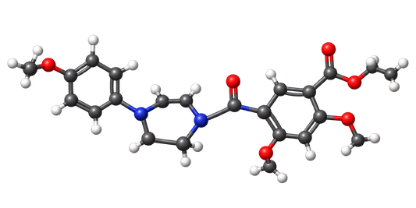
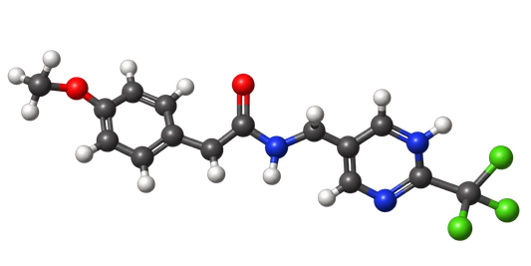



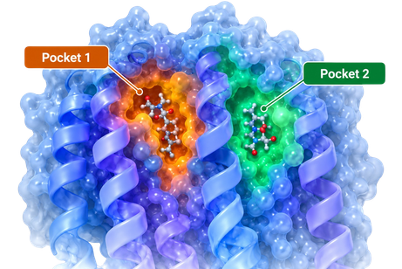
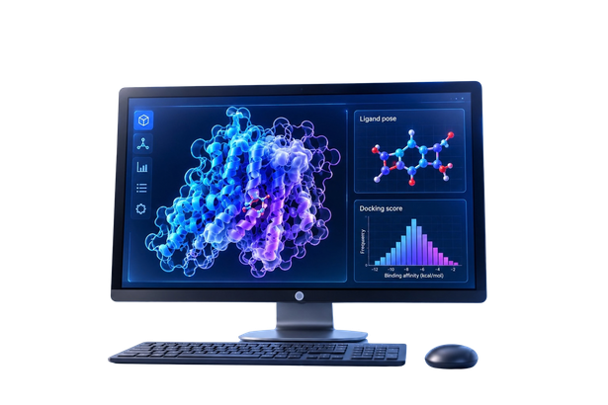
Building A Reproducible Computational Foundation
Reference Ligands
Molecular Library
GPR68 Structure
Known GPR68 modulators collected.
10,240
Experimental GPR68 structure from PDB 8Z68 isolated.
molecular structures successfully parsed.
Ogerin
MS48107
Binding pockets
GNINA
P2Rank used to identify candidate regions.
Docking environment technically validated.
RDKit Quality Control
Chemical Space
Why This Matters
10,240 loaded • 0 failed • 0 duplicate canonical SMILES
Mean MW 366.6 • LogP 2.59 • TPSA 78.9 Å²
Clean inputs reduce avoidable errors before modelling and screening

Slide 6
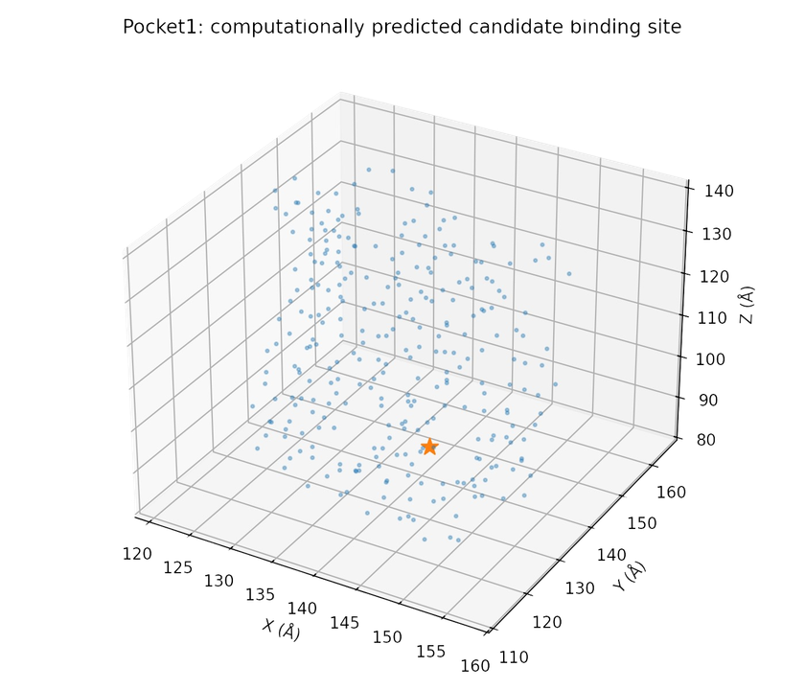
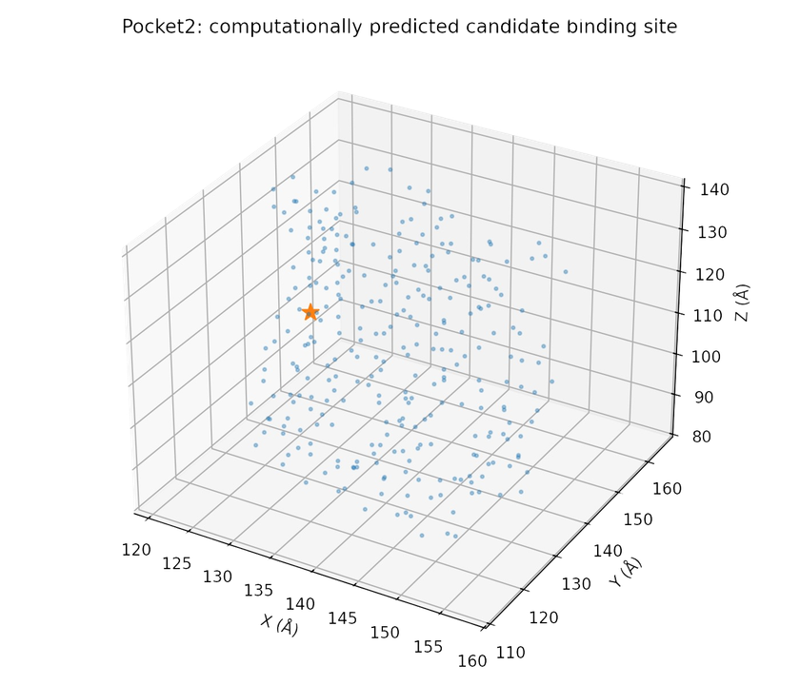
Structure-Based Experiment:
Two Candidate Regions On Experimental GPR68
Pocket 1 • Primary Candidate
Pocket 2 • Alternative Site
P2Rank score 7.06 • probability 0.366 • centre (145.764, 127.948, 98.930)
P2Rank score 6.87 • probability 0.353 • centre (129.885, 132.584, 117.625)
*These are computationally predicted candidate binding sites — not experimentally proven ligand-binding sites.

Slide 7




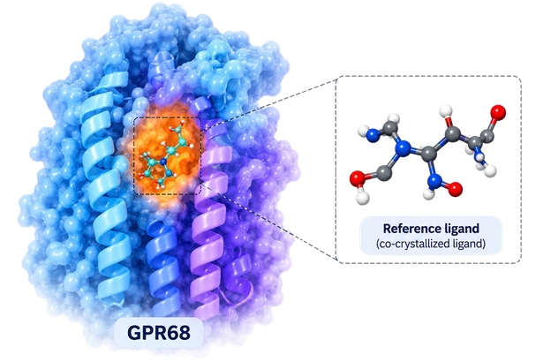
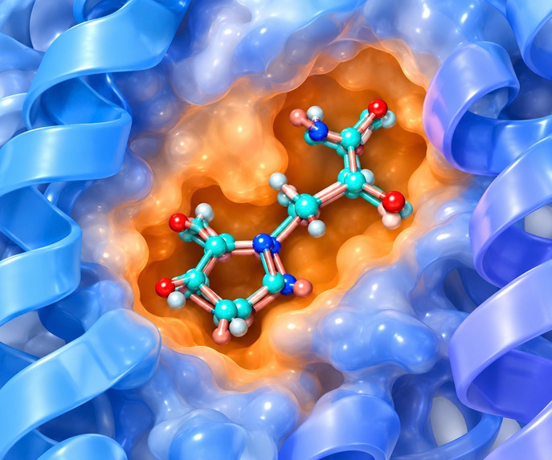



The GNINA Workflow: Reproducing A Reference Pose
Best redocking RMSD
Input Structure and Ligand
Redocked Pose
RMSD
0.594 Å
The receptor structure and benchmark ligands were processed and optimized before docking. These prepared inputs provide the foundation for predicting ligand binding within candidate GPR68 pockets
Lower RMSD = The predicted pose is geometrically closer to the reference pose.
Affinity
−8.51
GNINA docking score for the top pose.
Docking with GNINA (Reducing)
CNN Pose Score
0.979
Workflow Settings:
Neural-network assessment of pose plausibility.
  Same receptor and ligand
  Same search box and parameters as production run
  Redocking to produce the reference pose
CNN Pose Score
7.160
GNINA
CNN-derived affinity-related score.
What This Preliminary Result Means
The software installation, receptor/ligand inputs, search procedure and output parsing can produce a close redocked pose. This is technical validation of the workflow — not proof of GPR68 biology.

Slide 8
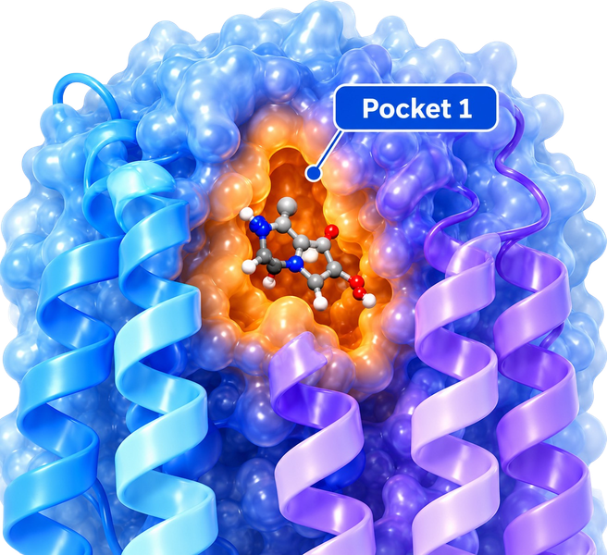
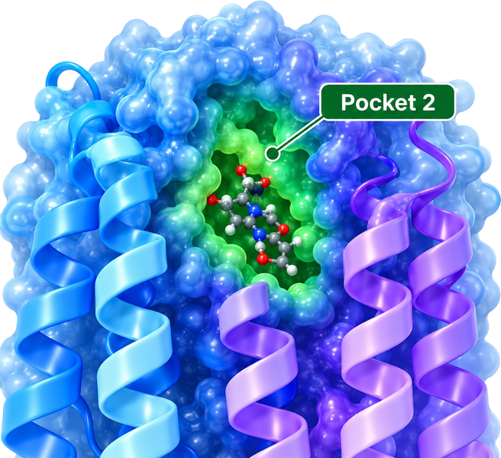
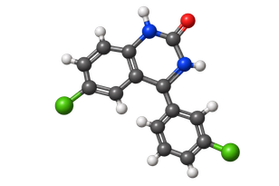
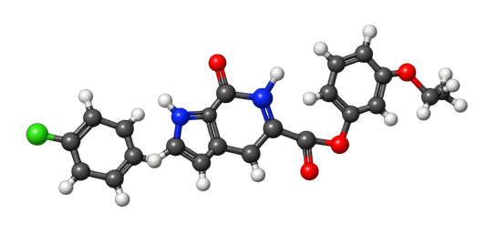
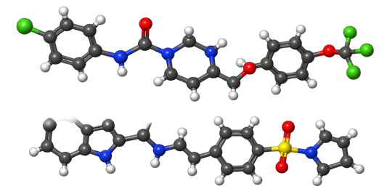
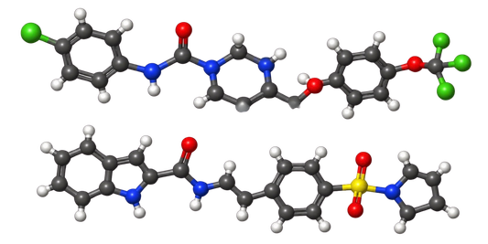


Known-Ligand Benchmark: Pocket 1 Versus Pocket 2
Benchmark Panel
Pocket 1
Pocket 2
Ogerin • MS48107 • lorazepam • ZINC32547799 • several weaker GPR68 reference comparators
Primary candidate region. Every benchmark ligand is docked here.
Alternative region. The exact same ligand set is docked here.
Ogerin
MS48107
lorazepam
ZINC32547799
weaker reference compound
weaker reference compound
Controlled Comparison
Docking to Pocket 1
Paired comparison between Pocket 1 and Pocket 2
Receptor preparation, ligand preparation, search-box dimensions, exhaustiveness, number of poses and other GNINA settings.
Constant
Same benchmark ligand set (Ogerin, MS48107, lorazepam, ZINC32547799, weaker comparators)
Docking to Pocket 2
Same GNINA settings for both pockets
Changed
Only the pocket centre.

Slide 9
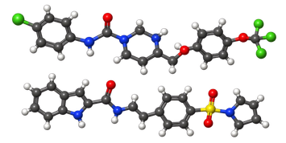
We Use Multiple Signals Instead Of Chasing One Docking Score
Affinity
CNNscore / CNNaffinity
Pose Consistency
Does one pocket show a more favourable and consistent conventional docking pattern for known modulators?
Do the neural-network metrics support the same pocket-level pattern?
Do known ligands occupy a coherent region and make structurally plausible contacts?
Stronger candidate should show converging evidence, rather than relying on a single scoring function.
Do top-ranked candidates adopt poses consistent with this reference-ligand pattern?
Known GPR68 Ligands
Benchmark Docking Pocket
Affinity + CNNscore/
CNNaffinity
Pose Consistency
Positive & Negative Controls
Convergent Evidence
Prioritize Candidates for Pilot Screening
Experimental Validation
Controls Matter
Decision Rule
Known active ligands such as Ogerin and MS48107 provide positive reference points
A candidate is prioritized when multiple independent signals converge: favorable docking affinity, supportive CNN metrics, and a plausible binding pose consistent with known GPR68 ligands and controls.
The benchmark is used to define and validate the screening region for pilot virtual screening; docking alone does not establish biological binding or GPR68 activity.
while ZINC32547799 and weaker reference compounds help determine whether apparently strong scores are specific or simply reflect nonspecific favorable interactions.

Slide 10



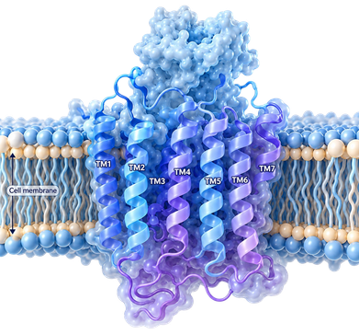
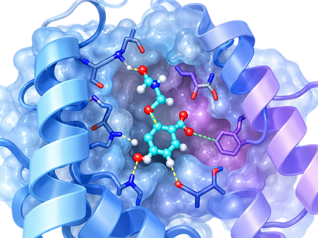
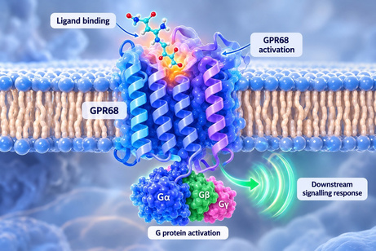
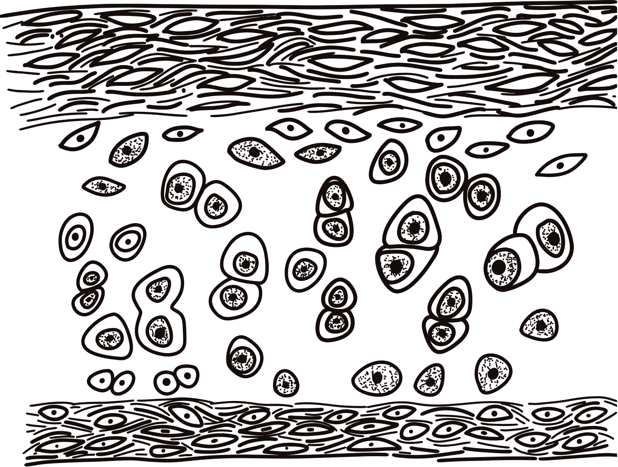
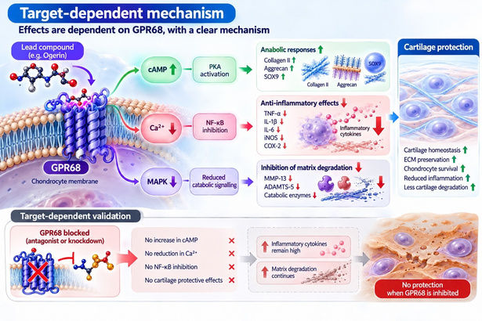

From Docking To Biological Validation: Our Next Steps
Immediate Next Steps
1. Finish the Benchmark
2. Pilot a Small Purchasable Set
3. Scale-Up Validation
Complete the docking and analysis of the current known-ligand set in both Pocket 1 and Pocket 2.
Select a few top-ranked and chemically diverse candidates for experimental testing.
After pilot testing, expand to a larger set of 6-10 chemically diverse candidates.
Long-Term Aim
To build a complete and coherent chain from in silico prediction to biological function and disease relevance.
1) Rational
Target
2) Reproducible Prediction
3) Structural Support
4) Receptor Response
5) Cartilage Protection
6) Mechanism
GNINA
Disease-relevant target in osteoarthritis
Reliable docking results using validated workflow
Modulation of GPR68 signalling and cellular response
Protection of OA-related chondrocytes (e.g., reduced inflammation)
Effects are dependent on GPR68, with a clear mechanism
Plausible binding mode and key interactions

Slide 11
References
  Hunter, D. J., & Bierma-Zeinstra, S. (2019). Osteoarthritis. The Lancet, 393(10182), 1745–1759.
  Goldring, M. B., & Otero, M. (2011). Inflammation in osteoarthritis. Current Opinion in Rheumatology, 23(5), 471–478.
  Loeser, R. F., Goldring, S. R., Scanzello, C. R., & Goldring, M. B. (2012). Osteoarthritis: A disease of the joint as an organ. Arthritis & Rheumatism, 64(6), 1697–1707.
  Kapoor, M., Martel-Pelletier, J., Lajeunesse, D., Pelletier, J. P., & Fahmi, H. (2011). Role of proinflammatory cytokines in the pathophysiology of osteoarthritis. Nature Reviews Rheumatology, 7(1), 33–42.
  Troeberg, L., & Nagase, H. (2012). Proteases involved in cartilage matrix degradation in osteoarthritis. Biochimica et Biophysica Acta, 1824(1), 133–145.
  Wang, M., Sampson, E. R., Jin, H., Li, J., Ke, Q. H., Im, H. J., & Chen, D. (2013). MMP13 is a critical target gene during the progression of osteoarthritis. Arthritis Research & Therapy, 15(1), R5.
  Verma, P., & Dalal, K. (2011). ADAMTS-4 and ADAMTS-5: Key enzymes in osteoarthritis. Journal of Cellular Biochemistry, 112(12), 3507–3514.
  Huang, X. P., Karpiak, J., Kroeze, W. K., Zhu, H., Chen, X., Moy, S. S., Saddoris, K. A., Nikolova, V. D., Farrell, M. S., Wang, S., Mangano, T. J., Deshpande, D. A., Jiang, A., Penn, R. B., Jin, J., Koller, B. H., Kenakin, T., Shoichet, B. K., & Roth, B. L. (2015). Allosteric ligands for the pharmacologically dark receptors GPR68 and GPR65. Nature, 527(7579), 477–483.
  Huang, X. P., Karpiak, J., Kroeze, W. K., Zhu, H., Chen, X., Moy, S. S., Saddoris, K. A., Nikolova, V. D., Farrell, M. S., Wang, S., Mangano, T. J., Deshpande, D. A., Jiang, A., Penn, R. B., Jin, J., Koller, B. H., Kenakin, T., Shoichet, B. K., & Roth, B. L. (2019). Design, synthesis, and characterization of ogerin-based positive allosteric modulators for G protein-coupled receptor 68. Journal of Medicinal Chemistry.
  Wei, W. C., Jacobs, B., Becker, E. B. E., & Glitsch, M. D. (2018). Reciprocal regulation of two G protein-coupled receptors sensing extracellular concentrations of Ca²⁺ and H⁺. Proceedings of the National Academy of Sciences, 112(34), 10738–10743.
  Wei, W. C., et al. (2018). Biased signalling of the proton-sensing receptor OGR1 by benzodiazepines. Cell Signalling.

Slide 12
Thank You
谢谢

