Slide 1
Optimization of Target Values in an Artificial Neural Network
Andrassik, Bhuyian, Yakar, Zauner​

Slide 2
Recap: Definitions
Target values → expected output a neural Network is trained to produce for a
specific given input
Class values → values assigned to the correct class position in the target vector
Non-class values → values used for all incorrect class positions in the target
vector

Slide 3

Recap: Encoding Methods
One-hot encoding
Class values
1 (cat / dog / rat)
Non-class value
0
These could be anything in [0, 1]!
→ Introduce adaptive assignment via Sigma-Adaptation

Slide 4
Adaptive Refinement - General Approach
Each epoch:
Record all outputs
Adjust the class value by averaging it with the most consistent class output seen so far
Adjust the non-class value by averaging all non-class outputs across the epoch (and previous guesses)
This method dynamically adapts the target values to match the evolving output behavior of the network

Slide 5
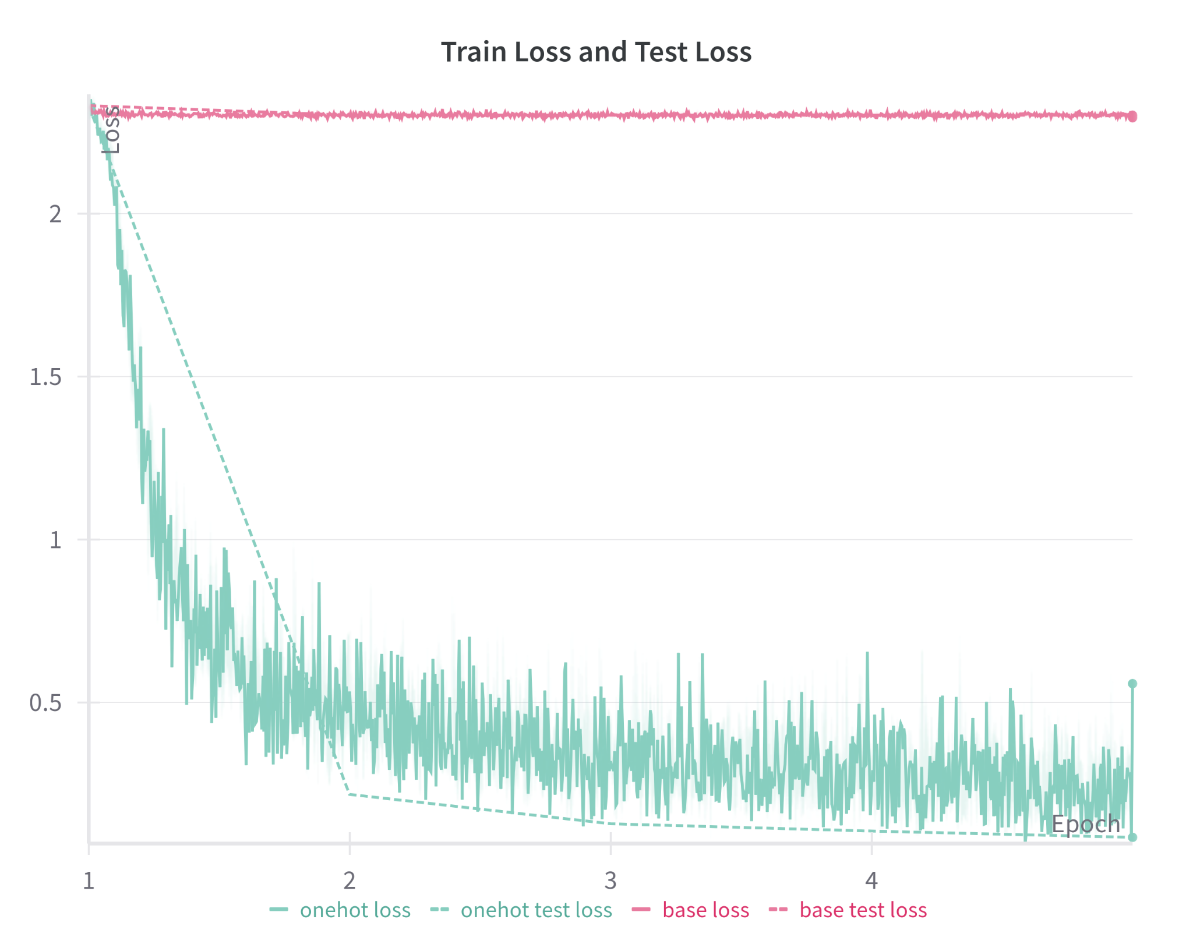
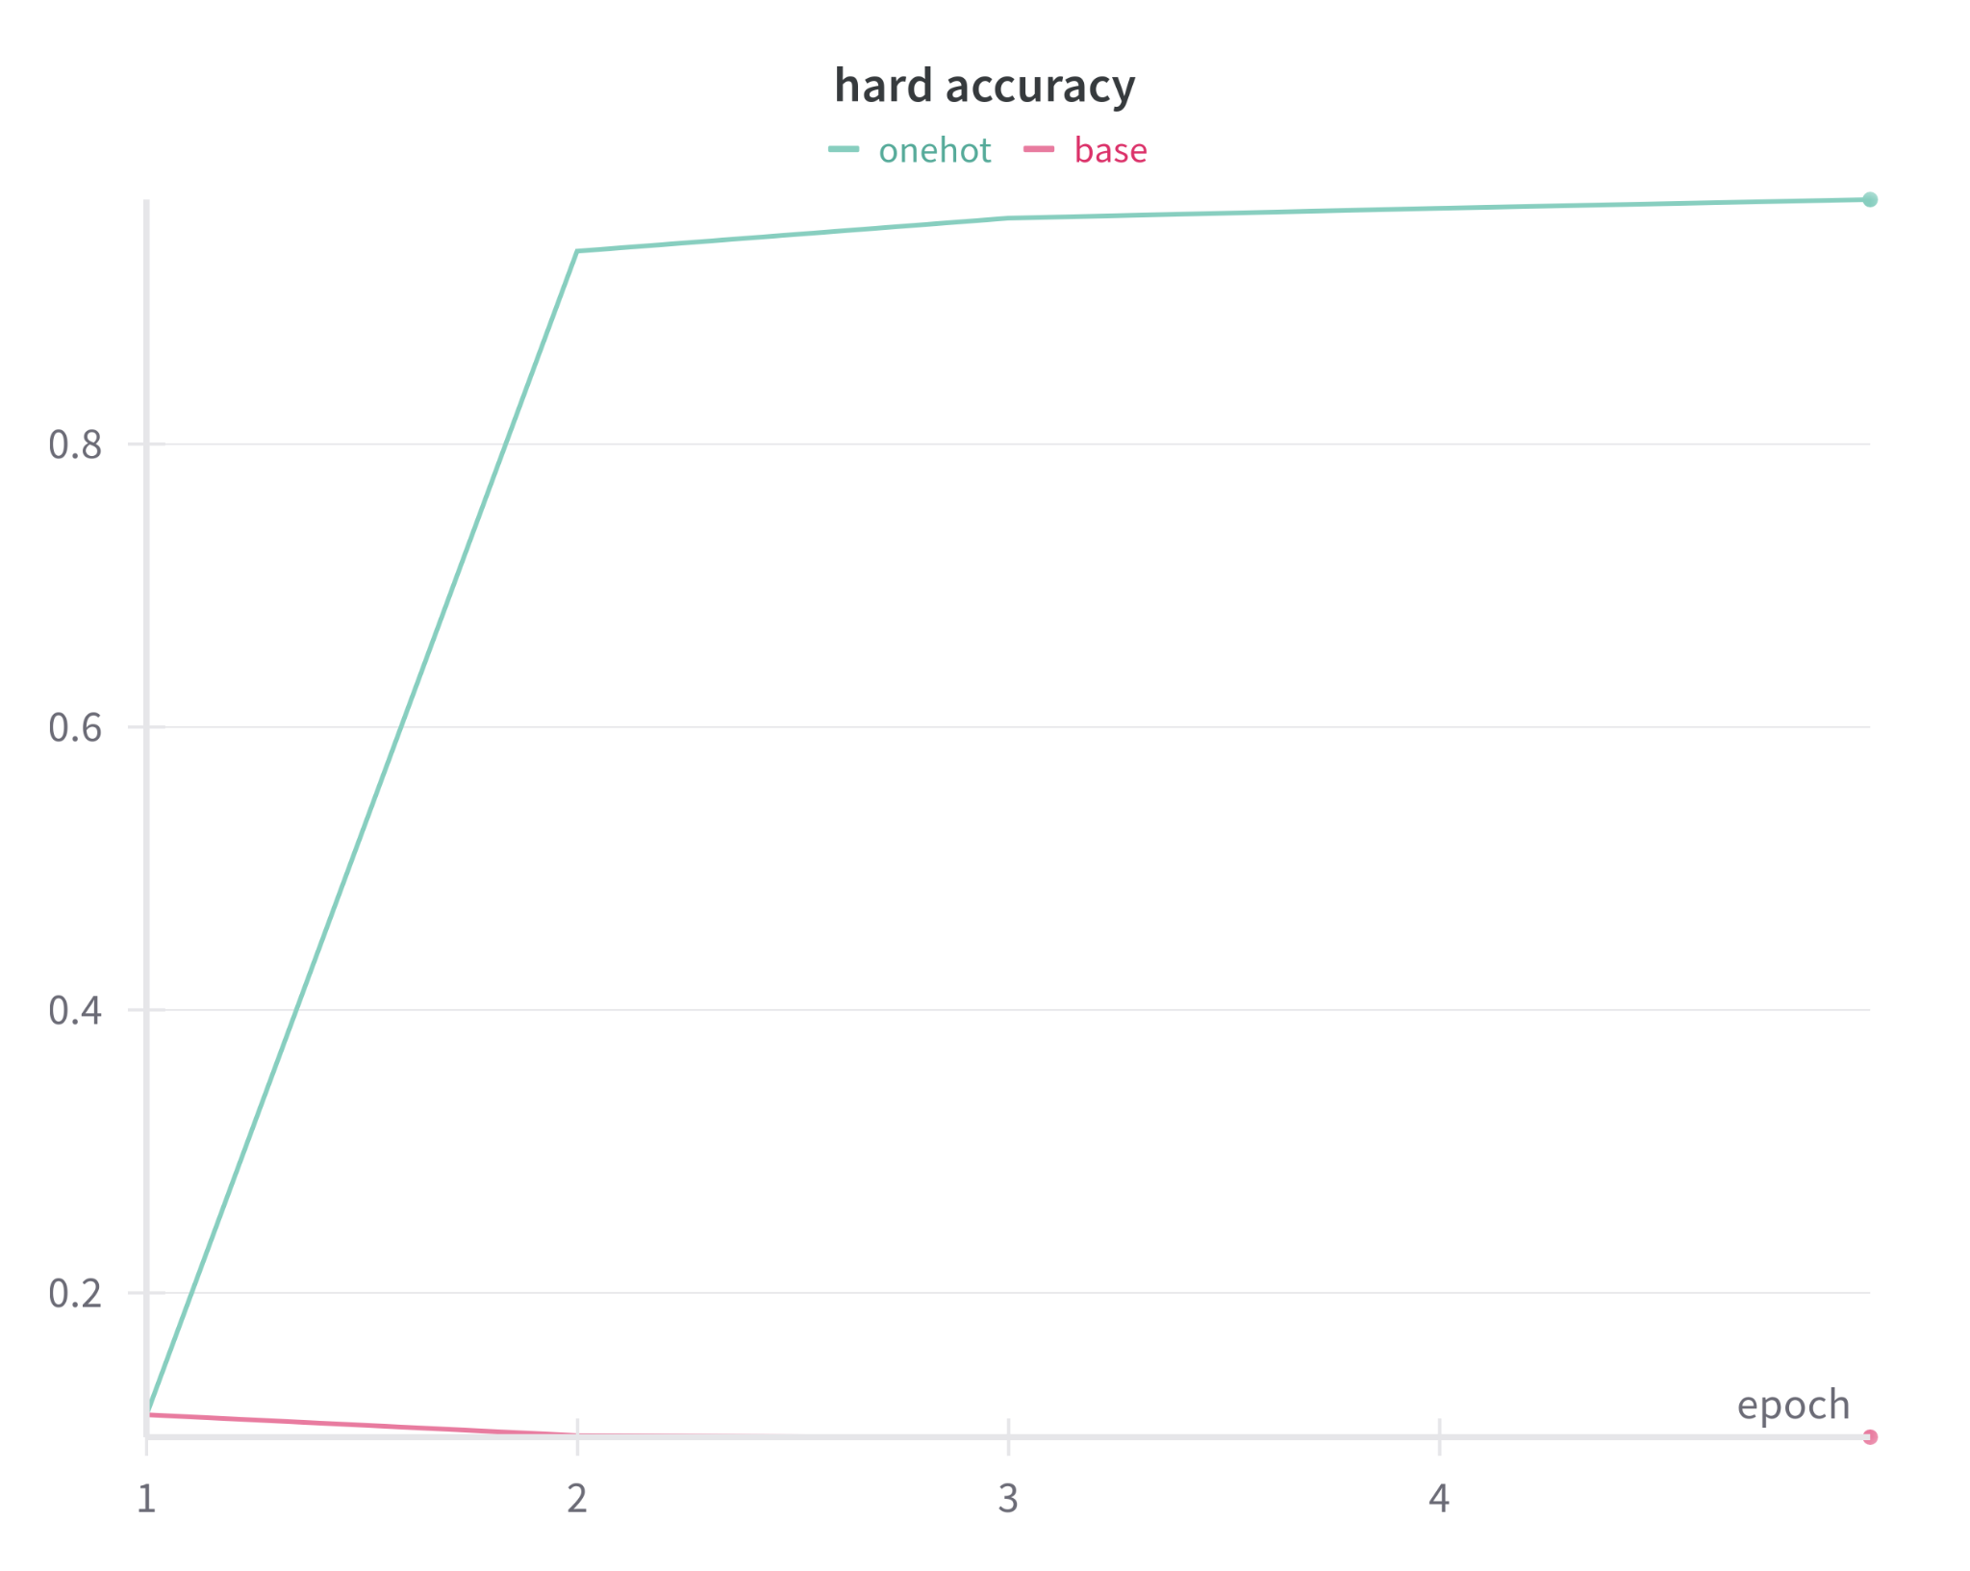
Base Approach Performance

Slide 6
σ-Adaptation Prototype
Uses the variability in outputs (standard deviation) to dynamically enforce separation
Steps:
Compute the sum of standard deviations for current outputs: σ_{sum}
For every class ensure:
All values remain within [0, 1]
|class - non-class| ≥ σ_{sum}
If too close:
Move non-class down by σ_{sum}
If this would exceed bounds clip to 0 or 1
Notes:
Wir nehmen gerade sigma sum statt sigma sum/2 weil es mit halbe nicht genug verschoben wird um gutes training zu ermöglichen.

Slide 7
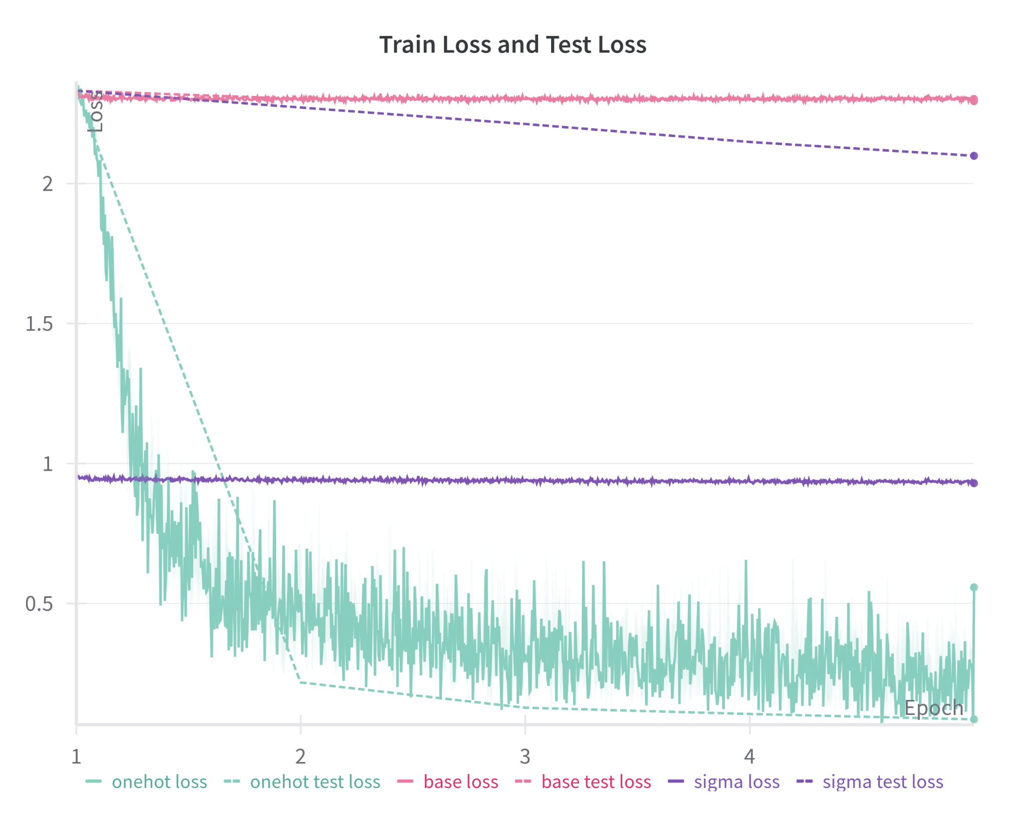
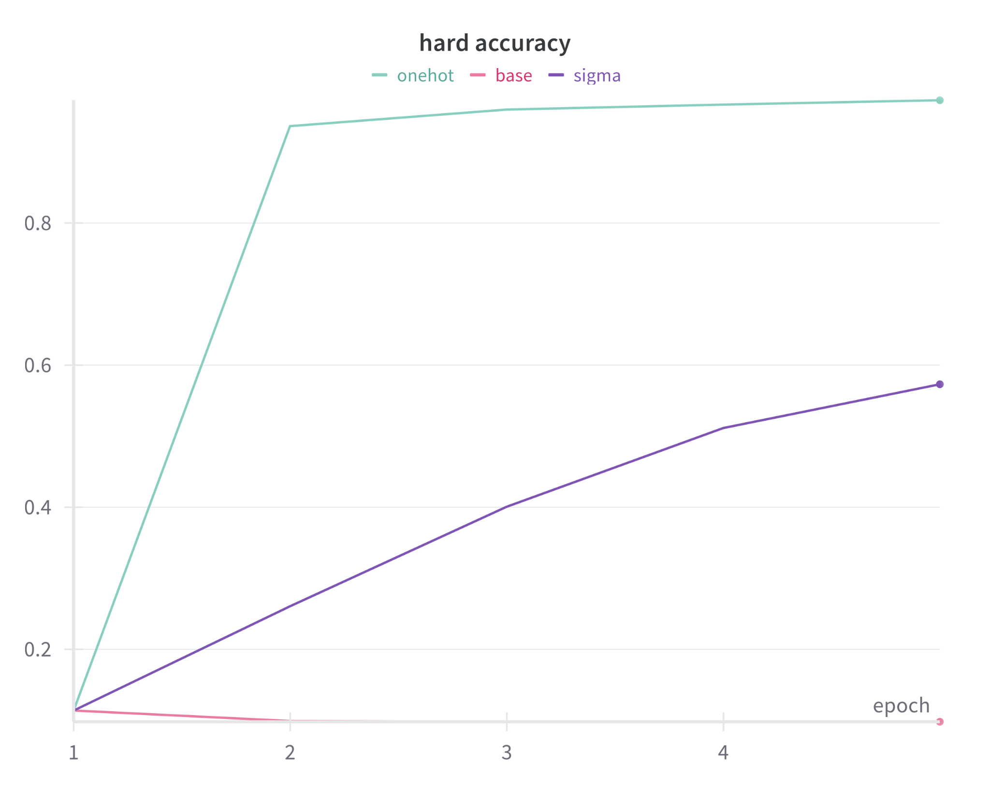
σ-Adaptation Performance
Notes:
man sieht overfitting aber bessere performance als base

Slide 8
Alternative σ-Adaptation Methods
Adjust both class and non-class values →
class_{adjusted} = class_{previous} + σ_{sum}
non-class_{adjusted} = non-class_{previous} - σ_{sum}
Use only half of sigma-sum →
class_{adjusted} = class_{previous} + (σ_{sum} * ½)
non-class_{adjusted} = non-class_{previous} - (σ_{sum} * ½)
Notes:
Wir nehmen gerade sigma sum statt sigma sum/2 weil es mit halbe nicht genug verschoben wird um gutes training zu ermöglichen.

Slide 9
Next Steps
We can increase accuracy by:
Improving the adaptation
Move more in early training
Adjust the calculation logic
…
Reducing Overfitting
Regularization techniques
…

