Slide 1
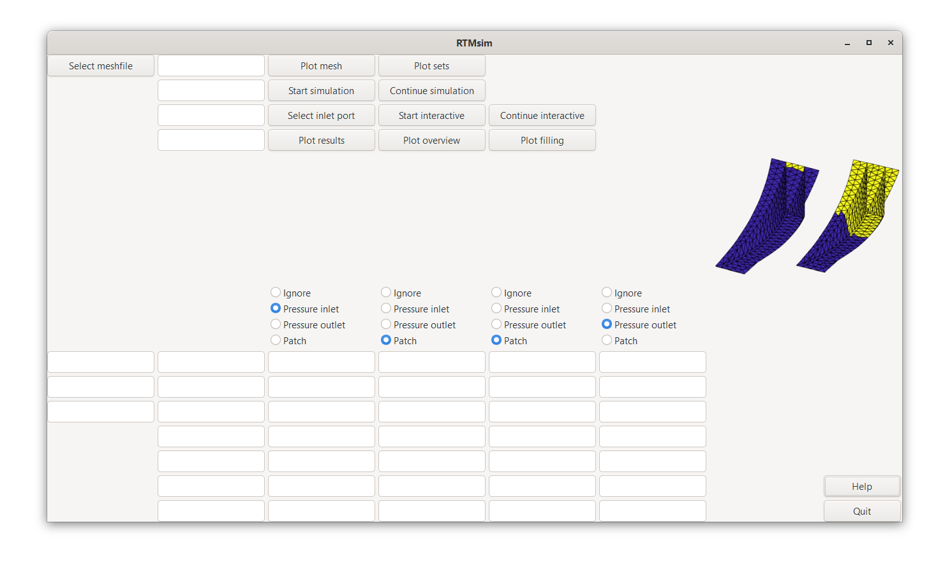
mesh file name
with path
simulation time
radius of inlet ports
file name of jld2 results file
Mesh file and all parameters in SI units
Radio button selection if defined sets 1, 2, 3 and 4 are ignored, used for pressure inlet or outlet, used as patch with different properties
injection pressure
thickness
initial cavity pressure
porosity
dynamic viscosity of resin
permeability in first principal direction
parameters for main preform
parameters for patch 1 if used
parameters for patch 2 if used
parameters for patch 3 if used
parameters for patch 4 if used
alpha for permeablity in second principal direction
x, y and z-components of the reference vector which is projected on the elements to define the principal directions

