Slide 1
Train Routing
Group 29
PENG Tao 13104616d
ZHAO Tianyi 13103359d

Slide 2
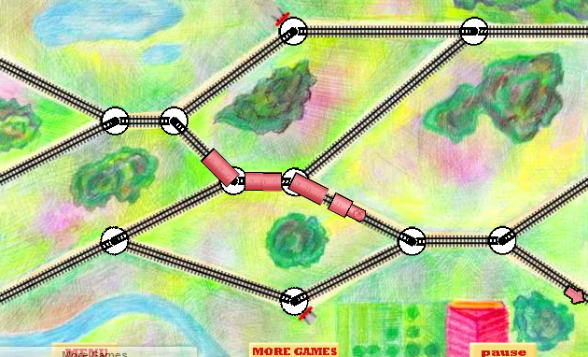
Problem description
Train routing:
Switch the joints -> Train travel to destination
Notes:
brief intro problen
game called
player->switcher without crashing, avoid

Slide 3
Project objectives
To design an interesting and reasonable game logic.
To implement a user-friendly and nice-looking game interface.
Notes:
mike

Slide 4
Difficulties
Class design;
Program flow;
GUI (GDI+);
Limited time;
Notes:
mike

Slide 5
responsibilities
PENG Tao | ZHAO Tianyi
Discuss the program framework, draw GDI+, add new features
Joint, Track, Transform class; | Train, Cab, RoadBlock class;
Test GameObject static library | Design GUI framework
Make special effects and optimize the visual effect | Design Login system (library and GUI)
Art direction | Optimize the game logic
Notes:
mike

Slide 6
Classes
Joint
Track
Train
Cab
RoadBlock
Transform
Login
Map and routing connection
Moving object
Interaction
Movement and calculation
GUI - User Info

Slide 7
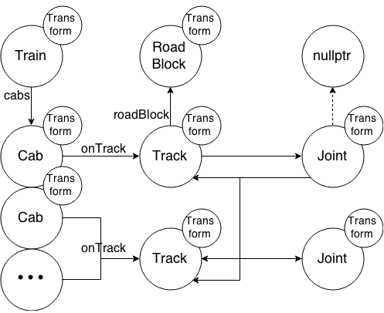
Classes

Slide 8
Joint and Track
Joint:
Track *Track0, *Track1, *Track2
Next(Track*)
bool ts //track switch
Track:
Joint *Joint0, *Joint1
bool hasRoadBlock; RoadBlock* roadBlock;
Next(Joint*)

Slide 9
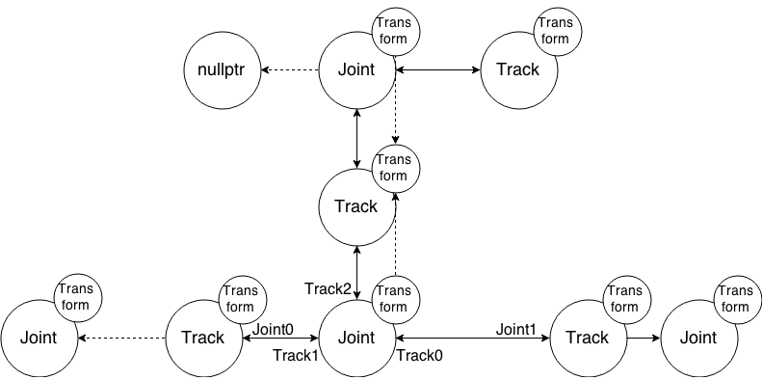
Joint and Track

Slide 10
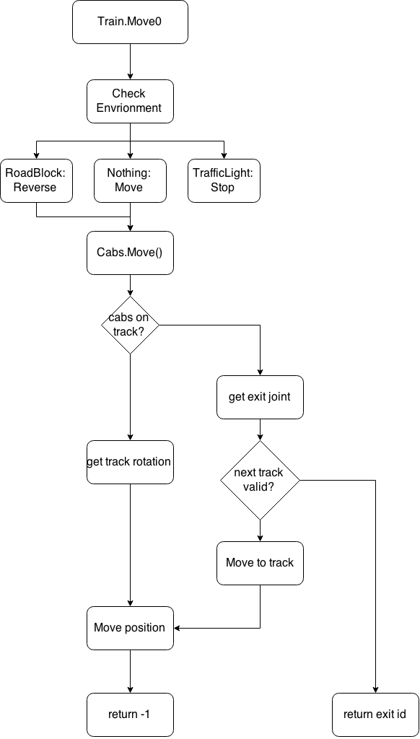
Train and Cab
class Train:
Cab* cabs;
Move(time);
class Cab:
Transform transform;
Track* onTrack;
Move(speed, time);

Slide 11
Train movement
Check envrionment
Physical movement
Verification
Movement adjustment & Exception handling
Return states

Slide 12
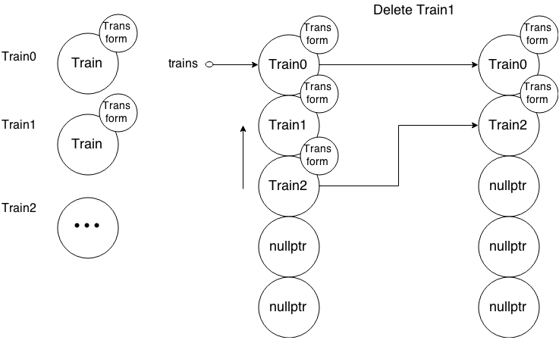
Multiple train & cabs
totalTrainCount

Slide 13
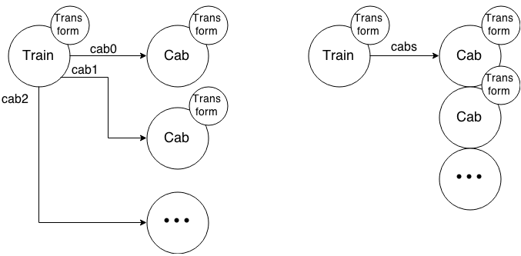
Multiple train & cabs

Slide 14
Transform Class
Key elements
Position
Rotation
Vector calculation
Add, Subtract, Scale, Distance, Intersection

Slide 15
Transform Class
All game object have Transform
Fields:
x, y, rotation;
Methods:
Move, MoveTo, Rotate, RotateTo, Scale, Normalize, Intersection

Slide 16
Traffic light
RoadBlock:
Reverse
-1
Traffic light:
Stop or Go
0 or 1
class RoadBlock:
int blockState;

Slide 17
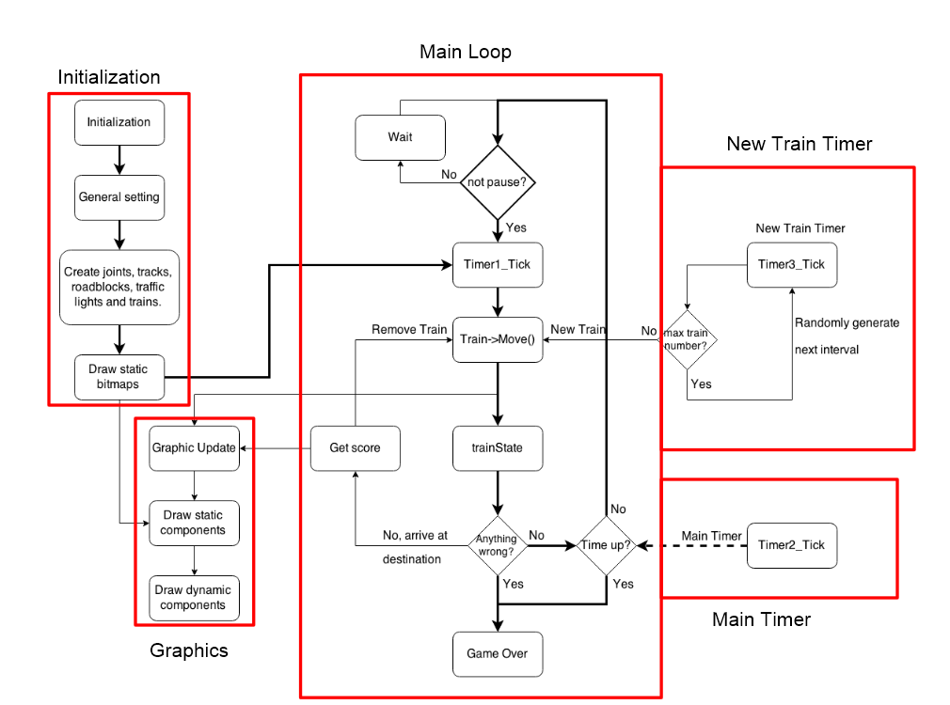
General flow

Slide 18
Highlights
Glowing effects
Main menu design
Ghost train
Bonus item
Game difficulty design

Slide 19



Glowing Effects

Slide 20
Glowing Effects
Example Code:
//Gowling
Pen ^ whitePen; PointF pt1; PointF pt2;
int alpha = 1, width = 16;
for (; width >= 3; width--) {
whitePen = gcnew Pen(Color::FromArgb(alpha++, 255, 255, 255), width);
g->DrawLine(whitePen, pt1, pt2);
}
//Highlight
whitePen = gcnew Pen(Color::FromArgb(255, 255, 255, 255), width);
g->DrawLine(whitePen, pt1, pt2);

Slide 21
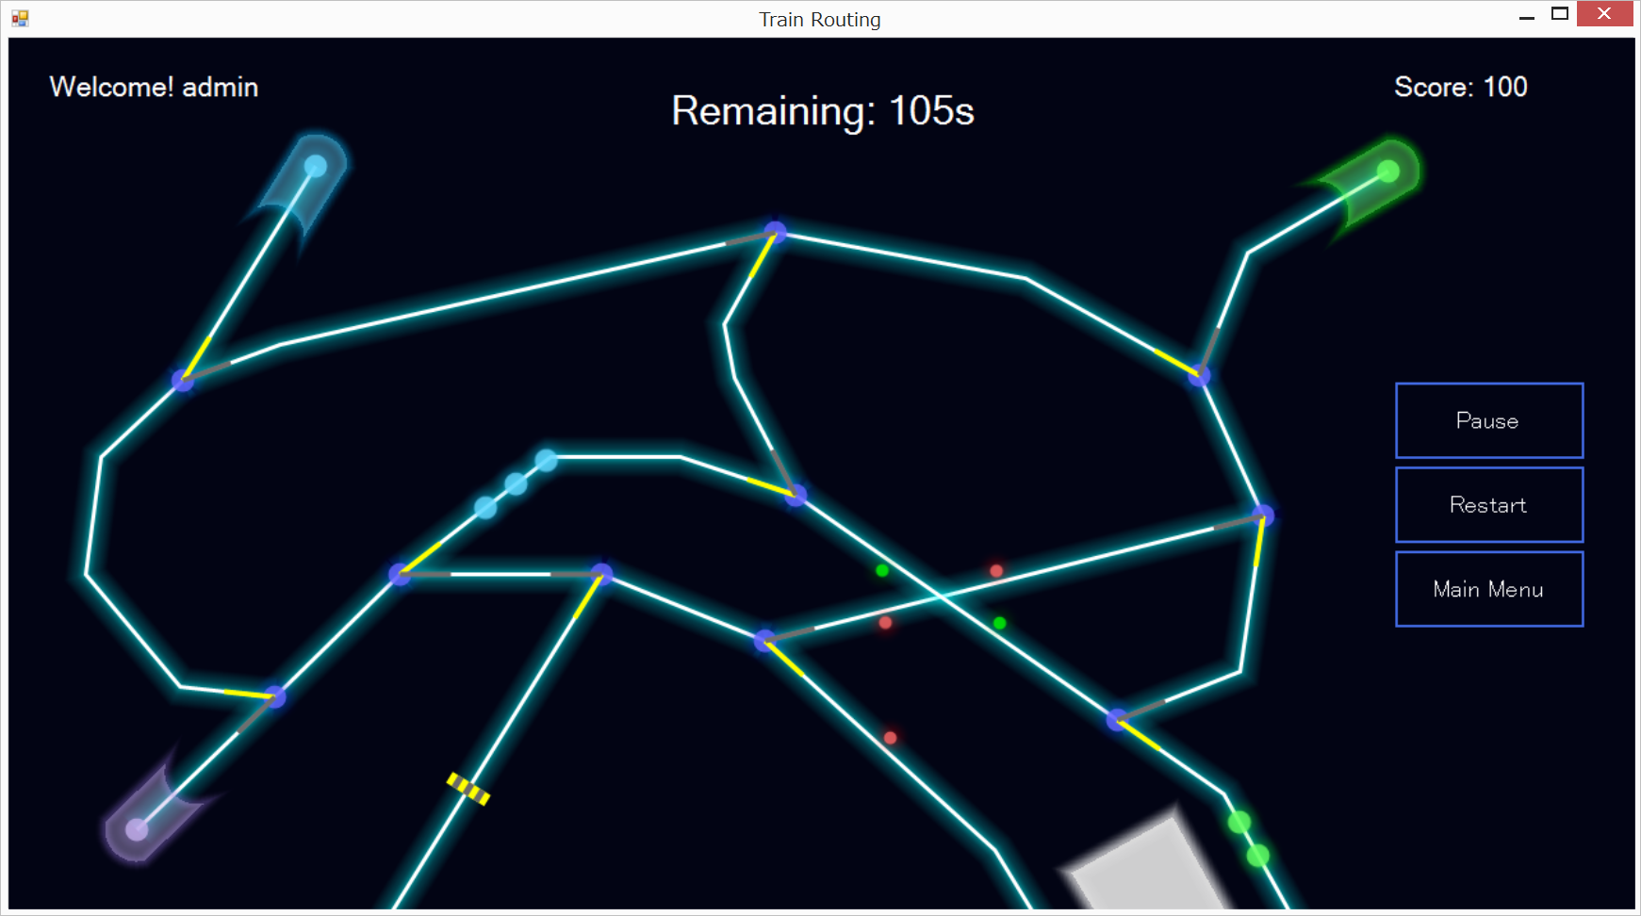
Glowing Effects

Slide 22
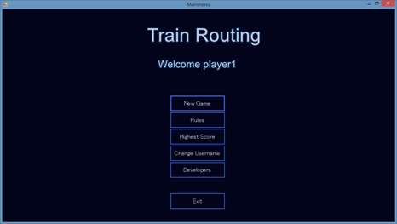
Main menu design
Similar UI style to game

Slide 23
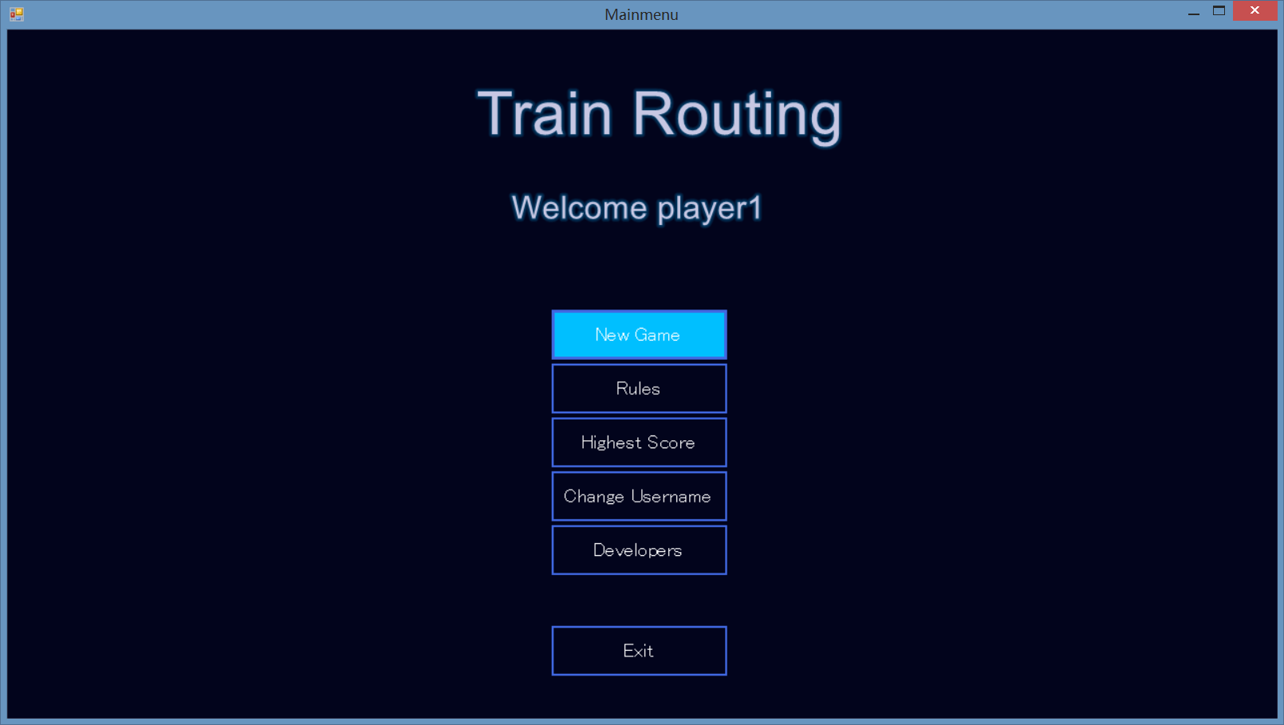
Main menu design
Interacitve style (Click) & Animation

Slide 24
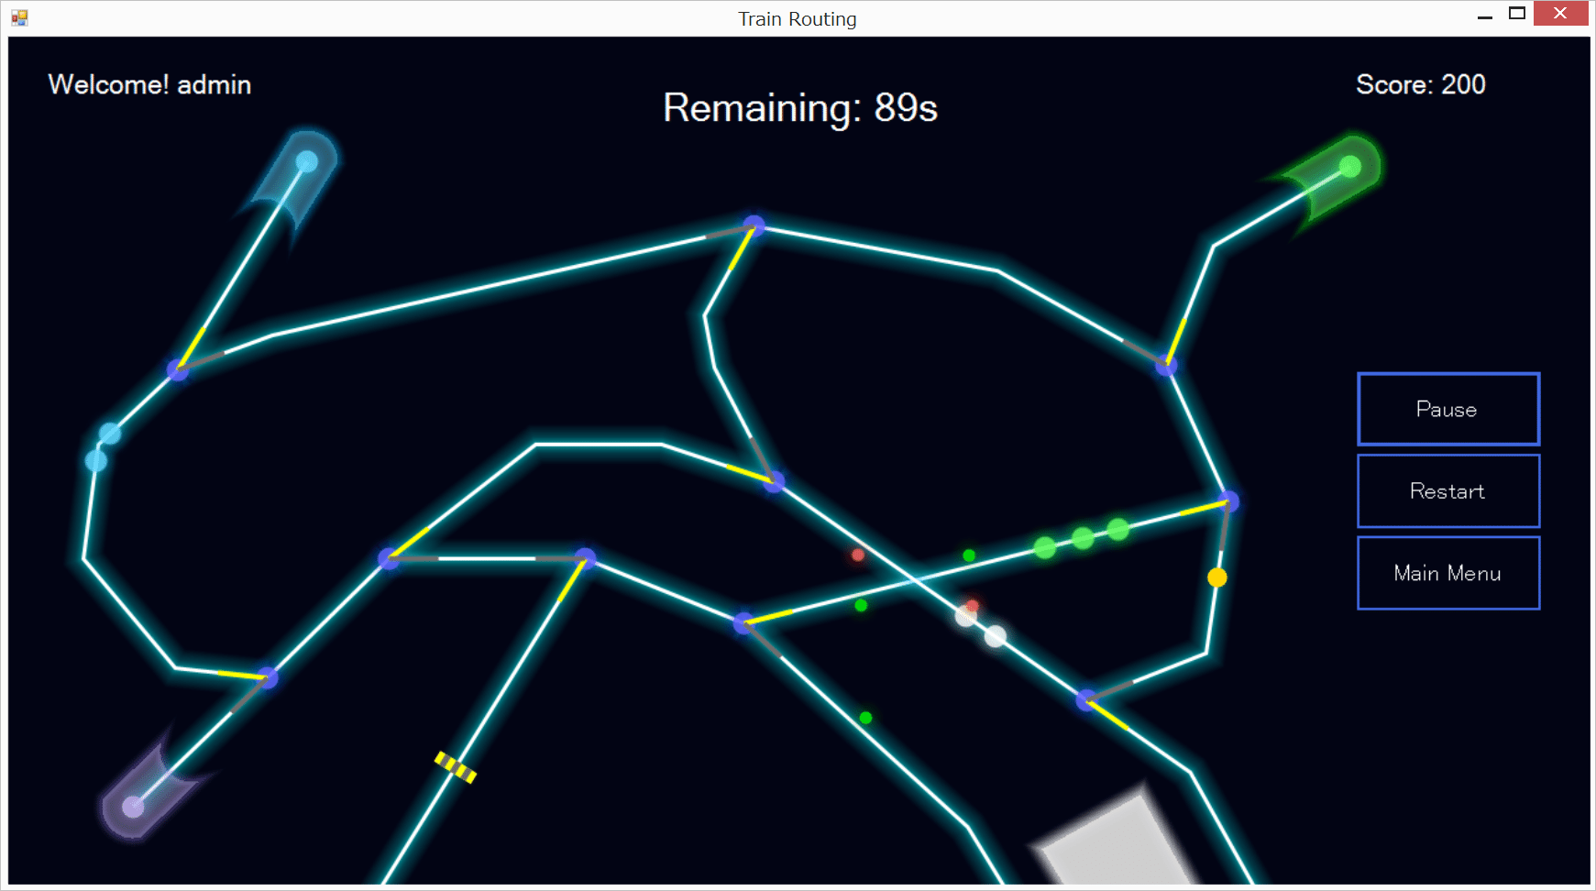
Ghost train

Slide 25
Bonus item

Slide 26
Game difficulty design

Slide 27
Game difficulty design
3 levels of difficulty:
Easy, Hard, Extreme
Traveling speed
Intervals
Maximum train numbers
Random range (speed, interval, cabs number)
More difficult, more chances to get scores.

Slide 28
Conclusion
An executable game with
reasonable logic,
interesting mode,
beautiful appearance,
user-friendly interface,
unique features,
additional effects.
Notes:
Finally we obtain our project objecties to a large degree

Slide 29
Demonstration

Slide 30
Q & A

