Slide 1
ADVANCED PROGRAMMING (83677)
Web Computational
Graph
A concurrent publisher/subscriber engine for building, executing, and visualizing computational graphs — with a live web dashboard.
Ziv Chaba (326681285)
zivchaba1000@gmail.com
Bar-Ilan University

Slide 2



BACKGROUND
Motivation
The project builds a modular system that combines design patterns, HTTP server, and a publisher/subscriber architecture to construct, execute, and visualize complex computational graphs — progressing from foundational exercises into one fully integrated application.
Design Patterns
HTTP Server & Servlets
Publisher / Subscriber
Observer, Decorator, Active Object, Singleton, Strategy, and Flyweight applied to real problems.
A generic, thread-pooled server with custom routing — built from sockets up.
Independent agents that communicate only through named topics, forming a live computational graph.
02 / 09

Slide 3



PROJECT DESIGN · MVC
Model
View
Controller
The Model Layer
Core Event-Driven State
Manages communication channels (Topic), the registry (TopicManagerSingleton), and the payload container (Message).
Processing Agents
Implements the Agent interface and its subclasses — BinOpAgent, PlusAgent, MulAgent, IncAgent, TextMergeAgent — to run calculations in the background.
Structural Topology
Represents and validates the processing network using the Graph and Node classes, checking for cycle deadlocks before execution.
03 / 09

Slide 4


PROJECT DESIGN · MVC
Model
View
Controller
The View Layer
Graphical Renderer
HtmlGraphWriter compiles logical graphs into HTML, translating topology and live state into a visual canvas.
Interactive Web Dashboard
The html_files/ directory (index.html, form.html, graph.html) renders the graph with Vis.js, displays live topic values, and reconstructs the underlying algebraic formula automatically.
04 / 09

Slide 5





PROJECT DESIGN · MVC
Model
View
Controller
The Controller Layer
HTTP Network Server
A concurrent, thread-pool-backed server (MyHTTPServer) with a stream decoder (RequestParser) that parses requests into structured RequestInfo objects.
Servlet Routing Handlers
Decouples network sessions from routing, dispatching client actions using longest-prefix matching to custom controllers:
ConfLoader
TopicDisplayer
HtmlLoader
Uploads, parses, bootstraps, and unloads configurations.
Exposes JSON API endpoints and supports zero-flicker client polling.
Serves static view assets securely from disk.
05 / 09

Slide 6
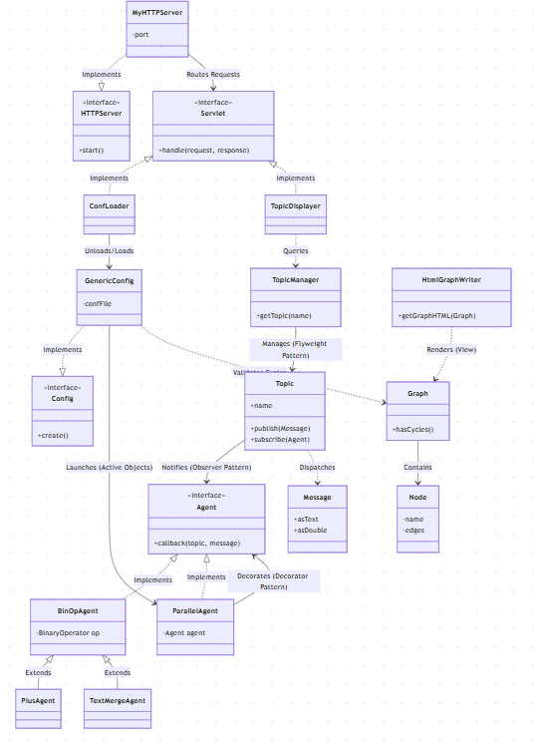

IN ACTION
The Live Dashboard
Upload a configuration file and watch the graph render instantly.
Publish a message to any topic and see the graph update live.
The values table refreshes automatically as the graph runs.
06 / 09

Slide 7



GOING FURTHER
Beyond the Requirements
TextMergeAgent Integration
Live Formula Reconstruction
A concrete, non-mathematical agent that merges mixed text and numbers.
The browser graph automatically traverses active nodes to reconstruct the algebraic equation.
Zero-Flicker Web Polling
Cascading Resets & Safe Rollbacks
A client-side, DOM-diffing polling script updates only modified cells to prevent screen flicker.
Unified state resets and robust rollback safeguards on invalid configurations.
07 / 09

Slide 8




REFLECTION
Takeaways
Design & Architecture
A deeper understanding of SOLID and GRASP principles, alongside MVC and MVVM architectures, for building maintainable applications.
Coding Proficiency
Stronger Java development skills, with a focus on data structures, file handling, and network communication.
Web & Scalability
Practical experience building robust, scalable RESTful services.
Career Readiness
A versatile skill set carried forward into professional software development.
08 / 09

Slide 9

Thank You
github.com/Ziv33/WebComputationalGraph

