Slide 1
Identifying Traffic Rule Violations(Speeding)
Ronald Wee (A0206046N)
Ziv Low (A0199634M)
Notes:
Need project title.
Eg. Speeding catcher
Other group’s title / projects:
Group 2: Instrumentify
Group 3: Vehicle navigation
Group 4: 1v1 Soccer (RL)
Group 5: Sign language
Group 6: Sign language recognition
Group 7: Recommendation Chatbot
Group 8: Pokemon Battle predictor
Group 9: Arrhythmia on ECG Classification using CNN
Focus on one algorithm and then modify it.

Slide 2
Table of content
Problem
Solution
Detailed description of procedure
Code breakdown
Demo

Slide 3
Problem
-Identifying traffic violations like speeding is a common task that can be automated
-This major task involves 4 subtasks:
Vehicle and car plate detection -> car tracking -> speed detection -> car plate recognition

Slide 4
Solution
-A real-time car tracking and speed prediction system, coupled with a license plate recognition technology
-Vehicles and car plates can be detected and identified using YOLOv5
-Vehicles can be tracked using correlation tracker from dlib library
-Speed of the vehicles can be calculated using distance moved in a second.
-License plate shall be recognized using EasyOCR

Slide 5
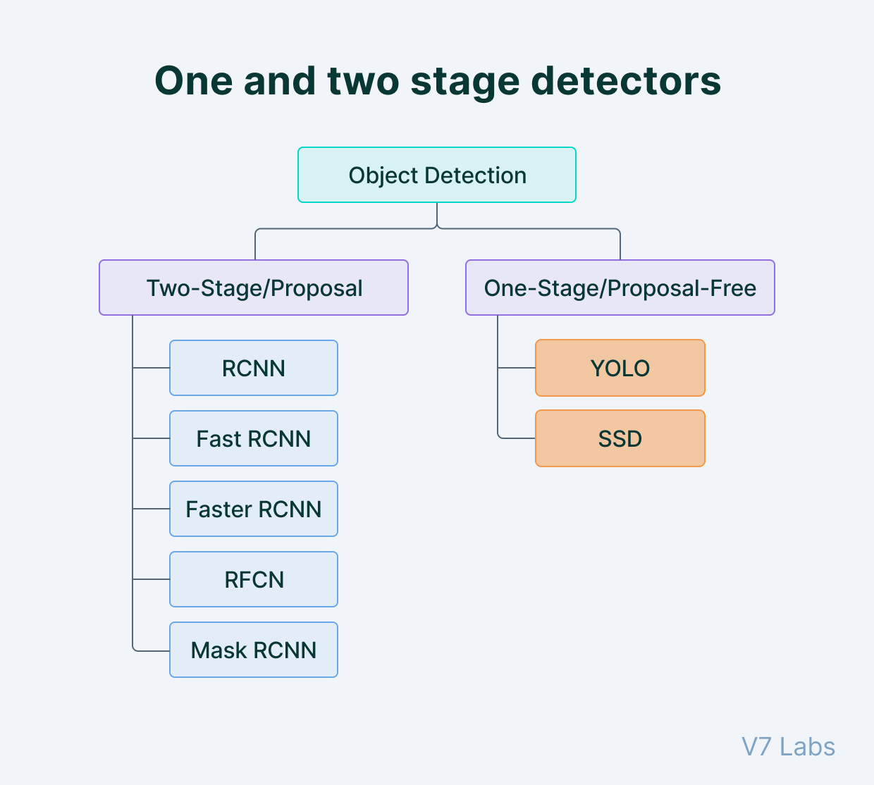
Detailed description of procedure
Detect
Track
Speed
OCR
1. Object detection
-Using YOLOv5 to detect cars and car plates in one inference iteration
-The YOLO algorithm works by dividing the image into N grids,
each having an equal dimensional region of SxS. Each of these N grids is
responsible for the detection and localization of the object it contains.
-YOLO is a much faster algorithm than its counterparts, running at as high as 45 FPS.
Notes:
Profs said that YOLO performance might be better than Haar cascade.
They want us to compare.

Slide 6
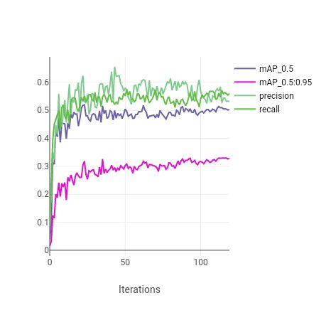
Training Results of YOLOv5
Detect
Track
Speed
OCR
2 classes
1) Land vehicles
2) Vehicle Registration Plate
- For each class, 500 images for train set, 200 images for evaluation set
-120 epochs, batch size of 16
- Best mAP_0.5 of 0.51374, best mAP_0.5:0.95 of 0.32928
Notes:
Further details on training of YOLOv5 custom model are on ClearML:
https://app.clear.ml/projects/ce0f0281647142ddbba51d6e14fa900f/experiments/56f8073be8ed4e2ebd13879bbffa4981/output/execution

Slide 7
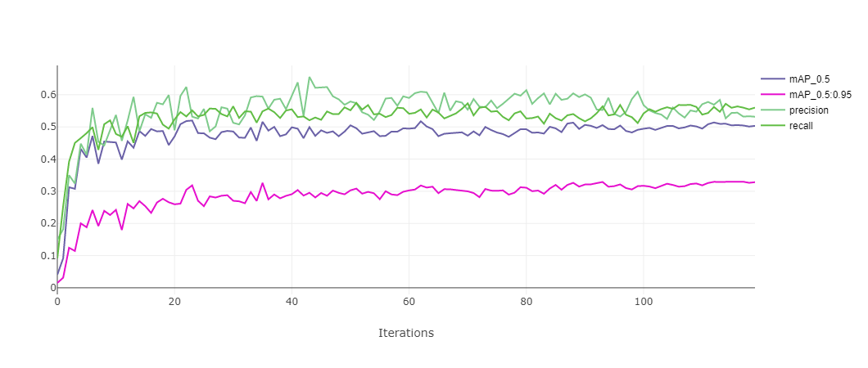
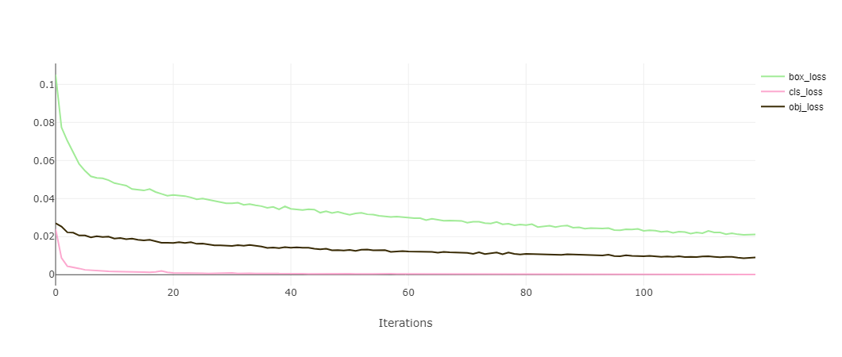
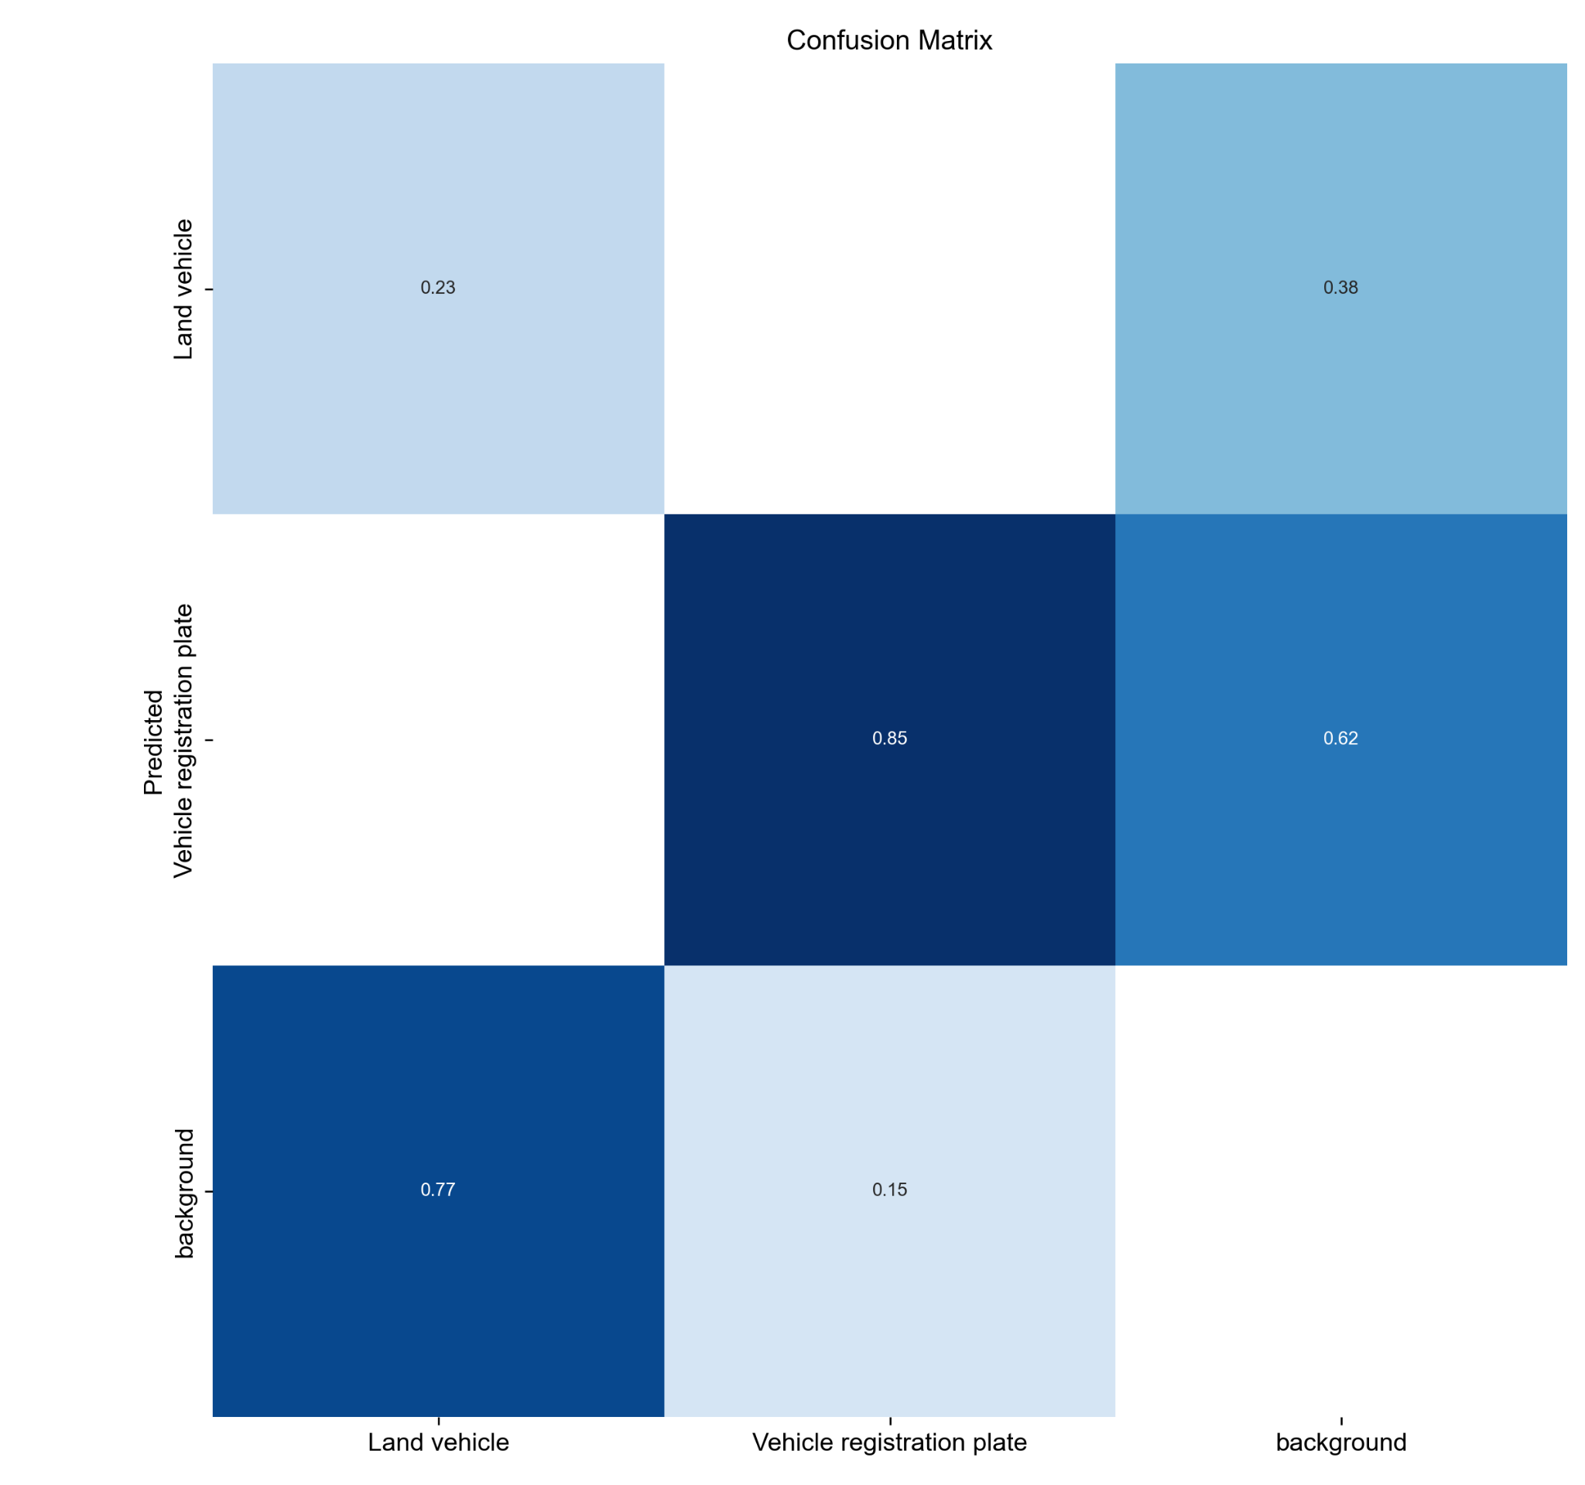
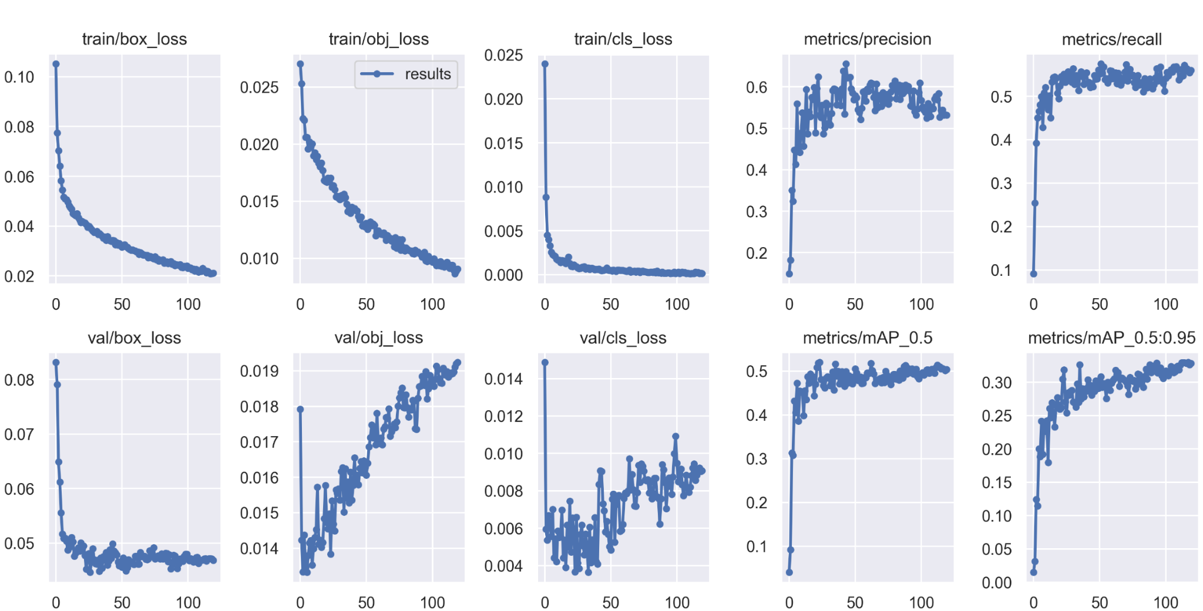
Training Results of YOLOv5
Detect
Track
Speed
OCR
Notes:
Further details on training of YOLOv5 custom model are on ClearML:
https://app.clear.ml/projects/ce0f0281647142ddbba51d6e14fa900f/experiments/56f8073be8ed4e2ebd13879bbffa4981/output/execution

Slide 8
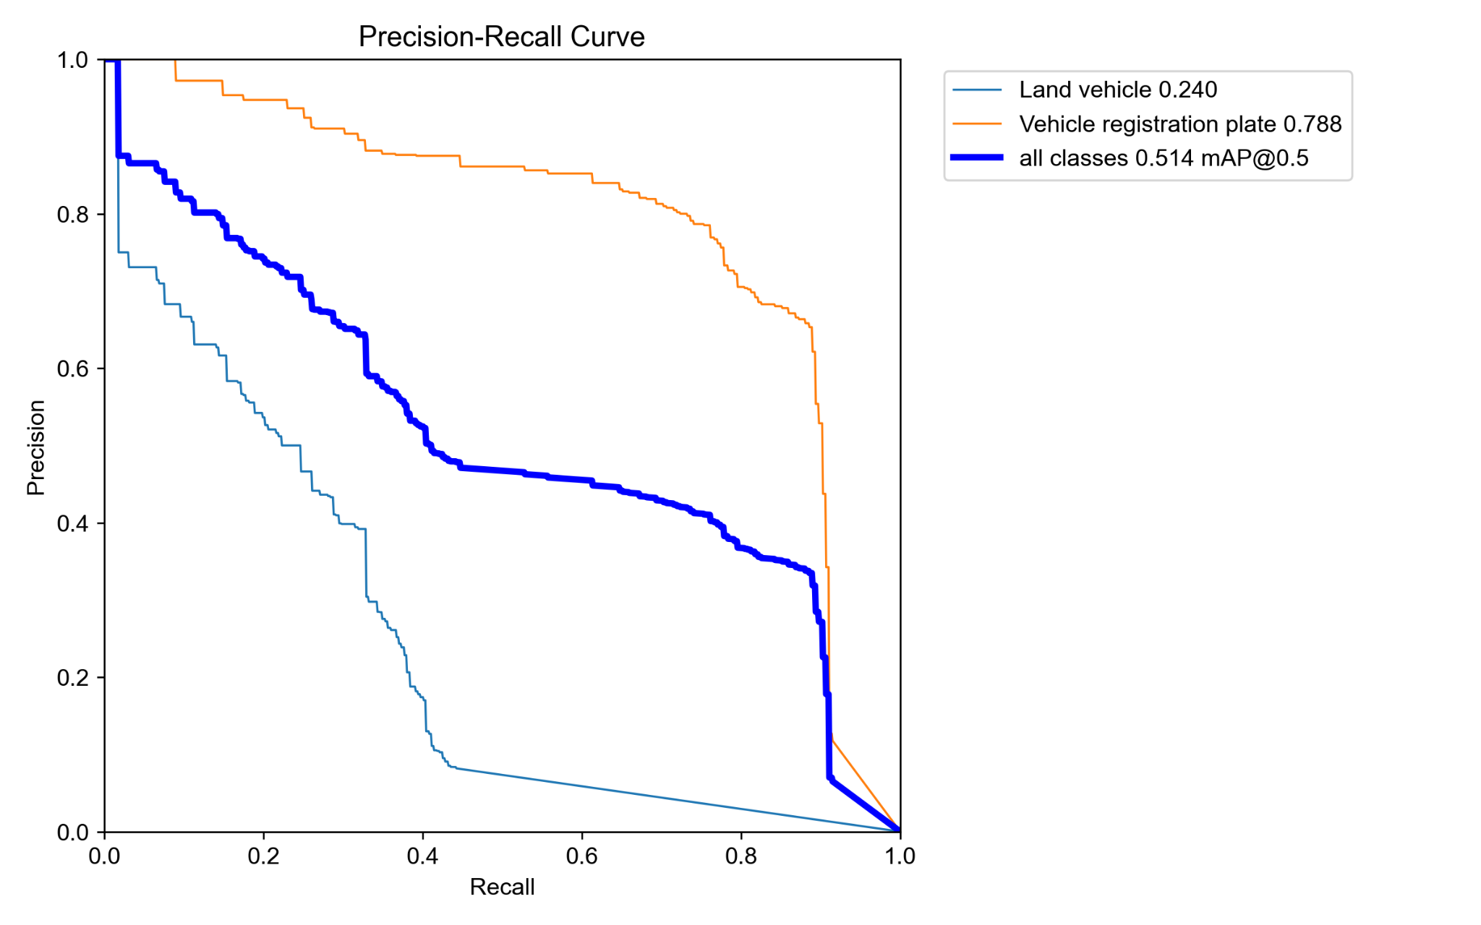
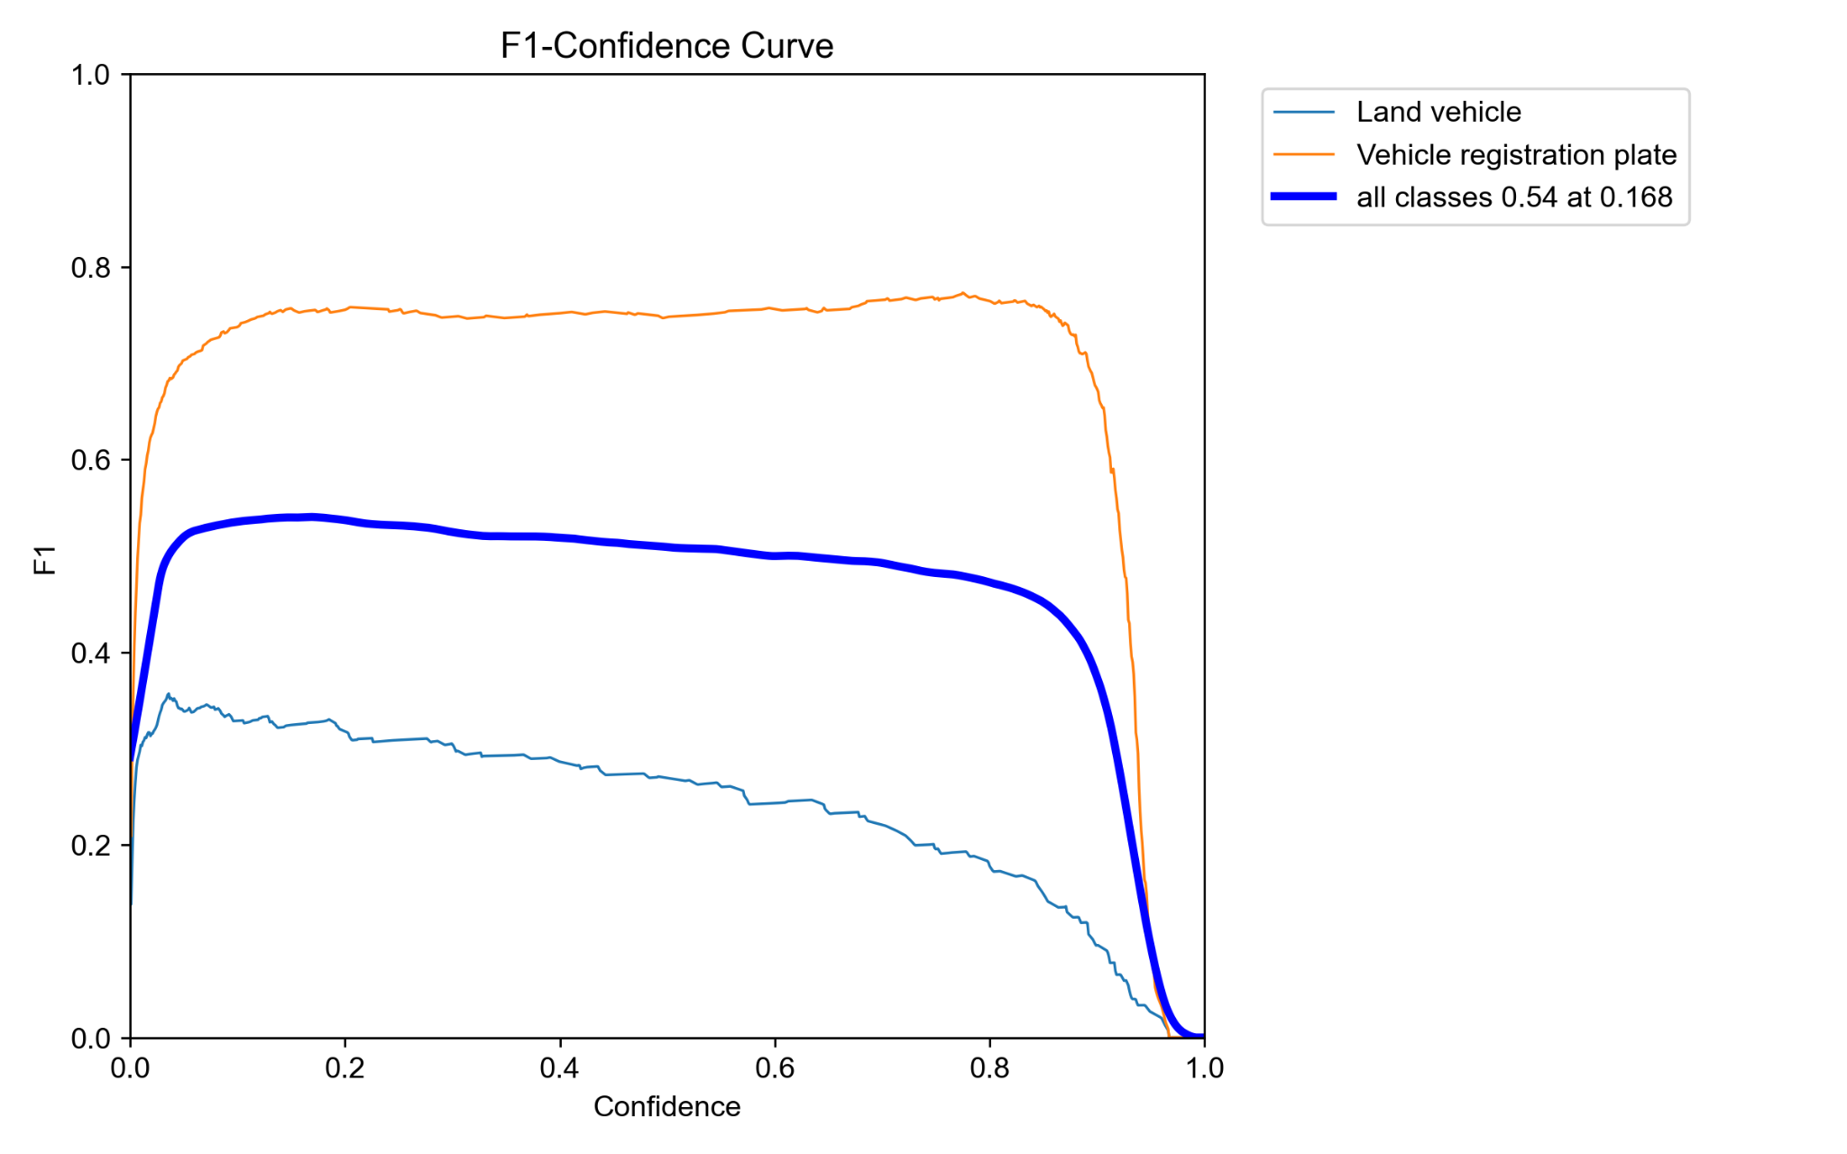
Training Results of YOLOv5
Detect
Track
Speed
OCR
Notes:
Further details on training of YOLOv5 custom model are on ClearML:
https://app.clear.ml/projects/ce0f0281647142ddbba51d6e14fa900f/experiments/56f8073be8ed4e2ebd13879bbffa4981/output/execution

Slide 9
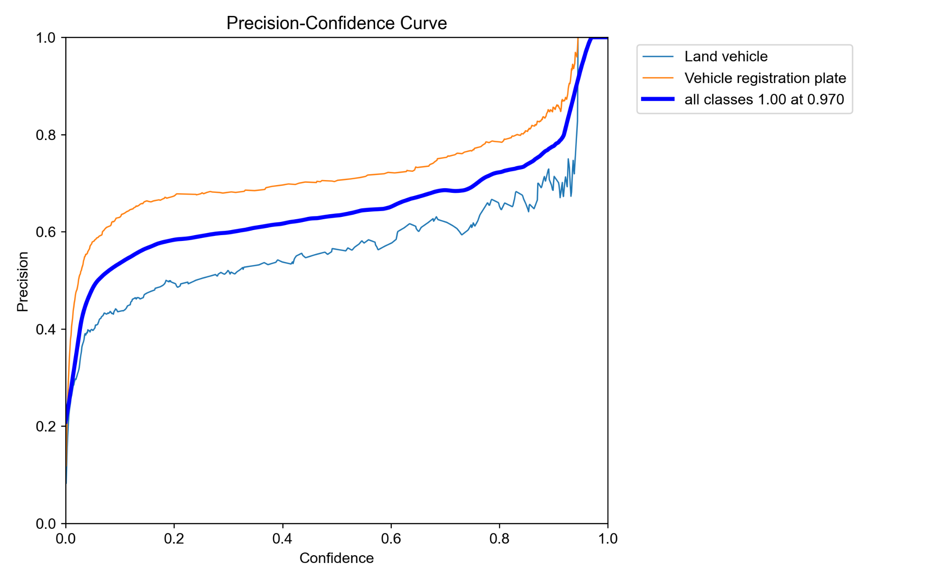
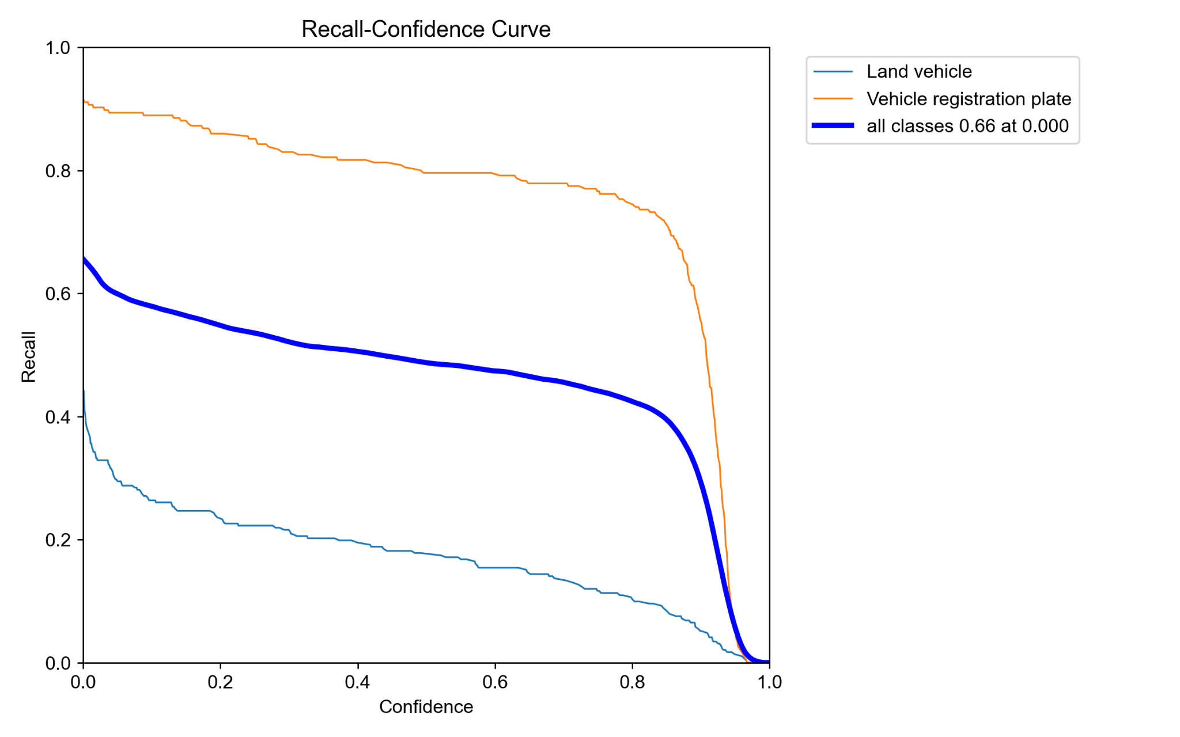
Training Results of YOLOv5
Detect
Track
Speed
OCR
Notes:
Further details on training of YOLOv5 custom model are on ClearML:
https://app.clear.ml/projects/ce0f0281647142ddbba51d6e14fa900f/experiments/56f8073be8ed4e2ebd13879bbffa4981/output/execution

Slide 10
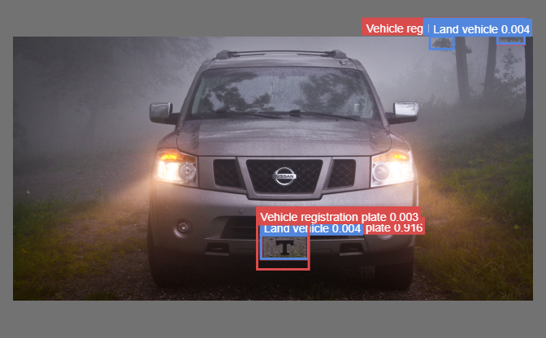
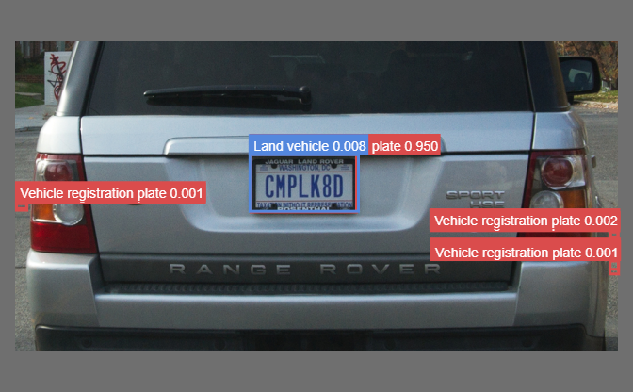
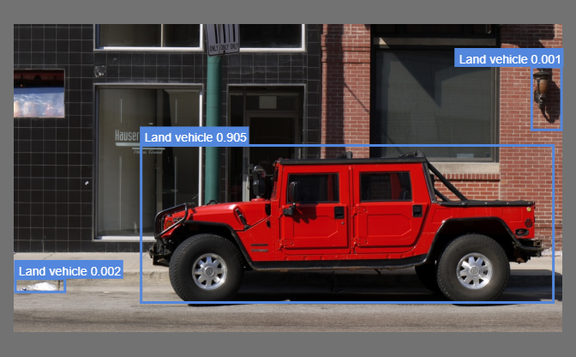
Training Results of YOLOv5
Detect
Track
Speed
OCR
Notes:
Further details on training of YOLOv5 custom model are on ClearML:
https://app.clear.ml/projects/ce0f0281647142ddbba51d6e14fa900f/experiments/56f8073be8ed4e2ebd13879bbffa4981/output/execution

Slide 11
Object detection code breakdown
Detect
Track
Speed
OCR
if 'haar_cascade' in inference_method:
haar_cascade_results = haar_cascade_model.detectMultiScale3(opencv_image, scaleFactor=1.1, minNeighbors=32, minSize=(30, 30), outputRejectLevels = True)
if 'YOLOv5' in inference_method:
yolo_inference_results = yolov5_model(opencv_image)
if 'ALPR_SDK' in inference_method:
# Get the result from ALPR-SDK
alpr_sdk_output_result = ultimateAlprSdk.UltAlprSdkEngine_process(
imageType,
pil_image.tobytes(), # type(x) == bytes
width,
height,
0, # stride
1 )
(Haar Cascade)
cv2.CascadeClassifier.detectMultiScale
(YOLOv5)
torch.load
(ALPR-SDK)
SDK engine process

Slide 12
Detailed description of procedure
Detect
Track
Speed
OCR
2. Object tracking
Correlation tracking
Perform object detection once (or once every N frames)
Apply a dedicated tracking algorithm that can keep tracking of the object as it moves in subsequent frames without having to perform object detection

Slide 13
Object tracking code breakdown
Detect
Track
Speed
OCR
# Loop through currently being tracked objects
for ID in _attributes.keys():
trackerQuality = _attributes[ID][key].update(input_image)
# If poor tracking quality
if (trackerQuality < threshold):
IDtoDelete.append(ID)
# Delete those with poor tracking quality
for ID in IDtoDelete:
_attributes.pop(ID, None)
dlib
correlation_tracker.update
Threshold to consider as bad tracking
pop away bad trackers
# Vehicle position
vehicle_position = vehicles[vehicleID]['vehicle_tracker'].get_position()
dlib
correlation_tracker.get_position
# Plate position
plate_position = plates[plateID]['plate_tracker'].get_position()

Slide 14
Detailed description of procedure
Detect
Track
Speed
OCR
3. Speed detection
-Distance moved are usually calculated in pixels per second, so pixels per meter needs to be calculated too, in order to find speed in meters per second
-If speed exceeds a certain threshold, an image of the car will be captured, and the image will be processed by the car plate recognition model

Slide 15
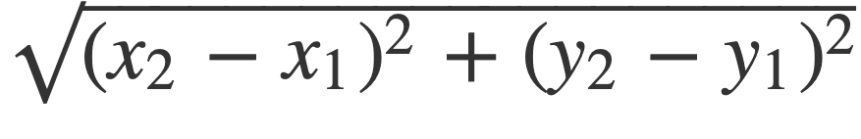
Speed detection code breakdown
Detect
Track
Speed
OCR
# Function to estimate speed in km/hr using ppm
def estimateSpeed(location1, location2, frame_rate):
d_pixels = math.sqrt(math.pow(location2[0] - location1[0], 2) + math.pow(location2[1] - location1[1], 2))
d_meters = d_pixels / PPM
speed = d_meters * frame_rate * 3.6 / TRACKER_FRAME_CHECK_INTERVAL
return round(speed, 1)
m/s → km/hr

Slide 16
Detailed description of procedure
Detect
Track
Speed
OCR
4. Car plate recognition
If vehicle speed is detected to be above speed limit set, take a picture of the car
Compensate for car plate orientation, size, brightness, and contrast
Segment individual characters on the car plate
Optical Character Recognition (OCR) is used to extract the alphanumerics of the license plate
The vehicle plate number and its detected speed shall be logged in a database

Slide 17
Car plate recognition code breakdown
Detect
Track
Speed
OCR
# Plate region of interest
roi = input_image[plate_box[1]:plate_box[3], plate_box[0]:plate_box[2]]
# Perform OCR using EasyOCR
ocr_results = easyocrReader.readtext(image=roi, decoder='greedy', add_margin=0.1, allowlist='ABCDEFGHIJKLMNOPQRSTUVWXYZ0123456789', paragraph=False)
# pytesseract_config
pytesseract_config = '--oem 3 --psm 6 -c tessedit_char_whitelist="ABCDEFGHIJKLMNOPQRSTUVWXYZ0123456789"'
# Perform OCR using PyTesseract
predicted_result = pytesseract.image_to_string(roi, lang='eng', config=pytesseract_config)
# Get OCR result from ALPR-SDK
plate_number = alpr_output['plates'][0].get('text', None)
Get plate’s region of interest
OCR using EasyOCR
Filter characters
OCR using PyTesseract
OCR result from ALPR-SDK

Slide 18
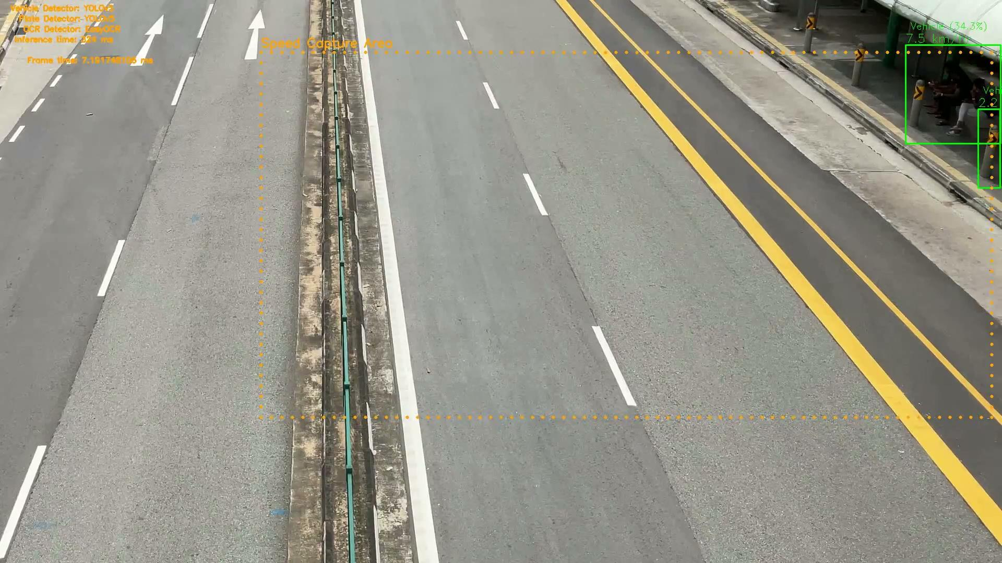
Demo
Vehicle detector:
YOLOv5
Plate detector:
YOLOv5
OCR:
EasyOCR
Notes:
traffic_both_1_output.mp4

Slide 19
Results
speed | plate_number | ocr_confidence | vehicle_confidence | plate_confidence
42.6 | 77285 | 11.1 | 71.7193901538849 | 27.8428703546524
37.3 | 5H14636 | 16 | 63.5352611541748 | 32.7839374542236
34.8 | 5797297 | 21.4 | 42.2741949558258 | 29.8604041337967
33.9 | SNHEOZET | 24.1 | 28.2537281513214 | 25.1484721899033
32.7 | 162825 | 54.6 | 41.5068298578262 | 31.4131796360016
30.9 | GBB64B1X | 50.3 | 79.8569858074188 | 50.2701461315155
30.6 | 6818C | 89.9 | 46.9869554042816 | 63.4440064430237
28.2 | SLP4178T | 27.7 | 70.8324253559113 | 25.3625452518463
27.6 | JE | 56.4 | 26.7004936933517 | 25.9304583072662
22.3 | SJT9E | 9.7 | 27.2349685430527 | 56.7676842212677
22.3 | 55655 | 83.9 | 51.7306447029114 | 42.1942830085754
Vehicle detector:
YOLOv5
Plate detector:
YOLOv5
OCR:
EasyOCR
Notes:
traffic_both_1_output.mp4

Slide 20
Limitations
Likely to perform badly in poor visibility conditions (night, rain)
Algorithm for calculating speed could be improved to increase accuracy
Small size of motorcycle license plate make it hard to detect and perform OCR on to get alphanumerics
Even the commercial ALPR-SDK does not seem to be able to correctly obtain the license plate of all the vehicles
The frame rate during runtime is quite bad due to the many loops in the ANPR algorithm implemented. The developers of the ALPR-SDK does not recommend to use python for video format inputs because python loops are notoriously slow compared to other languages.

Slide 21
Libraries & Softwares
Main libraries
Opencv
Dlib
EasyOCR
PyTesseract
PyTorch
YOLOv5
ALPR-SDK
Processing data
Google Open Images v7
Land vehicle
Vehicle registration plate
OIDv4 Toolkit
Numpy
Pandas
JSON
Shell script
ClearML
Wandb
DaVinci Resolve
Github repository for this project: https://github.com/ZivLow/esp3201-anpr
This project has been tested to run on Ubuntu 22.04 LTS.

Slide 22
Thank you

Slide 23
Additional Demo Videos

Slide 24
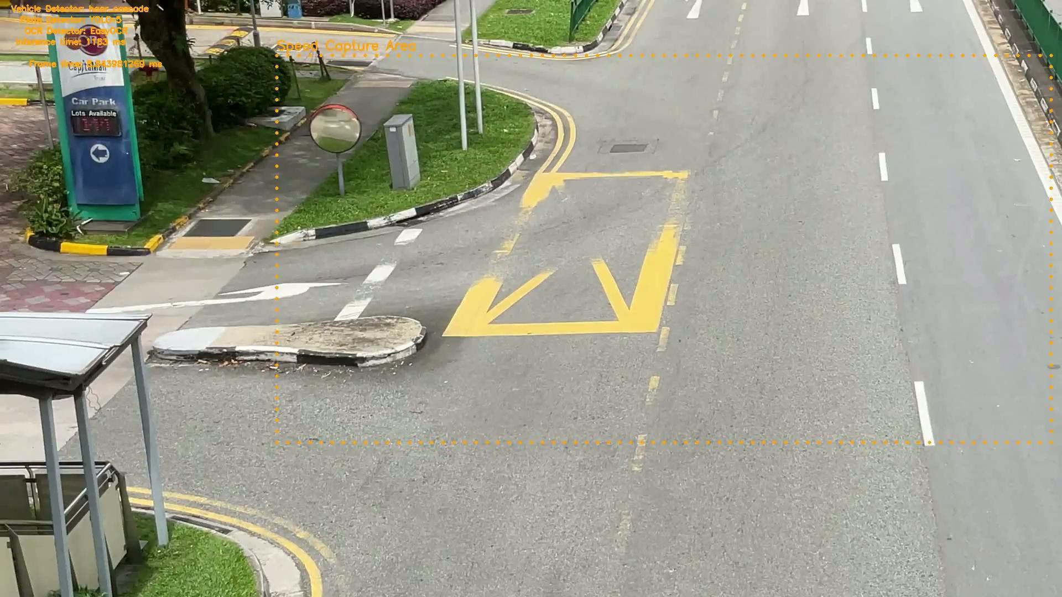
Demo
Vehicle detector:
Haar Cascade
Plate detector:
YOLOv5
OCR:
EasyOCR
Notes:
traffic_departing_2_output.mp4

Slide 25
Results
speed | plate_number | ocr_confidence | vehicle_confidence | plate_confidence
48.3 | SL496H | 56.8 |  | 43.6367630958557
42.4 | SCDGL | 64.5 |  | 56.7626714706421
38.1 | 50900 | 76.8 |  | 42.5362288951874
20.2 | LM9GW | 9.5 |  | 65.0614440441132
18.2 | SLX794701 | 60.2 |  | 27.2757023572922
16.1 | ISLE4505R | 68.8 |  | 28.6736279726028
15.3 | 29080 | 78.8 |  | 30.4684817790985
13.5 | 50 | 41 |  | 55.406266450882
Vehicle detector:
Haar Cascade
Plate detector:
YOLOv5
OCR:
EasyOCR
Notes:
traffic_departing_2_output.mp4

Slide 26
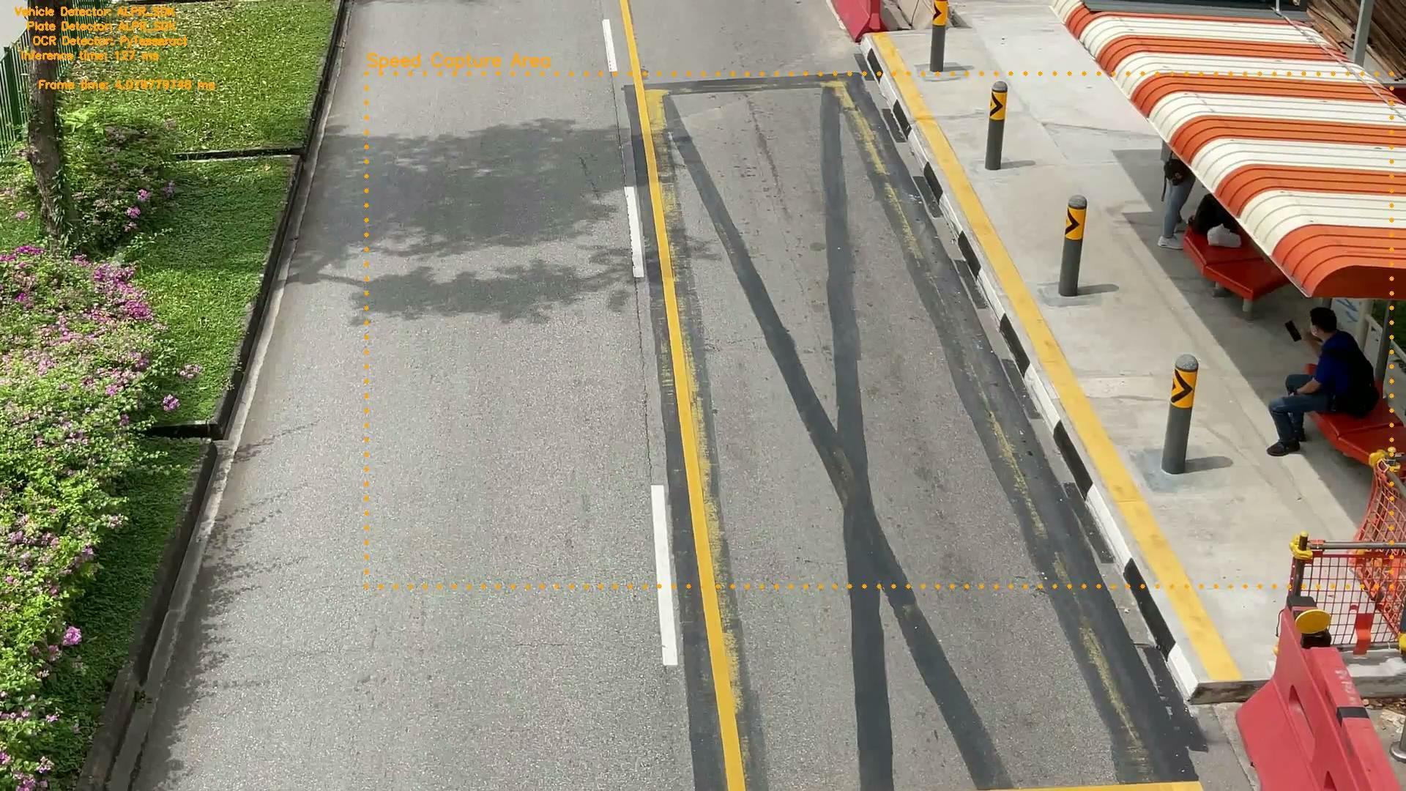
Demo
Vehicle detector:
ALPR-SDK
Plate detector:
ALPR-SDK
OCR:
PyTesseract
Notes:
traffic_oncoming_1_output.mp4

Slide 27
Results
speed | plate_number | ocr_confidence | vehicle_confidence | plate_confidence
61.7 | B | 0 | 99.85296 | 94.35342
59.9 | ISUZ | 0 | 98.67228 | 99.82504
55.9 | 1FGSBE3947 | 9 | 99.99857 | 68.59962
55.5 | SEE | 28 | 56.332 | 97.55537
55.2 | S | 0 | 99.8329 | 42.02955
53.9 | P | 0 | 35.92524 | 33.43075
52 | GO | 0 | 99.42055 | 97.22839
51.6 | NSIS | 17 | 92.75725 | 91.07891
50.8 | IGBBESU4X | 18 | 88.74494 | 99.99937
49 | SM | 25 | 68.827 | 57.04421
47.5 | SU | 0 | 67.90395 | 99.99997
46.8 | S | 0 | 86.86793 | 94.51488
45.4 | SSSEEOO | 8 | 82.09047 | 99.99999
Vehicle detector:
ALPR-SDK
Plate detector:
ALPR-SDK
OCR:
PyTesseract
Notes:
traffic_oncoming_1_output.mp4

Slide 28
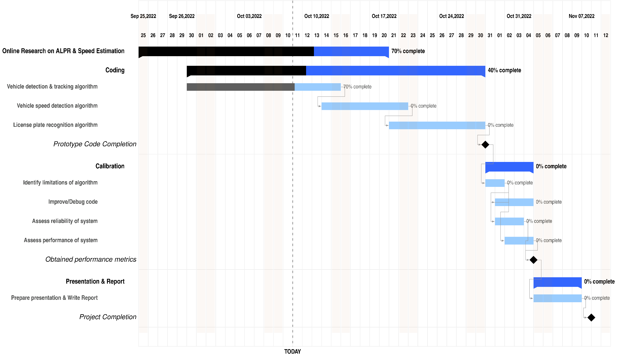
Plan

