Slide 1

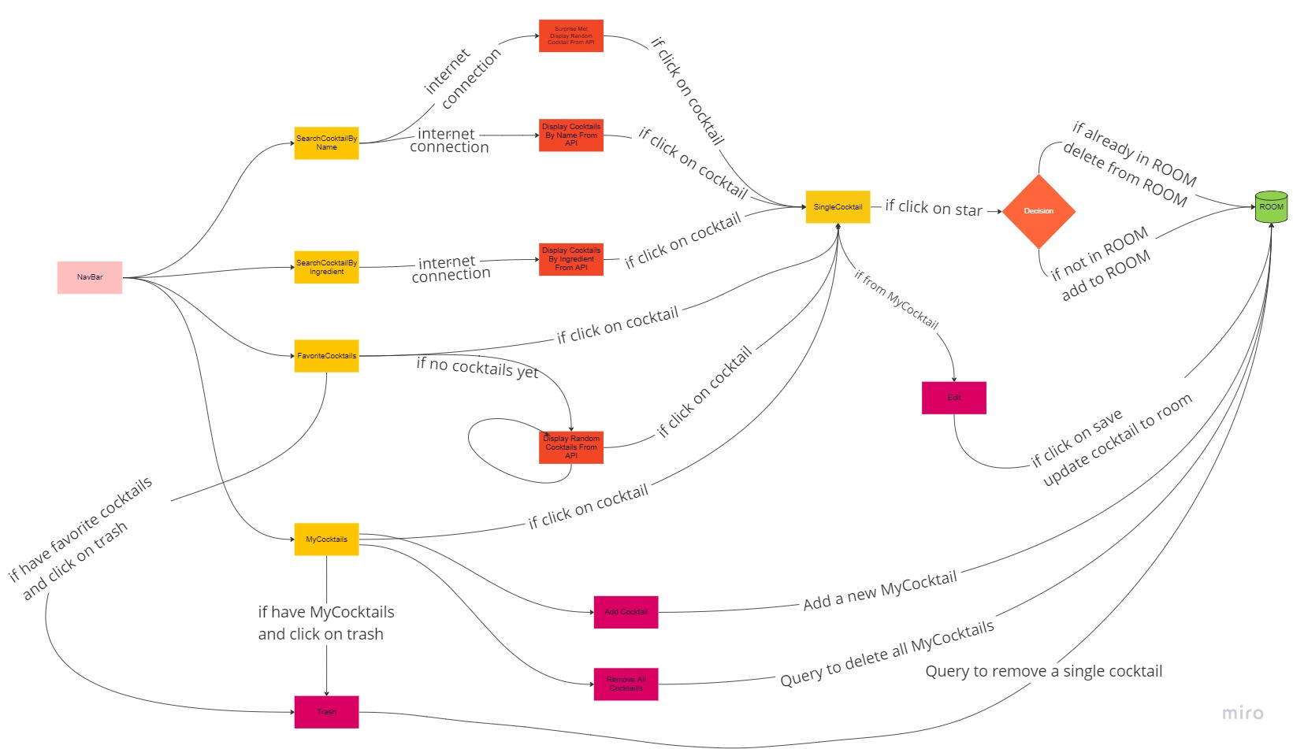
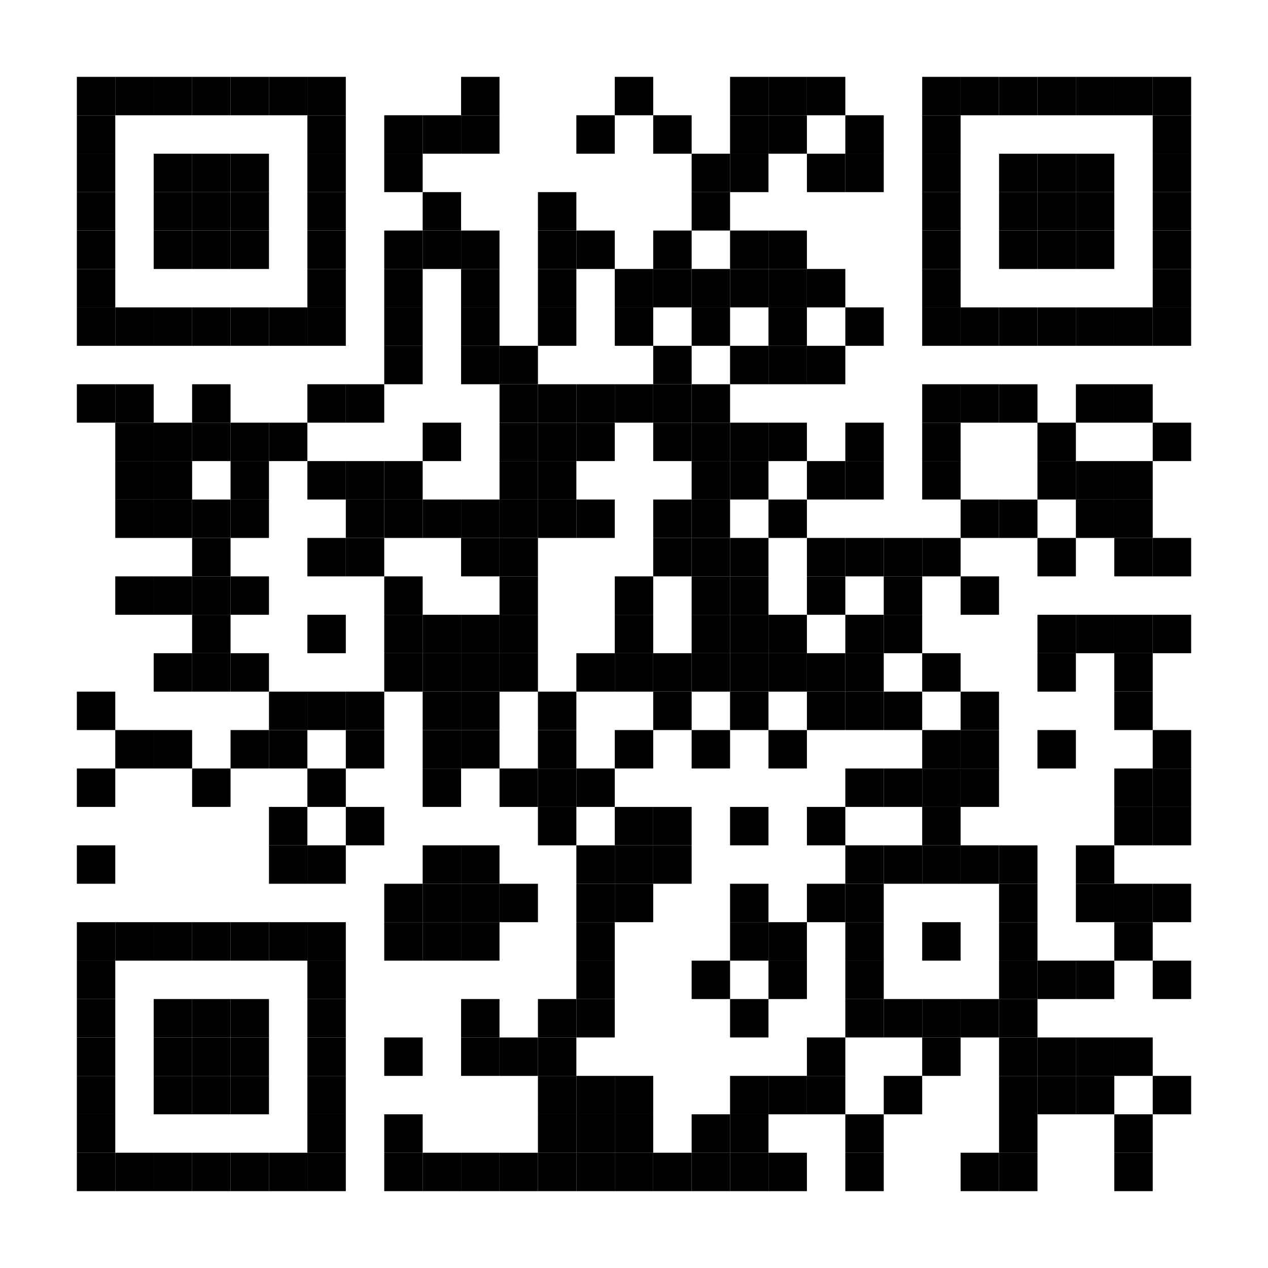
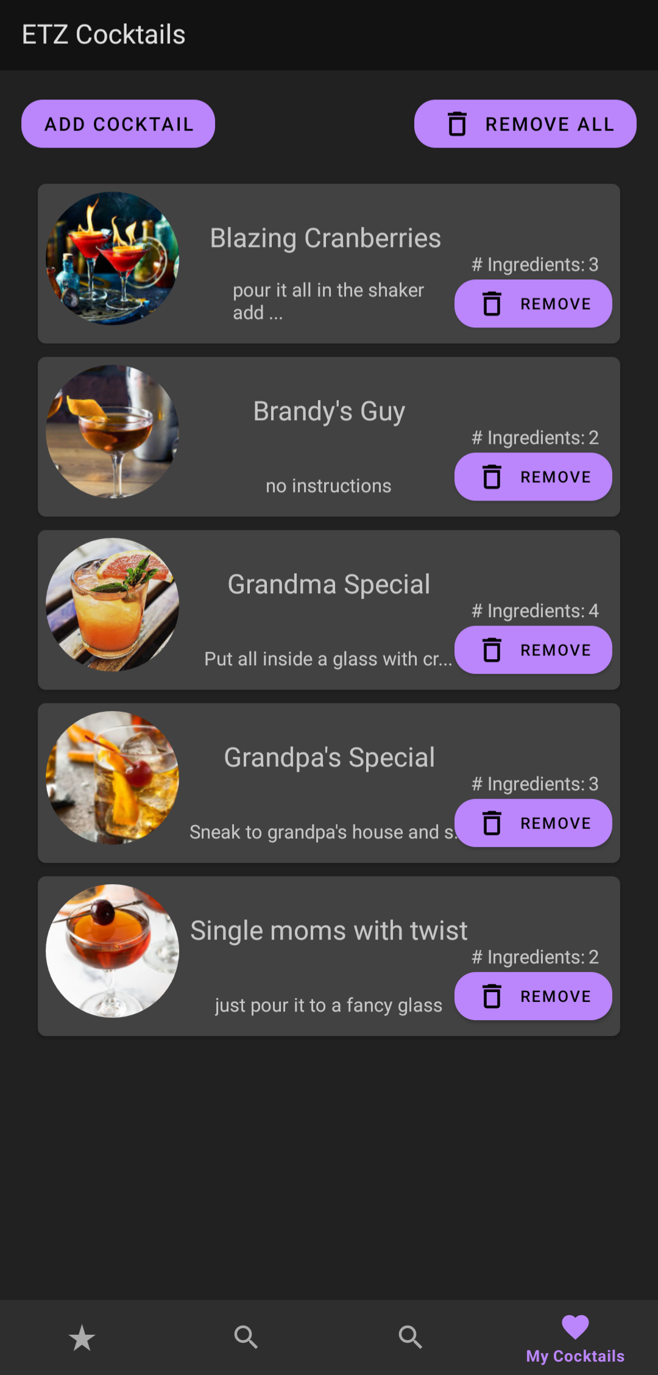
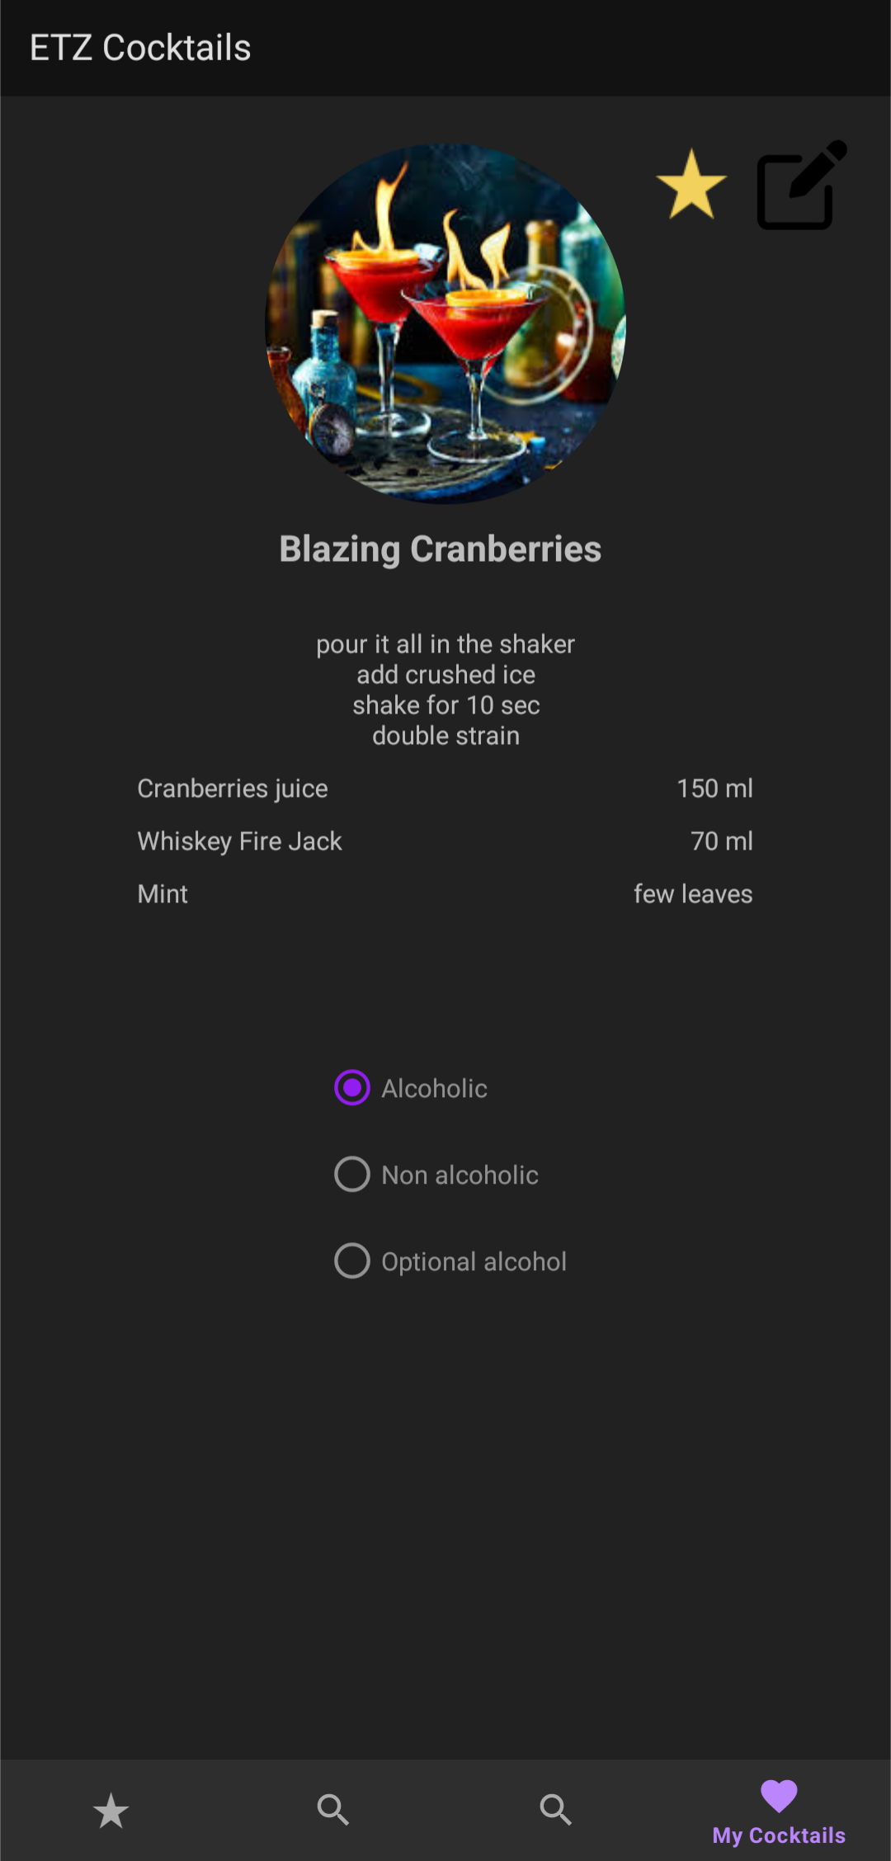
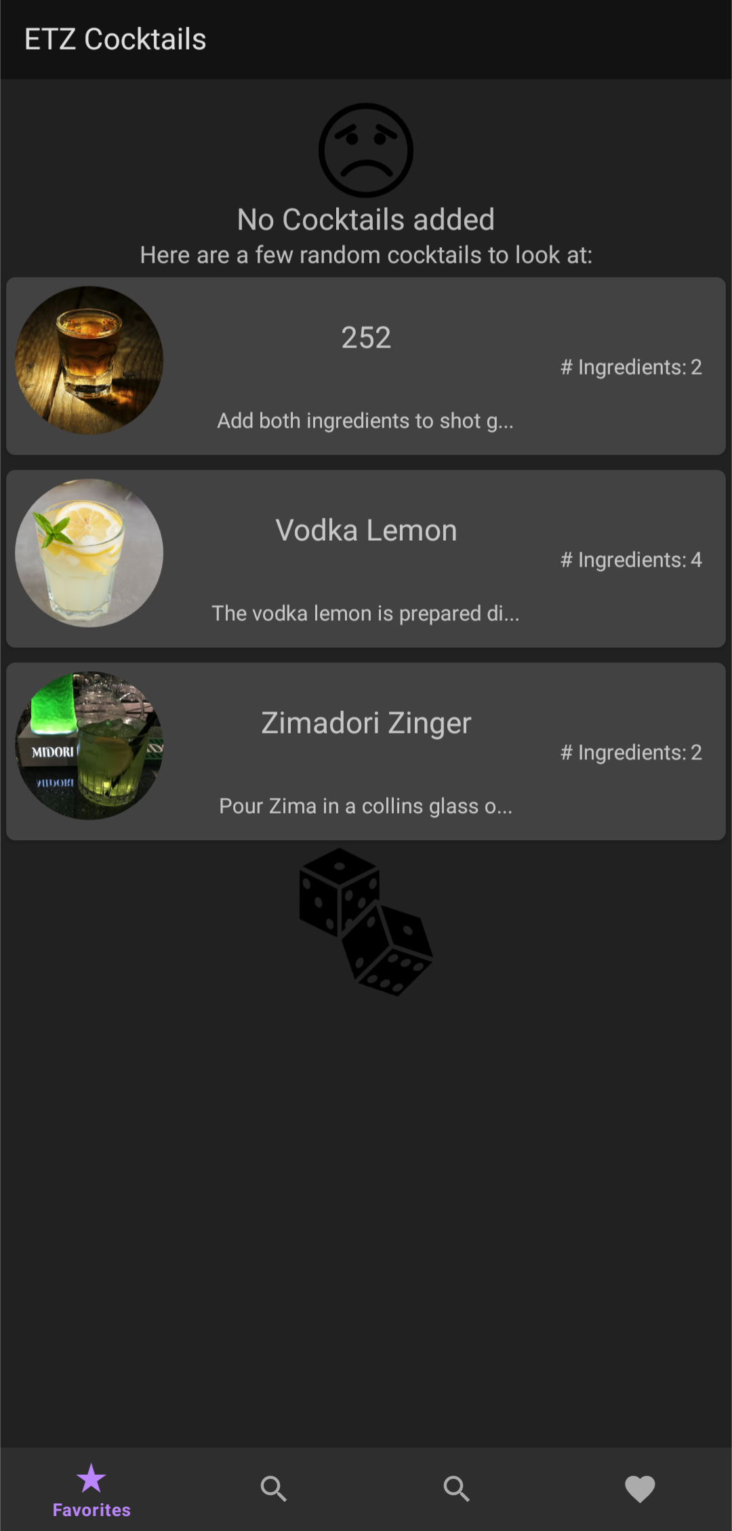
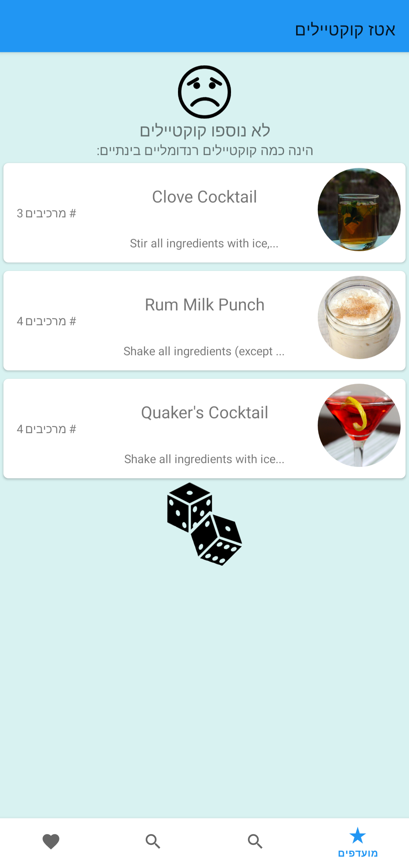
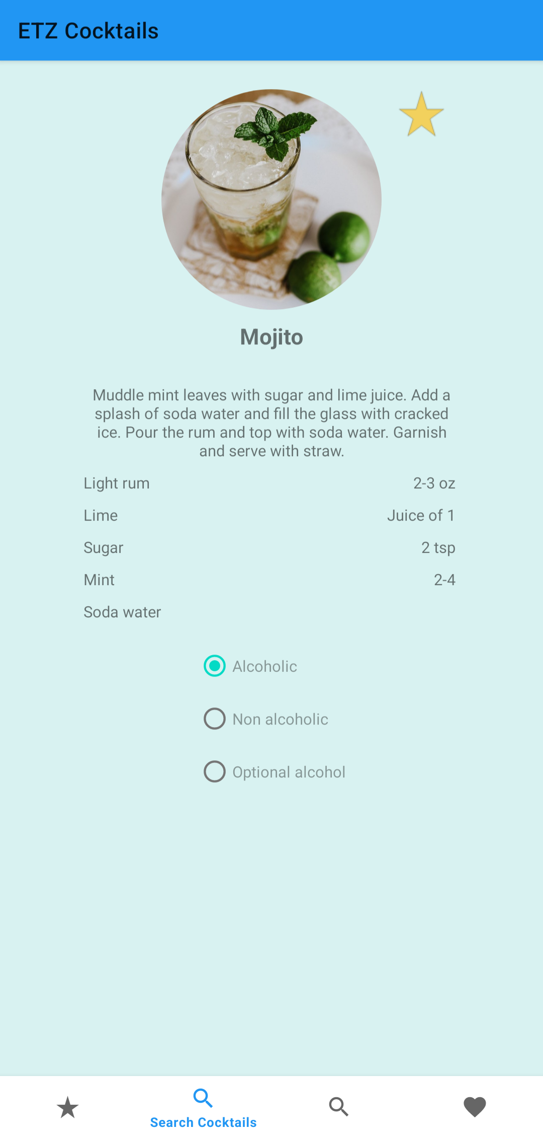
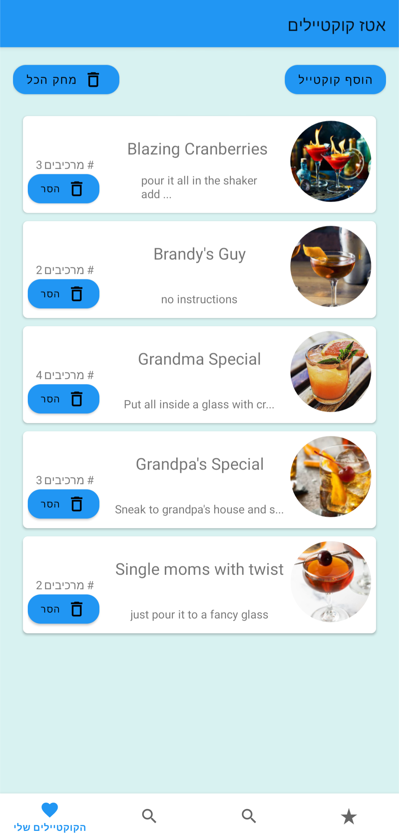
Android App Development in Kotlin | ETZ Cocktails Eytan Rahlin, Tony Hasson, Ziv Simchoni 2023, Semester A – תשפ"ג, סמסטר א
Eran Katsav
Introduction
ETZ Cocktails is a fun and easy-to-use Android app for anyone who loves cocktails. The app allows users to search for cocktail recipes by name or ingredient, add their own custom recipes, and save their favorite cocktails for quick and easy reference. With a user-friendly interface and a comprehensive database of cocktail recipes, ETZ Cocktails is the perfect app for mixologists, bartenders, and anyone who loves to shake up a good drink. Built using the MVVM architectural pattern and a variety of Android Jetpack components, the app is fast, reliable, and easy to navigate. Whether you're a seasoned bartender or just getting started, ETZ Cocktails is the perfect app to help you discover new and exciting drinks.
The app works both online and offline.
Goals And Objectives
Our objective was to develop a user-friendly app that enables users to easily create and discover new cocktails, as well as search for and save their favorite drinks from an extensive database. Despite the missing feature of online sharing, which we hope to incorporate in future updates, we are proud to have successfully achieved our goals and provide a seamless cocktail-making experience for our users.
Functional Diagram
Possible Future Implementations
Social sharing features: allowing users to share their favorite cocktails on social media platforms and enabling other users to try and rate these cocktails.
Expansion of the database: adding more cocktail recipes to the database, as well as including information about the history and origin of each cocktail, creating an educational and informative experience for users.
Personalization: allowing users to personalize their experience, such as creating a profile, setting up their preferences, and saving their favorite cocktails, leading to a more tailored experience for the user.
Youtube QR
GITHUB link

