Slide 1

PAPER·READ

Slide 2
一、LOCSTEPA: Logic-Simulation-Based Test Generation Procedure
Find out characteristics
studied the test sequences generated by several deterministic test generation procedures. under these test sequences, the fault-free circuits go through sequences of state transitions that have distinct characteristics.
Test generation using those charcteistics
using logic simulation on the fault-free circuit and considering a number of random patterns as candidates for inclusion in the test sequence at every time unit. make the fault-free circuit go through a sequence of state transitions that has characteristics
very similar to the sequence of state transitions it goes through under deterministic test sequences

Slide 3
Guidelines
From test generation sequences, get 5 guidelines:
Guideline 1: Generate an imitation test sequence that
brings the fault-free circuit into as many different states as
possible.
Guideline 2: If no new states can be reached, generate the
imitation test sequench such that it repeats the states already
reached before in the order they were reached for the first time.
Guideline 3: When it is impossible to reach a new state or
repeat a preceding sequence, select the lowest index state that
can be reached.
Guideline 4: When it is impossible to reach a new state
or repeat a preceding sequence, select a state that has been
visited a minimum number of times. if a choice exists, select
the lowest index state.
Guideline 5: Generate an imitation test sequence using as
many different total states as possible.

Slide 4
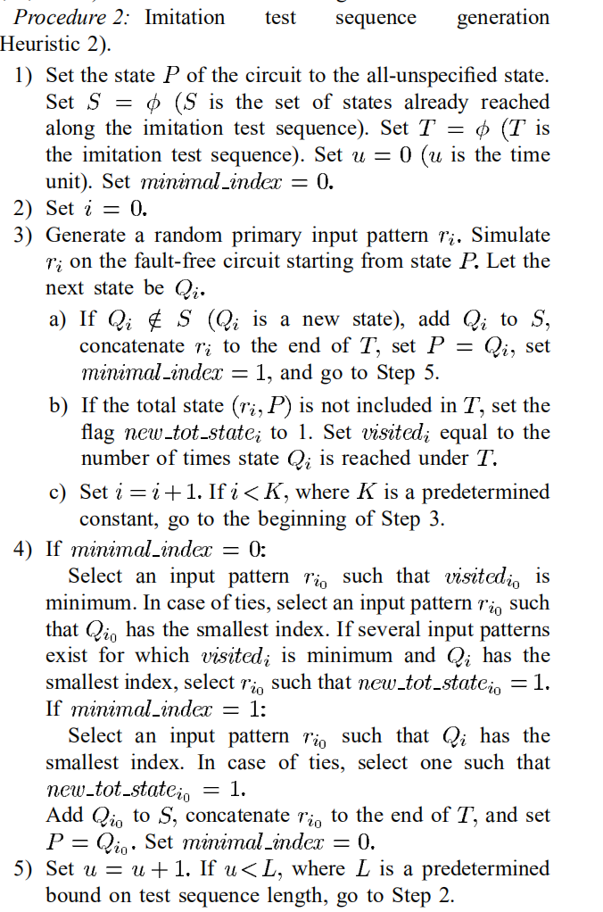
Procedures
procedure1:based on Guidelines 1,2, 4, and 5
procedure2:based on Guidelines 1,2, 3, and 5(as right)
procedure3:in order to generate thest sequences of length L, fisrtly, generating individual sequence of length ∆ by using procedure1, and repeat L/∆ times，and then concatenate
procedure4:same to procedure3 but generating individual sequence by using procedure2

Slide 5
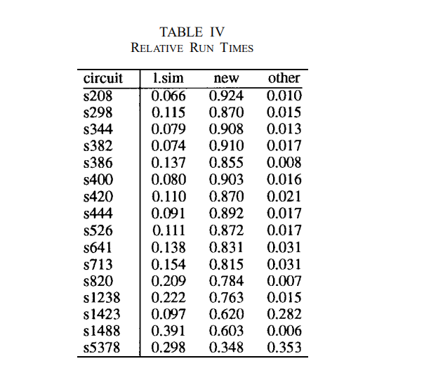
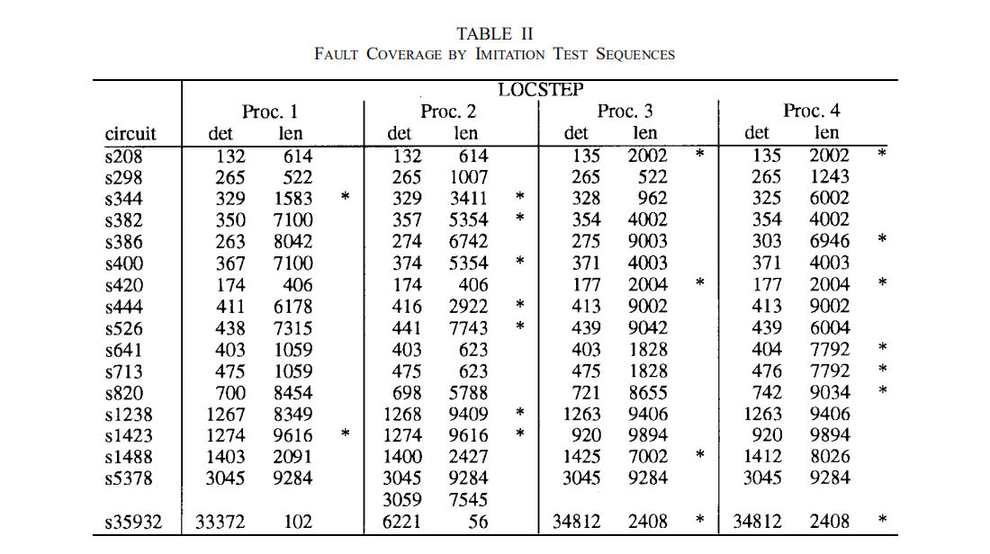
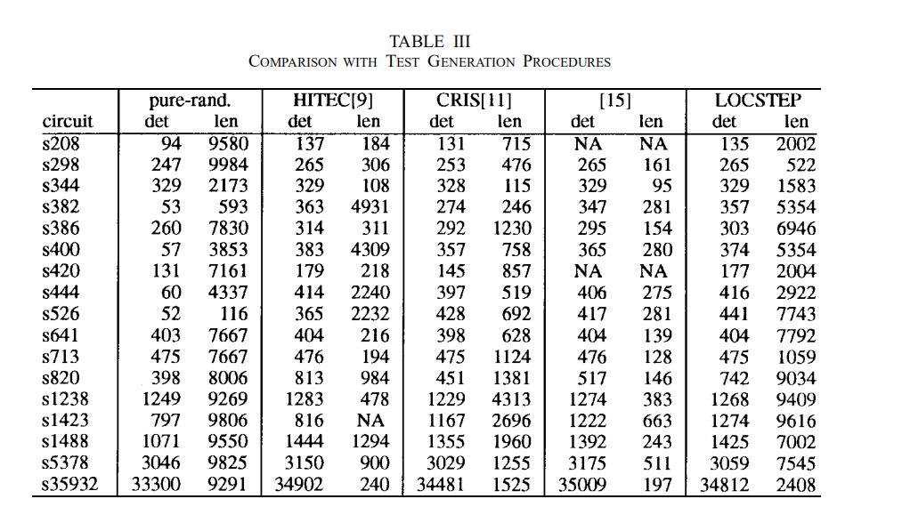
Experimental Result
the fault coverage of LOCSTEP is always better than that of pure random patterns. It is close to and sometimes even higher than the fault coverage of HITEC. It is higher than the fault coverage of [11] in most cases, and higher than [15] in many of the circuits.

Slide 6
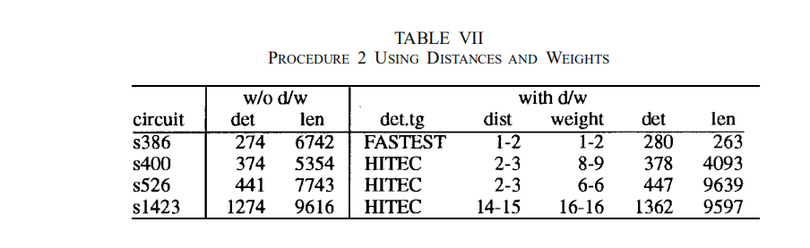
Distance and Weight Information
The distance between consecutive states and consecutive input patterns (the distance between two vectors v1 and v2 is the number of bits where v1 and v2 are specified to
opposite {0,1} values).
The weights of the states and input patterns (the weight of a vector v is the number of bits specified to 1 in v).
By add d/w restrition, fault coverage and sequences length is more effective

Slide 7
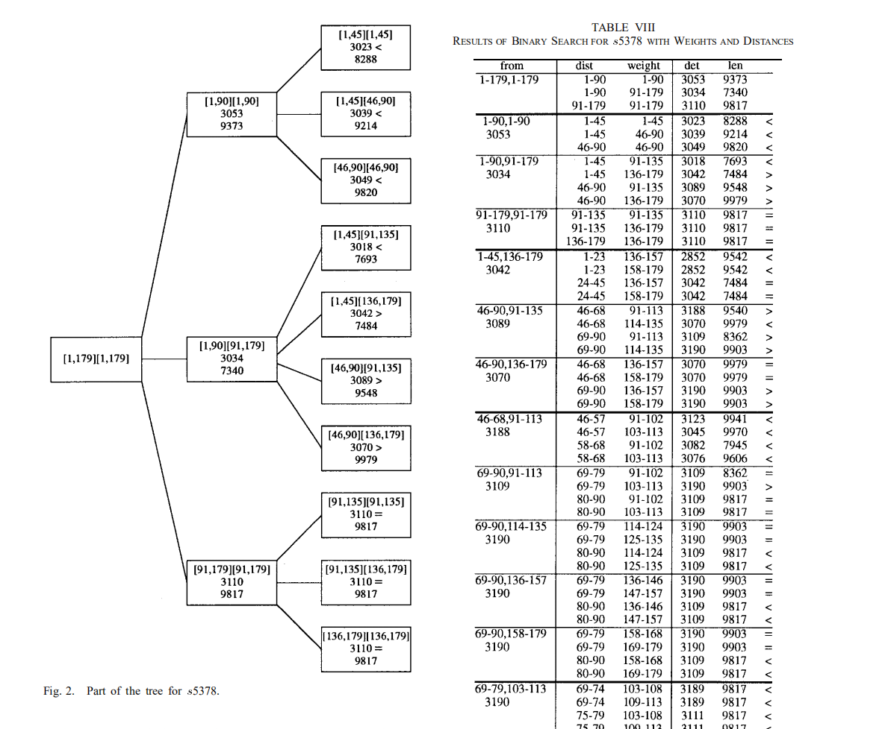
Selection of appropriate weight and distance
selected based on a deterministic test sequence for a subset of the faults

Slide 8
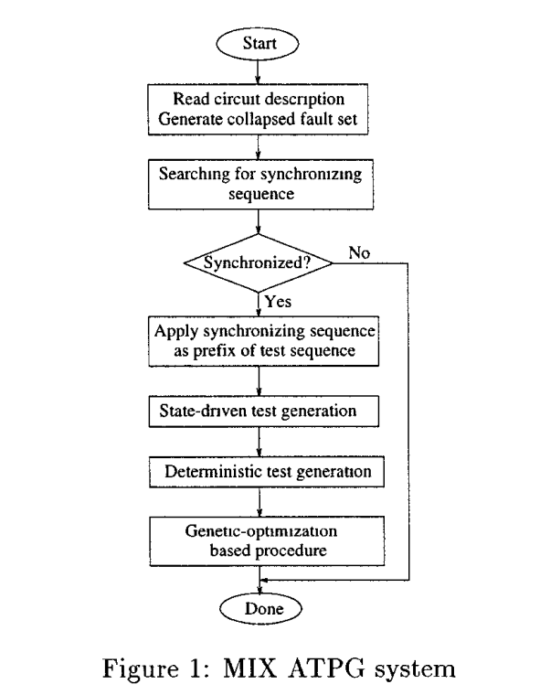
二、MIX : A Test Generation System for
Synchronous Sequential Circuits
combines sev_x0002_eral test generation approaches to derive test sequences exhibitang very high fault coverages at relatively low CPU times
a large number of dafferent approaches is used to attack faults with different characterastics
Several new technaques are incorporated into MIX

Slide 9
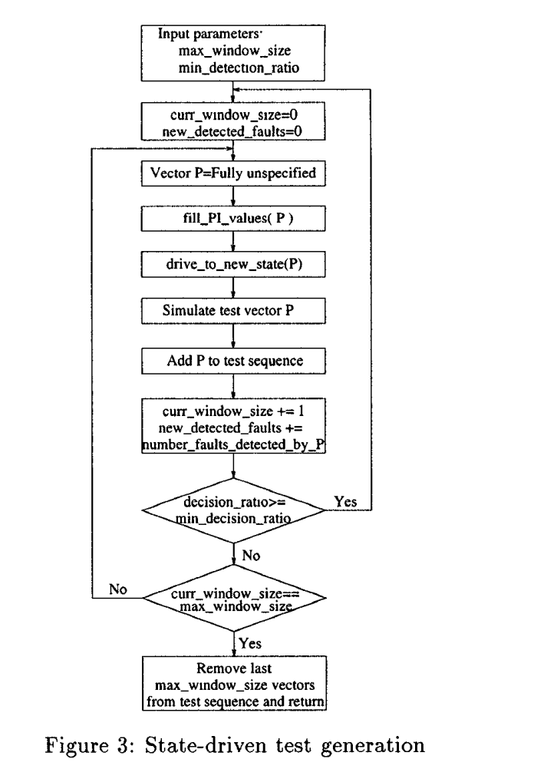
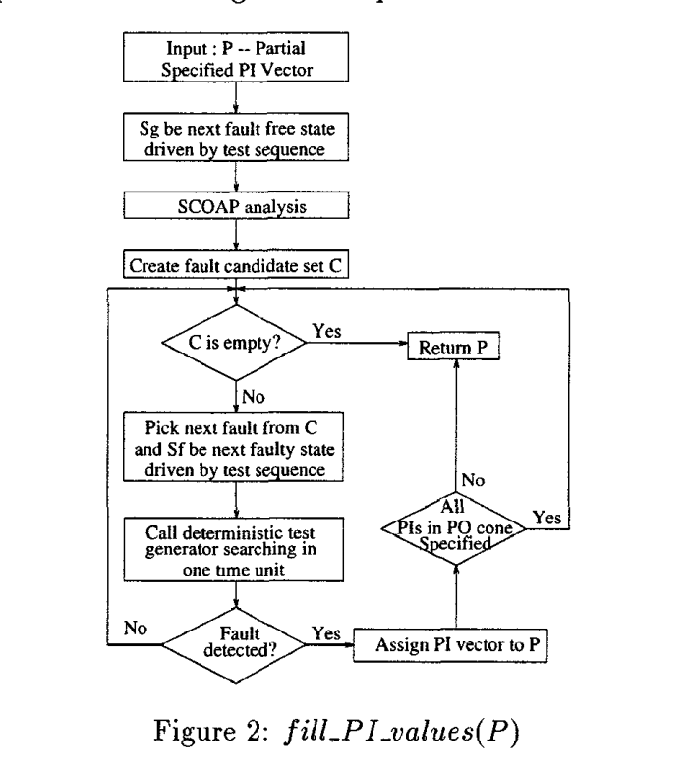
State-Driven Test Generation
Based on LOCSTEP, generating a sequence T of a fixed length L, but fill_PI_values() is used to determine input patern

Slide 10
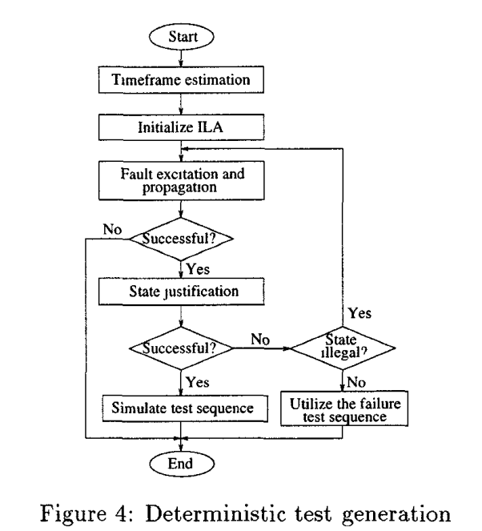
Deterministic Test Generation

Slide 11
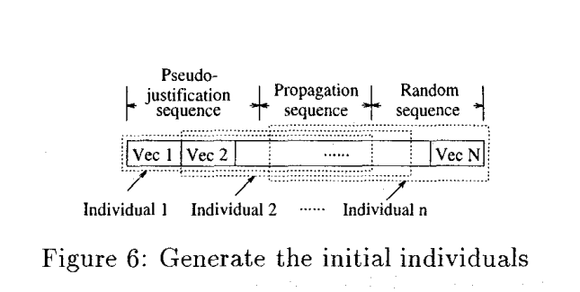
Genetic-Optimization Based Phase
concatenate the pseudo justification sequence with the propagation sequence of the fault(as right)
use the sequence to seed the genetic-optimization based test generation procedure
the genetic-optimization procedure is then called to create the best possible individual

Slide 12
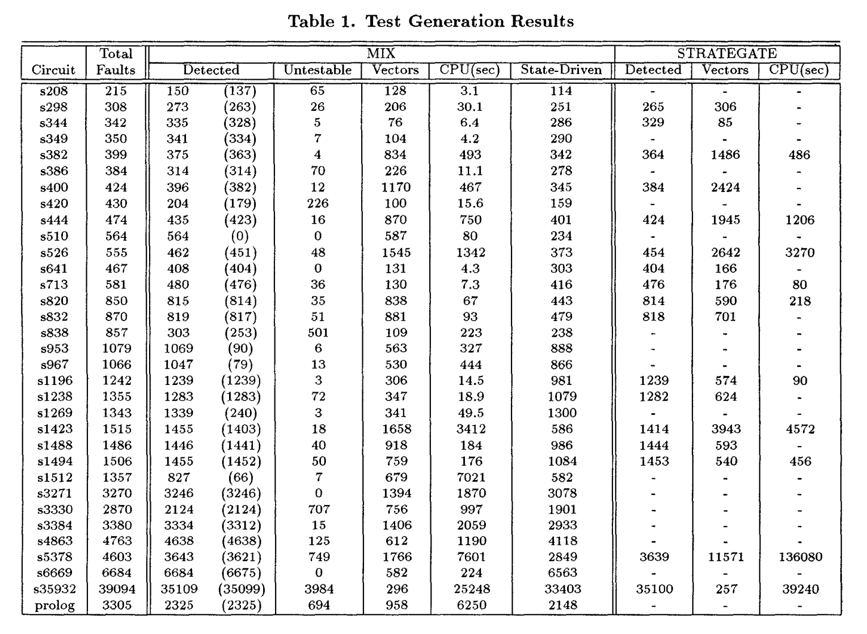
Result
MIX detects at least as many faults as STRATEGATE for all the circuits. For circuits s510 and s953 that cannot be synchronized using three-value simulation, MIX achieves the same fault coverage.

Slide 13
三、Forecasting the Efficiency of Test Generation Algorithms for Digital Circuits
To generate a test set for a given circuit (including
both combinational and sequential circuits), choice of an algorithm within a nirinber of existing test generation algorirhrns to apply is bound to vay from circuit to circuit.
the genetic algorithins are used to construct the models of existing test generation algorithins in rimking such choice more easily.
develop a Genetic Algorithm Forecasting Model (GAFM) in this paper using some ideas given in the relevant materials to model some well_x0002_known test pattern generation algorithms.

Slide 14
High Efficiency Parameters
TP:there should be less test patterns (TP) produced by the algorithm than by others
FC:the higher fault coverage (FC) should obtain by using these test patterns
TCPU:there should have relatively short CPU rime (TCPU) on which the algorithm will spend when running(Not consideration)

Slide 15
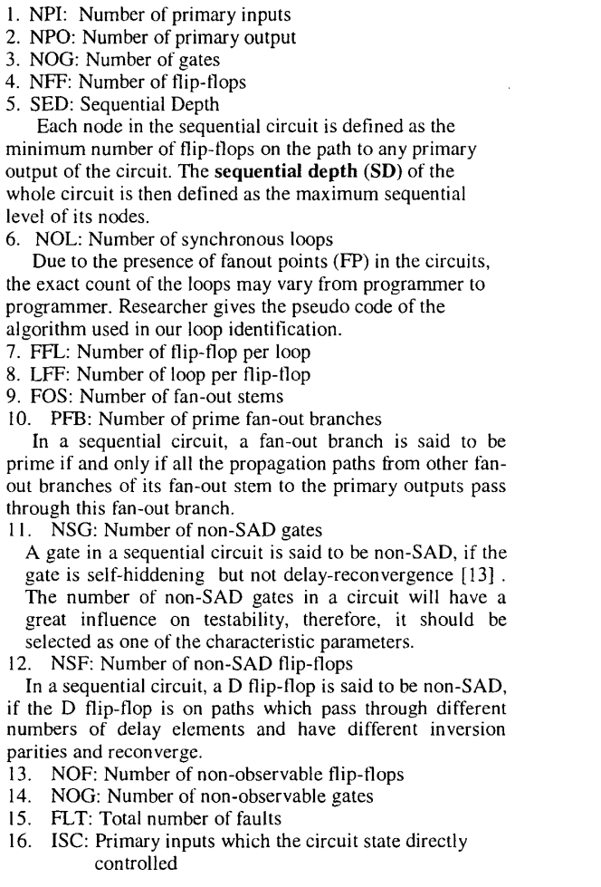
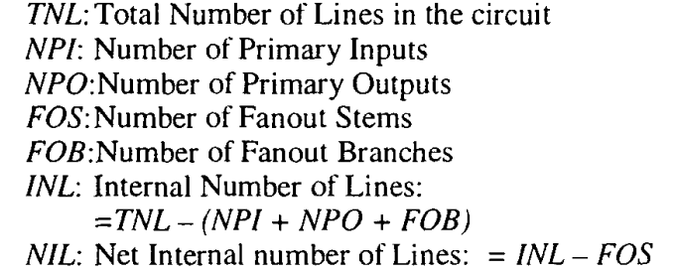
Characteristic defination
Combinational circuit
Sequential circuit

Slide 16

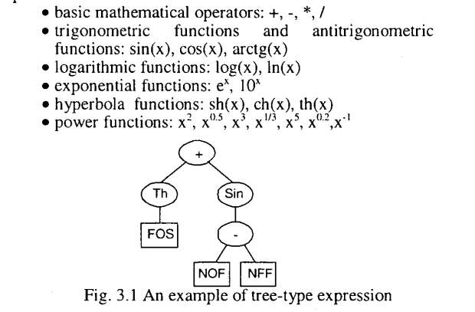
GAFM
Difination
Individual: In genetic algorithms, an individual is the representation of a potential solution to a given problem
Sample space: All individuals constitute a sample space.
Genes: A function hereditary unit that occupies a fixed location on a individual, has a specific influence on phenotype, and is capable of mutation to various allelic forms
Initial Population
Individuals at the 1st population are randomly generated by the system
employs a “top-down” method when generating a random expression to prevent system from generating trees that arc too complex to run
Fitness evaluation
Representation of individual
e(i,j) is the Forecasted Values testability parameter of j'th circuit for i'th individual
a(j) is the actual testability parameter of j'th circuit and f(i) reprent the i'th fitness
Genetic operation
crossover
mutation

Slide 17
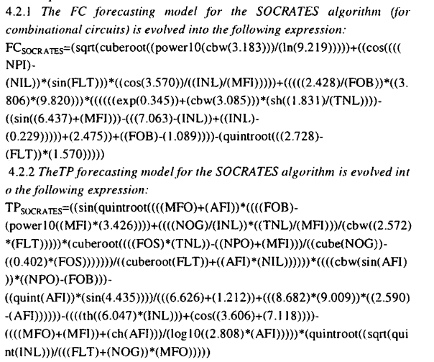
Experimental Results
generate FC and TP forecasting model for giving algorithm

Slide 18
THANKS

