Slide 1
10.1a: Basic Idea
Combine input information in a complex & flexible neural net “model”
Model “coefficients” are continually tweaked in an iterative process
The network’s interim performance in classification and prediction informs successive tweaks

Slide 2
10.2a: Network Structure
Multiple layers
Input layer (data get fed)
Hidden layers
Output layer
Nodes
Weights (like coefficients, subject to iterative adjustment)

Slide 3
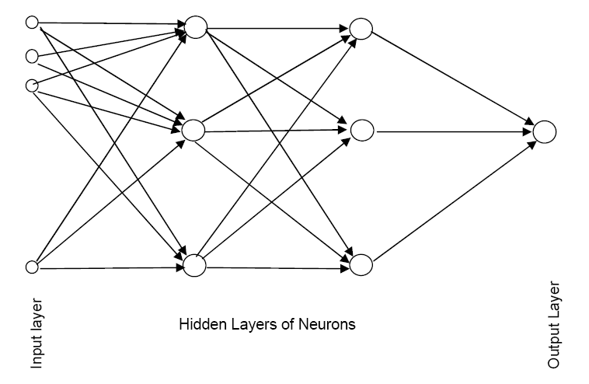
10.2a: Schematic Diagram

Slide 4
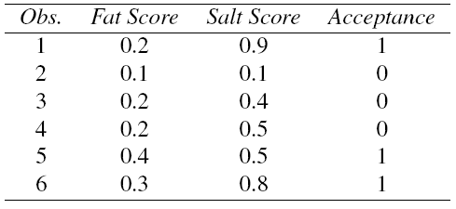
10.3a: Example – Salt & Fat Content in Cheese - Tiny Data

Slide 5
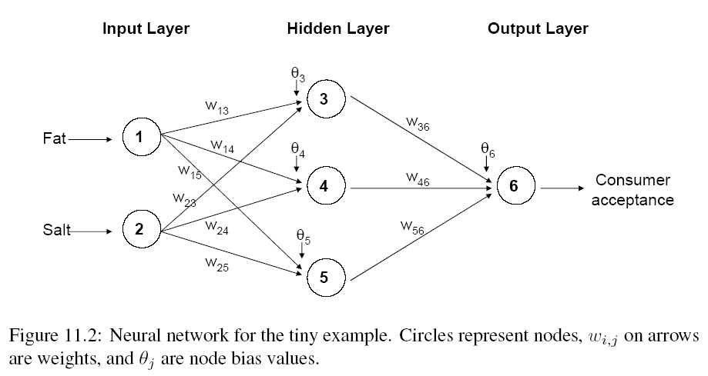
10.3a: Example – Using fat & salt content to predict consumer acceptance of cheese

Slide 6
10.4a: The Input Layer
0.2
0.2
0.2
0.2
0.9
0.9
0.9
0.9

Slide 7
10.5a: The Hidden Layer

Slide 8
10.5a: The Weights
The weights θ (theta) and w are typically initialized to random values in the range -0.05 to +0.05
Equivalent to a model with random prediction (in other words, no predictive value)
These initial weights are used in the first round of training

Slide 9
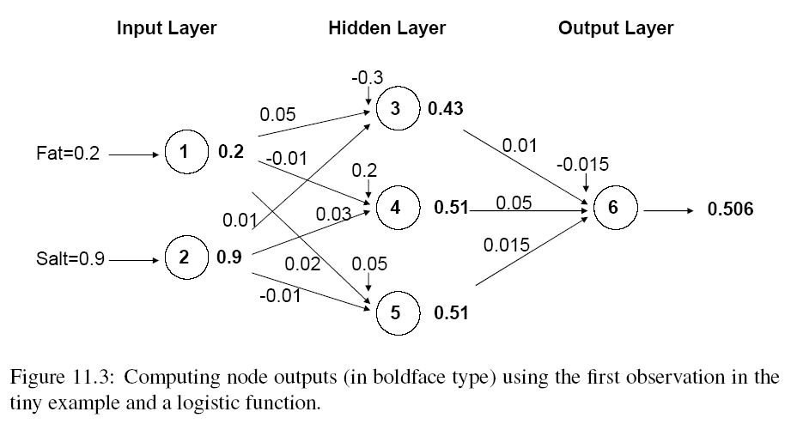
10.5a: Initial Pass of the Network

Slide 10
10.5a: Output of Node 3, if g is a Logistic Function

Slide 11
10.6a: The output node

Slide 12
10.6a: Output Layer
Use same function used in the hidden layer, i.e. a function g of the weighted average

Slide 13
10.6a: Mapping the output to a classification
Output = 0.506
If cutoff for a “1” is 0.5, then we classify as “1”

Slide 14
10.7a: Relation to Linear Regression
* No Hidden Layer
* One Output Node
* Activation Function – Identity Function

Slide 15
10.8a: Preprocessing Steps
Scale variables to 0-1
Categorical Predictors
Create dummy variables
If equidistant categories, map to equidistant interval points in 0-1 range
Transform (e.g., log) skewed variables

Slide 16
10.9a: Initial Pass Through Network
Goal: Find weights that yield best predictions
The process we described before is repeated for all records
At each record, compare prediction to actual
Difference is the error for the output node
Error is propagated back to the architecture to update the weights

Slide 17
10.9a: Back Propagation (“back-prop”)
Output from output node k:
Error associated with that node:
Note: this is like ordinary error, multiplied by a correction factor
Multiplier
Error

Slide 18
10.9a: Error is Used to Update Weights
l = constant between 0 and 1, reflects the “learning rate” or “weight decay parameter”

Slide 19
10.10a: Case Updating
Weights are updated after each record is run through the network
Completion of all records through the network is one epoch (also called sweep or iteration)
After one epoch is completed, return to first record and repeat the process

Slide 20
10.10a: Batch Updating
All records in the training set are fed to the network before updating takes place
In this case, the error used for updating is the Average of all errors from all records

Slide 21
10.10a: Why It Works
Big errors lead to big changes in weights
Small errors leave weights relatively unchanged
Over thousands of updates, a given weight keeps changing until the error associated with that weight is negligible, at which point weights change little

Slide 22
10.11a: Common Criteria to Stop the Updating
When weights change very little from one iteration to the next
When the misclassification rate/prediction accuracy reaches a required threshold
When a limit on runs is reached

Slide 23
10.11a: Avoiding Overfitting
With sufficient iterations, neural net can easily overfit the data
To avoid overfitting:
Track error in validation data
Limit iterations
Limit complexity of network

Slide 24
10.12a: Specify Network Architecture
Number of hidden layers
Most popular – one hidden layer
Number of nodes in hidden layer(s)
More nodes capture complexity, but increase chances of overfit
Number of output nodes
For classification, one node per class (in binary case can also use one)
For numerical prediction use one

Slide 25
10.12a: Network Architecture, cont.
“Learning Rate” (l)
Low values “downweight” the new information from errors at each step.
This slows learning, but reduces the tendency to move out of local structure
“Momentum”
High values keep weights changing
Moves out of local structures quickly

Slide 26
10.13a: Advantages
Good predictive ability
Can capture complex relationships
No need to specify a model

Slide 27
10.13a: Disadvantages
Considered a “black box” prediction machine, with no insight into relationships between predictors and outcome
No variable-selection mechanism, so you have to exercise care in selecting variables
Heavy computational requirements if there are many variables (additional variables dramatically increase the number of weights to calculate)

Slide 28
10.13a: Summary
Neural networks can be used for classification and regression
Can capture a very flexible/complicated relationship between the outcome and a set of predictors
The network “learns” and updates its model iteratively as more data are fed into it
Major danger: overfitting
Requires large amounts of data
Good predictive performance, yet “black box” in nature

