Slide 1
PA Assignment 1

Slide 2
Table of Content
HR Analytics (classification problem)
Data exploration
Data cleansing & Transformation
Correlation
Airbnb Singapore (regression problem)
Data exploration
Data cleansing & Transformation
Correlation
Summary & Further improvements

Slide 3
HR Analytics
1
Classification problem

Slide 4
HR Analytics
Human Resource (HR) uses analytics in their promotion screening operations
Data processing is laborious, placing time and resource constraints on HR
The goal is to:
Identify promotion candidates
Using predictive analytics

Slide 5
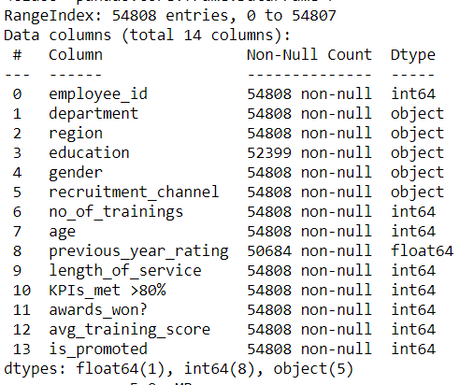
HR Data Exploration
In this dataset, there are:
14 total data columns
54808 data entries
5 categorical data columns out of 14
3 data columns with binary output
Target: “is_promoted” column

Slide 6
HR Data Exploration
Target: “is_promoted” column
 | Useless | Potentially weak | Likely strong
variables | employee_id | department region education gender recruitment_channel age length_of_service avg_training_score | Previous_year_rating KPIs_met >80% awards_won?
remarks | Serves no purpose to solve the issue | The variable could be biased due to disproportion distribution. | Straightforward indicators of promotion criteria, where actual performance matters

Slide 7
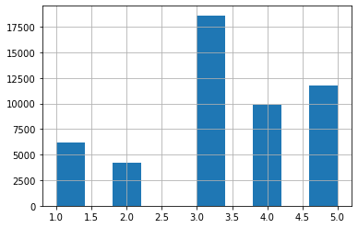
HR Data Exploration
Likely strong variable: previous_year_rating

Slide 8
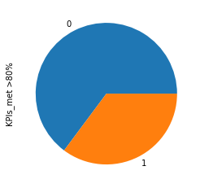
HR Data Exploration
Likely strong variable:KPIs_met >80%

Slide 9
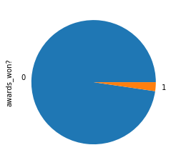
HR Data Exploration
Likely strong variable:awards_won?

Slide 10
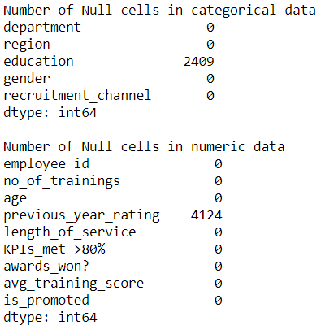
HR Data Cleansing & Transformation
NULL values:
2409 for education
4124 for previous_year_rating
Actions taken:
Assign null in education to ‘below secondary’
Drop null in previous_year_rating

Slide 11
HR Data Cleansing & Transformation
Reasons for Actions taken
Education:
The data could be useful
‘below secondary’ is bare minimum
Not justified to give out “bachelor’s” although it is the mode value
Previous_year_rating:
Null could represent the employee had just join the company
No appropriate value can be assigned

Slide 12
HR Data Cleansing & Transformation
Categorical to numeric
For the sake of correlation analysis, the 5 categorical column will have it’s value mapped to numeric values.
Column dropping
The “employee_id” column was dropped as the column was only used to uniquely identify each employee. It served no purpose towards the prediction
Notable action:
Gender is mapped to 0s and 1s, since it has binary output
Education is mapped with ordinal ranking based on the level
Department is mapped with ordinal ranking based on the count of each department from lowest to highest

Slide 13
HR Data Cleansing & Transformation
Outliers
There are outliers in some columns
However, age and length_of_service are likely not key criteria
Hence, it is left alone

Slide 14
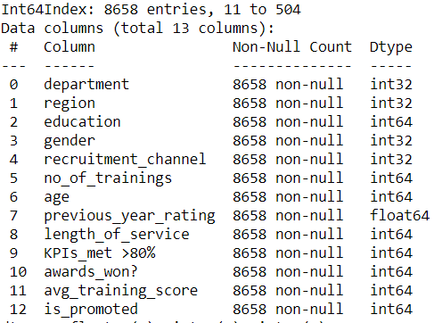
HR Data Cleansing & Transformation
Stratified sampling
The distribution of people recommended for promotion is uneven
There is a biasness with more people that is not recommended
Hence, stratified sampling is deploy to ensure fairness in the analysis
While it significantly reduces the data set, biasness has been eliminated

Slide 15
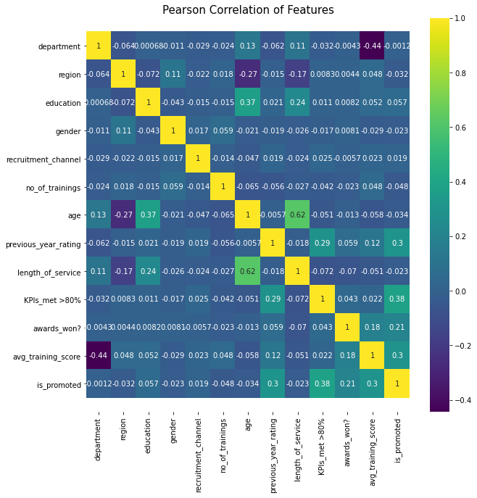

Slide 16
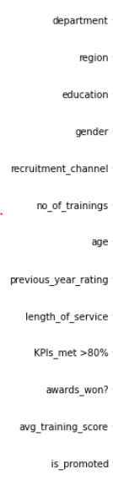
HR Correlation
Target: “is_promoted” column
Analysis:
Score ranges from -0.048 to 0.38
Likely key variables scored favourably as compared to predicted weaker variables
Favoured variables seems to be variables that reflect actual performance instead of factors with biasness
Where promotion screening should not be influence by the likes of education, gender or age
It reflects meritocracy as employees are recommended based on their effort they put in

Slide 17
HR Correlation
Target: “is_promoted” column
Reflection:
Refering back to assessment of columns in slide 6
As expected, likely key variables had a better score across the dataset
Surprisingly, “avg_training_score” did better expected
It scored higher than “award_won?”
I can infer that consistency also play a role in determining promotion candidate

Slide 18
Airbnb Singapore
2
Regression problem

Slide 19
Airbnb Singapore
Airbnb is a platform used by guest and host
It has enhance travel experience for its users
Broadening unique and personalized experiences available
The goal is to:
Predict rental price of listed properties

Slide 20
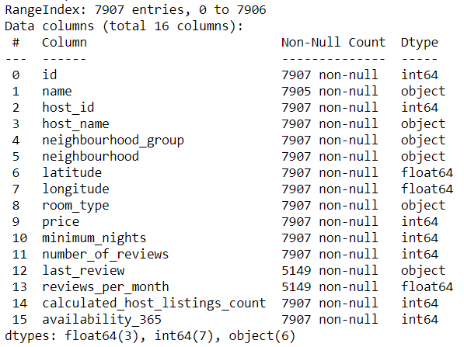
Airbnb Data Exploration
In this dataset, there are:
16 total data columns
7907 data entries
6 categorical data columns out of 16
0 data columns with binary output
Target: “price” column

Slide 21
Airbnb Data Exploration
Target: “price” column
 | Useless | Potentially weak | Likely strong
variables | Id name host_name host_id latitude* longitude* | neighbourhood_group neighbourhood number_of_reviews last_reviews reviews_per_month calculated_host_listings_count | room_type availability_365
remarks | Serves no purpose to solve the issue Latitude and longitude could still be useful | Variables are subjected to potential biased influence or disproportion distribution | Variable could be a key factor in determining price

Slide 22
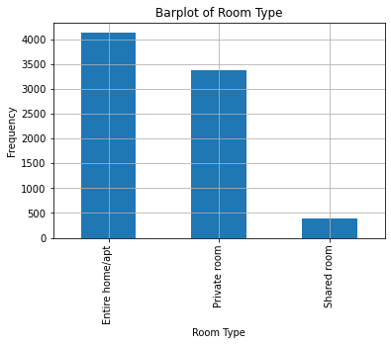
Airbnb Data Exploration
Strong variable: room_type

Slide 23
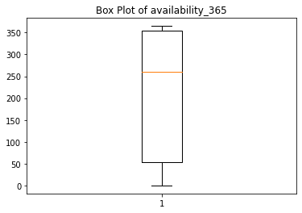
Airbnb Data Exploration
Strong variable: availability_365

Slide 24
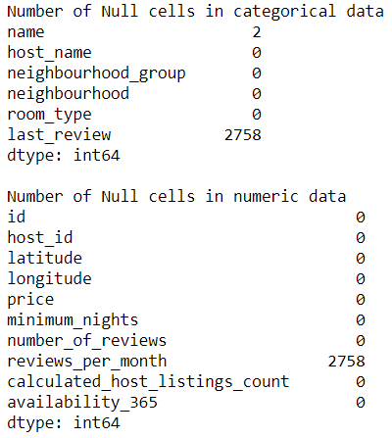
Airbnb Data Cleansing & Transformation
NULL values:
2 for name
2758 for last_review
2758 for review_per_month
Actions taken:
Drop null in name
Assign null as “0” in last_review and review_per_month

Slide 25
Airbnb Data Cleansing & Transformation
Reasons for Actions taken
name:
Unable to assign name
last_review:
Since last_review contain dates, transformation was done for this column to check if there is a date
If there is a date, it will “1”. Else it will be “0”
review_per_month
It is to reflect 0 review were made
since null could represent anything, it is safer to assign the minimum

Slide 26
Airbnb Data Cleansing & Transformation
Outliers
Only changes made were to “price” column
As it is the target column, any outliers need to be handled
Other columns that has were not touched to maintain the data it is

Slide 27
Airbnb Data Cleansing & Transformation
Categorical to numeric
In this dataset, only 3 of the 6 categorical column will be transform.
Neighbourhood and room_type is mapped with ordinal ranking based on the count of each department from lowest to highest
Last_review was already transformed when dealing with it’s null values
Column dropping
Id, name, host_id and host_name are dropped. As they served no purpose towards the prediction.
Neighbourhood_group is also dropped as the dataset will be limited to the central region.
As the prediction will move to a more area-centric analysis

Slide 28
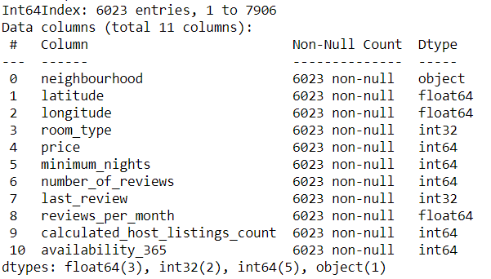
Airbnb Data Cleansing & Transformation
Data frame before correlation:
11 total data columns
6023 data entries
0 categorical data columns out of 11
1 data columns with binary output
Target: “price” column

Slide 29
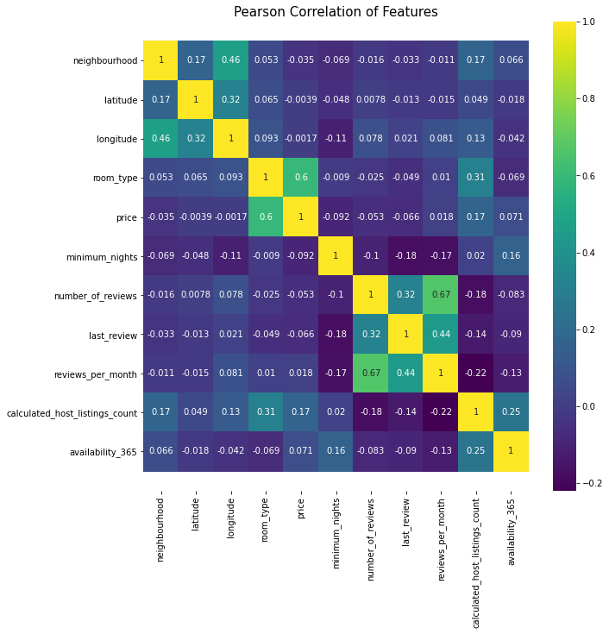

Slide 30
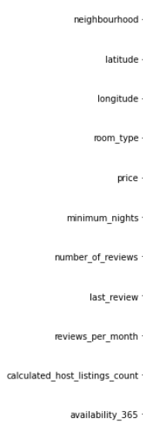
Airbnb Correlation
Target: “price” column
Analysis:
Score ranges from -0.092 to 0.6
1 of the likely key variables scores favourably
It is also the only variable that have a strong correlation
However, the gap between the 1 variable and other is abysmally huge
It seems that only “room_type” really matters in setting the price

Slide 31
Airbnb Correlation
Target: “price” column
Reflection:
Refering back to assessment of columns in slide 18
As expected, the predicted weak variable did not score well
Surprisingly, “availability_365” did not get a good score
I am still unable to decide whether I should drop latitude and longitude

Slide 32
Summary
3
& further improvement

Slide 33
Summary
The following assessment has been conducted on both data set:
Data exploration
Assessment of data column
Data cleansing & transformation
Correlation analysis of data set
Reflection on data column assessment after correlation
Data sets are ready for exporting

Slide 34
Further improvement
Improvement that can be made in assignment 2:
Scaling of variables if needed
Dropping of more columns if needed
Reflection:
For future data exploration, I could:
Account for more possible factors or scenario
Better understand and assess a column/variable

