Slide 1

Example: The Temperature Problem
A cabin in the snow
Wall temperature is 0°, except for a radiator at 100°
What is the temperature in the interior?

Slide 2
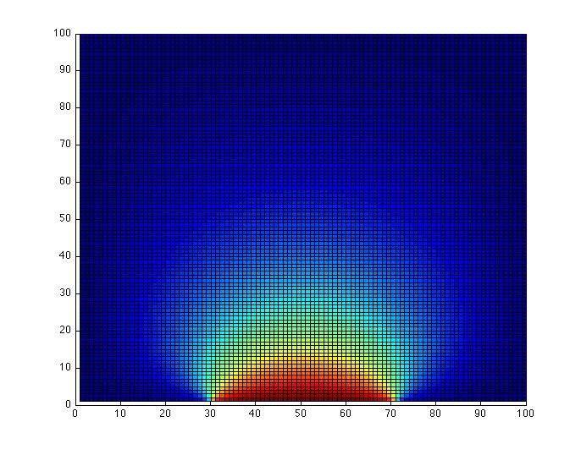
Example: The Temperature Problem
A cabin in the snow (the unit square ☺)
Wall temperature is 0°, except for a radiator at 100°
What is the temperature in the interior?

Slide 3
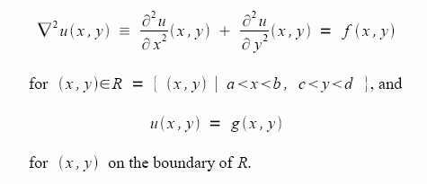
The physics: Poisson’s equation

Slide 4
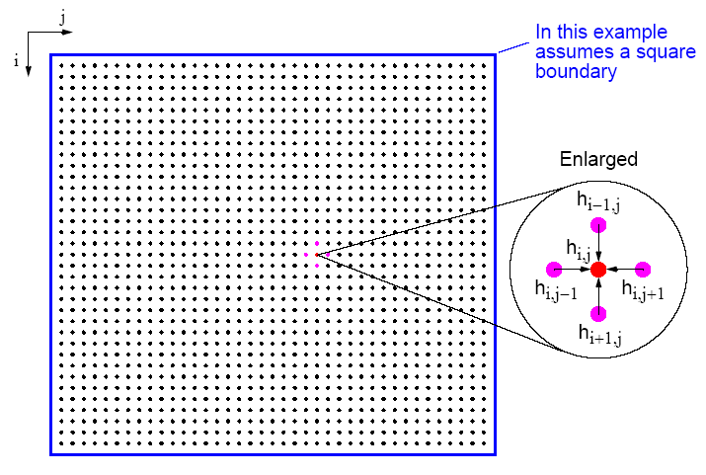
Many Physical Models Use Stencil Computations
PDE models of heat, fluids, structures, …
Weather, airplanes, bridges, bones, …
Game of Life
many, many others
6.43

Slide 5
Model Problem: Solving Poisson’s equation for temperature
k = n^{1/2}
Discrete approximation to Poisson’s equation:
t(i) = ¼ ( t(i-k) + t(i-1) + t(i+1) + t(i+k) )
Intuitively:
Temperature at a point is the average of the temperatures at surrounding points

Slide 6
Model Problem: Solving Poisson’s equation for temperature
k = n^{1/2}
For each i from 1 to n, except on the boundaries:
– t(i-k) – t(i-1) + 4*t(i) – t(i+1) – t(i+k) = 0
n equations in n unknowns: A*t = b
Each row of A has at most 5 nonzeros
In three dimensions, k = n^{1/3} and each row has at most 7 nzs

Slide 7
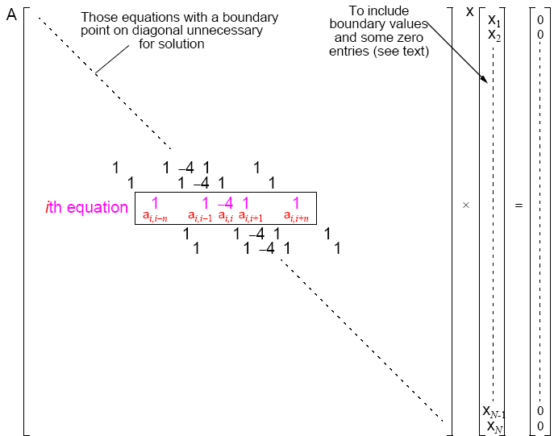
A Stencil Computation Solves a System of Linear Equations
Solve Ax = b for x
Matrix A, right-hand side vector b, unknown vector x
A is sparse: most of the entries are 0

