Slide 1
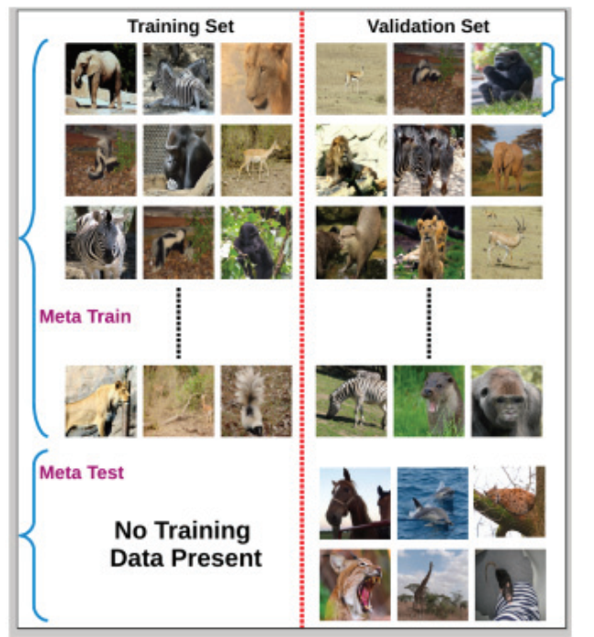
Adjust the replay samples can be important for the zero-shot. This can also formulate as a meta learning problem where new task parameter is in inner loop and old task samples (with trainable representation) are in outer loop. The goal is to make the replay sample do well in the new tasks space
T1
T2
Training
T3
The goal is to fast recover in testing. May also consider data augmentation to help meta-learning
Tn
Meta-training implicitly learn generic representation, despite of the task similarity.
KNN Neighbors as Training
Testing
Can we make this no training data present (like zero-shot learning, but we do not have unseen classes)

Slide 2




$$w_{LM}$$
Outer loop
LM
Sample (from memory and current task)
Inner loop
Similarity
…
$$w_{samp}^{1}$$
$$w_{samp}^{2}$$
$$w_{samp}^{3}$$
Prompt/learnable sample

Slide 3


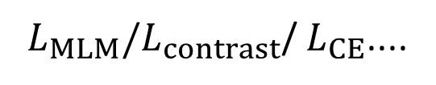



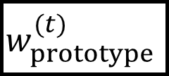

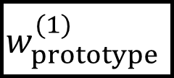



$L_{MLM}{/L}_{contrast}$/ $L_{CE}$....
$L_{CE}/$ $L_{Gen}$
$$w_{prototype}^{(1)}$$
$$w_{LM}$$
$$w_{LM}$$
$$w_{prototype}^{(1)}$$
$$w_{prototype}^{(t)}$$
…
…
$$w_{prototype}^{(t)}$$
$$x^{\left(⩽t−1\right)}$$
$$x^{\left(t\right)}$$
$$x_{sim}^{(t)}$$
$$x_{test}^{(1…t)}$$
Pre-training phase
fine-tuning phase
Goal: KT, prototype
Goal: CF prevention

Slide 4
We can use meta-learning to learn representative prototype. No good results yet
Good for extending to CIL/DIL
Helpful if Impt can learn a good representation
Representation (2-stage)
prototype
Impt in Fine-tune
With the help of projected gradient, we can further improve the KT
(NeurIPS Submission)
We found Soft-masking cannot prevent forgetting in the submission.
We used adapter and threshold for different datasets, which is not ideal
Trustworthiness
Improve the impt
Meta-learning
Instead of using gradient to compute the soft-mask, we can use meta-learning to do so. We can thus directly give the CF and KT goal in the meta loss

Slide 5



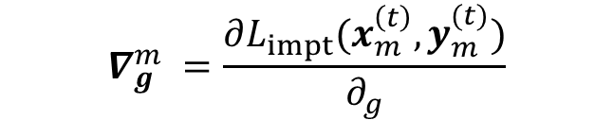
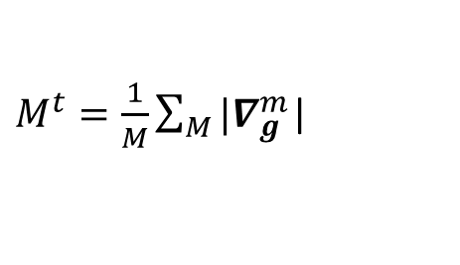
Meta Soft-mask
$$θ^{∗}=θ −µ (∇L_{task}(θ;D)⊗{\hat{M}}^{1:t})$$
Original
$$θ^{∗}=θ −µ ∇L_{task}(θ;D)$$
Manual Mask
$${\hat{M}}^{t}=M^{t}−µ (∇L_{task}(θ^{∗};D^{query})))$$
$$θ^{∗}=θ −µ (∇L_{task}(θ;D)⊗M^{0:t−1})$$
${s.t. θ}^{∗}=θ −µ (∇L_{task}(θ;D^{support})$ $⊗M^{1:t})$
$$∇_{g}^{m} =\frac{∂L_{impt}(x_{m}^{\left(t\right)},y_{m}^{(t)})}{∂_{g}}$$
$M^{t}=\frac{1}{M}\sum_{M}{{|∇}_{g}^{m}}$|

Slide 6










$$M$$
$$D^{cur}$$
$$⊗$$
$$D^{full}$$
$$θ$$
$$∇L_{task}$$
$$θ^{∗}$$
$$∇L_{meta}$$
$$⊗$$
$$M$$

Slide 7















$$M^{back}$$
Backward Mask Training
$$D^{cur}$$
$$⊗$$
$$D^{full}$$
$$θ$$
$$∇L_{task}$$
$$θ^{∗}$$
$$∇L_{meta}$$
$$D^{full}$$
$$M^{for}$$
Forward Mask and Network Training
$$θ$$
$$⊗$$
$$∇L$$
$$⊗$$
$$M^{back}$$

