Slide 1
AI ENGINEER INTERNSHIP · TECHNICAL CASE STUDY
Document Intelligence Platform
Intelligent extraction, financial validation and API delivery for invoices and financial statements
4
document types
140
automated tests
37
reconciliation checks
1
deployed service

Slide 2
The brief, and what was built
One deployed service that turns a document into structured, reconciled, retrievable data
WHAT WAS ASKED
• Accept PDF / JPG / PNG, up to 3 pages, and reject anything else gracefully
• Extract every visible field and table value, not a short fixed list with evidence
• Validate the financial relationships for each document type, per comparative period
• Store results and serve them through REST APIs and a dashboard
• Deploy it: a localhost-only submission is incomplete
WHAT WAS DELIVERED
• FastAPI service with four documented endpoints and Swagger UI
• Text layer or rasterise reader, then Claude vision with a schema constrained response
• Deterministic reconciliation engine - no model in the arithmetic
• PostgreSQL-backed dashboard with raw-JSON view
• Docker image and Render blueprint; no system packages required
Frontend and API are one process: one URL, one origin, no CORS.

Slide 3
The finding that shaped the design
Investigating the corpus before writing code changed the architecture
29 / 30
Their text is painted as vector path outlines.
Empty resource dictionary, no /Font, no /XObject — roughly a megabyte of path fill operators per page. pdfplumber and pypdf both return zero characters, on pages that look perfectly normal on screen.
A text layer only solution extracts nothing from 29 of the 30 files.
29 / 30
statement PDFs have no text layer and no embedded image
Rasterisation is the primary path
not a fallback bolted on for scanned documents
pypdfium2, not poppler
a self-contained wheel, so the container needs no system packages
Vision model over classical OCR
row-to-column association in dense comparative tables is exactly where Tesseract-class OCR fails

Slide 4
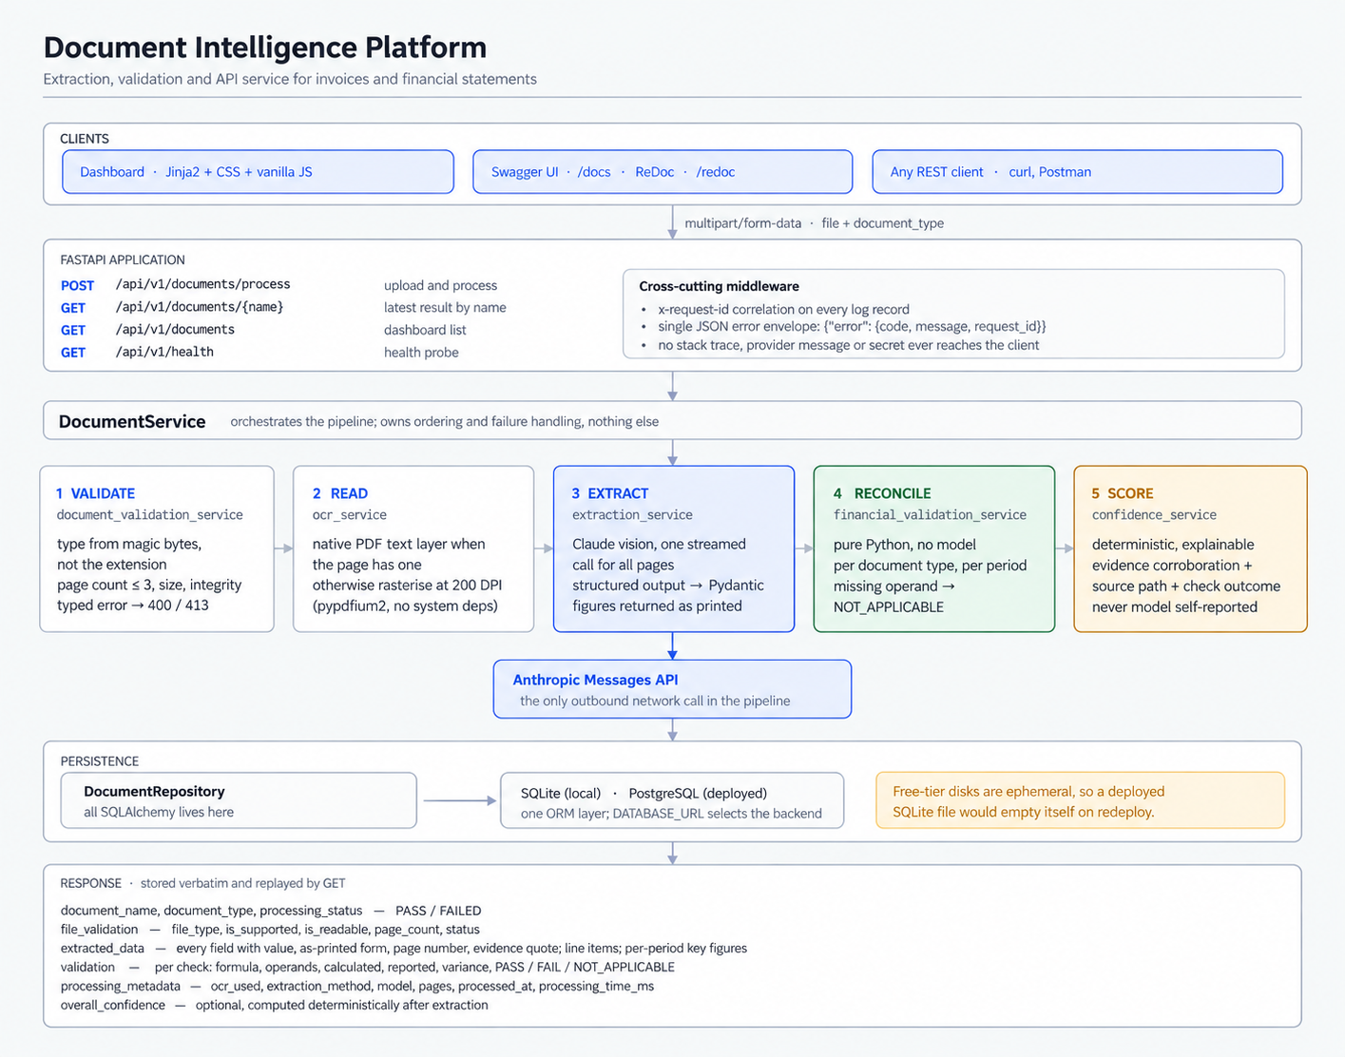
Architecture
Clear separation of concerns: each stage is one service with one job
One process, two surfaces
The dashboard and the API are served by the same application, so there is one deploy, one URL and no CORS.
Each stage is swappable
The reader, the extractor and the reconciler share no state; each is constructor-injected and separately testable.
One external call
Only the extraction stage leaves the process. Everything else — validation, arithmetic, scoring — is local and deterministic.

Slide 5
The pipeline, in five stages
DocumentService owns the ordering and the failure handling; nothing else
Score
confidence_service
• Computed after the fact, not asked for
• Evidence corroboration is the key signal
• Absent value scores null, not zero
1
2
3
4
5
Validate
document_validation_service
• Type from magic bytes, never the extension
• Empty, oversize, corrupted, > 3 pages
• Typed error → 400 / 413 / 422
Read
ocr_service
• Native text layer when the page has one
• Otherwise rasterise at 200 DPI
• EXIF rotation, downscale, JPEG encode
Extract
extraction_service
• One streamed Claude call, all pages
• JSON schema from Pydantic models
• Retry feeds the validator error back
Reconcile
financial_validation_service
• Pure Python — no model involved
• Per document type, per period
• Missing operand → NOT_APPLICABLE
A rejected upload is still stored with processing_status FAILED, so the dashboard shows what was attempted rather than dropping it.

Slide 6
Extraction: the model transcribes, the code interprets
The single most important design decision in the system
THE MODEL RETURNS
• Every figure as a string, exactly as printed
• "(1,234.56)" "1,23,456.78" "–"
• The caption, section and page for each row
• The line of text each value came from
• null for anything it cannot read — never a guess
THE APPLICATION DECIDES
• Parentheses mean negative
• Indian and Western digit grouping
• Currency symbols, Unicode and trailing minus
• Dash / Nil / N-A mean no value, not zero
• Every reconciliation, to the last decimal
Why split it this way
Numeric interpretation stays deterministic and unit-tested instead of depending on the model doing arithmetic; the as-printed form is preserved for audit; and the confidence model can verify that a figure really appears in the evidence text the model quoted.

Slide 7
Financial validation
Deterministic, per comparative period, and never inventing an operand
Invoice / receipt
quantity × unit_price = line amount
Σ line amounts = subtotal
subtotal + tax − discount = total
cash_paid − total = change
Balance sheet
total capital and liabilities = total assets
each section's components sum to that
section's own reported total
— derived from the document's structure
Profit and loss
interest earned + other income = total income
interest expended + opex + provisions
= total expenditure
income − expenditure = profit before MI
PBMI − minority interest = attributable
Cash flow
operating + investing + financing + FX
= net increase in cash
opening + net increase + cash acquired
= closing cash
Tolerance |calc − reported| ≤ 0.1 + 1e-5 × magnitude — a combined allowance, both terms configurable
An OR of absolute-or-relative is too loose at both ends: a 0.5% relative limit passes a 20,000-crore discrepancy, while an absolute limit sized for a statement is 11% of a 9.00 till receipt. A missing operand returns NOT_APPLICABLE and never fails the document.

Slide 8
Confidence that means something
Optional in the brief — implemented, but never asked of the model
SIGNAL WEIGHT
Why not ask the model?
A self-reported score is not evidence. It correlates with fluency, not with correctness, and it cannot be checked.
Every signal here is independently verifiable from the response itself — which is what makes the number explainable.
Source path
A PDF text layer is exact; a rendered page was read visually.
base 0.75 / 0.60
Evidence corroboration
The number is actually present in the quoted source text.
+0.20
Evidence completeness
A page number and a verbatim quote were both returned.
+0.05 each
Validation agreement
A figure inside a failing reconciliation is suspect.
+0.10 / −0.30
A field the document does not report scores null, not zero.
There is nothing to be confident about, and zero would read as “certainly wrong”. Values below 0.70 are highlighted in the dashboard.

Slide 9
API surface
Swagger generated from the same Pydantic models the endpoints return
POST
/api/v1/documents/process
One error envelope
{ "error": {
"code": "...",
"message": "...",
"request_id": "..." } }
14 typed codes. Stack traces and provider messages go to the log, never the body — asserted by a test.
multipart upload; file + document_type
GET
/api/v1/documents/{document_name}
latest stored result, case-insensitive
GET
/api/v1/documents
dashboard list; filter, search, paginate
GET
/api/v1/health
status, database, extraction_configured
THE STORED RESPONSE
• extracted_data — every field with its parsed value, as-printed form, page number and evidence quote; line items; per-period key figures; an explicit missing_fields list
• validation — per check: formula, operands, calculated, reported, variance, PASS / FAIL / NOT_APPLICABLE, and the tolerance applied
• processing_metadata — ocr_used, extraction method, model, pages, timestamp, elapsed milliseconds
The full response is persisted verbatim, so GET replays exactly what POST returned.

Slide 10
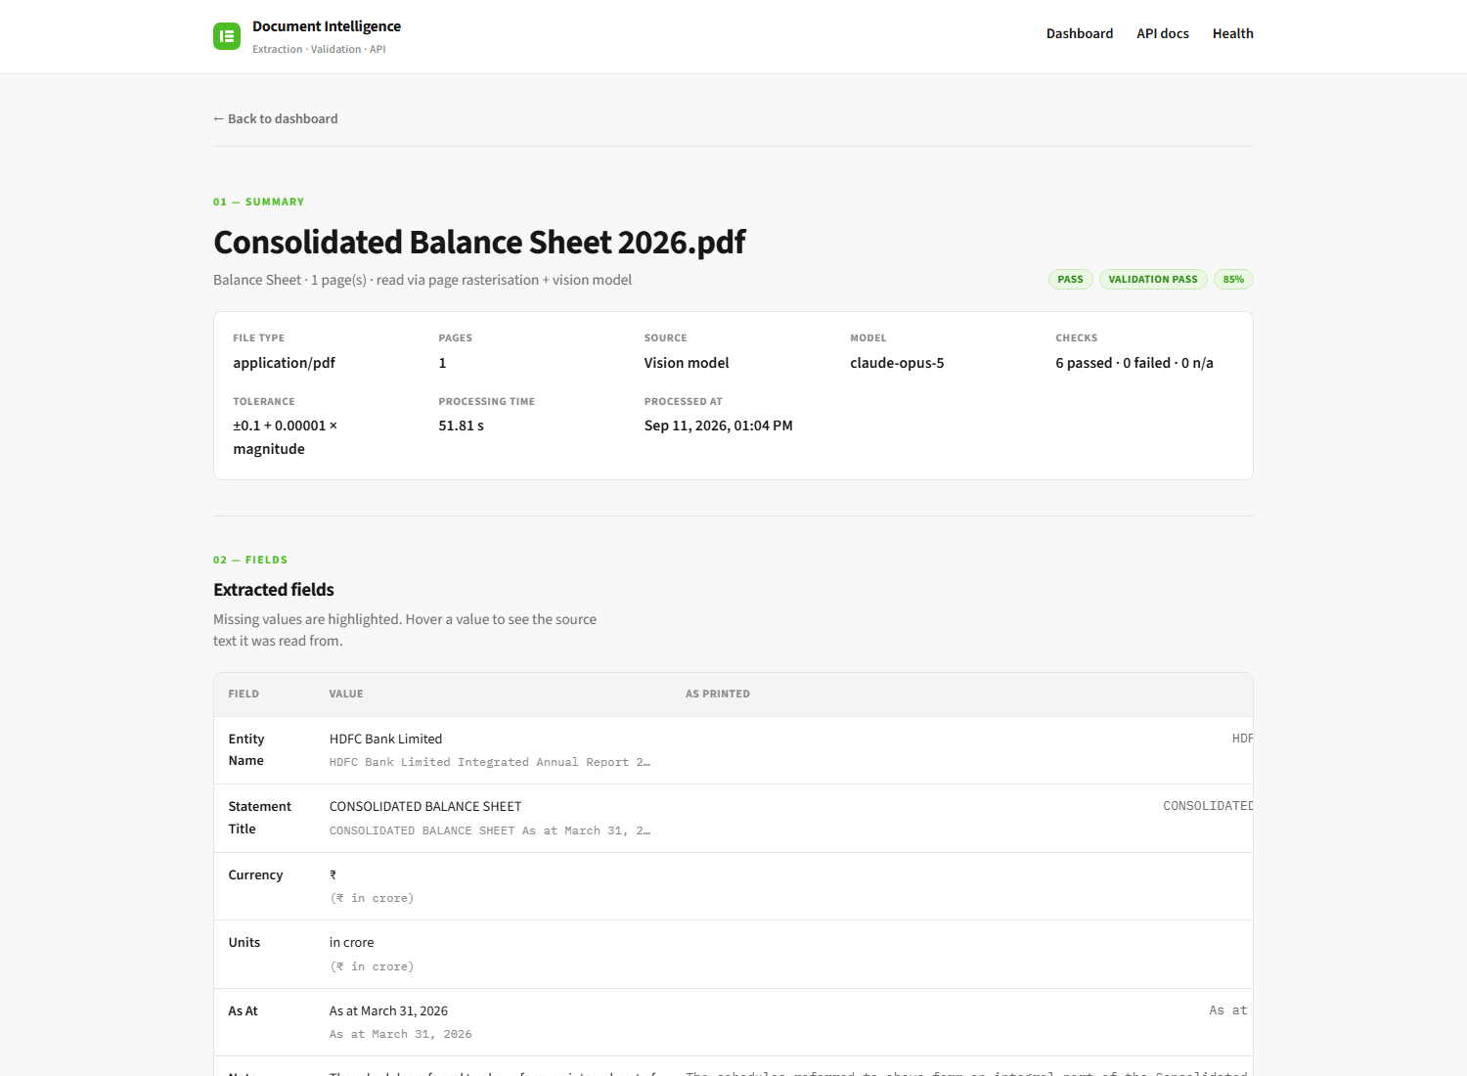
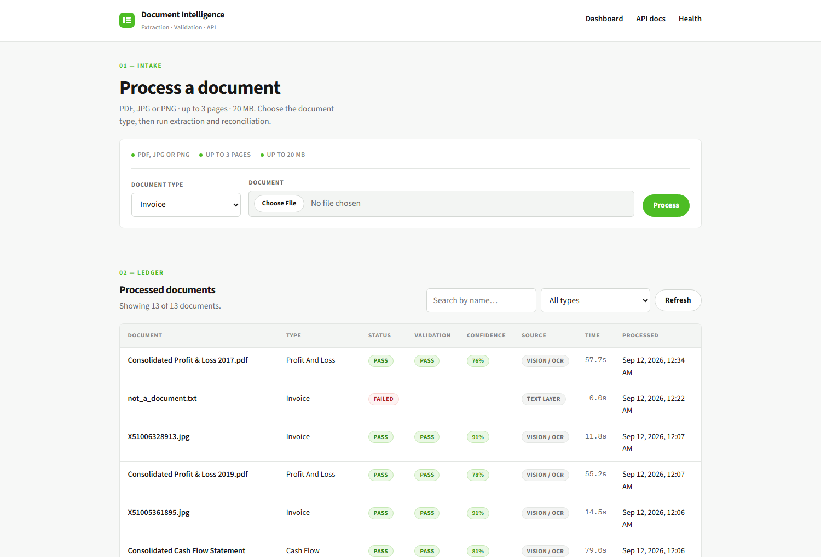
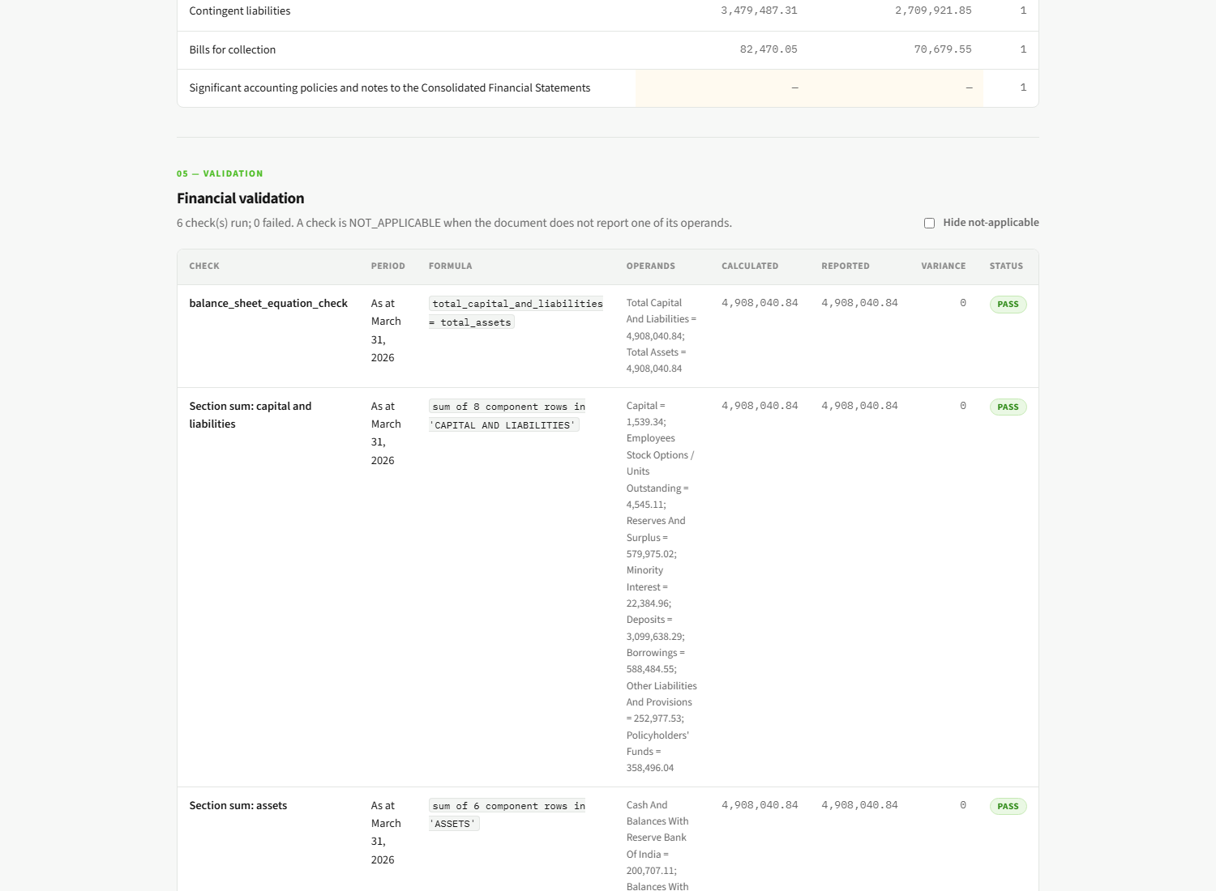
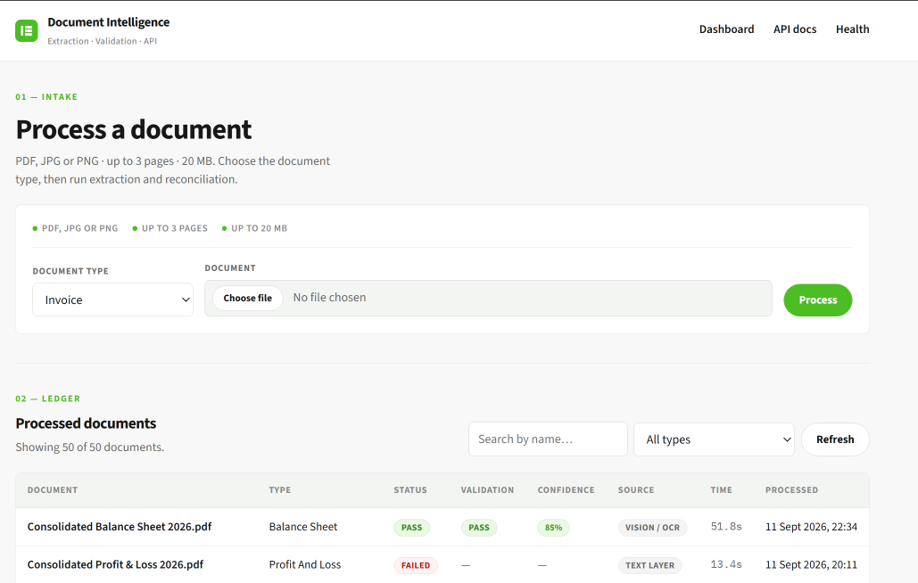
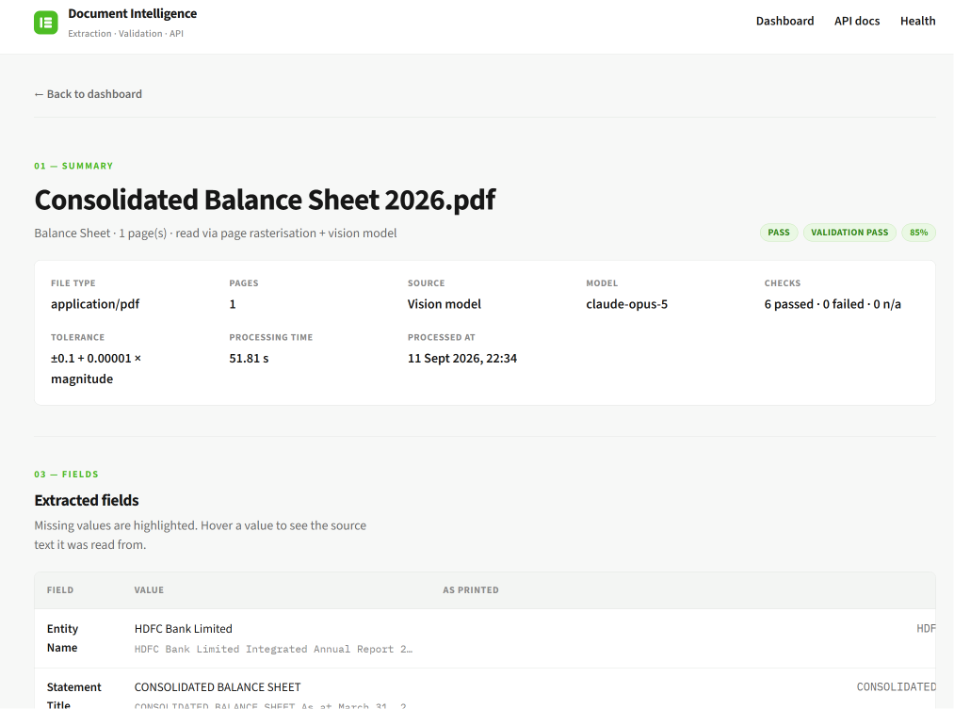
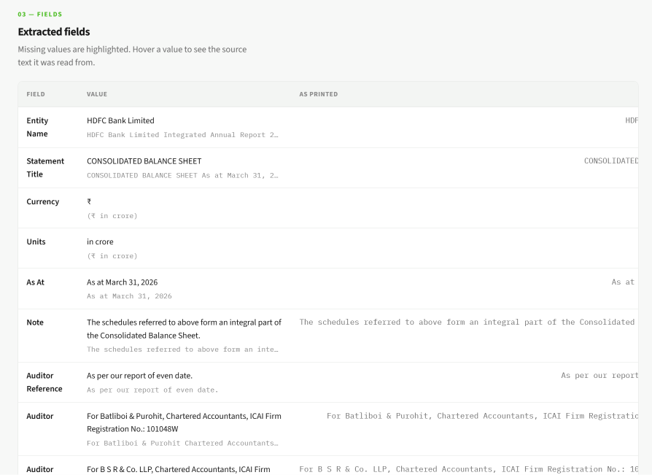
The dashboard
HTML, CSS and vanilla JS, calling the same public API
Upload, then every processed document with status, validation outcome and confidence.
Per document: extracted fields, per-period tables, every check with its arithmetic, and the raw JSON.

Slide 11
Engineering discipline
The parts that do not show up in a screenshot
●
Testing
●
Logging
●
Error handling
140 tests, zero network
The Anthropic client is stubbed throughout, so the suite runs the same in CI and with no API key.
Structured, correlated
Single-line JSON with an x-request-id on every record, returned in the response header and in error bodies.
One envelope, 14 codes
Typed exceptions map to HTTP status; a test asserts no internal detail reaches the client.
●
Security
●
Configuration
●
Modularity
Bytes over claims
File type from magic bytes, filename sanitised against traversal, size ceiling before read, container runs unprivileged.
Environment only
No secret has a default and none is committed; .env.example lists names, never values.
One job per module
Validation, reading, extraction, reconciliation, scoring, persistence and routing are separate and separately testable.

Slide 12
Deployment
One Docker image, no system packages, one service serving both frontend and API
WHY THE IMAGE IS SIMPLE
• Every dependency ships as a binary wheel
• No apt-get layer, no poppler, no compiler
• python:3.12-slim, runs as an unprivileged user
• render.yaml provisions service + database
THE TRAP WORTH NAMING
Free-tier container disks are ephemeral.
A deployed SQLite file is wiped on every redeploy and on cold start, so the dashboard would quietly empty itself part-way through an evaluation. The ORM layer is backend-agnostic; only DATABASE_URL changes, and the blueprint points it at managed PostgreSQL.
VERIFIED AFTER DEPLOY
• /api/v1/health returns ok, database connected, extraction_configured true
• Swagger UI loads; POST processes a real document; GET by name returns it; the list backs the dashboard
• An unsupported file returns 400 with the documented error envelope and no stack trace

Slide 13
Limitations, and what production would need
Stated plainly — knowing where the edges are is part of the work
KNOWN LIMITATIONS
• Accuracy is bounded by the vision model. The reconciliations catch internally inconsistent extractions; they cannot catch a value that is wrong self-consistently.
• The caption registry is English and oriented to the statement conventions in scope; an unusual caption leaves a check NOT_APPLICABLE rather than guessing.
• Processing is synchronous — 15 to 40 seconds per rasterised page. Fine for this brief, not for real concurrency.
• Confidence is an explainable heuristic, not calibrated against labelled ground truth.
• No authentication; the evaluation flow needs an open API.
WHAT I WOULD CHANGE FOR PRODUCTION
• Asynchronous processing: 202 Accepted + a job id, a queue, and streamed progress.
• Content-hash caching so an identical re-upload costs nothing.
• Store the source document and link evidence to bounding boxes, so the UI highlights the exact region.
• An accuracy eval harness in CI — labelled corpus, field-level precision and recall — so a prompt change cannot silently regress extraction.
• Auth, per-tenant isolation, rate limiting and a model spend cap.
• Alembic migrations, OpenTelemetry traces, per-request cost accounting.

Slide 14
Thank you
Happy to walk through the code, the prompts, the validation logic or the deployment
Live application https://document-intelligence-api-lffm.onrender.com
Swagger / OpenAPI https://document-intelligence-api-lffm.onrender.com/docs
Health https://document-intelligence-api-lffm.onrender.com/api/v1/health
Repository https://github.com/ZiyaSadik/document-intelligence-platform

