Slide 1
HMS
Online hospital for all medical services

Slide 2
introduction
During the past five years, a commitment has been made to promote the use of the Internet to provide medical services, although it is still in an exploratory stage. Internet connections in general have brought about a big change economy, and there is no doubt that they can improve service quality and provide comfort to people. As a supplement to offline health services, online health services are of great importance in alleviating the relative shortage of medical resources. With the development of technology, levels of online health services have continuously improved, resulting in traditional medical resources gradually becoming interconnected.

Slide 3
HMS
Internet hospitals is a term with a somewhat vague meaning. In general, it is an internet medical platform combining online and offline access for medical institutions to provide a variety of telehealth services directly to patients. It extends medical resources from the hospital to the internet by using information technology, and it develops online medical services and health services . It can be as simple as using the internet to make and manage appointments or renew prescriptions; however, it can also be a means citizens to communicate face-to-face with doctors via internet pages or public therapeutic platforms in apps such as WeChat (mobile social media apps) . Internet hospitals are online platforms but need to be based in existing institutions with consistent online and offline service supervision. They include both medical and nonclinical services but can only use internet technology to provide safe and appropriate medical services for the follow-up of common and chronic diseases online . Doctors are allowed to prescribe treatment for related diseases online after accessing the patient's medical records.

Slide 4
HMS
In light of the events and the epidemic spreading in the country, we thought of establishing an online hospital to help patients to limit the spread of the disease, and since the Internet has become in every Egyptian home, it has become easy to enter the hospital website and receive detection and treatment with ease, and also to reduce the load of patients who are unable
And to reduce congestion and for easy and quick response to the patient.

Slide 5
HMS
Objective
The primary purpose of this study was to understand the definition, establishment, and development status of online hospitals.
You can donate to the hospital or to patients who are unable to do so through Fawry service or Vodafone Cash.

Slide 6
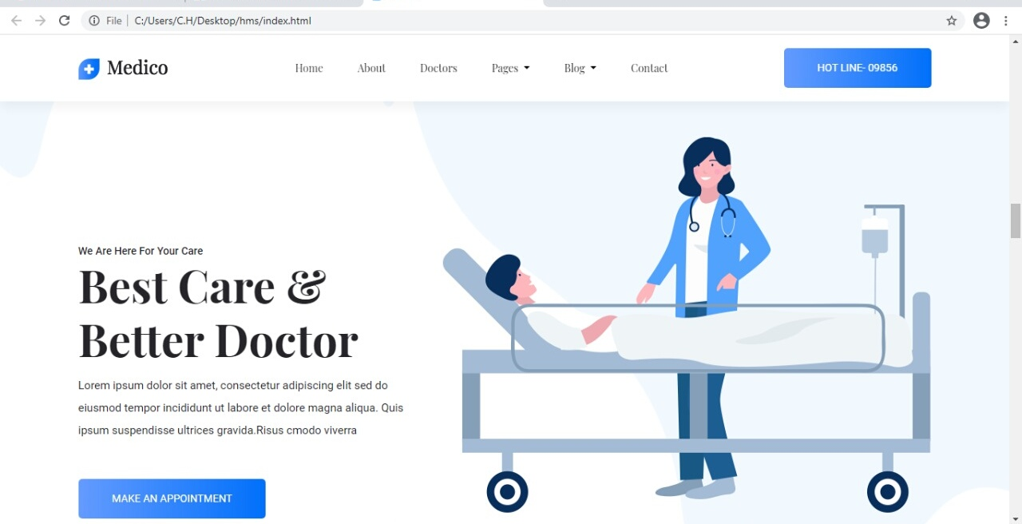
HMS

