Slide 1
MEACOMPASS
Reliability-Aware Early Prediction of Neural Network Development from Microelectrode-Array Assays
Toward Functional Digital Twins for Neural Organ-on-Chip Screening
The useful endpoint arrives at DIV12. Triage should not wait blindly.
DIV5
DIV7
FORECAST / WAIT
DIV12
5 days
DIV7 forecasts are available five days before the DIV12 endpoint for accepted cases.
136 chemicals • 4,192 complete longitudinal trajectories
MEACompass | locked retrospective evidence
01

Slide 2
THE CONCEPT
MEACompass forecasts—and knows when not to.
Evidence, uncertainty, and human review are part of one workflow.
OBSERVED
PREDICTED
DECISION SUPPORT
HYPOTHESIS
DIV5 + DIV7 physiology
DIV12 value + 90% interval
accept or abstain
future neural OoC adaptation
Uncertain cases continue to DIV12. MEACompass never terminates an assay autonomously.
MEACompass | locked retrospective evidence
02

Slide 3
SCIENTIFIC BOUNDARY
A credible forecast begins with an honest boundary.
WHAT THIS IS
WHAT THIS IS NOT
Retrospective rat cortical neural microelectrode-array research
Chemical-disjoint DIV12 prediction
Calibrated research decision support
Not organ-on-chip training data
Not human or external-device validation
Not an autonomous assay-termination system
Human neural OoC transfer remains a hypothesis until a frozen prospective study validates it.
MEACompass | locked retrospective evidence
03

Slide 4
EVALUATION DESIGN
The split follows the chemical—not the convenient row.
Every dose, alias, replicate, and well for one chemical stays together.
3 × 5 OUTER FOLDS
136 CHEMICALS
CHEMICAL BOOTSTRAP
Held-out chemicals only
Inner validation selects baselines and settings
Canonical CAS groups
4,200 complete trajectories
Paired uncertainty at the true generalization unit
Outer-test labels evaluate. They never select.
MEACompass | locked retrospective evidence
04

Slide 5
LOCKED PRIMARY RESULT
Frozen M1 improves all five endpoints against the fair comparator.
MAE gain versus inner-selected BT+; every paired chemical-bootstrap interval excludes zero.
Firing
14.2%
BT++
Bursts
17.0%
12.3–42.9%
Active electrodes
39.0%
gain versus the stricter post-audit comparator; significant on all five endpoints
Network spikes
15.6%
Coordinated activity
22.7%
DIV7 contribution
56.9–77.3%
Chemistry 11.2–31.8% • association, not mechanism
Failure case disclosed: tributyltin chloride
MEACompass | locked retrospective evidence
05

Slide 6
INTEGRITY BEFORE MOMENTUM
The negative control stopped us—then the audit earned conditional continuation.
BOUNDED AUDIT
REGISTERED STOP
CONDITIONAL PASS
No future-derived feature
Clean full-target shuffle
No alignment defect
Real M1 beat all 20 block-null runs
Chemical-block permutation showed a small bursts gain.
Failure remains visible
BT++ added as safeguard
Locked claims unchanged
The audit resolved a mechanism question. It did not erase the original stop.
MEACompass | locked retrospective evidence
06

Slide 7
CALIBRATED UNCERTAINTY
Nominal 90% intervals cover 91.0–92.4% in held-out chemicals.
90% nominal
Bursts 91.08%
Firing 91.53%
Active 92.13%
Spikes 91.03%
r 92.40%
Nested group CV+ • calibration uses training chemicals only • intervals travel with every forecast
MEACompass | locked retrospective evidence
07

Slide 8
SELECTIVE PREDICTION
Abstention clears the risk threshold on three endpoints—not five.
Accepted-case MAE reduction at 70% retained coverage; registered threshold = 15%.
Firing
18.9%
PASS
Bursts
4.6%
LIMITATION
Active electrodes
18.0%
PASS
Network spikes
5.3%
LIMITATION
Coordinated activity
28.4%
PASS
Uncertain cases continue to DIV12; this policy does not terminate assays.
MEACompass | locked retrospective evidence
08

Slide 9
TIME CAUSALITY
DIV7 is the earliest useful decision point; interpretability explains why.
DIV12
DIV7
56.9–77.3%
observed endpoint
DIV5 + 7 + 9
post-lock ablation
CHEM
11.2–31.8%
DIV5 + DIV7
primary locked model
DIV5
weaker
Interpretability is predictive, not causal.
One disclosed failure: tributyltin chloride
MEACompass | locked retrospective evidence
09

Slide 10
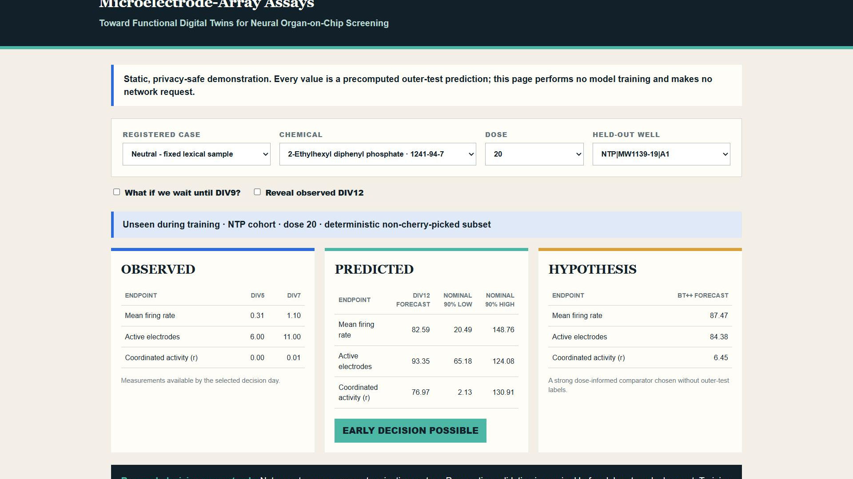
REAL PUBLIC DEMO
The demo keeps evidence, forecast, and hypothesis visibly separate.
LIVE • LOGGED OUT
OBSERVED
early DIV5 + DIV7 evidence
PREDICTED
DIV12 forecast + nominal 90% interval
HYPOTHESIS
future OoC transfer remains unvalidated
Precomputed held-out predictions • no training • no external requests
MEACompass | locked retrospective evidence
10

Slide 11
ADAPT, DO NOT DEPLOY BLINDLY
Cohort-shift evidence is encouraging; a new chip still requires local validation.
POST-LOCK SECONDARY
1 MAP
2 RETRAIN
5 / 5
Local endpoints + controls
Local longitudinal data
endpoint wins in both directions
ToxCast → NTP
10.3–34.5%
3 RECALIBRATE
4 VALIDATE
NTP → ToxCast
15.1–50.3%
Intervals + drift
Prospective human review
Held-out cohort shift; not external laboratory/device transfer.
The frozen EPA model is not a deployable neural OoC model.
MEACompass | locked retrospective evidence
11

Slide 12
REPRODUCE WITHOUT RETRAINING
The locked evidence rebuilds in minutes from committed predictions.
$ make setup
NO AUTOMATIC RETRAINING
$ make fetch-results
Saved predictions → tables → figures → demo
Manifest hashes verify the evidence bundle.
Full training requires an explicit locked-rebuild flag.
$ make test
$ make reproduce-lite
$ make demo
Forecast when evidence is strong; continue the assay when it is not.
MEACompass | locked retrospective evidence
12

