Slide 1
SYMMETRY
Symmetry Operators ➢ Translation ➢ Rotation ➢ Inversion ➢ Mirror ➢ Roto-inversion ➢ Roto-reflection ➢ Glide reflection ➢ Screw axis
Point Groups
Advanced Reading
Elementary Crystallography
M.J. Buerger
John Wiley & Sons Inc., New York (1956)

Slide 2

SYMMETRY
If an object is brought into self-coincidence after some operation it said to possess symmetry with respect to that operation.
SYMMETRY OPERATOR
Given a general point a symmetry operator leaves a finite set of points in space
A symmetry operator closes space onto itself

Slide 3
NOTES:
Presence of symmetry enables us to consider only a part of a object (or other entity → which could even be infinite) in conjunction with the symmetry operators (see coming slide for explanations)
All symmetry operators may not be required to understand/analyze/generate a structure (→ but a few basic ones are)
The effects of many symmetry operators may be identical (especially in lower dimensions or when mirror symmetric objects are not involved)
Certain combination* of symmetry operators (without a translational component) can also leave a finite set of points$ and these are called the Point Groups
Certain combination* of symmetry operators involving translations can leave a periodic array of (finite set of) objects in space → the Space Groups
* Only certain specific combinations are allowed which possess this property
$ Given a general point

Slide 4
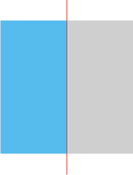
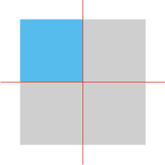
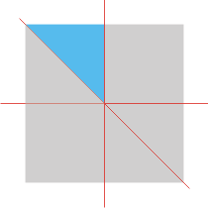

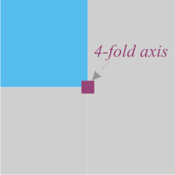
Why do I need to talk about symmetry and symmetry operators?
If the object, collection of objects, crystal etc. (which is under consideration) has some symmetry then the whole need not be described, but only a part can be described along with the symmetry operators.
For example consider a square (as below). ▪ A half the square with a mirror plane (mirror line in 2D) can give the whole square. ▪ Or a quarter of a square with two mirror planes or ▪ a diagonal half of the quarter with three mirror planes. (note: mirror planes in 2D are lines)
m
m
m
Else one could have considered a quarter of the object along with a four-fold rotation operation (with symbol ▪ and which rotates space by 90°).

Slide 5
Classification of Symmetry Operators
Dimension of the Operator
Takes an object to its mirror form or not
Based on
If the operator acts at a point or move a point
If it plays a role in the shape of a crytal or not (Macroscopic/Microscopic)

Slide 6
Symmetry operators
Translation
Takes object to same form → Proper
Type I
Rotation
Symmetries
Mirror
Roto- reflection
Type II
Takes object to enantiomorphic form → improper
Inversion
Roto- inversion
(Mirror image form)
Classification based on the dimension invariant entity of the symmetry operator
Operator | Dimension
Inversion | 0D
Rotation | 1D
Mirror | 2D

Slide 7
Symmetry operators
Rotation
Mirror
Influence the external shape of the crystal
Macroscopic
Inversion
Symmetries
Screw Axes
Microscopic
Do not Influence the external shape of the crystal
Glide Reflection

Slide 8
Minimum set of symmetry operators required
R  Rotation
G  Glide reflection
‾R  Roto-inversion
S  Screw axis
Ones acting at a point
Ones with built in translation

Slide 9
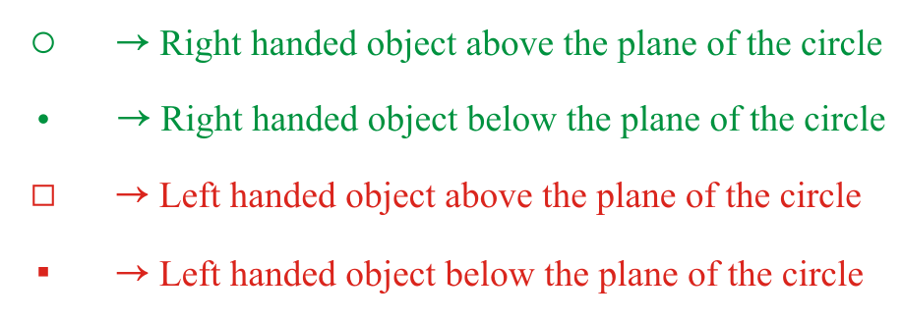
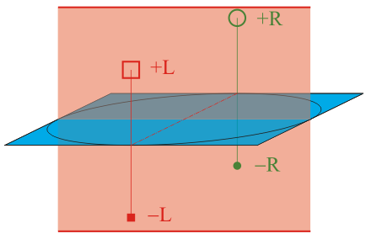
Notation for representing left and right handed objects
To start with we use the notation as described below. (Occasionally deviating from this as well!).
Ultimately, we will turn to ‘International Tables of Crystallography’ symbols in b/w.
+R
−R
+L
−L

Slide 10
Translation
The translation symmetry operator (t) moves an point or an object by a displacement t or a distance t.
A periodic array of points or objects is said to posses translational symmetry.
Translational symmetry could be in 2D or 3D (or in general nD).
If we have translational symmetry in a pattern then instead of describing the entire pattern we can describe the ‘repeat unit’ and the translation vector(s).
∞
t
∞
∞
t
∞








Slide 11
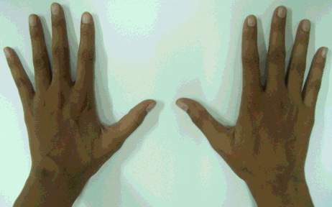
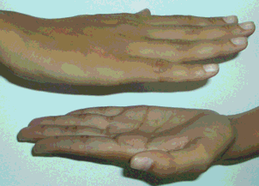
Mirror and Inversion
With note on left and right handed objects
The left hand of a human being cannot be superimposed on the right hand by mere translations and rotations
The left hand is related to the right hand by a mirror symmetry operation (m)
The right hand is called the enantiomorphic form of the left hand
Another operator which takes objects to enantiomorphic forms is the inversion operator (i) (in the figure to the right below- between the two hands (in the mid-plane) at the centre is an inversion operator)`
m
Inversion operator

Slide 12
Rotation Axis
Rotation axis rotates a general point (and hence entire space) around the axis by a certain angle
On repeated operation (rotation) the ‘starting’ point leaves a set of ‘identity-points*’ before coming into coincidence with itself.
As we are interested mainly with crystals, we are interested in those rotations axes which are compatible with translational symmetry → these are the (1), 2, 3, 4, 6 – fold axis.
If an object come into self-coincidence through smallest non-zero rotation angle of θ then it is said to have an n-fold rotation axis where:
The rotations compatible with translational symmetry are  (1, 2, 3, 4, 6)
Click here for proof
⇒
Crystals can only have 1, 2, 3, 4 or 6 fold symmetry
* explained in an upcoming slide

Slide 13
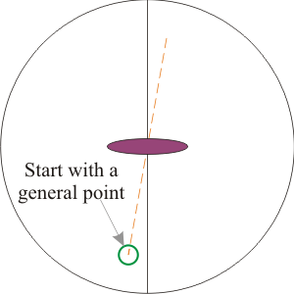
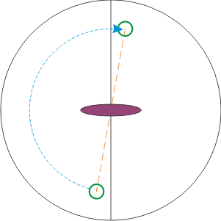
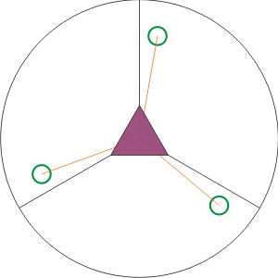
Symbol for 2-fold axis
θ=180°
n=2
2-fold rotation axis
Then the operation of the 2-fold leaves two points
Symbol for 3-fold axis
θ=120°
n=3
3-fold rotation axis

Slide 14
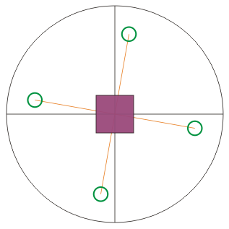
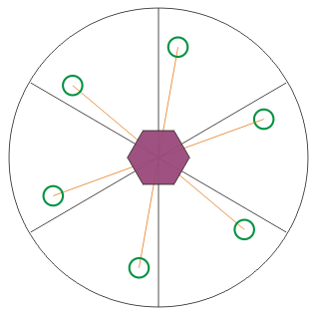
θ=90°
n=4
4-fold rotation axis
θ=60°
n=6
6-fold rotation axis

Slide 15
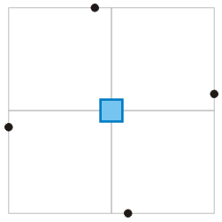
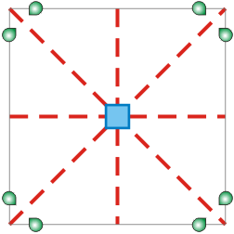
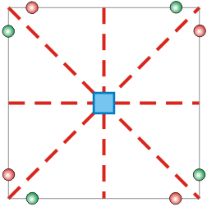
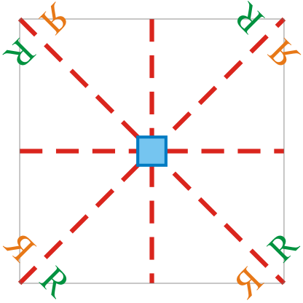
Identity Points/Objects
If we start with a general point, then the operation of symmetry operator(s) will leave a (finite) set of points. These symmetrically related set of points are called identity points.
An extension of the concept of Identity points is to use identity objects which can show left or right handedness.
Some examples are shown below.
4-fold leaves 4 identity points
Alternate diagram
4mm
Right Handed
4mm
Left Handed
Right Handed
4mm point group leaves 8 identity points: 4 left handed (orange circle) and 4 right handed (green circle)
Left Handed

Slide 16
Compound Symmetry Operators
Translation, mirror, inversion & rotation are simple symmetry operators which we had considered
Roto-inversion and Roto-reflection are compound symmetry operators which do not involve translation → both these take left handed objects to right handed form ➢ For generating point groups (to be considered later) one of the two operators is sufficient and hence we will consider roto-inversion only in future.
Glide reflection and Screw are compound symmetry operators involving translation → Only Glide reflection takes left handed objects to right handed form
It is important to note in these operations the compound operator acts before leaving a identity-point (i.e. Roto-inversion is NOT rotation followed by a inversion).
In some cases these compound operators can be broken down into a combination of two operators. In a combination (unlike a compound) the individual operators express themselves fully – i.e. the first operator acts first and then the second acts on the result of the first operation.

Slide 17
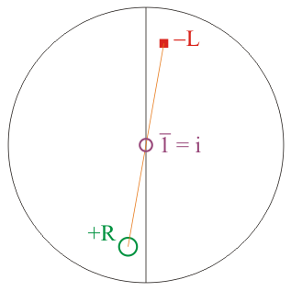
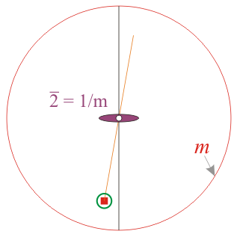
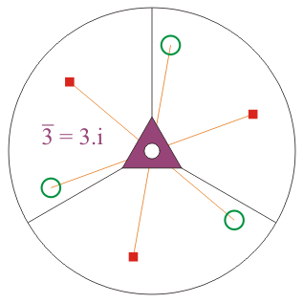
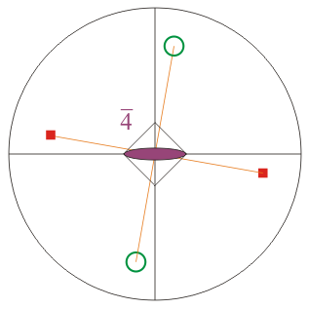
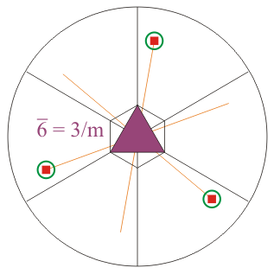
Roto-inversion
A roto-inversion operator rotates a point/object and then inverts it (inversion operation) in one go.
A left handed object will be taken to its right handed form by the operation.
We will only consider 1,2,3,4,6 - fold rotations (crystallographic) as a part of the roto-inversion operation.
Roto-inversion operations
Compatible with translational symmetry

Slide 18
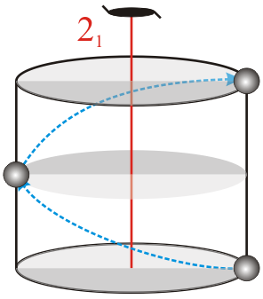
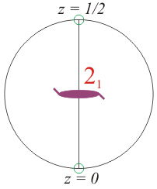
Screw Axis
A screw (axis) operator rotates a point/object and then moves it a fraction of the repeat distance in one go.
The faction which the screw axes move is called the pitch of the screw.
We will only consider (1, 2, 3, 4, 6) - fold rotations (crystallographic) as a part of the screw axes.
The screw axes to be considered are: ➢ 2₁ ➢ 3₁ , 3₂ ➢ 4₁ , 4₂ , 4₃ ➢ 6₁ , 6₂ , 6₃ , 6₄ , 6₅
The normal and screw axis both give the same effect on the external symmetry of the crystal

Slide 19
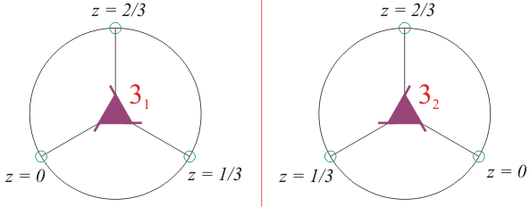
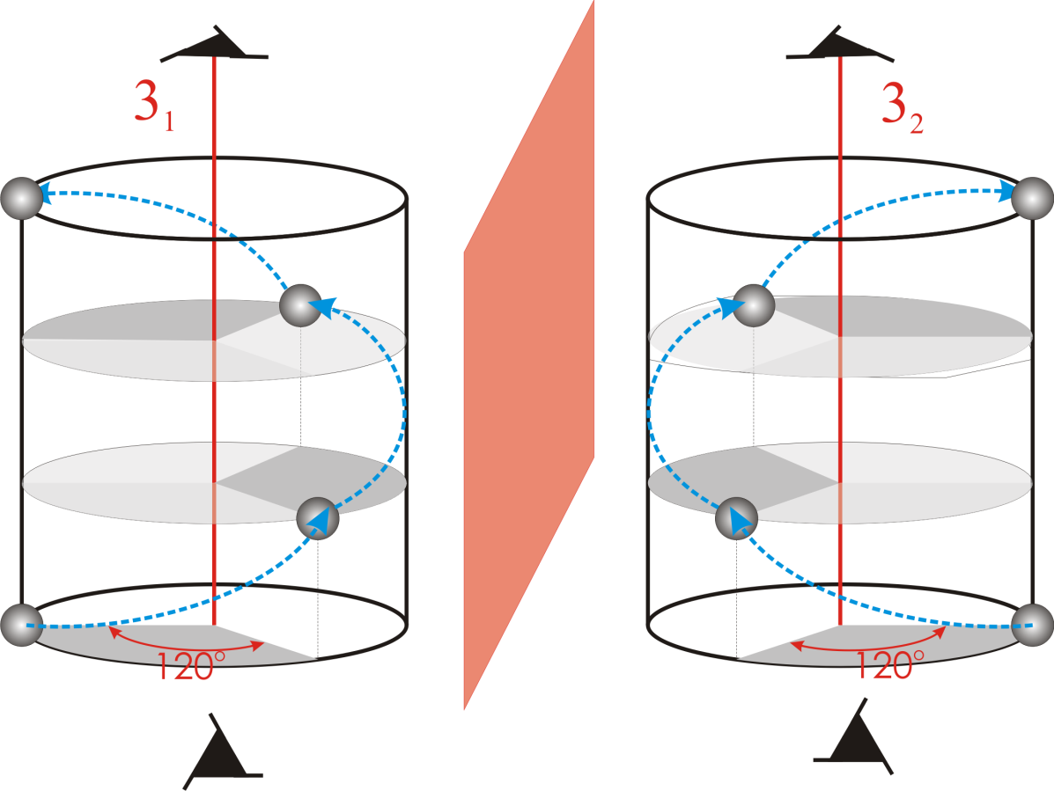
The 3₂ axis produces a rotation of 120° along with a translation of 2/3.
The set of points generated are: (0,0) (120°,2/3) (240°,4/3=1/3) (360°,6/3=2)…
This is equivalent to a left handed screw (LHS) of pitch 1/3

Slide 20
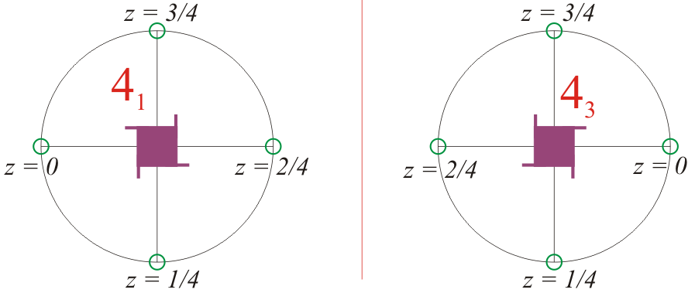
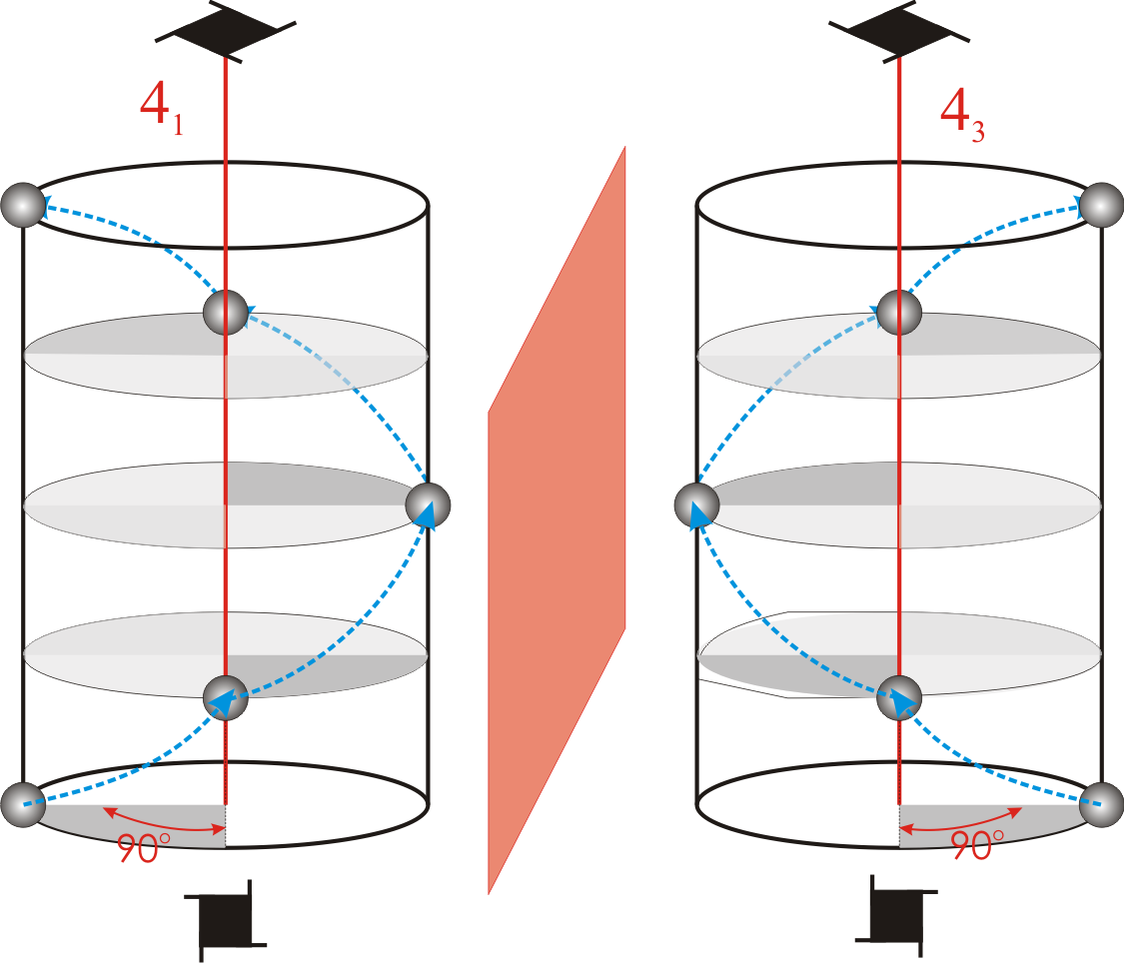
The 4₃ axis is a RHS with a pitch of 3/4
The effect of 4₃ axis can be thought of as a LHS with a pitch of 1/4

Slide 21
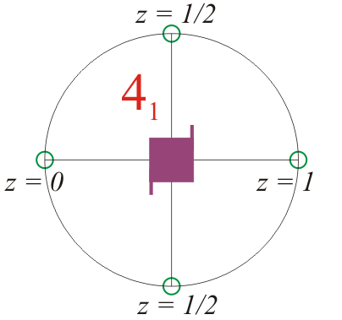
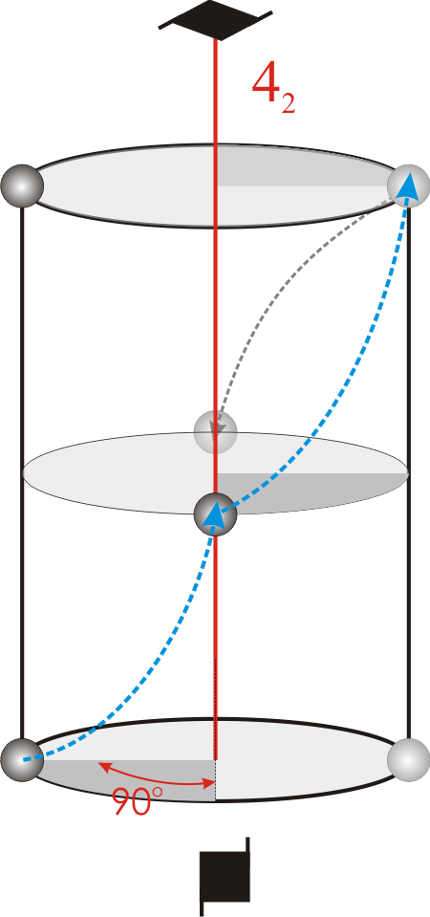
The 4₂ axis generates the following set of points: (0,0) (90°,1/2) (180°,2/2=1) (270°,3/2=1/2) (360°,4/2=2)
The grey arrowhead maps the (270°,3/2) point to (270°,1/2) → to keep points within unit cell

Slide 22
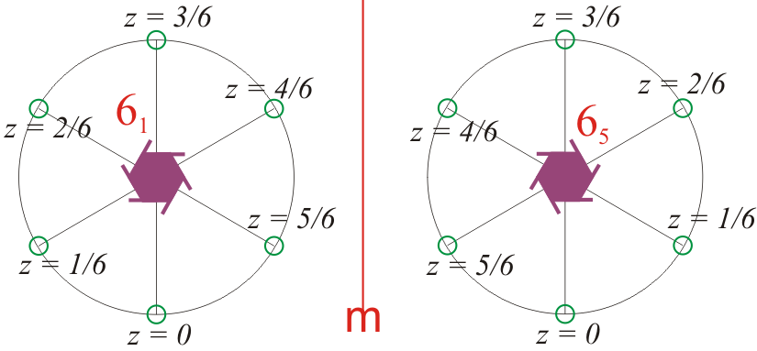
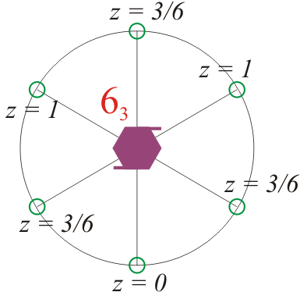
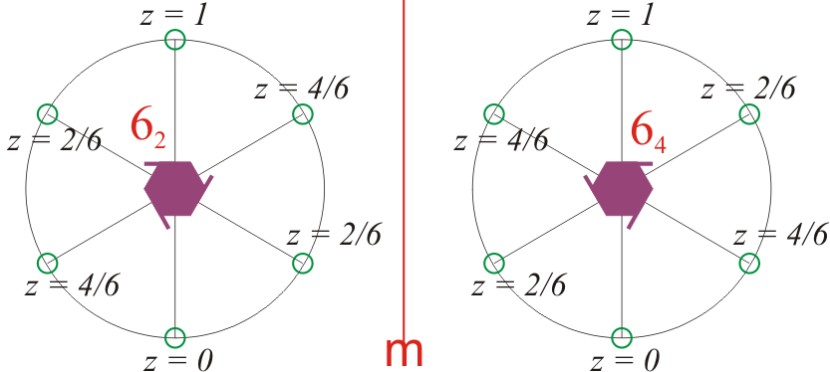

Slide 23

Glide Reflection
A glide (reflection) operator move a point/object by a fraction of the repeat distance and reflects the object in one go.
Kinds of ‘Glides’ are considered in crystallography: ➢ Axial Glide (a, b, c) → ➢ Diagonal Glide (n) → ➢ Diamond Glide (d) →

Slide 24
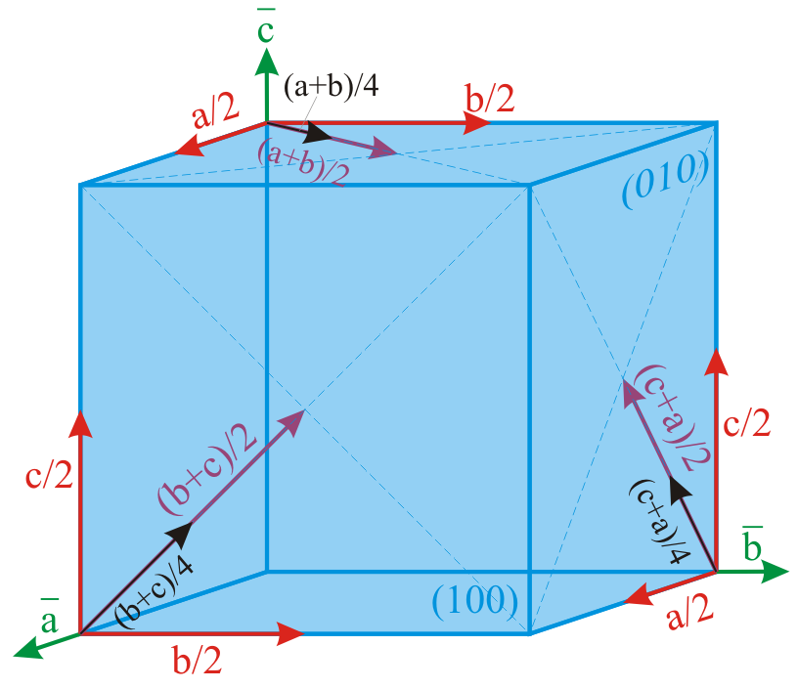
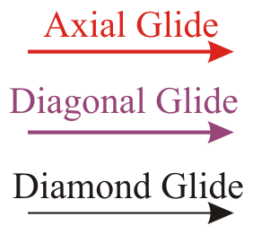
Different type of glides

Slide 25
Point Groups and Space Groups
We have so far considered various types of symmetry operators- those with translation and those without (keeping our focus on those related to crystals).
The symmetry operators without translation (rotation, inversion, mirror, roto-inversion, roto-reflection) leave a finite number of identity-points and even those involving translation (glide and screw) leave a finite number of identity-points within the unit cell.
Symmetry operators which do not involve translation can combine with one another in certain specific ways so as to leave a finite number of identity-points (i.e. arbitrary combinations are not possible). ➢ The number of such possible combinations (along with ‘single’ symmetry operators) is 32 and these are called the 32 Point Groups. ➢ One such combination is 4mm* ➢ An example of a disallowed combination is 22 (with an included angle of (say) 15°)*.
There are 7 distinct point group symmetries of lattices (14 Bravais Lattices) which correspond to the 7 Crystal Systems.
When all symmetry elements are allowed to combine- including those with translation- then we end up with 230 space groups.
There are 14 distinct space group symmetries of Lattices → the 14 Bravais Lattices
* Considered in upcoming slides
We shall not formally derive the 32 point groups or the 230 space groups- interested readers may consult Elementary Crystallography by M.J. Buerger

Slide 26
Point group symmetry of Lattices →
7 crystal systems
Symmetries acting at a point
R ⊕ ‾R
32 point groups
Along with symmetries having a translation
G + S
230 space groups
Space group symmetry of Lattices →
14 Bravais lattices
R + ‾R → rotations compatible with translational symmetry (1, 2, 3, 4, 6)

Slide 27
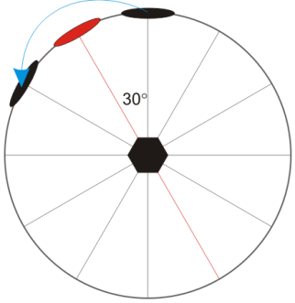
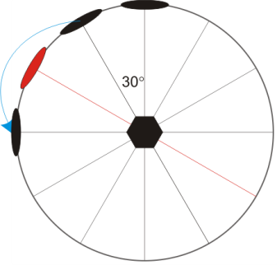
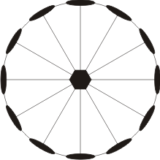
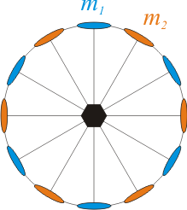
Allowed combinations
As mentioned before only some combinations of symmetry operators are allowed.
4mm is an allowed combination (as below) provided that the two mirrors are at 45° and the line of intersection of the mirror is the line of the 4-fold axis. When ever we write a symbol for a combination (according to the Hermann–Mauguin notation)- the symbol has a precise meaning w.r.t to the relative orientation of the component operators.
As shown below 2-fold axes with an included angle of 30° is an allowed combination → leading to point group 622 → Starting with just the two 2-fold axes- by repeated action of the two folds twelve 2-fold axes are created → which automatically implies that a 6-fold is perpendicular to the two 2-folds!
Active 2-fold is in red
622
m₁
m₂
4
The 2-folds have been coloured differently to understand the origin of the 6-fold
622
Right Handed
4mm
Left Handed
Notes:
Last bullet is unclear. Please show example, or elaborate.
27

Slide 28
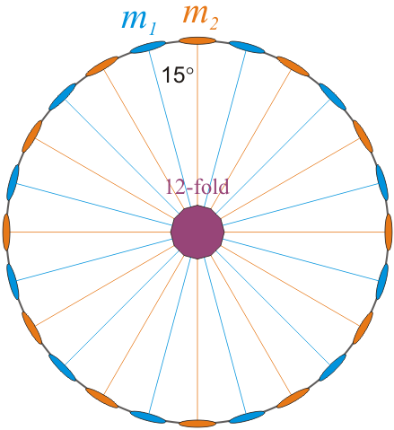
Disallowed combinations
Most of the possible combinations of symmetry elements are actually disallowed! If we randomly chose two rotation axes and put them at some random angle- more likely than not that would be a disallowed combination (note that there are only 22 allowed combinations → along with the single operators (10 in number) we get the 32 point groups)
As shown below two 2-fold axis with an included angle of (say) 15° is a disallowed combination → this is because the presence of two 2-folds with an included angle of 15° implies the presence of a 12 fold perpendicular to the plane of the 2-folds → which is a disallowed rotational symmetry in crystallography.
Another example of a combination which is disallowed is (say) two 2-fold axes with an included angle of 7° (360° is not divisible by 7!). In this case: the action of one two fold on the other repeatedly, would lead to an infinite number of two folds on the plane and hence an infinite number of points (if we start with one point) (i.e. space would not close on itself!).

Slide 29
Positioning a object with respect to the symmetry elements
In this part we briefly consider the effect of positioning an object with respect to the distribution of symmetry elements
As seen in the example of 4mm point group- placing an object in special positions reduces the number of identity-points/’objects’ produced by the point group.
General site → 8 identity-points
On mirror plane (m₁) → 4 identity-points
On mirror plane (m₂) → 4 identity-points
Site symmetry 4mm → 1 identity-point
Note: this is for a point group and not for a lattice → the black lines are not unit cells

Slide 30
Positioning of a motif w.r.t to the symmetry elements of a lattice → Wyckoff positions
A 2D lattice with symmetry elements

Slide 31
Multi-plicity | Wyckoff letter |  | Site symmetry | Coordinates
8 | g | Area | 1 | (x,y) | (-x,-y) | (-y,x) | (y,-x)
 |  |  |  | (-x,y) | (x,-y) | (y,x) | ((-y,-x)
4 | f | Lines | ..m | (x,x) | (-x,-x) | (x,-x) | (-x,x)
4 | e |  | .m. | (x,½) | (-x, ½) | (½,x) | (½,-x)
4 | d |  | .m. | (x,0) | (-x,0) | (0,x) | (0,-x)
2 | c | Points | 2mm. | (½,0) | (0,½)
1 | b |  | 4mm | (½,½)
1 | a |  | 4mm | (0,0)
g
f
e
b
d
a
c
Number of Identi-points
Any site of lower symmetry should exclude site(s) of higher symmetry [e.g. (x,x) in site f cannot take values (0,0) or (½, ½)]

Slide 32
g
f
e
b
d
a
c
Exclude these points
f
Exclude these points
d
e
Exclude these points

Slide 33
In crystallography when we talk of Symmetry; the natural question which arises is: Symmetry of What?
The symmetry of the following entities are different and should not be confused with one another!
Lattice
Motif
Symmetry of the
Crystal
Unit Cell
Eumorphic crystal (equilibrium shape and growth shape of the crystal)
The shape of the crystal corresponds to the point group symmetry of the crystal

Slide 34
Effect of decoration of a lattice on the symmetry
We briefly consider this aspect here- details can be found in the topics on Geometry of Crystals and Making Crystals
An Infinite Lattice can be represented by a Unit Cell.
On decorating the lattice with objects the symmetry of the lattice may be: ➢ Maintained ➢ lowered
A special type of object which is repeated identically (in shape, orientation colour etc.) at each lattice point is called a Motif.

Slide 35
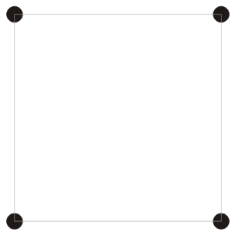
Consider a square (which could also function as a unit cell of a crystal if decorated with a motif)
The square shape (and also the collection of four points in the corners of a square) have some basic symmetries as shown below
Complete set of symmetries
i
Square
Symmetries
Which can be written as
4 m₁ m₂ i
4-fold
Which can be further abbreviated as
m_{v} = m₁
m_{d} = m₂
4mm
4 points at the vertices of a square

Slide 36
Effect of the decoration → a 2D example
Two kinds of decoration are shown → (i) for an isolated object, (ii) an object which can be an unit cell.
4mm
Redundant mirrors which need not be drawn
Redundant inversion centre
Can be a unit cell for a 2D crystal
4mm
Decoration retaining the symmetry
This is not a Motif as it is not repeated identically at each point
Motif

Slide 37
mm
m
m
Possible UCs
of Crystals
Motifs

Slide 38
4
No symmetry
If this is an unit cell of a crystal → then the crystal would still have translational symmetry
This is a Crystal
This is Amorphous!!
Motif: object with no symmetry

Slide 39
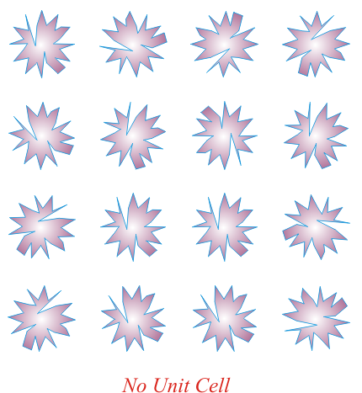
Amorphous
Not a Motif (as repeated at random orientations)

Slide 40
Lattices have the highest symmetry
(Which is allowed for it) ➢ Crystals based on the lattice can have lower symmetry

Slide 41
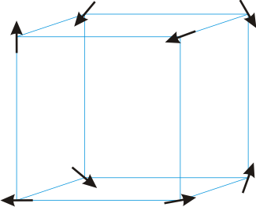
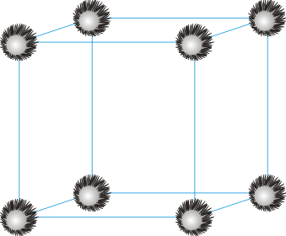
Amorphous arrangement No unit cell
Unit cell of Triclinic crystal

