Slide 1
Loops

Slide 2
In general, statements are executed sequentially: The first statement in a function is executed first, followed by the second, and so on. There may be a situation when you need to execute a block of code several number of times.

Slide 3
Programming languages provide various control structures that allow for more complicated execution paths.
A loop statement allows us to execute a statement or group of statements multiple times. The following diagram illustrates a loop statement −

Slide 4
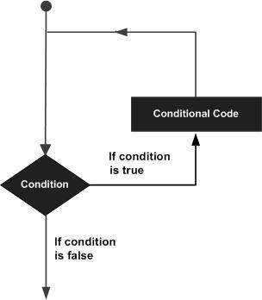

Slide 5
While loop
A while loop statement in Python programming language repeatedly executes a target statement as long as a given condition is true.
Syntax
The syntax of a while loop in Python programming language is −
while expression:
statement(s)

Slide 6
Here, statement(s) may be a single statement or a block of statements. The condition may be any expression, and true is any non-zero value. The loop iterates while the condition is true.
When the condition becomes false, program control passes to the line immediately following the loop.
In Python, all the statements indented by the same number of character spaces after a programming construct are considered to be part of a single block of code. Python uses indentation as its method of grouping statements.

Slide 7
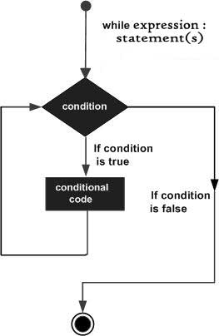

Slide 8
example
count = 0
while (count < 9):
print 'The count is:', count
count = count + 1
print "Good bye!"

Slide 9
For Loop
It has the ability to iterate over the items of any sequence, such as a list or a string.
Syntax
for iterating_var in sequence:
statements(s)

Slide 10
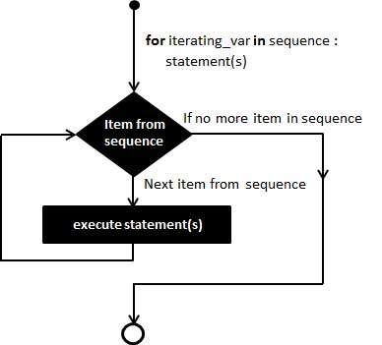

Slide 11
examples
for x in range(6): print(x)

Slide 12
for x in range(2, 6): print(x)

Slide 13
for x in range(2, 30, 3): print(x)

