Slide 1
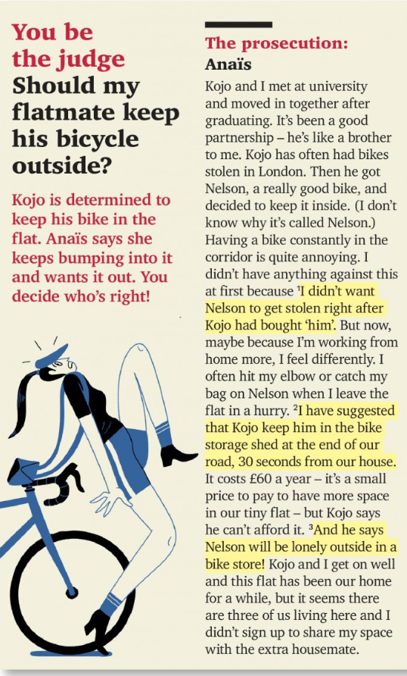
Flatmate: A person who shares a flat (apartment) with you.
Prosecution: The side in an argument or court case that accuses someone of doing something wrong.
Graduate: To complete your studies at a university or college and receive a degree.
Partnership: A relationship between two people who live, work, or do something together.
Constantly: Happening continuously, repeatedly, or all the time without stopping.
Corridor: A long, narrow passage inside a building with doors leading into rooms; a hallway.
Annoying: Making you feel slightly angry, impatient, or bothered.
In a hurry: Doing something very quickly because you do not have enough time.
Suggest: To put forward an idea, plan, or proposal for someone to consider.
Storage shed: A small outdoor building used for keeping tools, equipment, or bicycles safe.
Afford: To have enough money or resources to buy or pay for something.
Lonely: Feeling sad because you are alone or isolated from others.
Get on well: To have a friendly and harmonious relationship with someone.
Sign up for (something): To agree to participate in, accept, or take part in a situation or arrangement.
Housemate: A person who lives in the same house as you.

Slide 2
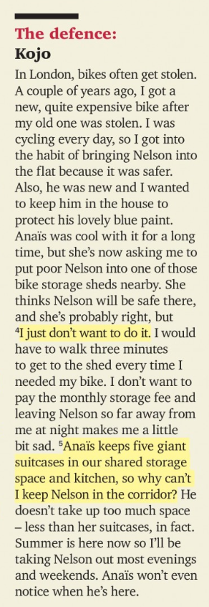
Defence: The side in an argument or court case that defends their actions and responds to accusations.
Get into the habit of: To start doing something regularly or automatically over time.
Protect: To keep someone or something safe from harm, damage, or theft.
Be cool with (something): To accept, agree with, or not be bothered by a particular situation.
Storage fee: An amount of money paid regularly for storing items in a secure place.
Shared: Owned, used, or experienced by two or more people together.
Take up (space): To fill or occupy a particular amount of space or time.
Notice: To become aware of something by seeing, hearing, or feeling it.

Slide 3
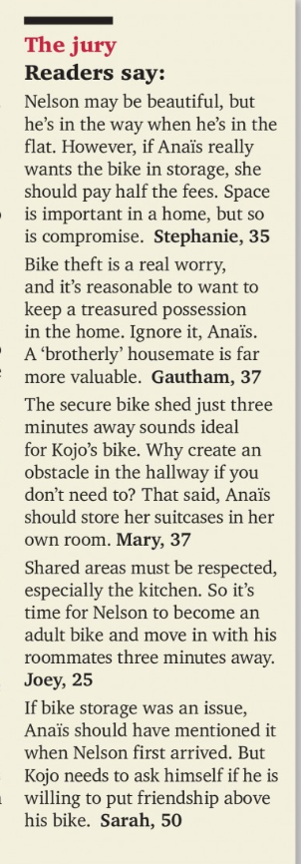
Jury: A group of people chosen to listen to facts in a debate or trial and make a decision or judgement.
In the way: Blocking a path or space, making it difficult for people to move freely.
Compromise: An agreement in an argument where both sides give up a part of what they want.
Theft: The crime of stealing something from a person or place.
Reasonable: Fair, practical, sensible, or showing good judgement.
Treasured: Highly valued, precious, or deeply loved.
Possession: Something that you own or have with you.
Valuable: Worth a lot of money, or extremely useful and important.
Ideal: Perfect, most suitable, or satisfying all requirements.
Obstacle: An object or problem that blocks your path or makes progress difficult.
Respect: To show care, consideration, and proper regard for someone's rights or property.
Mention: To speak or write about something briefly, without going into detail.
Be willing to (do something): Ready, prepared, or happy to do something if required.

Slide 4
Flatmate Dilemmas & Living Spaces
Whose side are you on—Anais or Kojo?
Explain why you think one flatmate's situation is more reasonable than the other's.
Where should the line be drawn regarding personal items in shared areas?
Is keeping a bicycle in a hallway different from storing large suitcases?
What makes a "good flatmate"? How important is compromise when sharing a home with friends?

Slide 5
2. Belongings, Theft & Safety
How would you protect a valuable or treasured possession?
If you owned an expensive bicycle in a big city with high theft rates, where would you store it?
Is £60 a year a small price to pay for security, or should Kojo refuse to pay it on principle?

Slide 6
3. Conflict Resolution & Communication
Did Anais handle the situation correctly?
Should she have raised the issue as soon as Kojo bought the bike, or was it fair to change her mind later when working from home?
Which reader opinion from the jury made the most sense to you?
Do you agree with Stephanie (split the fees), Gautham (ignore it for friendship), Mary (move the suitcases too), Joey (respect shared areas), or Sarah (put friendship first)?
How would you solve this conflict if you were a neutral third flatmate living with them? What fair compromise would you propose?

Slide 7
Mind vs. Matter
• Mind (verb): To feel annoyed, bothered, or unhappy about something. Used for a person's feelings (e.g., "Do you mind...").
• Matter (verb): To be important or significant. Used for things or situations (e.g., "It doesn't matter").
2. Remember vs. Remind
• Remember (verb): To bring a fact, event, or idea back into your own mind without outside help.
• Remind (verb): To cause someone else to remember something (e.g., "remind someone to do something").
3. Rob vs. Steal
• Rob (verb): To illegally take property from a person or place using force or threats. Focuses on the victim or location (e.g., "rob a bank / rob me").
• Steal (verb): To take something that belongs to someone else without permission. Focuses on the object taken (e.g., "steal a bike").

Slide 8
4. Advise vs. Warn
• Advise (verb): To give someone helpful suggestions or recommendations about what they should do.
• Warn (verb): To alert someone about potential danger, problems, or negative consequences before they happen.
5. Avoid vs. Prevent
• Prevent (verb): To stop an event or action from happening at all.
• Avoid (verb): To stay away from a person, place, or situation to stay safe or comfortable.
6. Borrow vs. Lend
• Borrow (verb): To temporarily receive something from someone with the intention of returning it (Direction: Take from someone).
• Lend (verb): To temporarily give something to someone expecting to get it back (Direction: Give to someone).
7. Win vs. Beat
• Win (verb): To achieve victory in a game, competition, match, or prize (Object: game / medal / prize).
• Beat (verb): To defeat an opponent or competing team in a game or context (Object: person / team / rival).

Slide 9
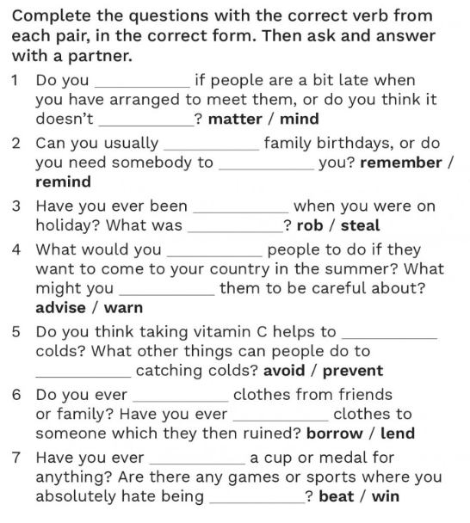

Slide 10
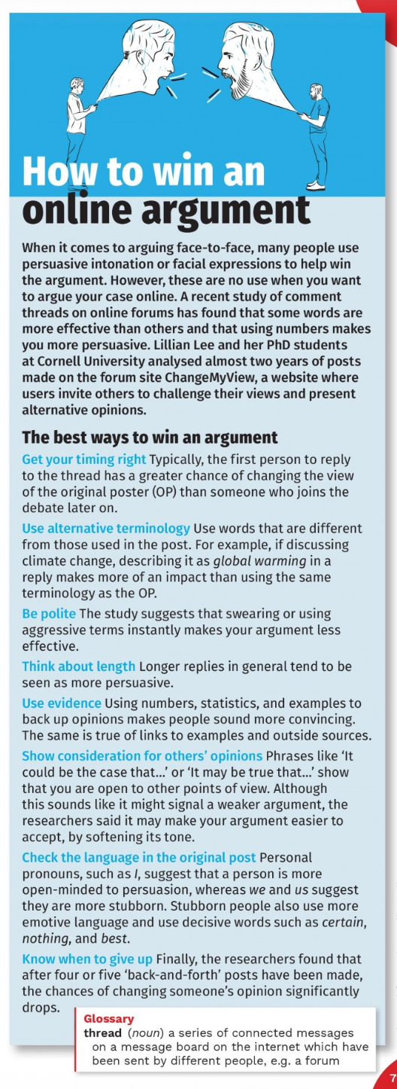
Paragraph 1: Introduction
  State the topic clearly without copying the prompt word-for-word.
  Provide brief context or contrast (e.g., While some people believe …, others argue Y).
Paragraph 2: Arguments FOR (The Positive Side)
  Present 2–3 clear points with explanations and real-world examples.
Paragraph 3: Arguments AGAINST (The Opposing Side)
  Present the alternative viewpoint objectively.
Paragraph 4: Conclusion
  Summarize the main points and give your balanced final opinion.

Slide 11
