Slide 1
What controls our sleep?
light – age – work – phones – food – exercise – medicine – stress
Which three things have the biggest effect on sleep?
How might they affect our body clock?
Which of your ideas do you think a scientist would agree with?
Which ideas are you unsure about?

Slide 2
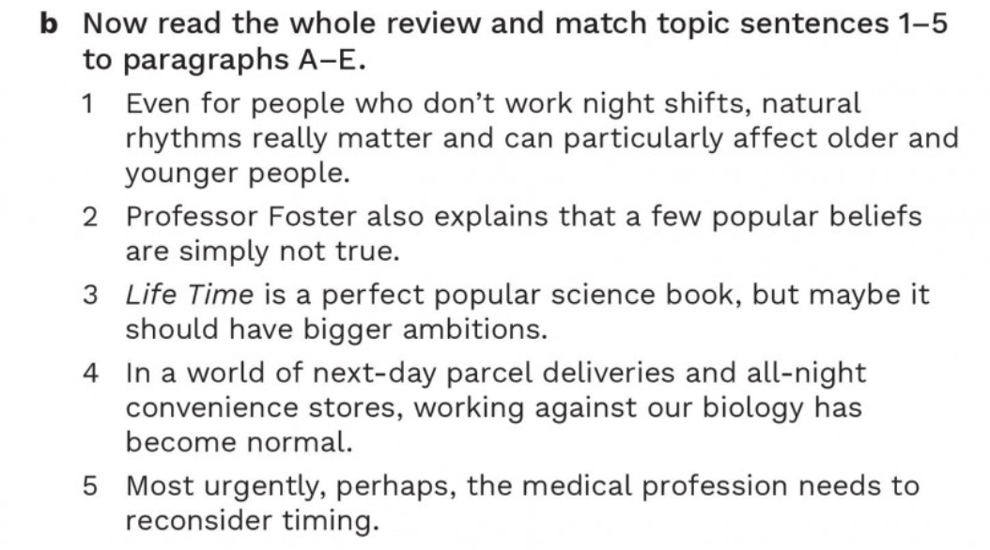
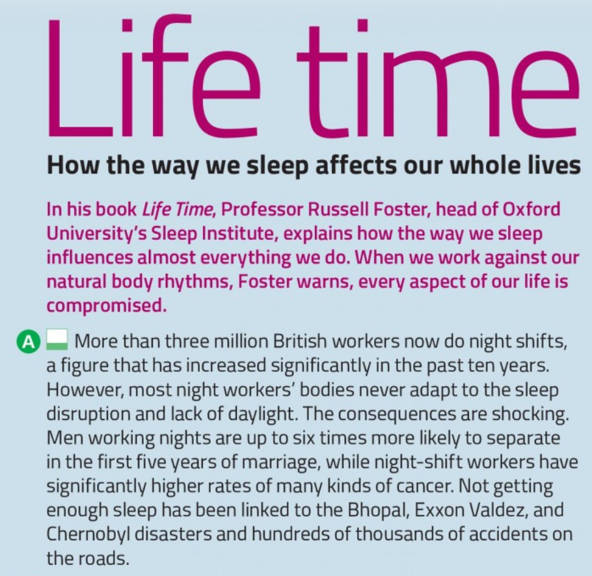
Night shift a period of work during the night
Figure a number or statistic that represents an amount
increase significantly to become considerably greater in amount, number or level
adapt to to change in order to become suitable for a new situation
Disruption an interruption that prevents something from continuing normally
lack of not having enough of something
Consequence a result of an action or situation, especially a negative result
up to as much as; the maximum possible amount
Separate to end a relationship or stop living together
Rate he number or amount of something measured in relation to another amount
Significantly by a large or important amount
be linked to to have a connection with something
Disaster a very serious event that causes great damage or suffering
Accident an unexpected event that causes damage, injury or harm
on the roads while travelling or driving on roads
useful expressions
sleep disruption — interruption of a normal sleep pattern
lack of sleep — not getting enough sleep
higher rates of — greater numbers or levels of something
be linked to — be connected with
be likely to do something — probably do something
4

Slide 3
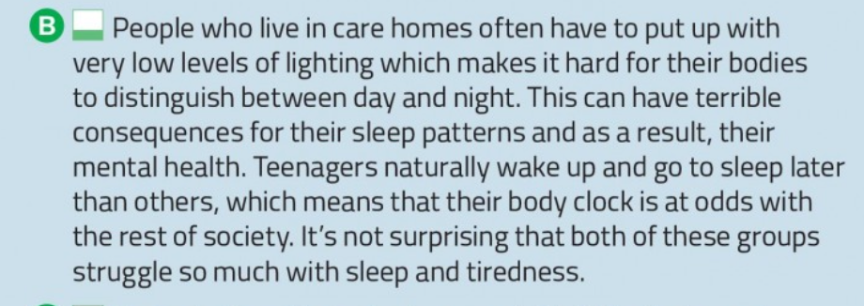
1
care home a place where people who need regular care live and are looked after
sleep pattern the regular way in which a person sleeps and wakes
body clock the natural system that controls regular body activities such as sleeping and waking
Useful expressions
put up with something = tolerate something unpleasant
distinguish between A and B = recognise the difference between A and B
as a result = because of this / consequently
be at odds with something = be in conflict with something
struggle with something = have difficulty dealing with something

Slide 4
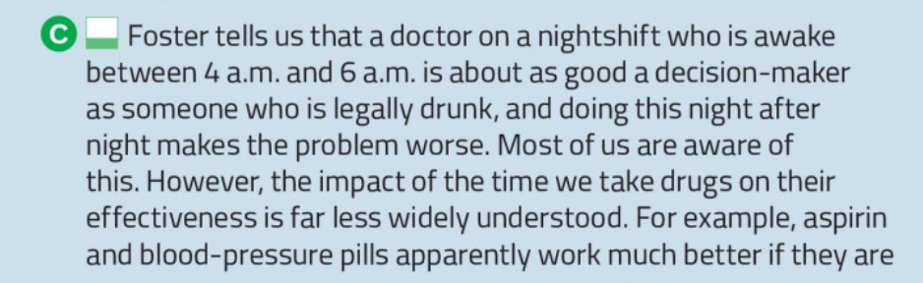
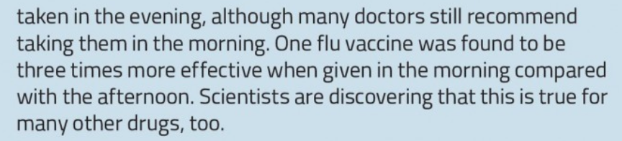
5
Impact a strong effect or influence
Drug a substance used as medicine to treat or prevent a
medical condition
Aspirin a common medicine used to reduce pain, fever and inflammation
blood-pressure pill a medicine used to help control blood pressure
Apparently according to what seems to be true or according to available information
Vaccine a substance given to protect a person against a particular disease
be found to be to be discovered or shown to have a particular quality
compared with considered alongside something else in order to identify differences
Useful Expressions
be aware of something = know or realise something
have an impact on something = have a strong effect on something
the effectiveness of something = how successfully something produces the desired result
recommend doing something = suggest doing something

Slide 5
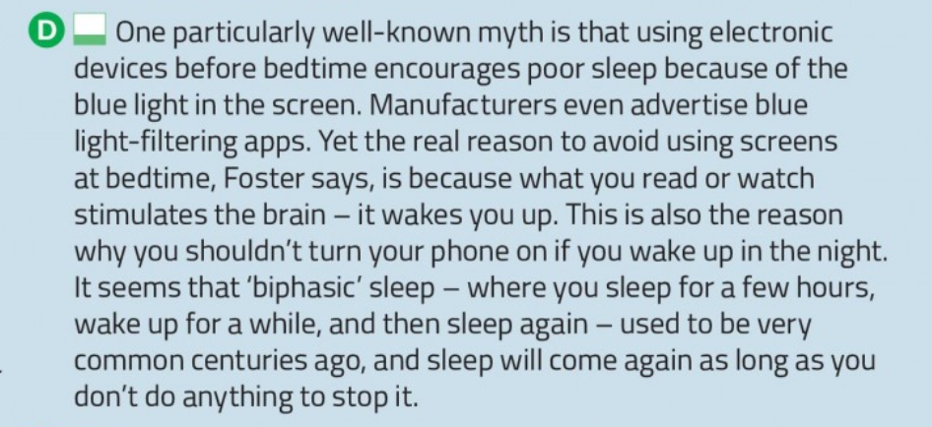
2
Useful expressions
be encouraged to do something = be made more likely to do something
avoid doing something = deliberately not do something
stimulate the brain = make the brain more active
used to do something = did something regularly in the past
as long as = provided that / on the condition that
Particularly Especially
Myth a widely believed idea that is not actually true
blue light a type of visible light produced by sources such as electronic screens
Manufacturer a company that makes products, usually in large quantities
Advertise to tell people about a product or service in order to encourage them to buy or use it
Stimulate to make something, especially the brain or a physical process, more active
Biphasic involving two separate phases or periods
Common happening frequently or existing in large numbers
as long as provided that; on the condition that

Slide 6
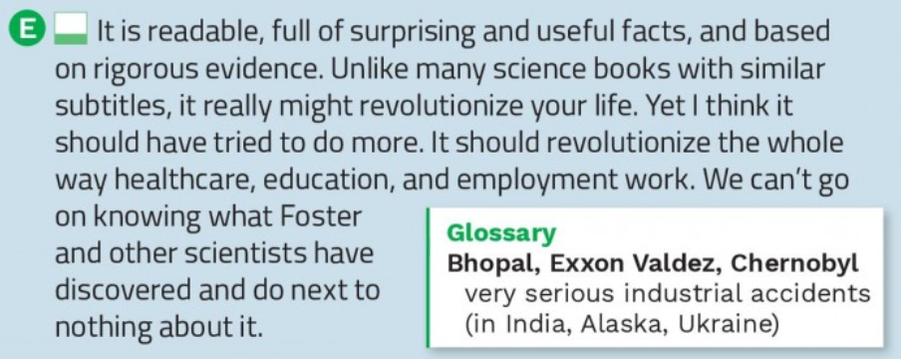
Useful expressions
be based on evidence = be supported by facts or information
rigorous evidence = evidence collected or examined in a very careful and thorough way
unlike something = in contrast to something
revolutionize something = completely transform something
Readable easy or enjoyable to read
based on using something as its main source, foundation or support
Rigorous extremely thorough, careful and accurate
Evidence facts or information that show whether something is true
Subtitle a secondary title that gives additional information about a book or other work
Revolutionize to completely change something in a significant way
go on doing something continue doing something
do next to nothing do almost nothing

Slide 7
Discussion Topics
Do night shifts have serious effects on people's health?
Should society adapt to people's natural body rhythms?
Should teenagers be allowed to start school later?
How do phones and screens affect our sleep?
Does it matter when we take medicine?

