Slide 1
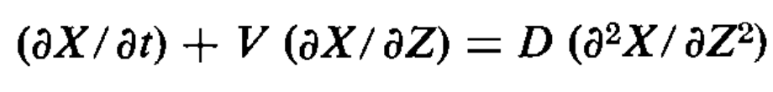
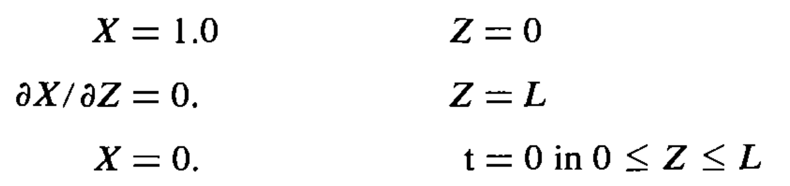
Advection-diffusion benchmark
Physical model
1-dimensional advection-diffusion is considered:
X is concentration; V is velocity (constant); D is diffusivity; Z is position.
Cleary and Adrian, 1973, Soil Science Society of America Journal

Slide 2
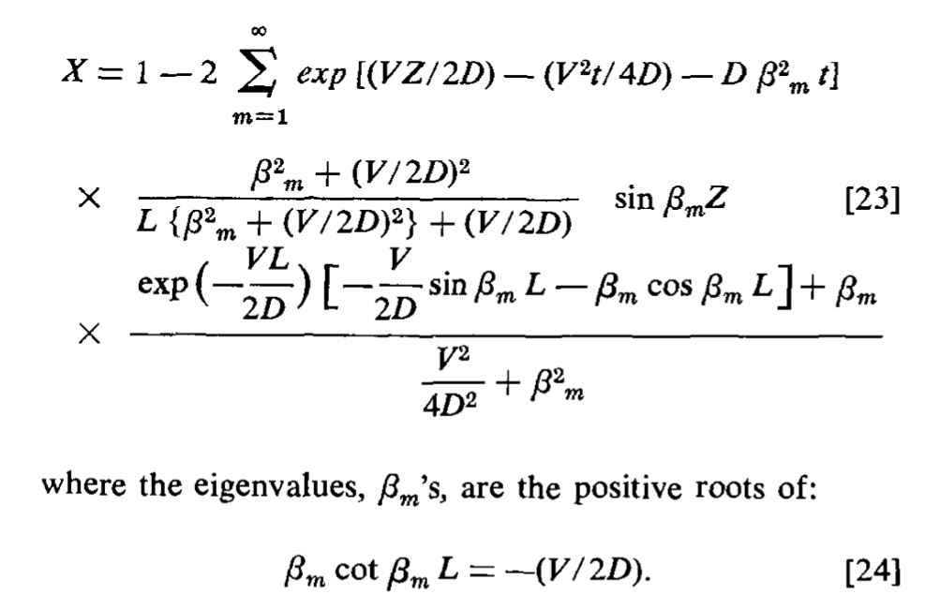
Advection-diffusion benchmark
Solution:
Cleary and Adrian, 1973, Soil Science Society of America Journal

Slide 3
Advection-diffusion benchmark
Simulation:
Zero gradient wall B.C. for U, C
C=1
U=constant, C(t = 0) = 0
𝛛C/ 𝛛x = 0
Zero gradient wall B.C. for U, C

Slide 4
Advection-diffusion benchmark
Results
Cleary and Adrian, 1973, Soil Science Society of America Journal

