Slide 1
D2D Security and Federated Learning
Ziyan Aarif Karmali
18BCI0272

Slide 2
Methodology
The objective of this project is to build a decentralized network with Federated learning in order to predict the next word a person would type depending on the given input to the algorithm. By using a deep learning neural network model, I would like the model to predict and get what is the probability of certain words to be typed by the user next. By using a federated learning technique, the next word that will be predicted will also be personalized according to the user since this process is different for each user.

Slide 3
Algorithm
Initialize the training dataset along with giving tokenized values provided by google dataset
Preprocess the training data
Model training and accuracy prediction
Giving model weights to local server(phone)
Training over local data
Prediction

Slide 4
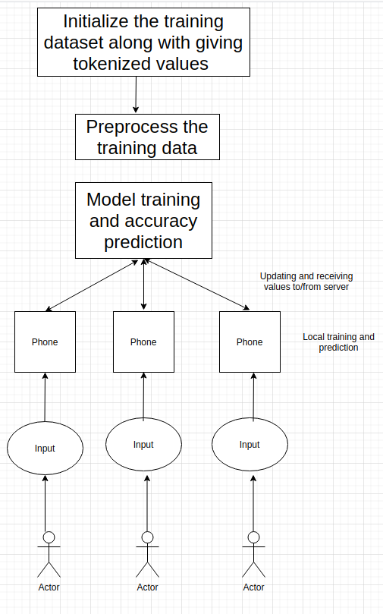
Diagram of approach

Slide 5
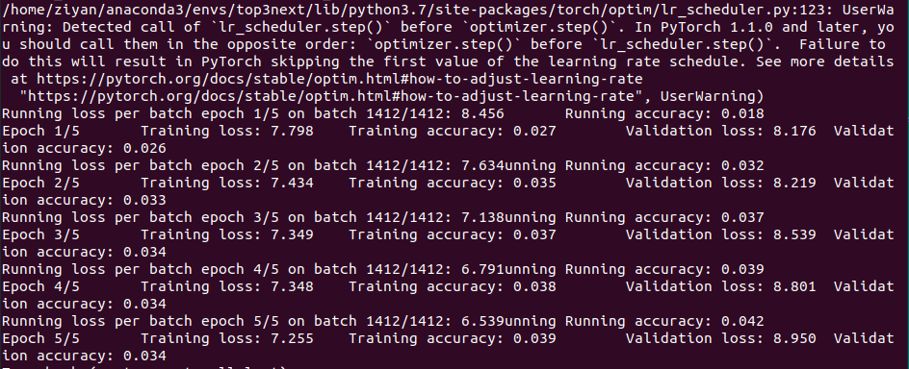
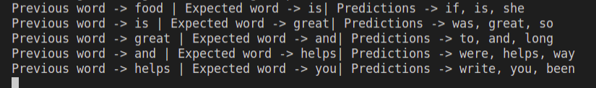

Slide 6
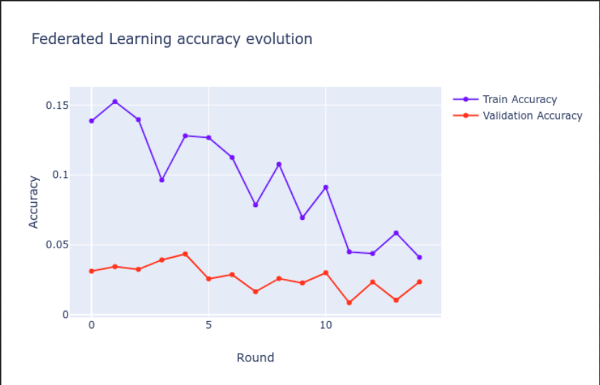

Slide 7
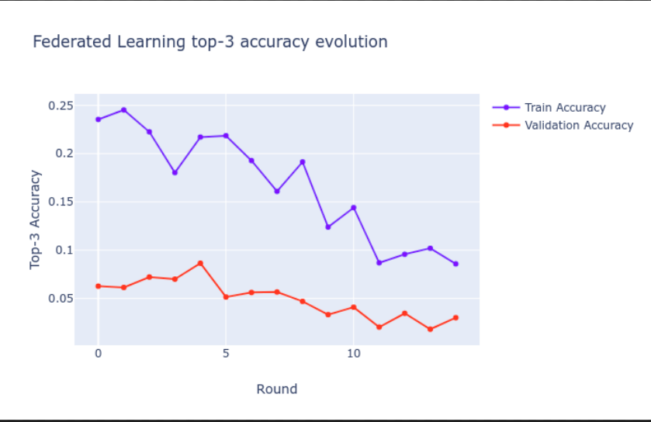

Slide 8
Result
Therefore now it can be see that the prediction of the next word is mostly accurate and works specific to user device.

