Slide 2
Cache Group 1
squid server
HAproxy
squid server
PoP
squid server
Cache Group 2
squid server
HAproxy
squid server
HAproxy
squid server
Cache Group 3

Slide 3


website dns
global server load balancer
source website
6
2
3
PoP(CDN)
5
1
local dns
7
4
clients

Slide 4
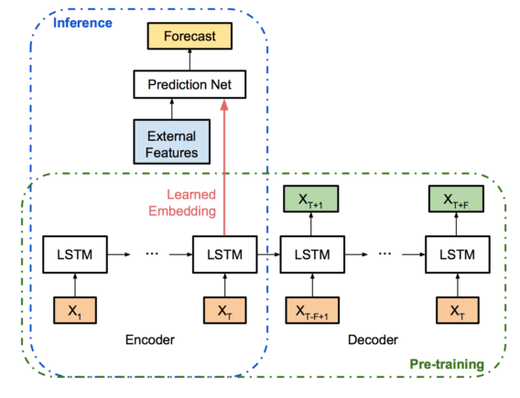
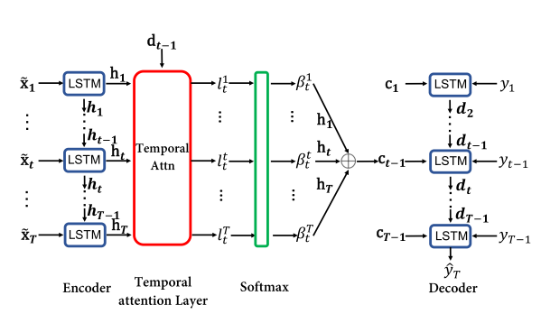

Slide 5







$$y_{t}$$
Prediction
Feed forward network
Encoder
Decoder
$$x_{1}$$
lstm
lstm
latent
variable
lstm
lstm
$${\hat{x}}_{1}$$
$$x_{2}$$
lstm
lstm
lstm
lstm
$${\hat{x}}_{2}$$
………………………………………………………
………………………………………………………
$$x_{T}$$
lstm
lstm
lstm
lstm
$${\hat{x}}_{T}$$

Slide 6
Encoder
Decoder
$$x_{1}$$
lstm
lstm
latent
variable
lstm
lstm
$${\hat{x}}_{1}$$
$$x_{2}$$
lstm
lstm
lstm
lstm
$${\hat{x}}_{2}$$
………………………………………………………
………………………………………………………
$$x_{T}$$
lstm
lstm
lstm
lstm
$${\hat{x}}_{T}$$

Slide 7
Input Layer
Hidden Layer
Output Layer

Slide 8
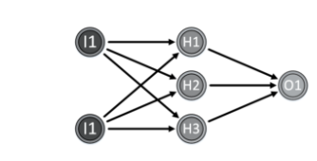

Slide 9
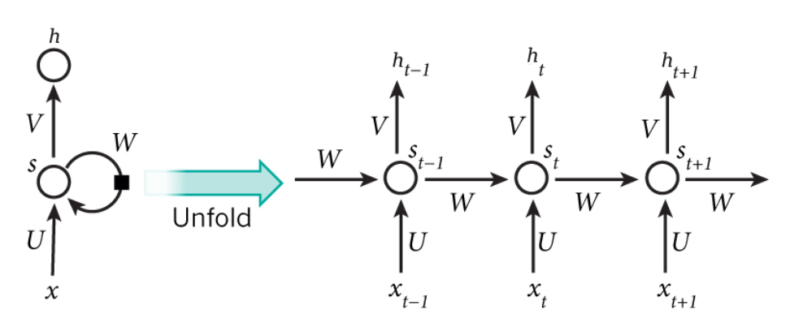

Slide 10





















$$h$$
$$h_{t−2}$$
$$h_{t−1}$$
$$h_{t}$$
$$y$$
$$W^{′}$$
$$W$$
$$s_{t−2}$$
$$W$$
$$s_{t−1}$$
$$s_{t}$$
$$s$$
$$W$$
$$I$$
$$I$$
$$I$$
$$I$$
$$x$$
$$x_{t−2}$$
$$x_{t−1}$$
$$x_{t}$$

Slide 11
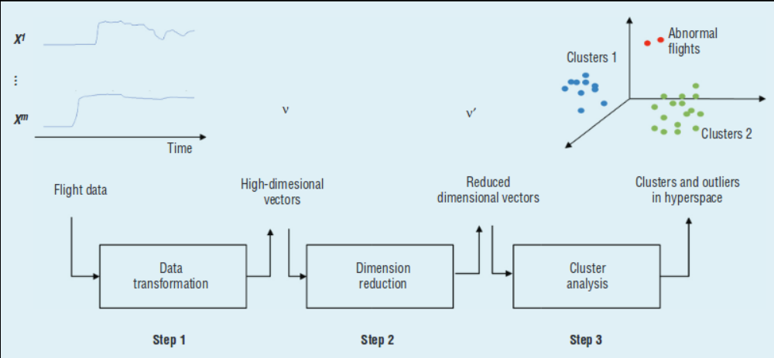

Slide 12
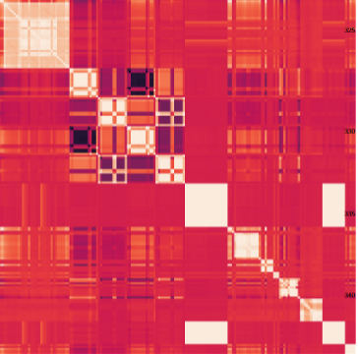


$$x^{1}$$
……
$$x^{m}$$
High Dimensional Data
Correlation analysis
Clustering

