Slide 1
SCReAM Congestion Control
Our implementation vs UMN's reimplementation
A controlled, like-for-like comparison — same video, same network, fair config
GstreamerExp · Hypothesis H5

Slide 2
What we compared
Both stacks stream the same 60 s camera clip on one machine over loopback.
The network is squeezed the same way for both: a Linux shaper replays three recorded 5G patterns —
• HO — a sudden handover drop
• RB — bumpy tower-sharing
• CQI — smooth signal drift (high capacity)
Same bitrate limits. UMN's delay signal turned on so the comparison is fair.
HOLDING CONSTANT
Video
1280×1024, 10 fps, 60 s
Host
single machine, loopback
Shaper
tc on lo, 5G traces ×1/3
Reps
3 per trace
Varies
only the SCReAM build

Slide 3
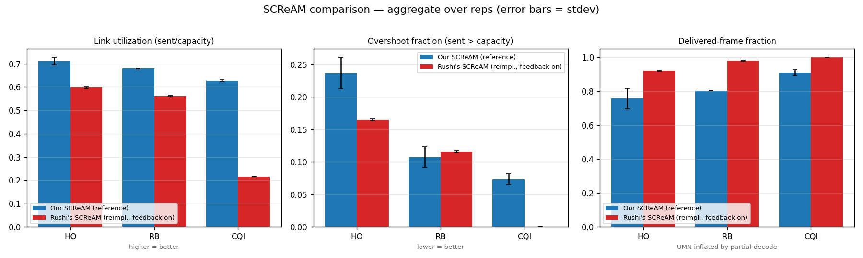
Result: ours uses the network better
63%
OURS — bandwidth used
on the high-capacity link
22%
UMN — bandwidth used
same link, same moment
Ours raises and lowers its sending rate to match the link.
UMN's sends a near-constant ~780 kbps on every trace — even when the capacities differ 2.5×. It doesn't follow the network.

Slide 4
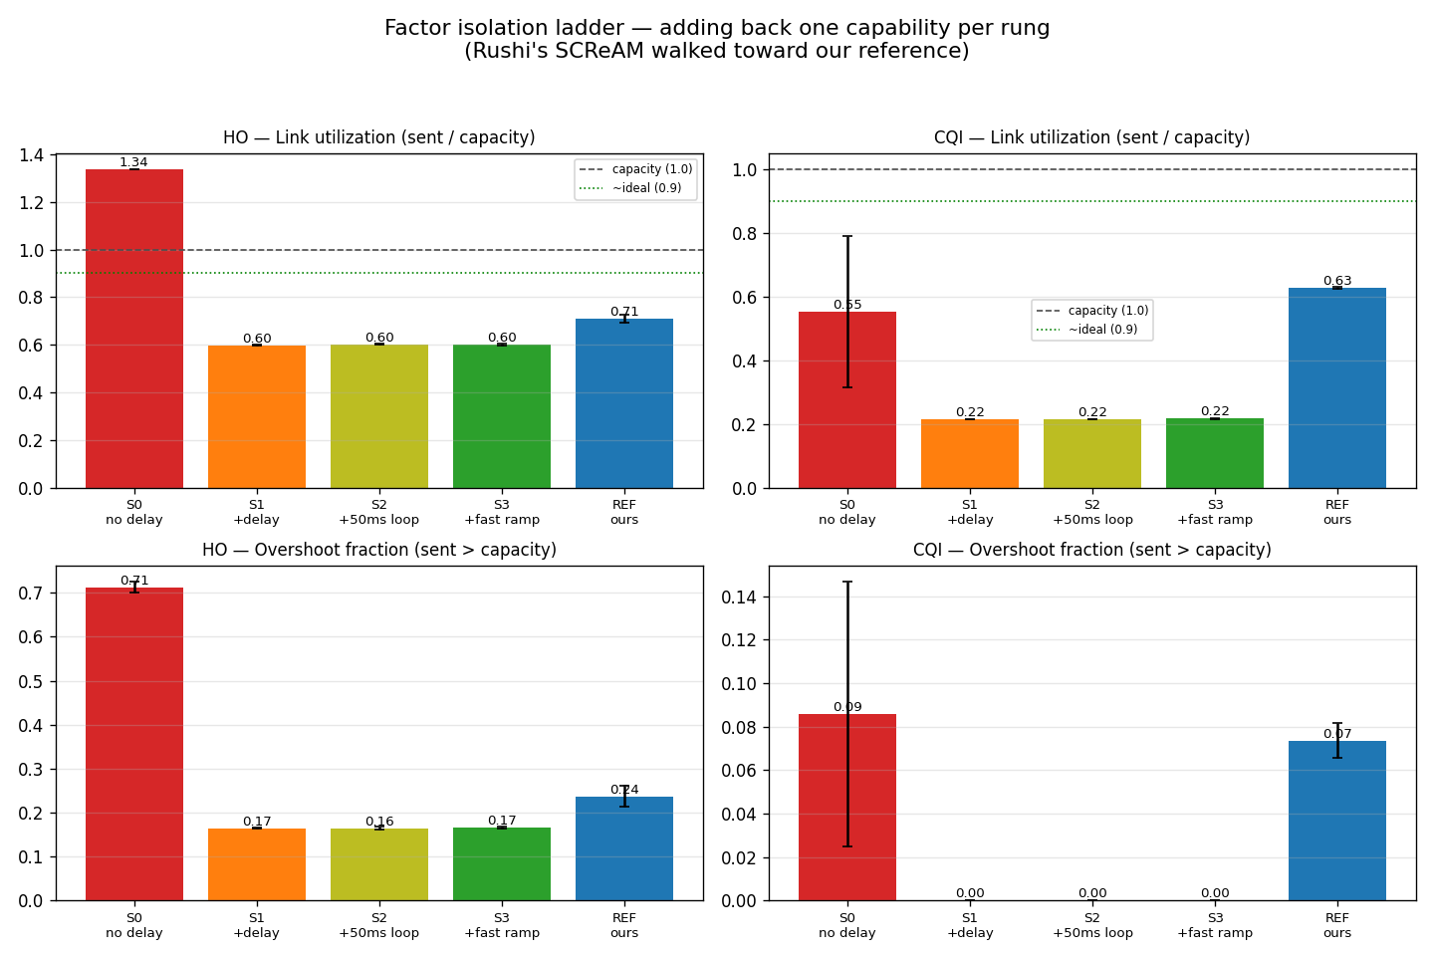
Why: the controller can't drive the encoder
UMN's controller decides a rate correctly — but that decision never reaches the video encoder.
The encode loop writes the new rate onto an already-running software encoder, which the library ignores; the rate is fixed when the encoder opens.
We ruled out timing: making the loop 4× faster changed nothing (S2, S3 below).
Analogy a thermostat that correctly says “turn down the heat” — but the wire to the furnace is cut.

Slide 5
Two independent reasons ours is more mature
1 · Measured
Open control loop
On the software path we tested, the controller's rate is computed but never applied — the loop is open. Ours is closed: the framework applies the rate to the encoder automatically.
Evidence: sent rate exceeded the commanded rate in ~89% of decisions.
2 · From code review
Simpler control law
UMN's is a fixed-gain multiply-up (×1.05) / down (×0.8) loop on yes/no signals, with no memory. The reference uses a congestion window and a continuous queue-delay trend with adaptive steps.
Not measured here — the wiring gap masked it. From reading the source.

Slide 6
Takeaway
Our SCReAM tracks a changing link; UMN's holds a near-constant rate.
The cause is implementation maturity — a closed control loop and the reference algorithm — not a flaw in SCReAM itself.
HONEST CAVEATS
• UMN's deployed NVENC encoder uses the same no-reopen code path we tested, so the gap very likely applies there too — only the unused VAAPI path reopens. Not yet run on NVENC hardware.
• We measured network behavior (how well it uses the link), not delivered video quality (PSNR).
• Single-host loopback reproduces bandwidth and delay, not real 5G radio effects.

