Slide 1
Report of Explainable Machine Learning Models And The Application In Real-Rorld Use Case
Ziyang Ye
Georgetown University
Notes:
I‘m Scott, I work with Su-In Lee at the University of Washington, and I hope you enjoy exploring model interpretability with us this afternoon. XX

Slide 2
Why?!
chance John will have repayment problems
model
55%
No loan
John, a bank customer
Why?!
AI magic!
Notes:
We'll start with a simple motivational example. This is John, a typical bank customer. Like many consumers today, when he applies for a loan, information about him is sent through a predictive model XX.
This model is designed to calculate the risk that John will have repayment problems, XX which, unfortunately for John, is 55%. And because his risk is high, the bank declines his loan application XX.
A natural first question John has XX is “Why?” The bank XX also want to know why, because these are key business decisions. But unfortunately for the data scientist that built this model XX, she used a complex model and so these questions are hard to answer XX …. XX

Slide 3
 | Interpretable | Accurate
Complex model | ✘ | ✔
Simple model | ✔ | ✘
Interpretable or accurate: choose one.
😀 ⚖️
💰
Notes:
The reason the data scientist used a complex model is because they are often very accurate on large data sets XX, but that same complexity also makes them hard to interpret XX. In contrast, simple models are easy to interpret XX, but are often less accurate XX. This leads to a trade-off XX between interpretability and accuracy.
This trade-off is particularly painful for the bank since accuracy directly corresponds to profitability XX, while interpretability has important implications for customer satisfaction XX and even legality. This tradeoff effects a wide range of applications, and so many recent methods have been developed to address it. XX

Slide 4
Input value
Output value
Complex models are inherently complex!
But a single prediction involves only a small piece of that complexity.
Notes:
These methods do not try and make an entire complex model interpretable, because there is inherently too much to succinctly explain. Instead they focus on explaining a single prediction XX, because mapping a single input to an output involves only a small part of the complexity of the overall model. XX

Slide 5
data
model
prediction
.
.
.
Notes:
How do we explain the prediction of a potentially complex model?
One approach is to change the model inputs, where x_1 could for example represent John’s age, and see how the model behaves. By hiding XX such a feature from the model … XX, or a set XX of features, we can learn about how features effect the model’s output. XX
If we want to summarize these effects, we can attribute an importance value to each feature XX, and replace the model with a simple sum. XX

Slide 6
data
prediction
.
.
.
Notes:
These feature attributions approximate the effect of hiding XX features from the original model. XX

Slide 7
data
prediction
.
.
.
Notes:
Note that these attributions are specific to the model, f, being explained, and also, x, the input data used for this prediction.
It turns out that this way of explaining a model’s prediction, as a sum of feature attributions, is widely used. XX

Slide 8
LIME
DeepLIFT
LIME
Ribeiro et al. 2016
Shrikumar et al. 2016
Shapley reg. values
Shapley reg. values
Relevance prop.
Lipovetsky et al. 2001
Bach et al. 2015
QII
QII
Shapley sampling
Shapley sampling
Path expectations
Datta et al. 2016
Štrumbelj et al. 2011
Saabas 2014
Notes:
In fact, there are at least seven different explanation methods that all use a sum of feature attributions to explain complex models.
XX LIME is popular method designed to explain model predictions by fitting a simple model to the original complex model locally. Where local means near the current set of inputs we are explaining. The simple model they use is a linear model of toggled inputs, and so can be viewed as a sum of feature attributions.
XX There are three methods based on ideas from game theory about allocating credit. They also produce a sum of feature attributions.
All of these methods can explain the output of any black box model, however there are also methods designed to interpret the output of specific types of complex models. XX

Slide 9
Additive feature attribution methods
DeepLIFT
LIME
DeepLIFT
LIME
Ribeiro et al. 2016
Shrikumar et al. 2016
Shapley reg. values
Shapley reg. values
Relevance prop.
Relevance prop.
Lipovetsky et al. 2001
Bach et al. 2015
QII
QII
Shapley sampling
Shapley sampling
Path expectations
Path expectations
Datta et al. 2016
Štrumbelj et al. 2011
Saabas 2014
Notes:
Path expectations is targeted at tree ensemble methods, while XX DeepLIFT and relevance propagation target neural networks.
Since these methods all produce explanations of the same form, they can be considered part of the same class, which we call XX “additive feature attribution methods”. XX

Slide 10
Additive feature attribution methods
data
prediction
.
.
.
Notes:
Noting this previously unappreciated unity among explanation methods is helpful, but even more interesting is that a connection with game theory implies XX there is only one way to assign feature feature attributions while maintaining two natural properties. What are these properties? XX

Slide 11
Additive feature attribution methods
data
prediction
.
.
.
1
Local accuracy
Notes:
The first is local accuracy, which states XX that the sum of the feature attributions equals the original model’s prediction. XX

Slide 12
data
.
.
.
1
Local accuracy

Slide 13
data
1
Local accuracy

Slide 14
data
.
.
.
2
Consistency
Notes:
The second is consistency, which states that if toggling a feature XX in one model XX

Slide 15
data
.
.
.
2
Consistency

Slide 16
data
.
.
.
2
Consistency
Notes:
makes a larger difference than toggling the same feature XX in another model XX

Slide 17
data
.
.
.
2
Consistency

Slide 18
data
.
.
.
2
Consistency
Notes:
then the feature should be attributed a larger value XX in the first model than the second. Under these two conditions the feature attribution values are forced to be the classic Shapley values from game theory. XX

Slide 19
Additive feature attribution methods
LIME
DeepLIFT
Shapley reg. values
Relevance prop.
QII
Shapley sampling
Path expectations
Notes:
A number of current methods XX have not previously considered these properties and the uniqueness result they imply, and this has important implications for each of them. In contrast, XX methods already connected with game theory are consistent with these properties, but are less efficient to compute than these other approaches. XX

Slide 20
LIME
DeepLIFT
SHAP
Shapley reg. values
Relevance prop.
QII
Shapley sampling
Path expectations
Notes:
We propose a unification of these approaches that leverages the unique strengths of each.
This unified approach presents a set of ideal values, SHAP values, that can then be approximated by different methods. What are these values? XX

Slide 21
SHapley Additive exPlanation (SHAP) values
The goal of SHAP is to explain the prediction of an instance x by computing the contribution of each feature to the prediction.
Base rate
Prediction for John
20%
55%
How did we get here?
SHAP values add up to the difference between the expected model output and the actual output for a given input. This means that SHAP values provide an accurate and local interpretation of the model's prediction for a given input.
Notes:
To see, let’s return to John and answer why his loan application was denied. To explain his denial it is important to start with the base rate of loan repayment problems XX, denoted here by the expected value of the model’s output.
To explain John's risk XX, we need to explain how we got from the base rate XX, to his risk of 55%. XX

Slide 22
SHapley Additive exPlanation (SHAP) values
When we are explaining a prediction f(x_i), the SHAP value for a specific feature i is just the difference between the expected model output and the partial dependence plot at the feature’s value x_i
20%
35%
55%
70%
90%
Base rate
Day trader
Open accounts = 1
Age = 20
Married
Notes:
To do this we start at the expected value of the model output, and then condition on a single feature XX, John's age. Since this increases John's risk by 15% we attribute that increase to John's age.
XX Next we condition on John's occupation, which is very unstable, and again attribute the change in expected model output to his occupation as a day trader.
If we repeat this for his open accounts XX and marital status XX we end up conditioning on all the features and so arrive at 55%, John’s predicted risk. XX

Slide 23
SHapley Additive exPlanation (SHAP) values
The order matters!
SHAP values result from averaging over all N! possible orderings.
Day trader
Age = 20
Notes:
It is important to note that in this process the order matters! For example the impact of John being a day trader might be particularly bad because he is also young. Which means if we reversed the order that we added age and occupation, their marginal effects would be different.
XX SHAP values result from averaging over all N! possible orderings. Of course this not how we want to actually compute the values, but we will discuss that later. XX

Slide 24
LIME
DeepLIFT
SHAP
Shapley reg. values
Relevance prop.
QII
Shapley sampling
Path expectations
Notes:
SHAP values have very interesting connections with all these methods, but for the sake of brevity we will just focus on one connection, XX the one between SHAP and LIME. XX

Slide 25
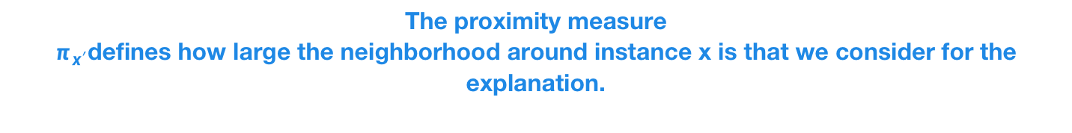
LIME —— Local Interpretable Model-agnostic Explanations
The proximity measure
$π_{x′}$defines how large the neighborhood around instance x is that we consider for the explanation.
The loss function to force g to well approximate f
Optional regularization of g
Kernel specifies what ‘local’ means
A class of interpretable models (linear models)
G is the family of possible explanations, for example all possible linear regression models。
Notes:
LIME is a popular recent method designed to interpret the predictions of any model, and is based on minimizing the following objective, which uses a loss function XX that forces a simple model g, to approximate the output of the complex model f, locally. Where what local means is defined by a density kernel XX pi_x.
The simple model g is constrained to a class of interpretable models, XX which they choose as linear models. The simple model can also be further constrained with regularization. XX
This is a very useful objective, but it raises several questions. XX Such as how do we pick the loss, regularizer, and perhaps more importantly, the kernel pi_x, which is our definition of locality. In the original paper LIME made heuristic choices for these parameters. But it turns out that because LIME is part of the additive feature attribution method class XX

Slide 26
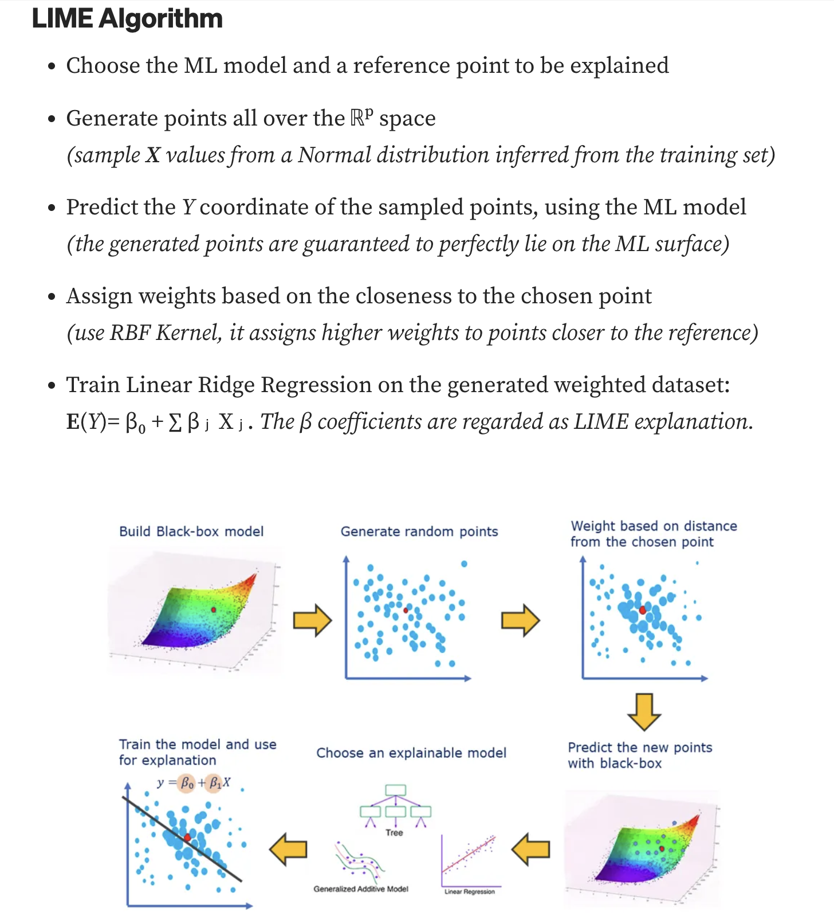
LIME generates a new dataset consisting of perturbed samples and the corresponding predictions of the black box model. On this new dataset LIME then trains an interpretable model, which is weighted by the proximity of the sampled instances to the instance of interest.
Notes:
L, Omega, and pi_x are all forced under local accuracy and consistency!
We derived what they are XX and the new kernel we found XX is significantly different from previous XX heuristically chosen kernels. XX

Slide 27
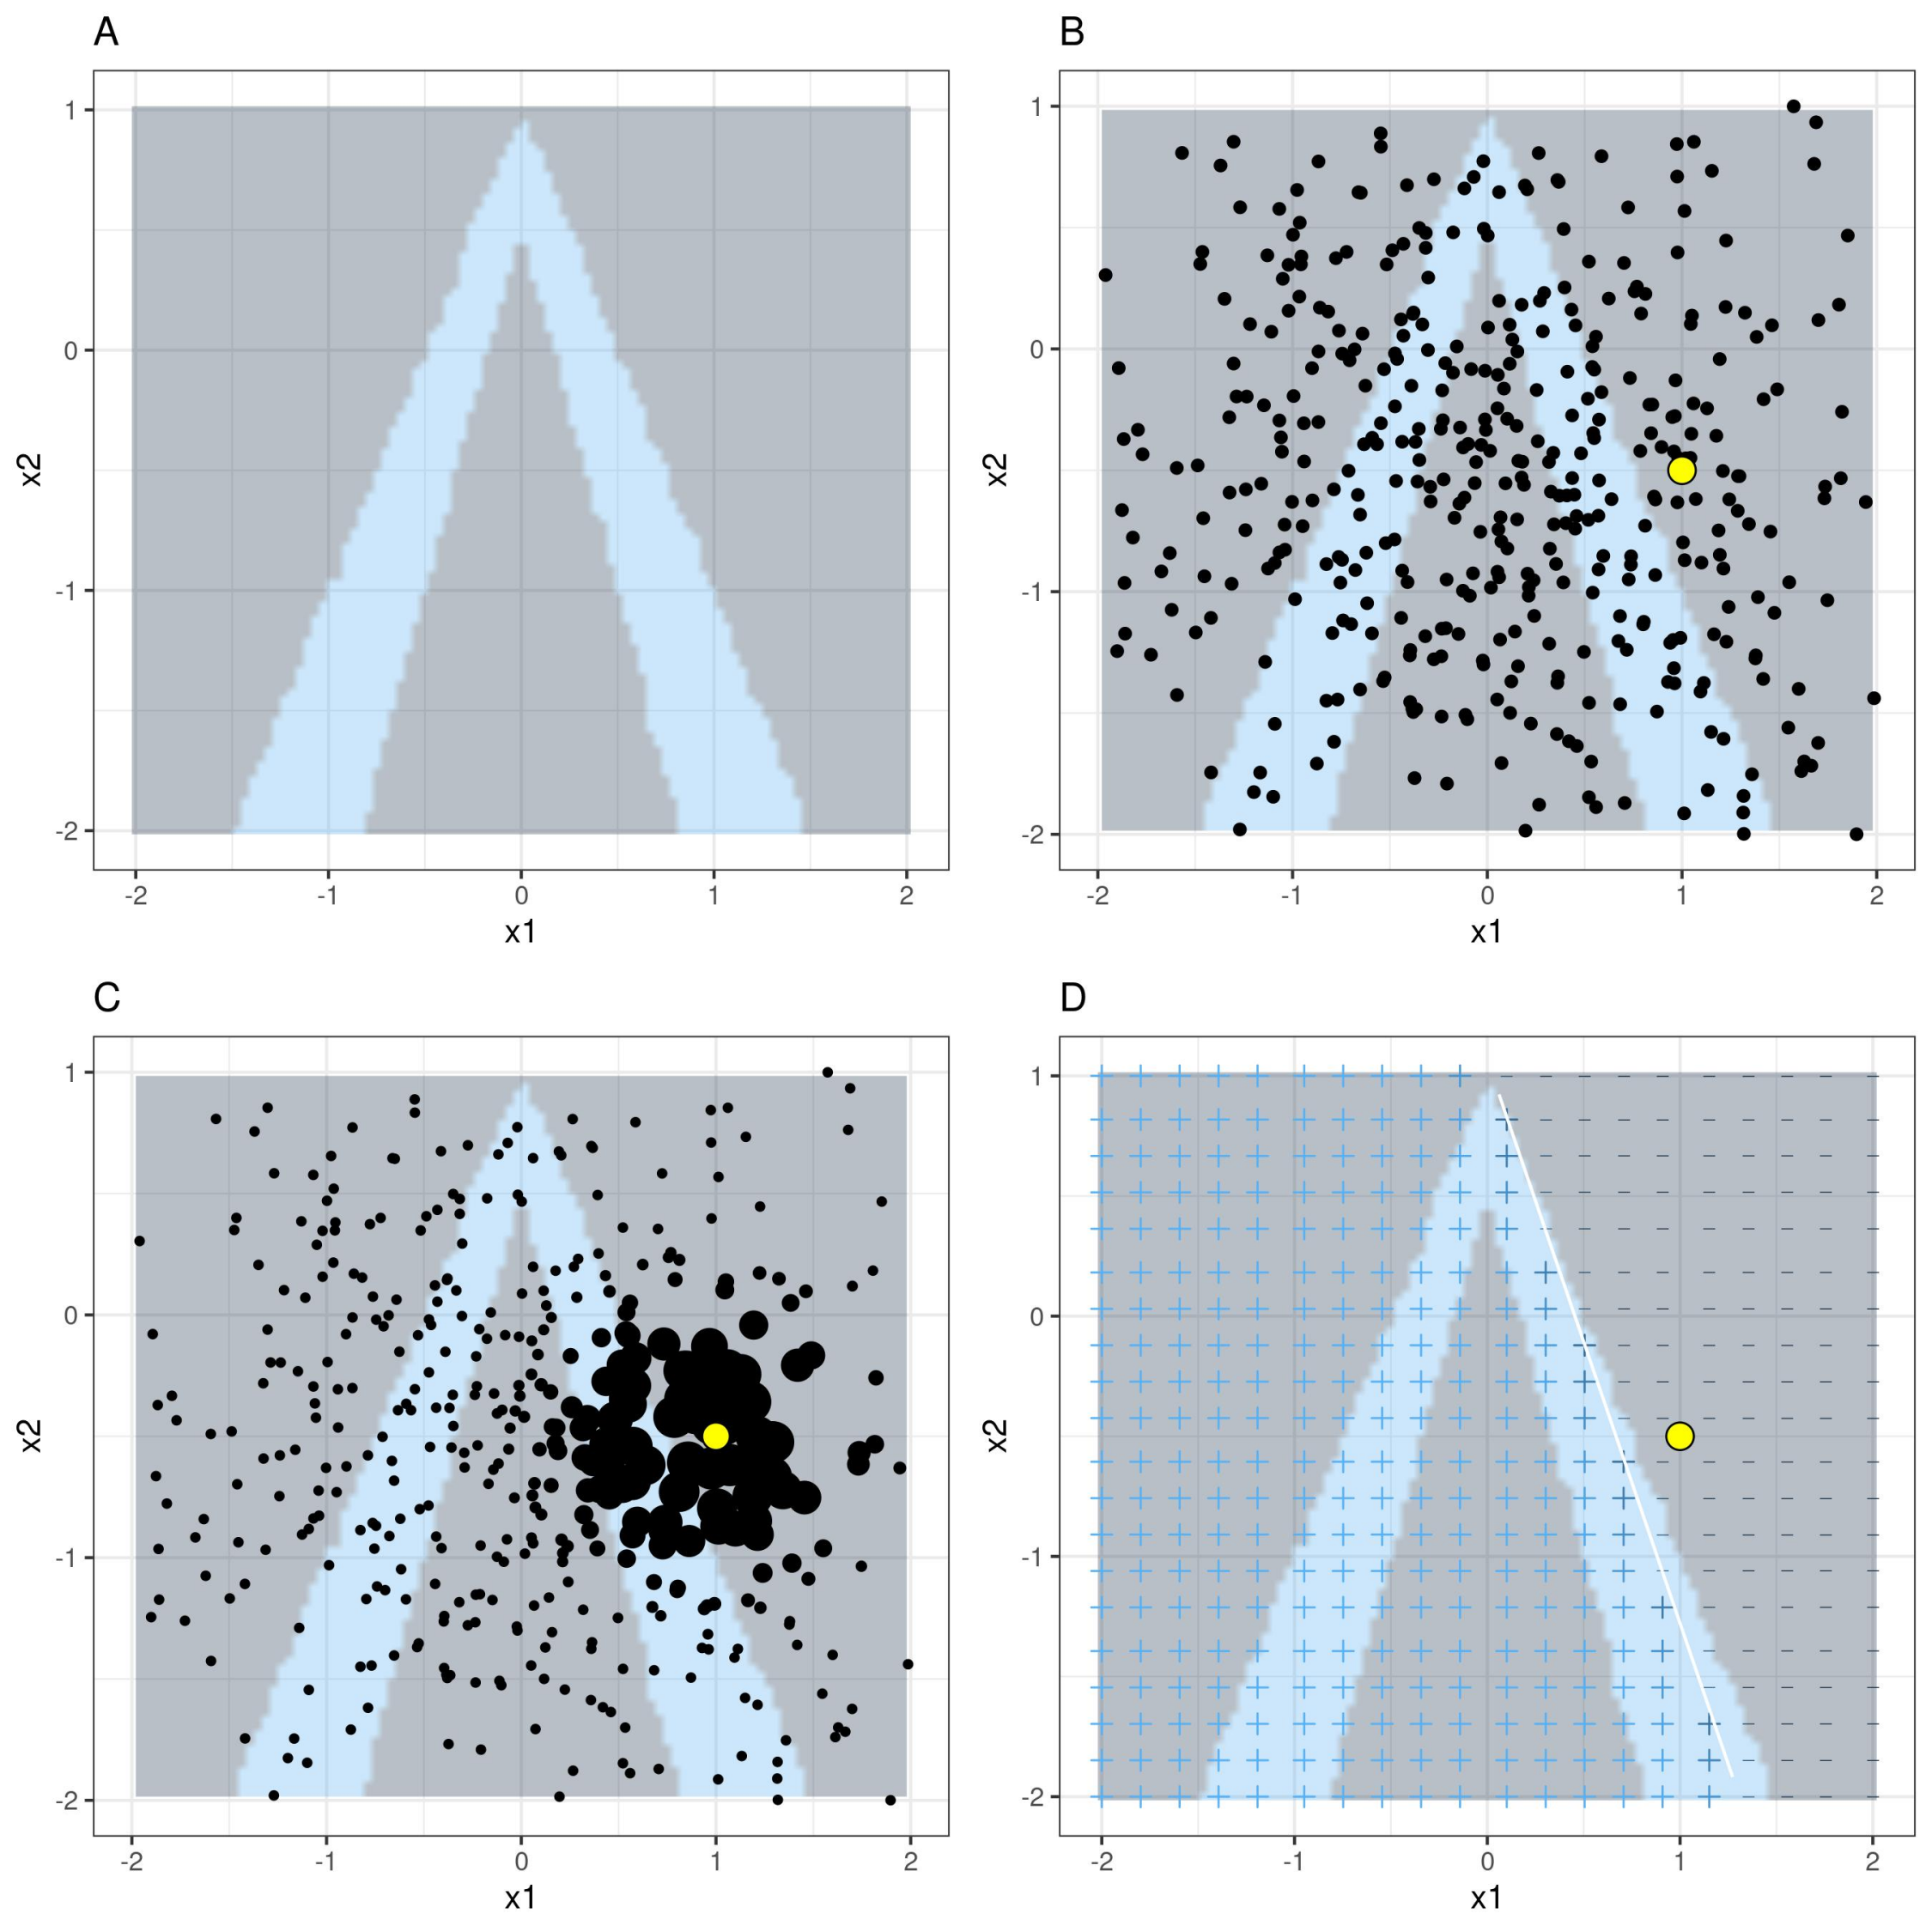
LIME algorithm for tabular data.
A) Random forest predictions given features x1 and x2. Predicted classes: 1 (dark) or 0 (light).
B) Instance of interest (big dot) and data sampled from a normal distribution (small dots).
C) Assign higher weight to points near the instance of interest.
D) Signs of the grid show the classifications of the locally learned model from the weighted samples. The white line marks the decision boundary (P(class=1) = 0.5).

Slide 28
How can we trust their explanation?
Make a comparisonwhen ground-truth of feature importance is available
1. Obtain the ground-truth feature importance on generated dataset.
2. We compare SurvShap and SurvLIME by utilizing Kendall's rank correlation coefficient and assessing the local accuracy of the model's prediction regarding feature importance.
Notes:
To see how conforming to local accuracy and consistency impacts real explanations, consider a medical example about prioritizing antiviral drug delivery. We observe three symptoms: cough, fever, and congestion, and then the model produces a treatment priority score.
The drug is very effective in the early stages of an infection, so these people should have high priority, but the drug is less effective later. XX

Slide 29
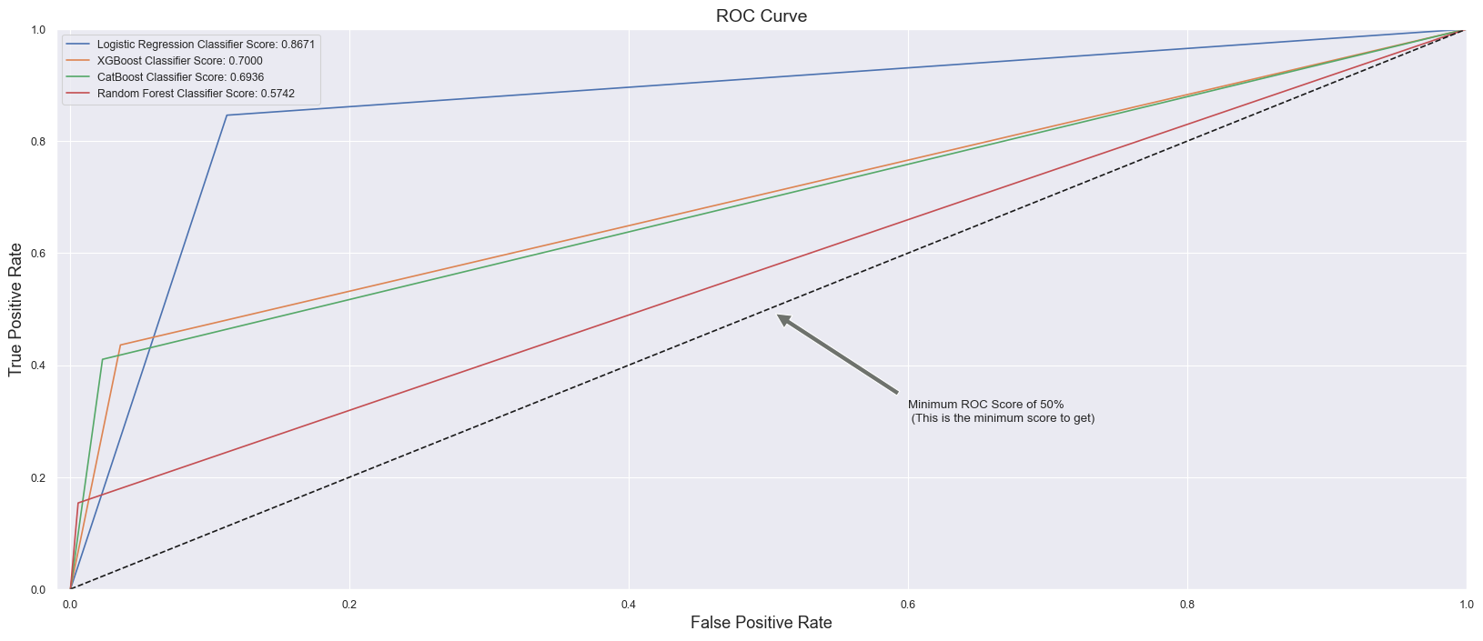
Real-World Use Case: Predicting Company Bankruptcy in Taiwan
Notes:
SHAP also obtains improved computational efficiency over previous game theory methods.
The gray lines represent the true SHAP value of a feature in two different models. Shapley sampling uses random samples over permutations to estimate feature attributions XX

Slide 30
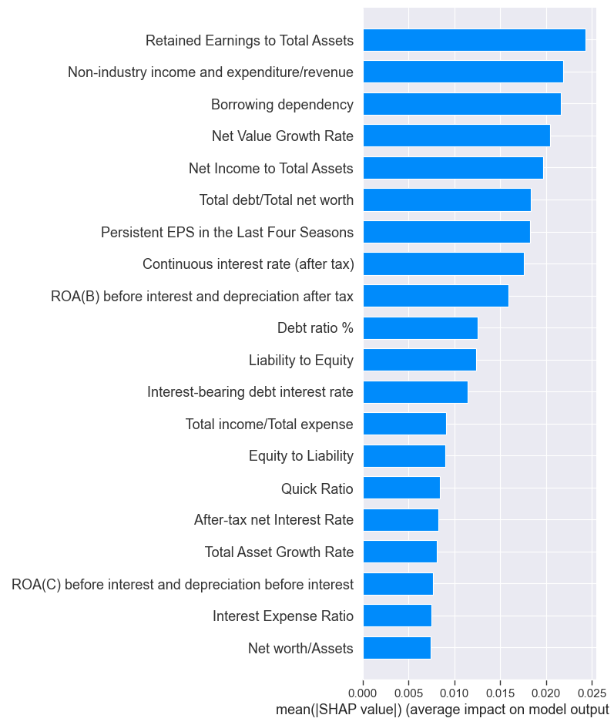
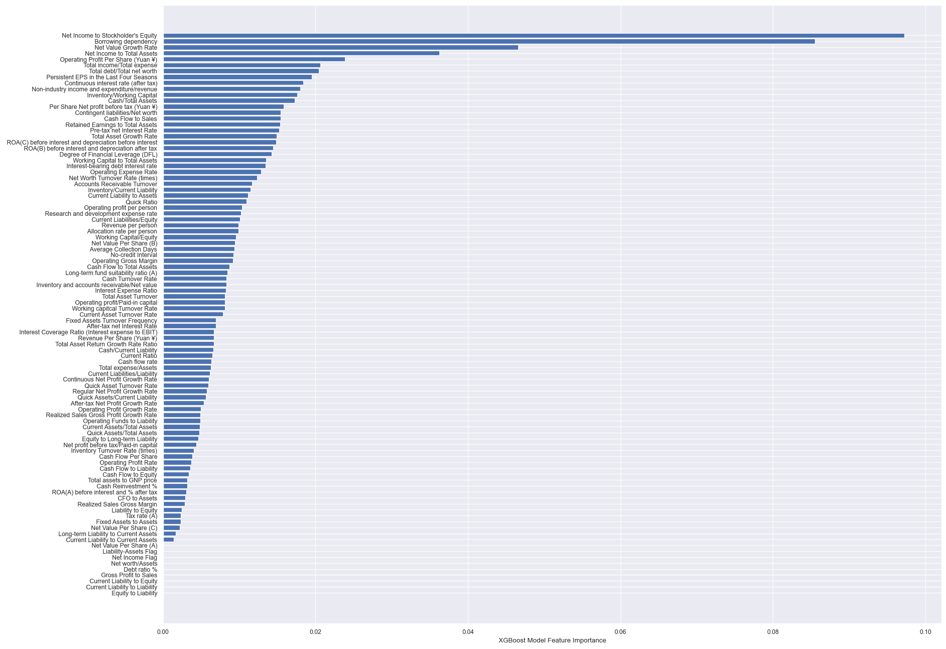
Real-World Use Case: Predicting Company Bankruptcy in Taiwan
Notes:
SHAP also obtains improved computational efficiency over previous game theory methods.
The gray lines represent the true SHAP value of a feature in two different models. Shapley sampling uses random samples over permutations to estimate feature attributions XX

