Slide 1
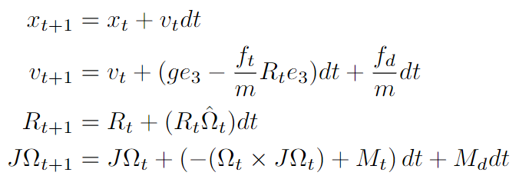
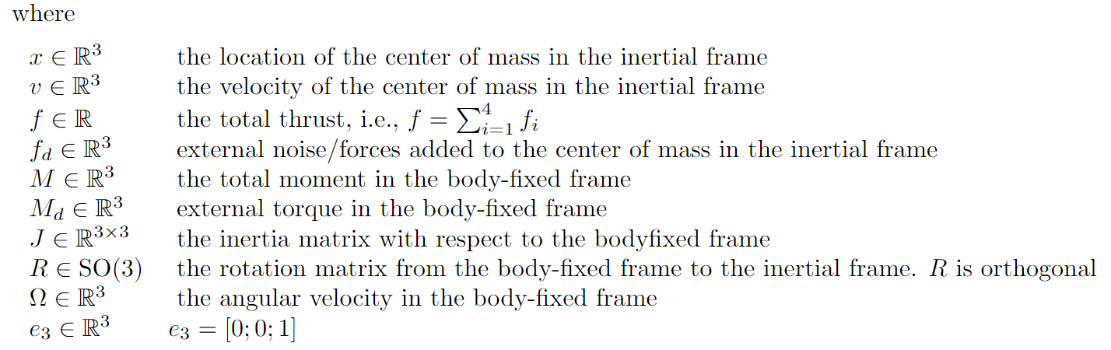
Quadrotor dynamics

Slide 2
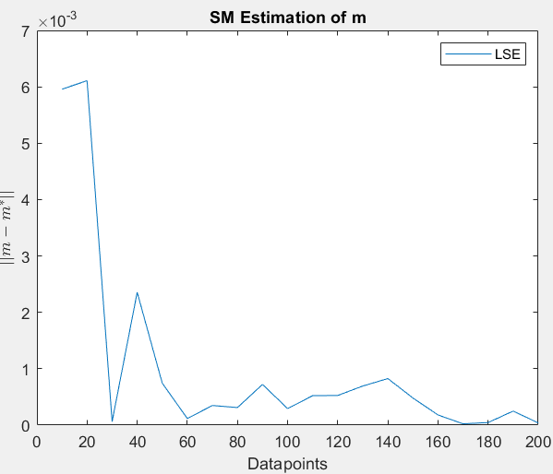
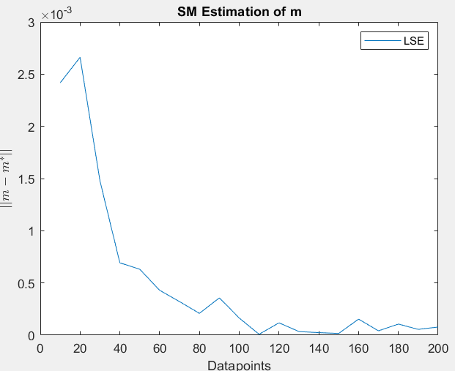
LSE
Under truncated Gaussian noise
Under uniform noise

Slide 3
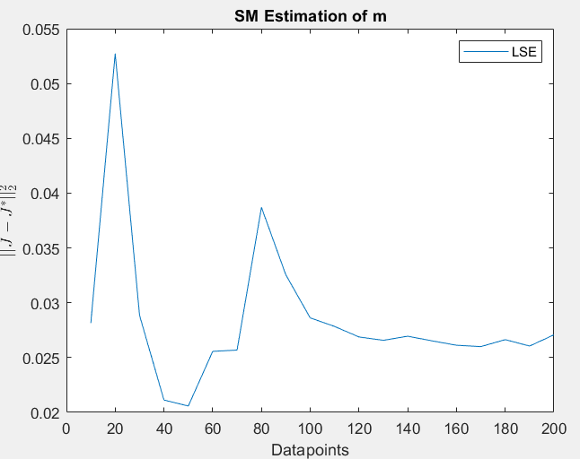
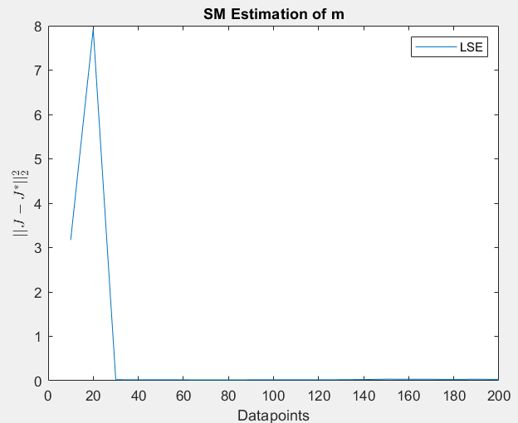
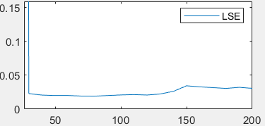
Estimation for J
Under truncated Gaussian noise
Under uniform noise

Slide 4
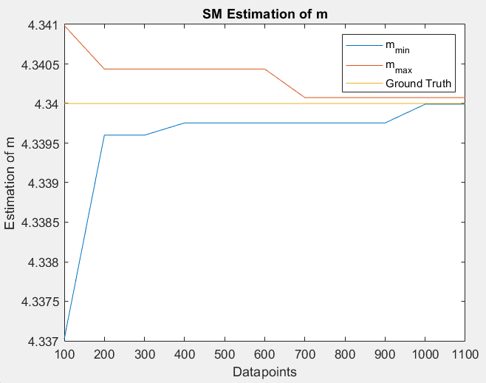
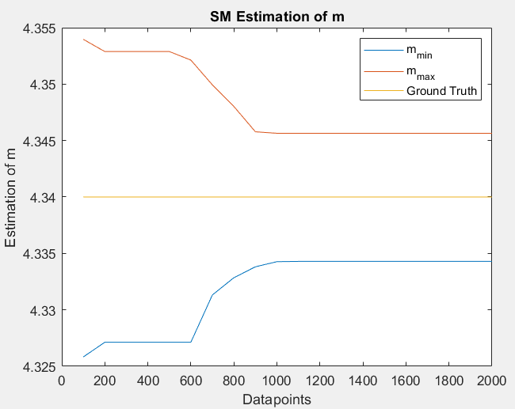
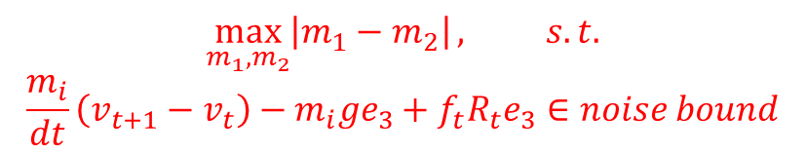
Set Membership
$$\max_{m_{1},m_{2}}\left|m_{1}−m_{2}\right|, s.t.$$
$$\frac{m_{i}}{dt}\left(v_{t+1}−v_{t}\right)−m_{i}ge_{3}+f_{t}R_{t}e_{3}∈noise bound$$
Gaussian
Uniform
The bound shrinkage as noise bound shrinkage

Slide 5
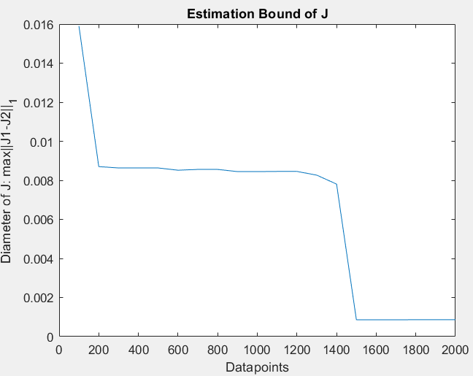
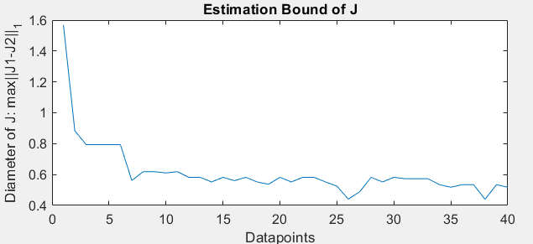
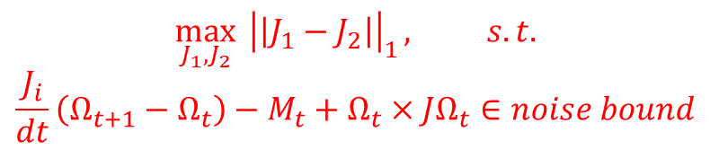
Set Membership
J defined as diagonal matrix will fall into local minimums.
Here I defined elements of J as decision variables.
Truncated Gaussian
$$\max_{J_{1}, J_{2}}{{ \left|\left|J_{1}−J_{2}\right|\right|}_{1}}, s.t.$$
$$\frac{J_{i}}{dt}\left(Ω_{t+1}−Ω_{t}\right)−M_{t}+Ω_{t}×JΩ_{t}∈noise bound$$
Note: I didn’t plot the contour graph because J1 and J2 is optimized through 1-norm. I find it difficult to use contour graph to show the shrinkage of the estimated uncertainty set.
Uniform

