Slide 1
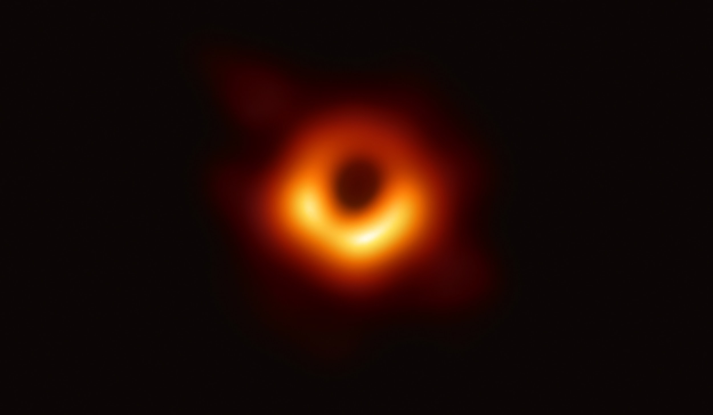

AC297r Fall 2019
Milestone 3
Optimal Real-time Scheduling for Black Hole Imaging
EHT Group: Queena, Shu, Yiming
Advisor: Cecilia

Slide 2
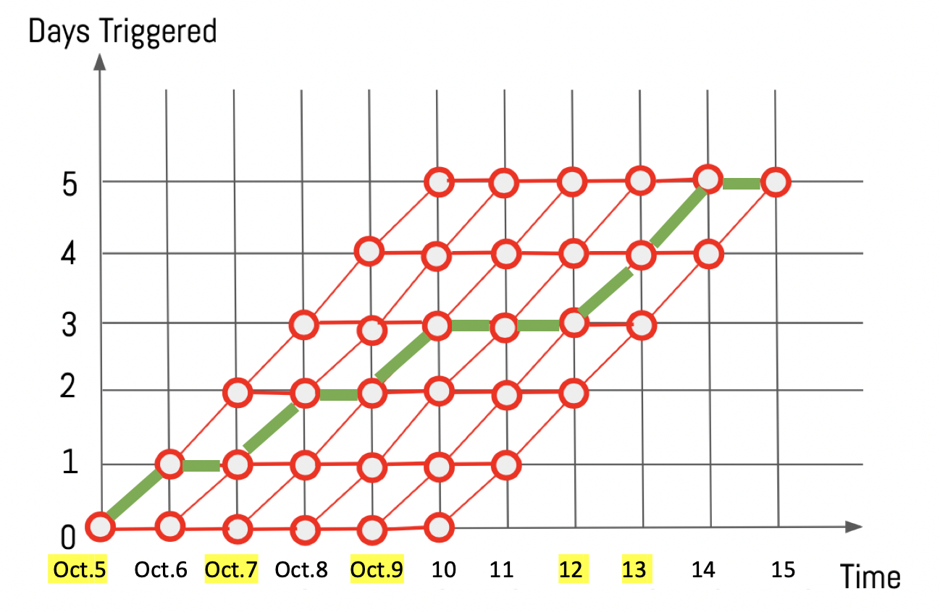
Previously…
Problem Statement
We are going to build a model that can:
In total, choose 5 days from a 10-day window
On each day, determine the optimal strategy for future remaining days
If possible, provide a confidence level on its suggestion
Also provide the second optimal strategy
Notes:
The main problem is to choose 5 days with the best weather in a 10-day window . Since we got weather forecast everyday, we will solve a subproblem on each of the following day. We also want to know how certain we are when we choose our best path.

Slide 3
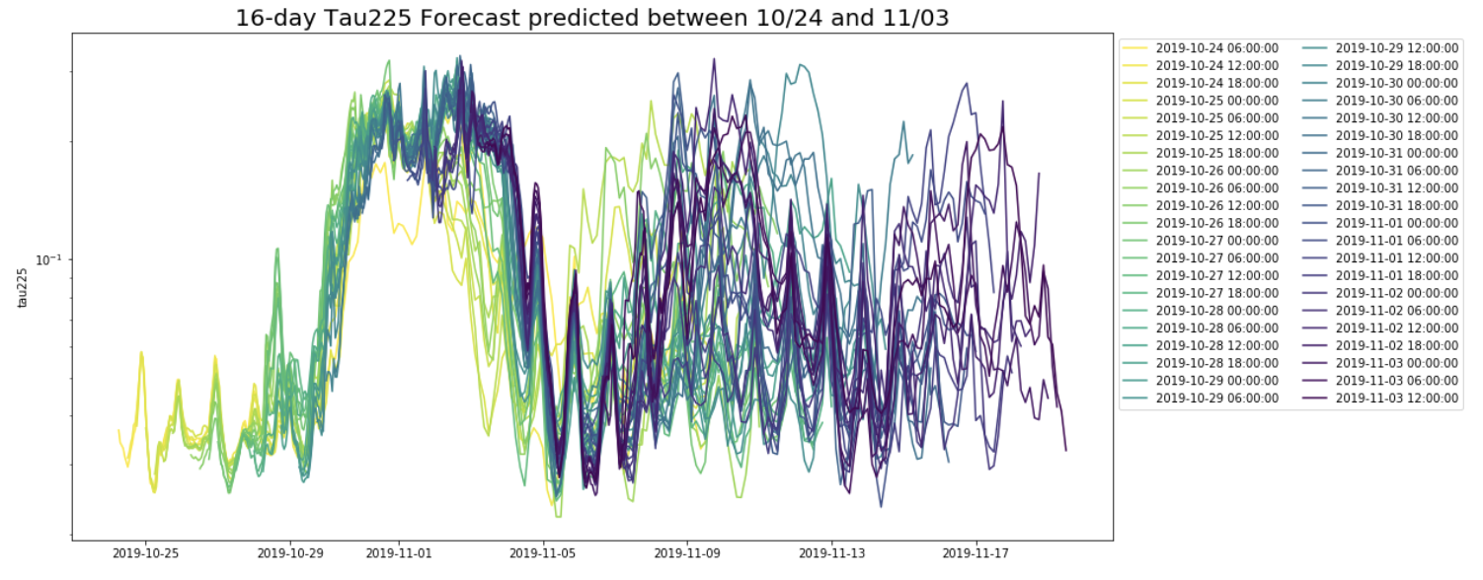
Previously…
Data
Every 6 hours, we get 16-day atmosphere forecast from GFS.
Tau_225(absorption directly above head, the smaller the better)
Notes:
Every 6 hours, we get 16 day
We are basically choosing the days with the smallest tau

Slide 4
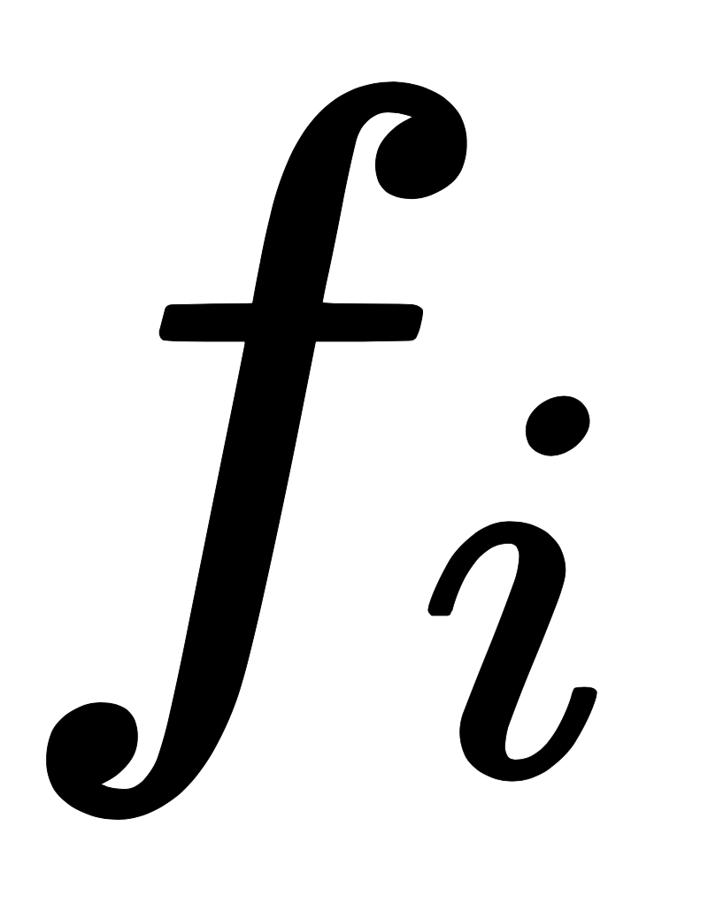
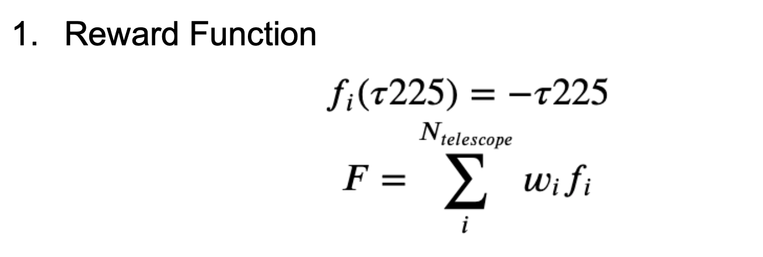
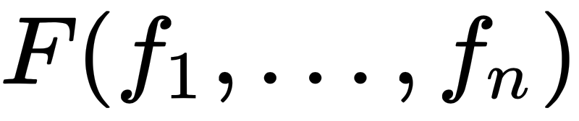
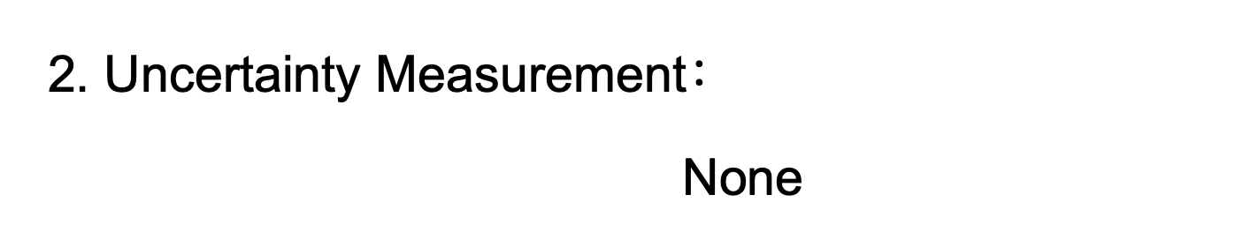
Previously…
Model Design & Baseline Model
Reward Function
2. Uncertainty Measurements
3. Optimization
4. Model Evaluation
reward of a single telescope i.
Total reward for
all telescopes
Notes:
In our baseline model, we set the small f, that is reward function of a single telescope, total reward big F is just a weighted sum of small f ,

Slide 5
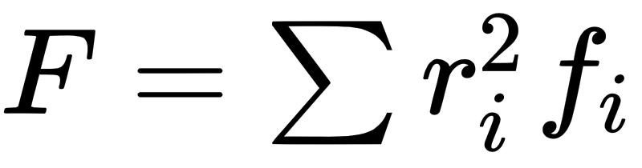

Reward Function
: reward of a single telescope i
: total reward of all telescopes on a given date
where r is the radius of each telescope
where D is the distance matrix
Notes:
Small f here could be anything, negative tau, negative log, exponential… but this requires astrophysics knowledge and the experts will define this for us.
Big F could be a weighted sum or weighted inner product of small f’s. where the weights could be the distance between telescopes. These are hyperparameters that could be tuned by experts.

Slide 6
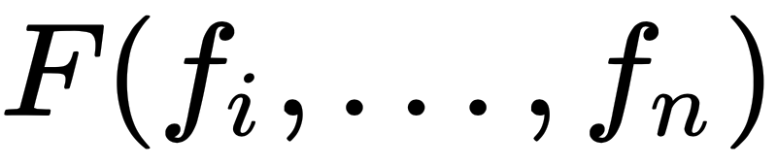
Model Design
Reward Function
2. Uncertainty Measurements
3. Optimization
4. Model Evaluation
Measure performance
based on real weather afterwards.
Compare with:
Baseline Model
Random path
Best path afterwards
reward of a single telescope i.
Total rewards for
all telescopes
Uncertainty of atmosphere forecast (how far in the future)
Uncertainty associated with a specific date
Notes:
To build on top of the baseline model, we are going to add the uncertainty measurements. We identified two kinds,

Slide 7
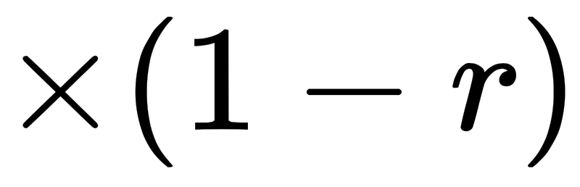
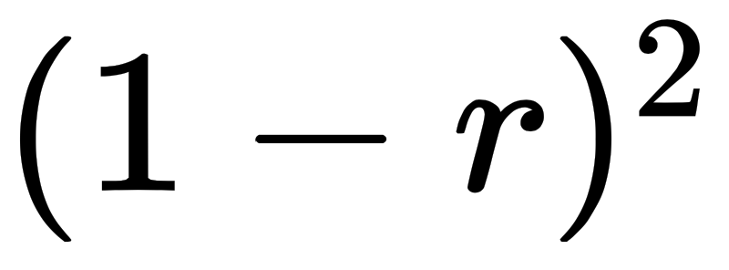
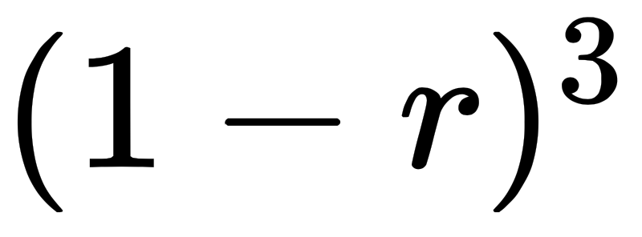
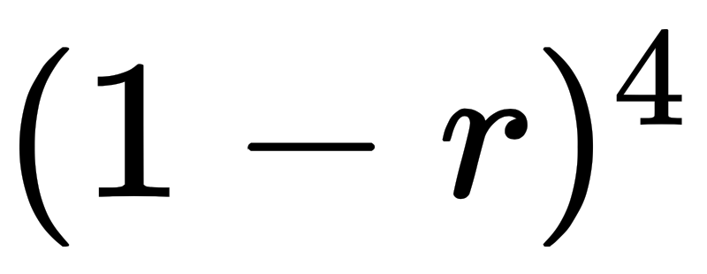
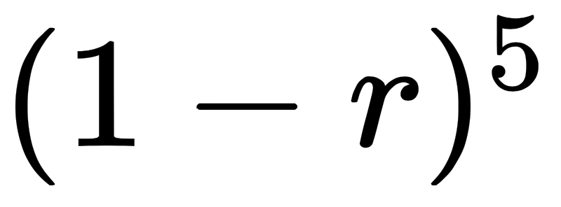
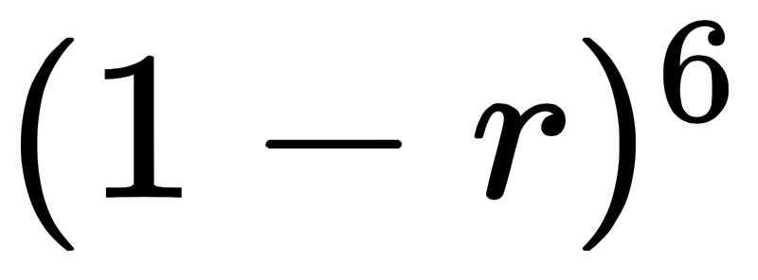
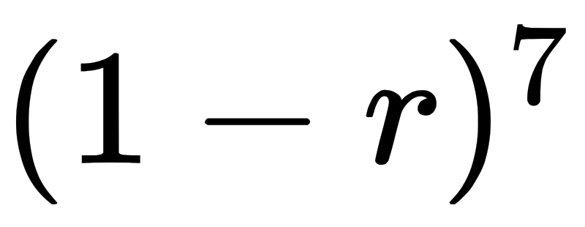
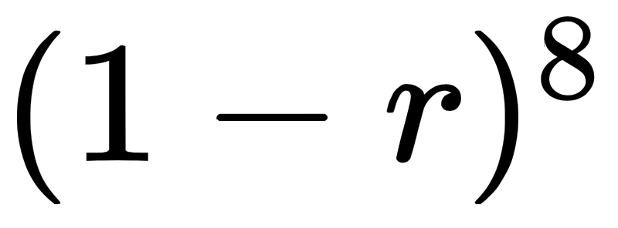
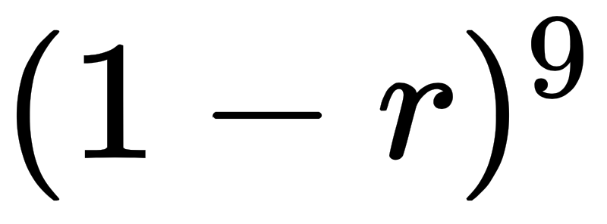
Uncertainty I
Uncertainty of atmosphere forecast: only depends on how far in the future the weather forecast model is predicting
Method 1: discount factor
Day1 | Day2 | Day3 | Day4 | Day5 | Day6 | Day7 | Day8 | Day9 | Day10
19.03 | 13.93 | 16.24 | 16.38 | 18.80 | 12.99 | 17.02 | 19.03 | 18.81 | 14.06
Notes:
The first type of uncertainty only depends on how far in the future the weather forecast model is predicting,
To incorporate that, we can multiply the rewards for each day by a discount factor to get the present value, just like economics.

Slide 8
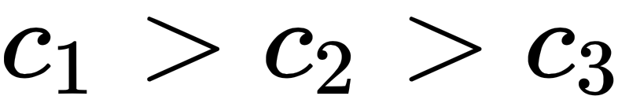
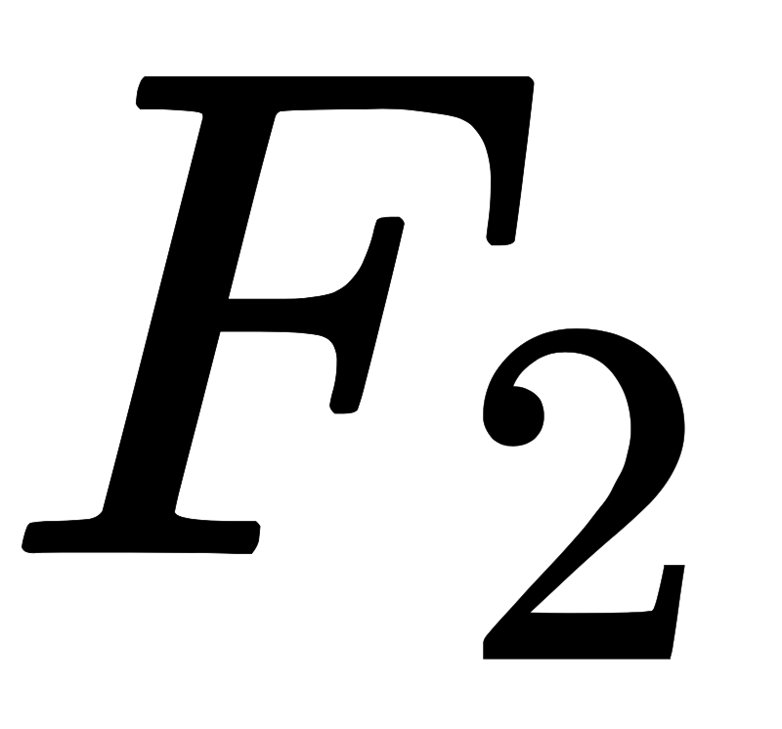
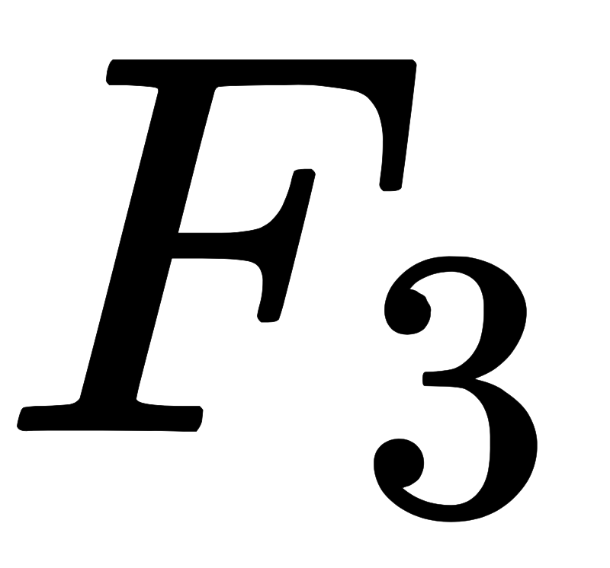
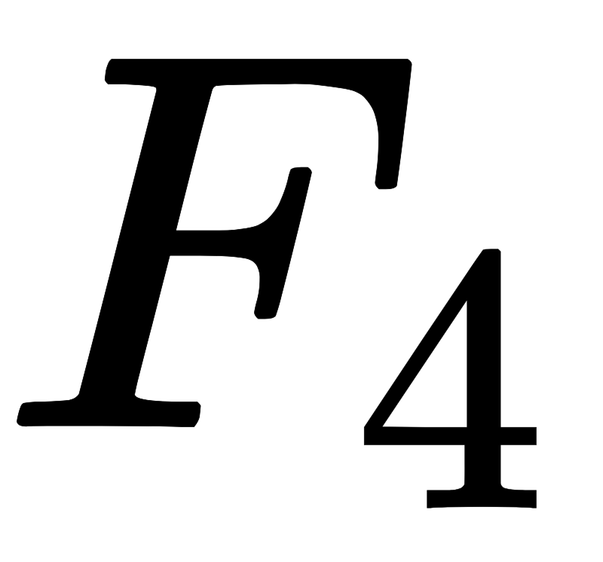
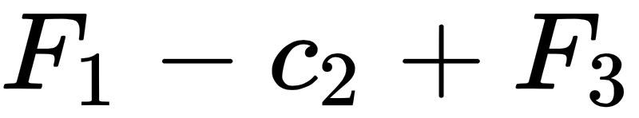
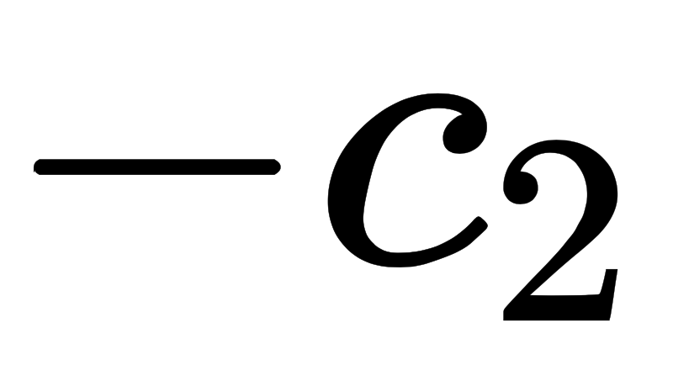
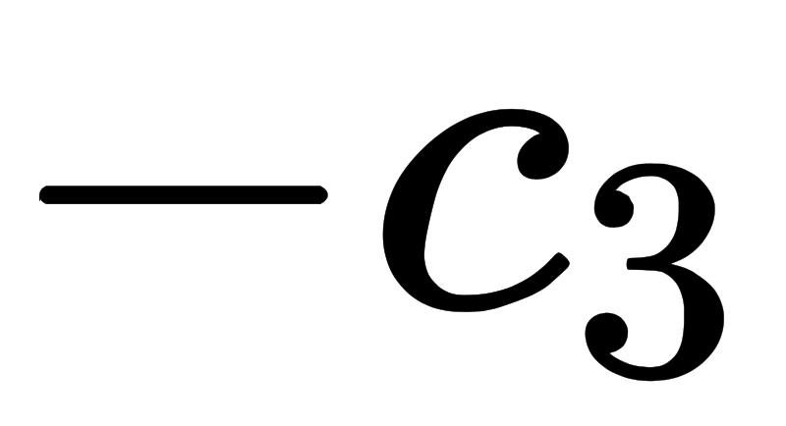

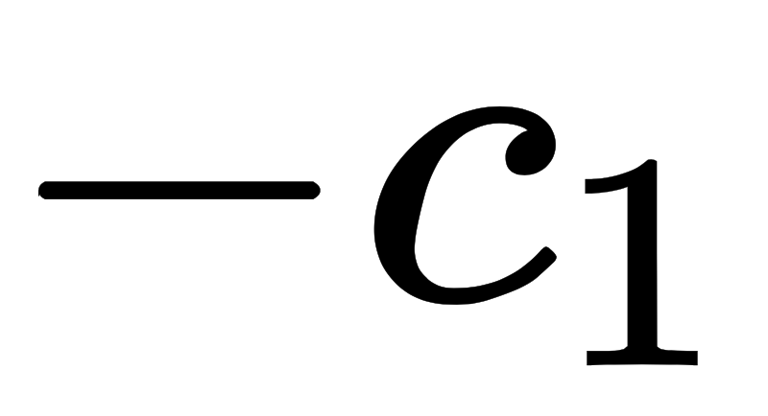
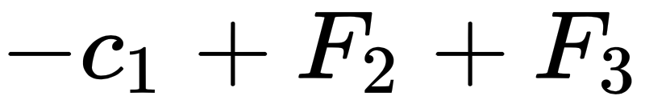
Uncertainty I
Method 2: constant penalty term
# Days Triggered
Time
Notes:
The second method is to subtract a constant penalty term if we skip a day. Here is a simplified 4 choose 2 problem. If all the F scores are equal, skipping the first day would give us heavier penalty than skipping a later day, because that hurts our flexibility in making decisions in the future.

Slide 9
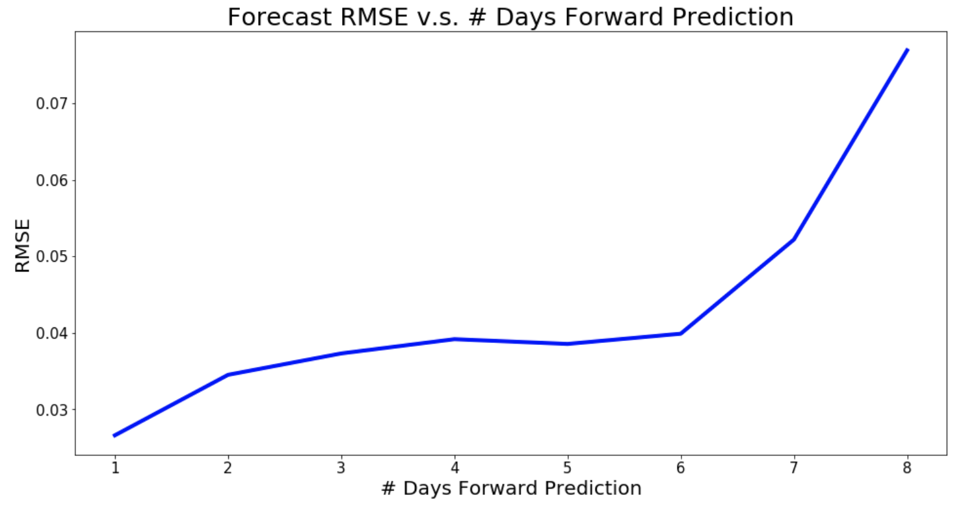
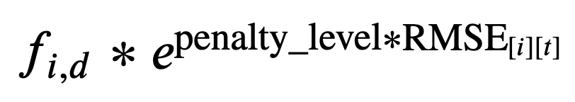
Uncertainty I
Method 3: RMSE forecast penalty
For a single telescope i on day d:
t
d
penalty term
t: how far is day d from the current
Design Choice of Exponential:
penalty_level = 0 -> penalty term = 1
exaggerate the difference
between small and large RMSE
when penalty_level is large

Slide 10
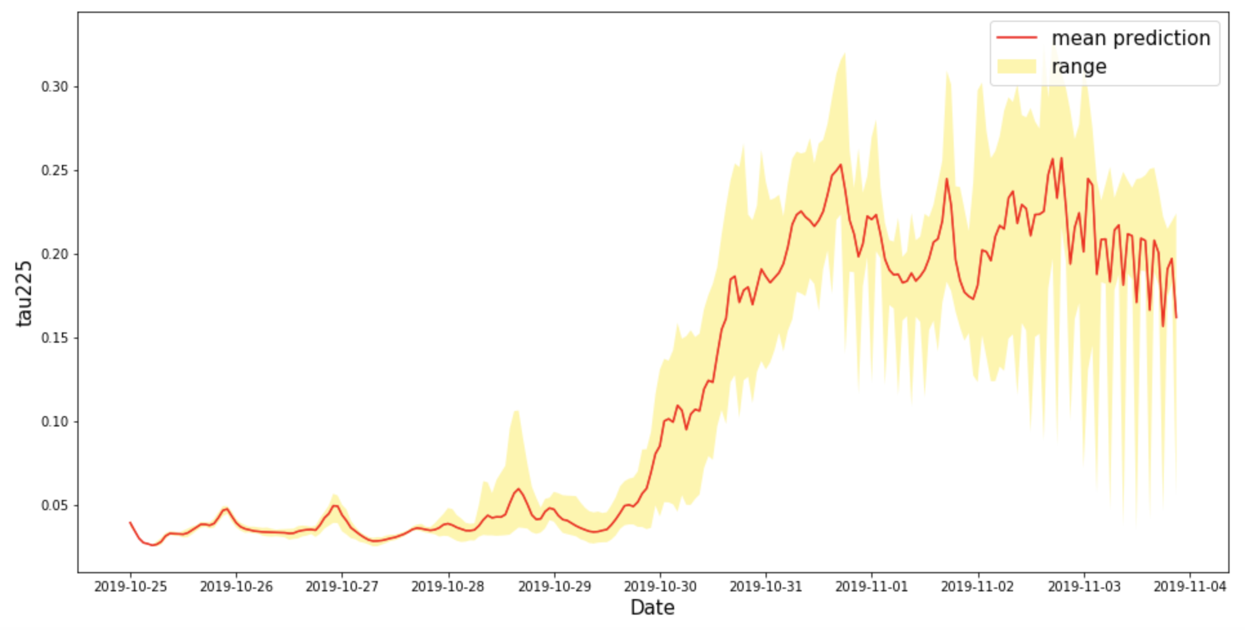
Uncertainty II
Incorporating uncertainty associated with a specific date
Notes:
Only use the latest prediction in the above methods.

Slide 11
Uncertainty II
Incorporating uncertainty associated with a specific date
Notes:
Only use the latest prediction in the above methods.

Slide 12

Uncertainty II
Method 1: STD of Date
For a single telescope i on day d:
penalty term

Slide 13

Uncertainty II
Method 2: Sampling from Distribution
For a single telescope i on day d:
Now changed to:
N(latest, MSE)

Slide 14

Uncertainty II
Method 2: Sampling from Distribution
For a single telescope i on day d:
Algorithm:
1. Sample N samples for
2. Perform optimization for the N trails and generated path w.r.t each trail
3. Provide the most frequent path as the final suggested path, and use its frequency as our level of confidence.

Slide 15
Model Evaluation
Choose 5 days From Oct.25 - Nov.03, 2019
Model | Oct 25 | Oct 26 | Oct 27 | Oct 28 | Oct 29 | Oct 30 | Oct 31 | Nov 1 | Nov 2 | Nov 3 | Final Score
Ground-Truth Best |  |  |  |  |  |  |  |  |  |  | 0.59
Random Pick |  |  |  |  |  |  |  |  |  |  | 0.42
Baseline |  |  |  |  |  |  |  |  |  |  | 0.57
Discount Factor |  |  |  |  |  |  |  |  |  |  | 0.59
RMSE forecast penalty |  |  |  |  |  |  |  |  |  |  | 0.59
STD of Date |  |  |  |  |  |  |  |  |  |  | 0.57
Sampling Distribution | 0.93 | 0.82 | 0.72 | 0.88 | 0.96 | 0.99 |  |  |  |  | 0.57
I
II

Slide 16
Model Next Steps
data, Data, DATA!
Detailed setting & Possible Combinations
Choose 5 days From Oct.25 - Nov.03, 2019
Model | Oct 25 | Oct 26 | Oct 27 | Oct 28 | Oct 29 | Oct 30 | Oct 31 | Nov 1 | Nov 2 | Nov 3 | Total Reward
Ground-Truth Best |  |  |  |  |  |  |  |  |  |  | 0.59
Random Pick |  |  |  |  |  |  |  |  |  |  | 0.42
Baseline |  |  |  |  |  |  |  |  |  |  | 0.57
Discount Factor |  |  |  |  |  |  |  |  |  |  | 0.59
RMSE forecast penalty |  |  |  |  |  |  |  |  |  |  | 0.59
STD of Date |  |  |  |  |  |  |  |  |  |  | 0.57
Sampling Distribution | 0.93 | 0.82 | 0.72 | 0.88 | 0.96 | 0.99 |  |  |  |  | 0.57
I
II

Slide 17
Challenges & Next Steps
What tells:
Uncertainty can help us adjust to a better path
Different models have different behaviors
Doesn’t tell:
(can’t compare between models)
The case is too special…
Overfit
Next Steps for Modeling:
data, Data, DATA!
Detailed setting & Possible Combinations

Slide 18
Final Deliverable
Input
Output
Atmosphere Prediction
Window Info:
Start/end date, # days to trigger
Suggested Optimal Path
(with level of confidence)
Second Optimal Path*
(with level of confidence)
Explanation of our suggestion:
The reward for each telescope;
Visualization of the path;
…...
Must Enter
Telescope Info:
schedule, availability, weight
Reward Function Formula
Penalty Term
Baseline length matrix
…...
Could Change

Slide 19
Software Organization
scheduling_tool\
scheduling_tool\
test\
__init__.py
test_schedule.py
user_interface.py
read_data.py
processing_data.py
make_suggestions.py
Run.py
setup.py
requirements.txt
LICENSE
README.md

Slide 20
GUI Showcase

Slide 21
Challenges & Next Steps
What tells:
Uncertainty can help us adjust to a better path
Different models have different behaviors
Doesn’t tell:
(can’t compare between models)
The case is too special…
Overfit

Slide 22
Uncertainty I
Method 3: RMSE forecast penalty
For a single telescope i on day d:
t
d
penalty term
t: how far is day d from the current

