Slide 1
Stylometric features + XGBoost: reading writing style
No neural network: 45 hand-made numbers about how a text is written, fed to a small tree model
Input text
First 60 words
45 style features
XGBoost
prob_ai
answer, review, article…
same length for every text
sentences, words, punctuation
trees on the 45 numbers
P(AI) in [0, 1]
Data · train on HC3, test on three more sets
What the 45 features measure
Set | What it contains | Use
HC3 | Human vs ChatGPT answers | train / val / test
MAGE | Human vs many LLMs, many domains | test only
RAID | Many generators and domains | test only
New gen. | Texts from new generators (D) | test only
Style, not meaning. Same code is used for training and for predict(), so the demo matches the notebook.
45
60
features per text
words used per text
• Sentence length, word length, vocabulary variety
• Punctuation, contractions, first-person words
• 24 common function words (the, of, so, but…)
Train 6,000 · val 2,000 · test 2,000, half human / half AI. HC3 is split by question, so one question never appears in both train and test.
EE6405 · P7 AI-generated text detection · Part A — YANG JIAYUE (G2601996H)
1
Notes:
Detector A reads writing style instead of meaning. We cut every text to its first 60 words, so length cannot give the answer away. From these words we compute 45 simple numbers, like sentence length, punctuation use and common small words. An XGBoost model turns them into the probability that the text is AI. We train on HC3 only, and test on HC3, MAGE, RAID and the new generators.

Slide 2
Results: strong on HC3, near chance elsewhere
Trained on HC3 only; threshold chosen on HC3 validation; 2,000 HC3 test texts, 1,000 per other set
Detector performance
Cross-dataset generalisation (AUROC)
 | HC3 | MAGE | RAID | New generator | After attack
AUROC | 0.99 | 0.56 | 0.66 | 0.76 | —
F1 | 0.96 | 0.55 | 0.65 | 0.84* | —
TPR@1%FPR | 0.67 | 0.04 | 0.03 | 0.03 | —
Train ↓ Test → | HC3 | MAGE | RAID
HC3 | 0.99 | 0.56 | 0.66
MAGE | 0.72 | 0.68 | 0.69
RAID | 0.65 | 0.60 | 0.89
HC3+MAGE+RAID | 0.99 | 0.66 | 0.86
* New-generator set is 71% AI, so its F1 is higher than on the 50/50 sets and should not be compared with them. — attack set will be scored once E releases it.
Rows: training set · columns: test set · darker = higher AUROC. Diagonal and pooled cells are in-domain.
Conclusion Style features separate human and ChatGPT text almost perfectly inside HC3 (AUROC 0.99), but drop to 0.56–0.76 on other generators and domains, and catch only 3–4% of AI texts at 1% false positives. Training on more varied data helps, but does not close the gap.
EE6405 · P7 AI-generated text detection · Part A — YANG JIAYUE (G2601996H)
2
Notes:
On HC3 the detector is very good: AUROC 0.99. But when we test on MAGE and RAID the AUROC falls to 0.56 and 0.66, close to random guessing. On the new generators it reaches 0.76. At a strict 1 percent false positive rate, it finds only 3 to 4 percent of AI texts. So style features alone do not travel across datasets. Training on mixed data helps a little.

Slide 3
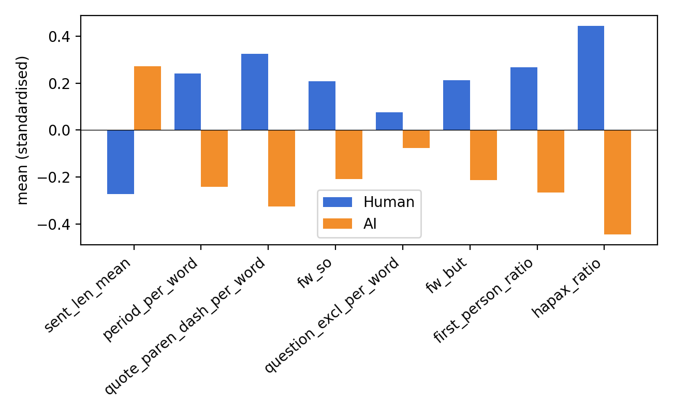
Why it fails: style habits belong to one dataset
What the model learned on HC3, and where that knowledge stops working
Longer sentences point to AI
HC3 humans write short, informal answers with more commas, dashes, “I”, “so” and “but”. This gap is strong inside HC3.
The gap is not universal
Human texts in MAGE and RAID come from other domains and writing styles. The HC3 habits no longer separate them, so AUROC falls to 0.56–0.66.
Caveats
Standardised mean of the top features on HC3 test (blue = human, orange = AI).
• Texts under 40 words are not judged (prob_ai = 0.5).
• Short or ChatGPT-like essays can still be missed: the style model scores one 49-word AI essay at 0.0003.
• TPR@1%FPR rests on few texts, so it is noisy.
Reference
Guo et al., 2023. How close is ChatGPT to human experts? (HC3). arXiv:2301.07597
Li et al., 2024. MAGE: Machine-generated text detection in the wild. ACL
Dugan et al., 2024. RAID: robust evaluation of machine-generated text detectors. ACL
Chen & Guestrin, 2016. XGBoost: a scalable tree boosting system. KDD
EE6405 · P7 AI-generated text detection · Part A — YANG JIAYUE (G2601996H)
3
Notes:
Why does it fail? On HC3, human answers are short and informal, with more commas, dashes and words like I, so and but. AI answers have longer sentences. The model learns exactly these habits. In MAGE and RAID, human text looks different, so the same habits no longer work. Style features are fast and easy to explain, but they should be used with other detectors.

