Slide 1
PART B / RESEARCH OVERVIEW
GPT-2 & GLTR-Based AI Text Detection
WHAT IS GPT-2?
OUR APPROACH
GPT-2 is an autoregressive language model that predicts the next token from preceding context.
GPT-2 → PPL + GLTR
We use its token probabilities as detection features—not as a detector itself.
Logistic Regression → Human / AI
RESEARCH WORKFLOW
01
02
03
04
05
Dataset
→
Feature
→
Classifier
→
Performance
→
Generalization
Preparation
Extraction
Training
Evaluation
& Integration
HC3 · MAGE · RAID
PPL · GLTR
Logistic Regression
ROC · F1 · Ablation
Cross-dataset · API

Slide 2
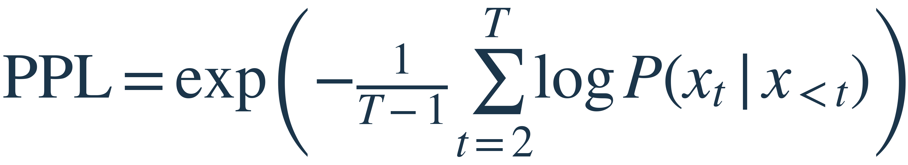

PART B / FEATURE ENGINEERING
From language probabilities to detection signals
01
GLTR RANK DISTRIBUTION
02
TOKEN-LEVEL HIGHLIGHTING
HC3 calibration set · average token proportions
Actual GPT-2 token ranks from the notebook
Human
AI
90%
82.9%
“Artificial intelligence is changing the world.”
66.3%
intelligence
is
changing
60%
Artificial
—
r=2
r=1
r=39
30%
the
world
.
r=1
r=2
r=1
0%
Top 10
11–100
101–1000
>1000
Top 10
11–100
101–1000
>1000
AI uses more top-10 tokens: 82.9% vs 66.3% for human text.
Initial token unscored · 5 of 7 others are Top 10 (71.4%).
PERPLEXITY
Likelihood-based signal
GLTR PROPORTION
rₜ = observed token rank

Slide 3
PART B / GPT-2 + GLTR AI TEXT DETECTION
Does combining features really help?
Performance by feature configuration
AUROC
F1
Experimental control
0.9667
Same HC3 split · StandardScaler ·
Logistic Regression
PPL only
0.8889
0.9556
BEST AUROC
GLTR only
0.9355
0.9722
Combined
0.9722
BEST F1
Combined
0.9444
0.9444
Combined
KEY TAKEAWAY
Combining PPL + GLTR gives the best overall performance on HC3.

Slide 4
PART B / Test & Conclusion
Cross-Dataset Generalization
AUROC & F1 across datasets
Why does performance drop?
HC3-trained detector · No retraining on external datasets
01
Distribution shift
Dataset
AUROC
F1 Score
Writing styles, topics, and text lengths may differ from HC3.
HC3
0.9622
0.9355
02
Unseen generators
Other language models can produce different token-rank patterns.
MAGE
0.6444
0.4611
03
Feature limitations
RAID
0.7500
0.6200
PPL and GLTR capture likelihood patterns rather than authorship directly.

