Slide 1
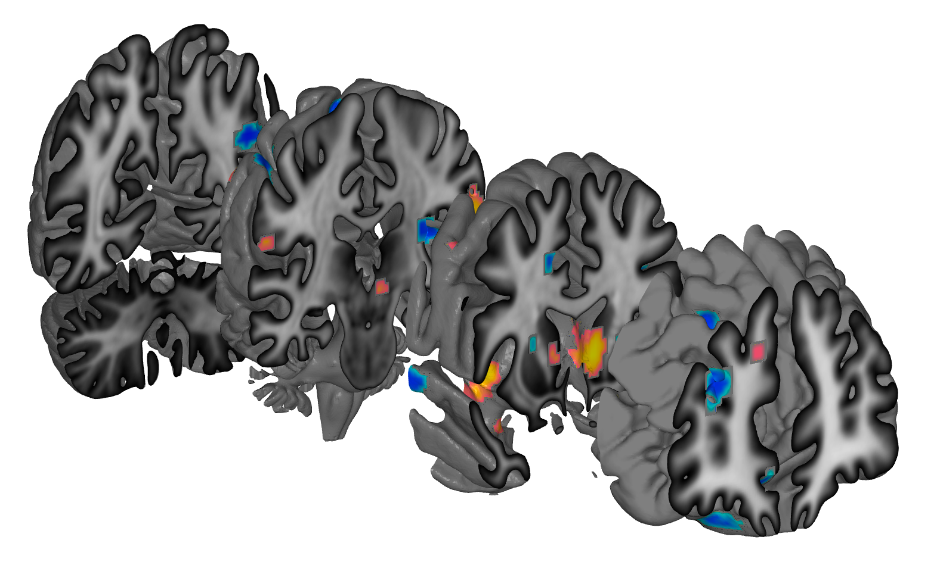
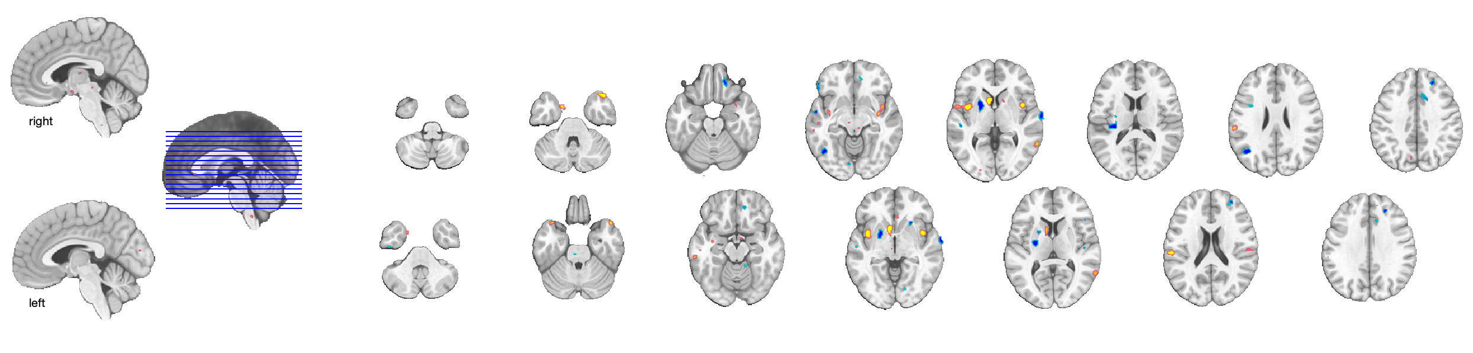
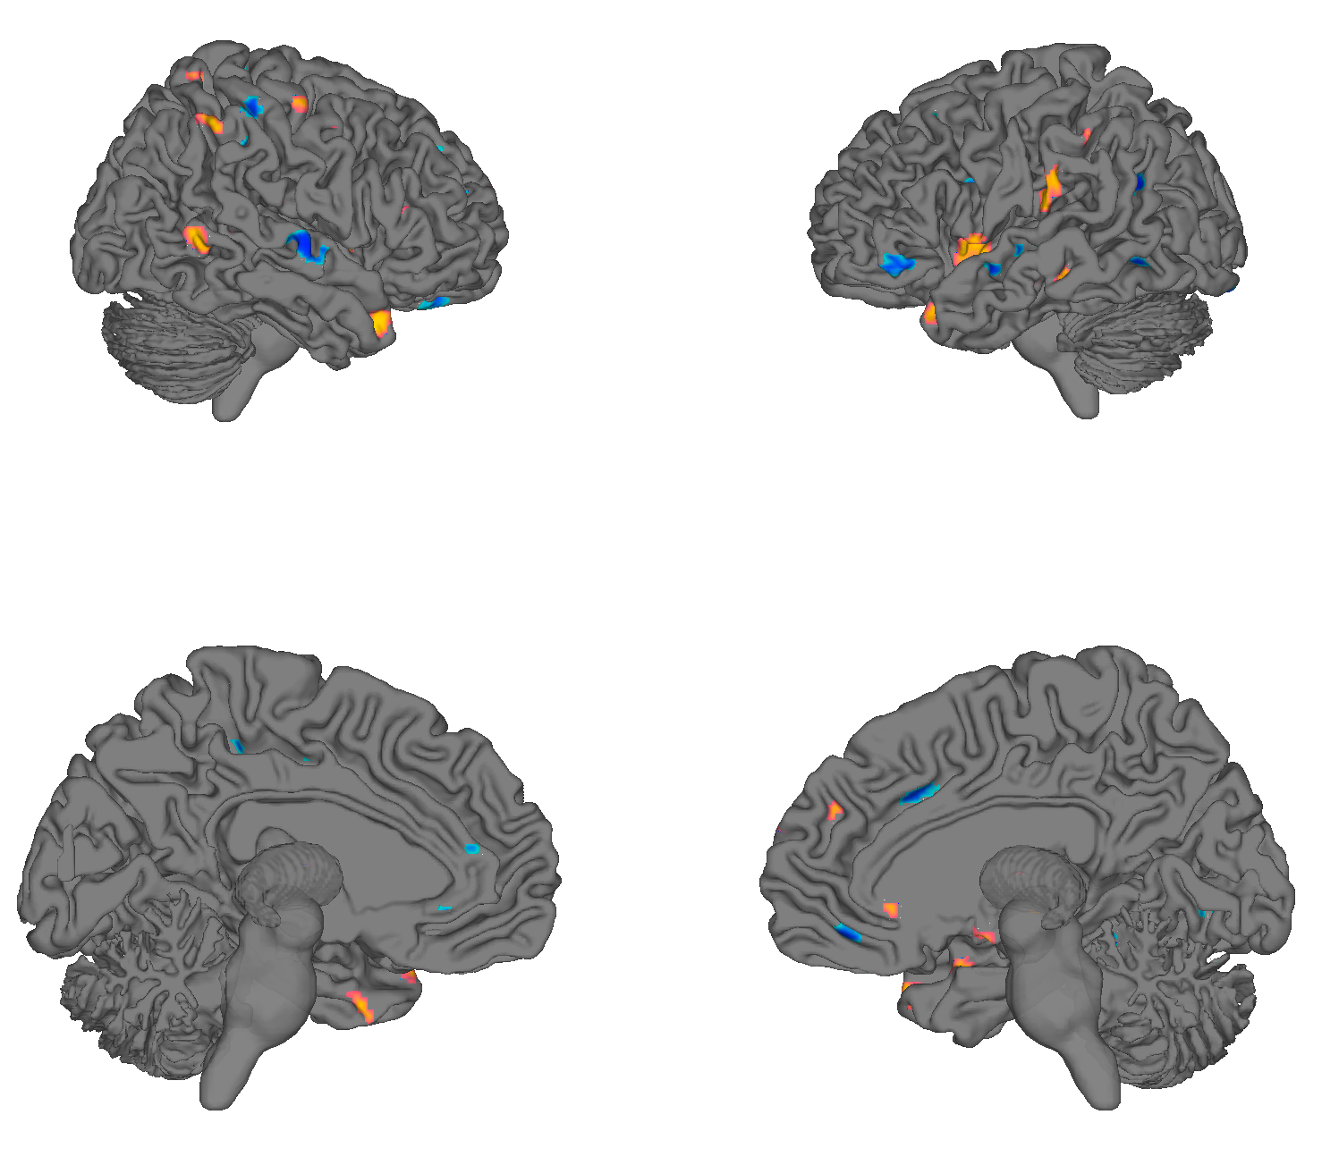
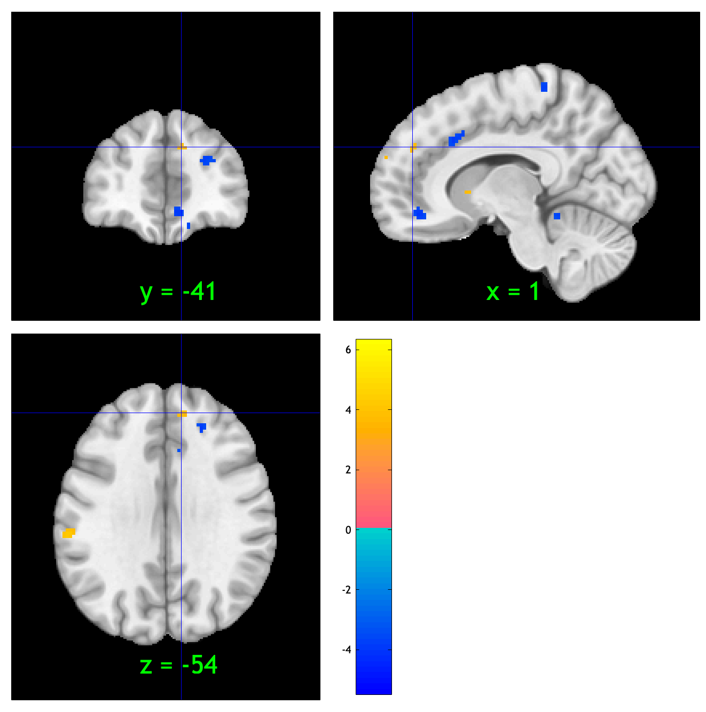
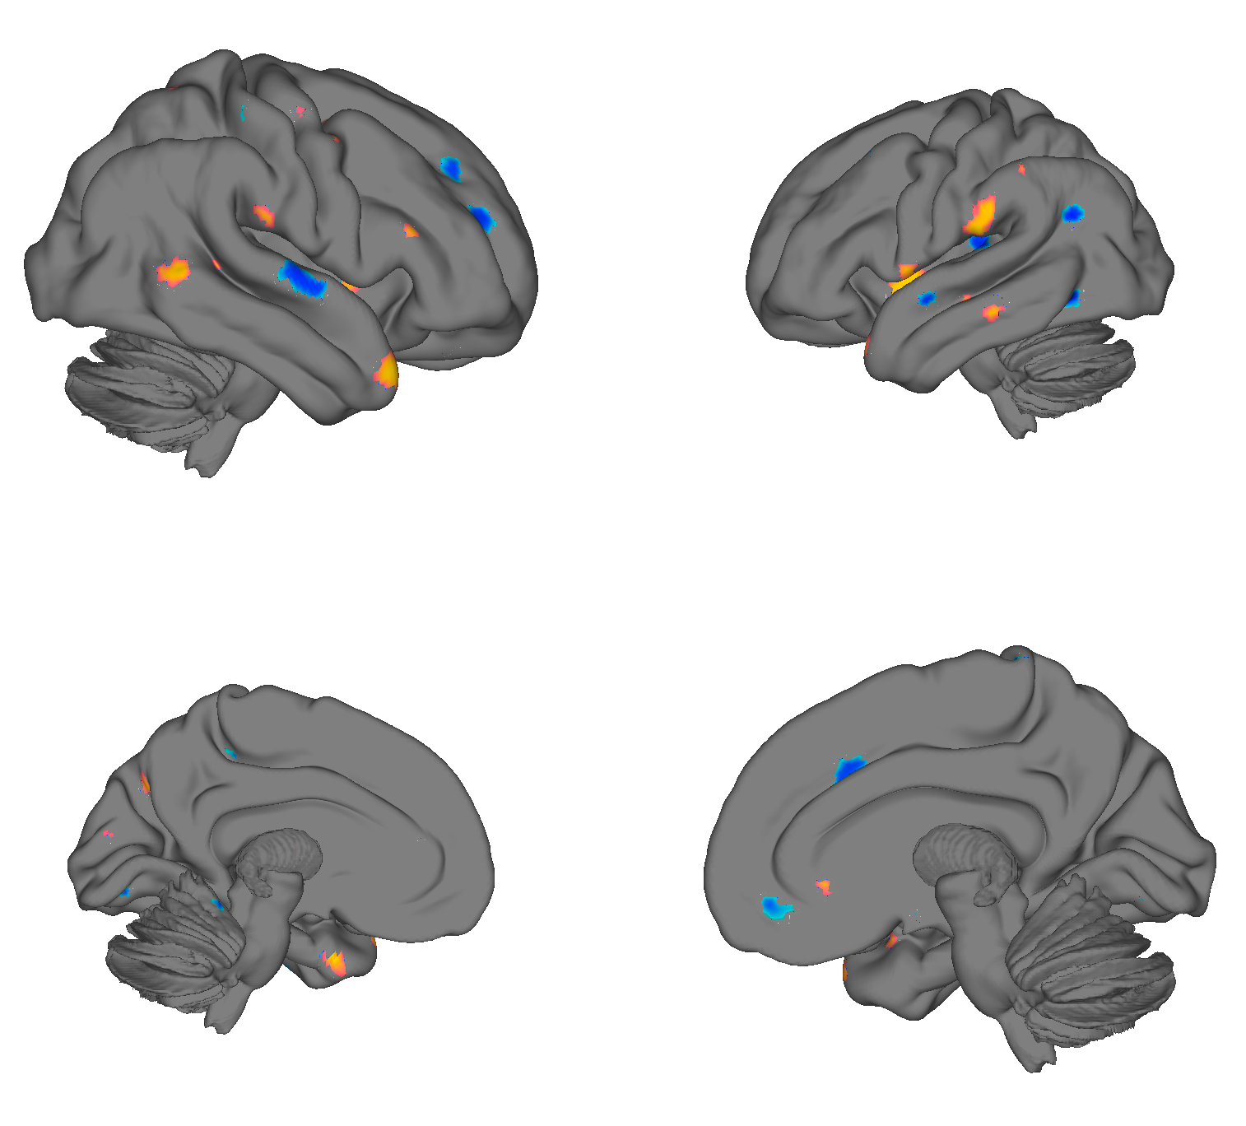
Notes:
vps = load_image_set('zhouVPS');
create_figure; surface(vps, 'coronal_slabs_4', 'nolegend');
create_figure; surface(vps, 'foursurfaces', 'nolegend');
create_figure; surface(vps, 'foursurfaces_hcp', 'nolegend');
create_figure; montage(vps');
orthviews(vps)

