Slide 1
Fs7ny
Supervised by
Dr. Cherry Ahmed
TA. Ashraf Mohey
Implemented by
20140168 | Abdel-aziz Abdel-naser Abdel-aziz
20140234 | Mohamed Fawzy Abdel-salam
20140055 | Israa Abdel-naby

Slide 2
Project Idea
When people decide to take a vacation.
Preparing for such trips is managed by many companies.
they don’t have a platform to advertise their offers.
So a system is required to be the platform where the customer can:
view and surf offers made by different companies.
select an offer that suits him/her.
book tickets and pay for them on the platform.

Slide 3
Problem significance
A platform for the traveling companies to advertise their offers is missing
Deliver such a platform will be win-win situation for all.
Creating a cross-platform System
previous solutions:
Street-posters
Flayers
Social Media Events

Slide 4
System architecture
Web-based 3-Tier architecture
User Interface Tier
Application Logic Tier
DataBase Tier

Slide 5
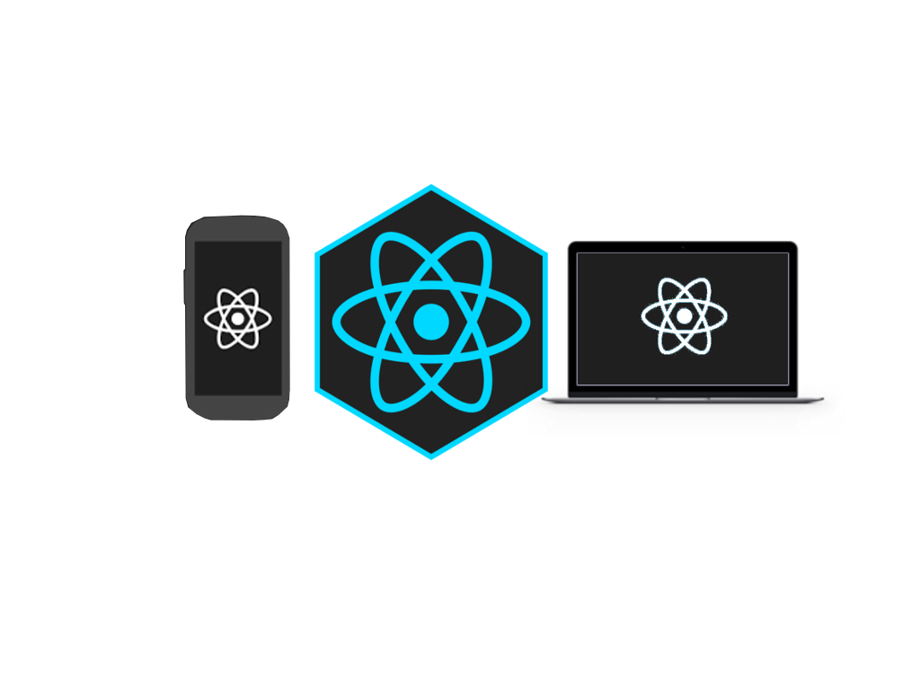




Slide 6
Functional Requirements

Slide 7
SignUp
Why: Necessary feature gives the system the ability to add new users
Expected Input: User information like: userName, password, email ...
Expected Output: Confirmation Message
Interacts to: Customer or Company
Process: Receives the parameters for the View sends them to the model to add new user to the database
SignIn
Why: Necessary feature enables the user to login to the system
Expected Input: userName, password
Expected Output: Confirmation Message
Interacts to: Customer or Company
Process: Receives the parameters from The View working with the model to search the database for the userName and returns true if found and the password matches else returns false

Slide 8
AddTrip
Why: enables a Company of adding new trip
Expected Input: trip details
Expected Output: confirmation message
Interacts to: Company
Process: gets the parameters from the View and sends them to the Model to store them
ReserveTrip
Why: The user must be able to reserve a trip as he wants to attend.
Expected Input: Trip that the customer specifies.
Expected Output: Notification with a successful reservation for the trip.
Interacts To: Customer.
Process: The customer asks the system to reserve a trip after viewing its details then the system make the customer able to pay the fees and reserve a seat for the customer on the trip.

Slide 9
Non-Functional Requirements

Slide 10
ID: QR1
TAG: Usability
TITLE: Prominent search feature
DESCRIPTION : The search feature should be prominent and easy to find for the user.
WHY: In order for a user to find the search feature easily.
ID: QR2
TAG: Usability
TITLE: Usage of the search feature
DESCRIPTION: The different search options should be evident, simple and easy to understand.
WHY: In order to for a user to perform a search easily.

Slide 11
ID: QR3
TAG: Usability
TITLE: Usage of the result in the list view
DESCRIPTION: The results displayed in the list view should be ordered by user selected attributes or by default ordered by departure date and company rate. Selecting trip should be in one tap
WHY: In order to make the user able to find his trip easily.
ID: QR4
TAG: Reliability
TITLE: The fault tolerance of the system.
SCALE: If the system loses the connection to the Internet or the system gets some strange input, the user should be informed.
MEASURE: Measurements obtained from trials during testing.
MUST: 100% of the time.

Slide 12
ID: QR5
TAG: Response Time
TITLE: The fastness of the search
SCALE: The response time of a search
MEASURE: Measurements obtained from 1000 searches during testing.
MUST: No more than 2 seconds 100% of the time.
WISH: No more than 1 second 100% of the time.
ID: QR6
TITLE: Internet Connection
DESCRIPTION: The application should be connected to the Internet.
WHY: In order for the application to communicate with the database.

Slide 13
Use-case Diagram

Slide 14
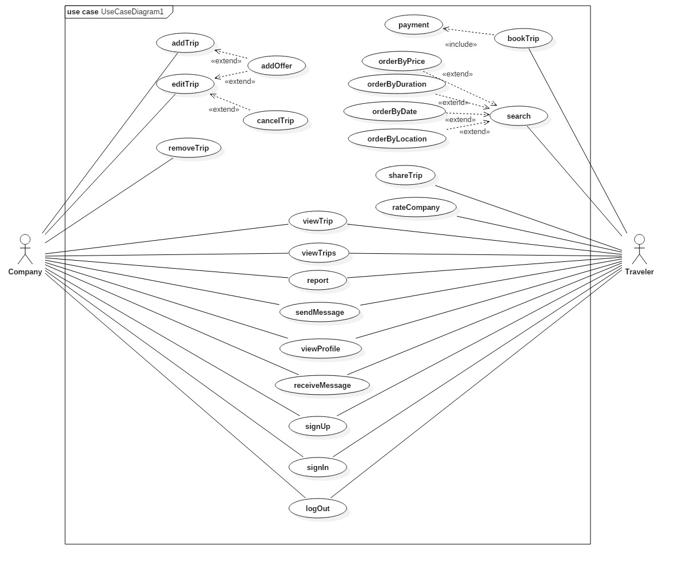

Slide 15
Sample Use-cases

Slide 16
Use Case ID | 001
Use Case Name: | SignUp
Actors: | Company, Customer
Pre-conditions:
Post-conditions: | The user logs in and accesses the contents of the website and can make his/her allowed functions
Flow of events: | User Action | System Action
The user registers as company or Traveler
 | The system displays the form to user to enter his/her email and password….and all the required information
The user enters all the required information
 | The system validates the user's input and saves the data in the data-base.
Exceptions: | User Action | System Action
1. The user enters his/her information and the e-mail is not valid.
 | The system displays an error
 | 2. The user enters an email that already exists in the system data-base
 |  | The system replies with error.
Includes: | Validations
Notes and Issues: | The validation function would be between the system and the user, it will send message to the email the user entered to verify, and on the other side it has a data to check if the data that the user entered is unique or not.
Notes:
1

Slide 17
Use Case ID: | 002
Use Case Name: | addTrip
Actors: | Company
Pre-conditions: | Logged-in user.
Post-conditions: | Company saves the Trip
Flow of events: | User Action | System Action
 | Company chooses “Add Trip”
 |  | Site displays the form that contains the information needed for creating a new Trip
 | Company inputs the information and press “Add”
 |  | System saves the information in the data-base
Includes:

Slide 18
Use Case ID: | 003
Use Case Name: | bookTrip
Actors: | Traveler
Pre-conditions: | Logged-in user.
Post-conditions: | Traveler books the trip.
Flow of events: | User Action | System Action
 | Traveler chooses “Book Trip”
 |  | Site displays the payment form to let the user enter his credit-card ID.
 | Traveler inputs his data and clicks “Book”.
Exceptions: | User Action | System Action
 | user enters invalid credit-card
 |  | System displays “Invalid credit-card” message to the user.
Includes:

Slide 19
Class Diagram

Slide 20
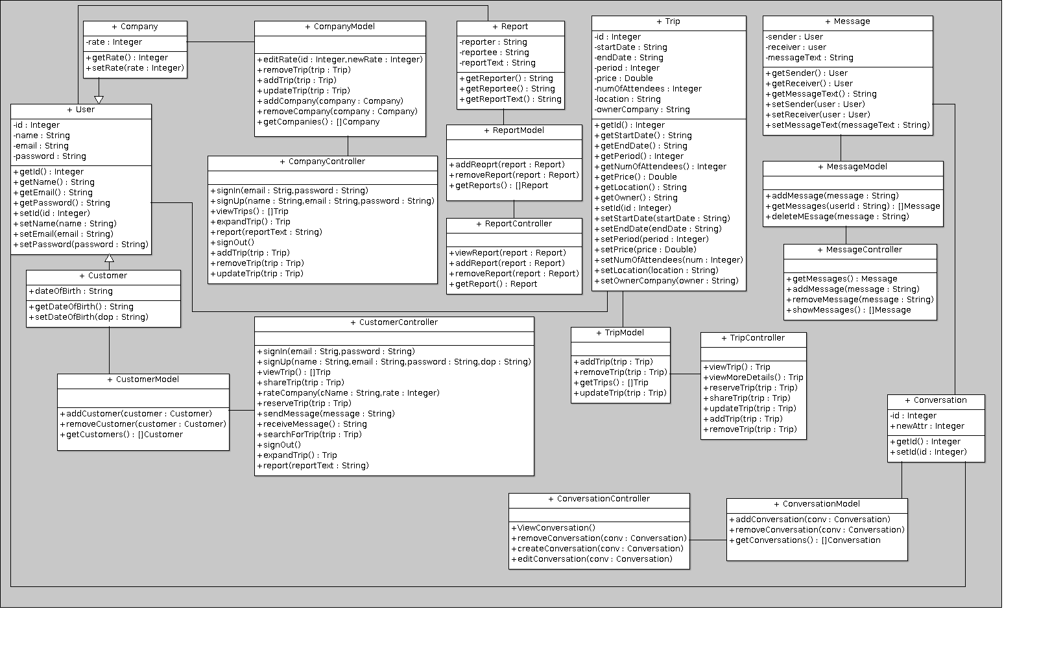
Notes:
1

Slide 21
Sequence Diagram

Slide 22
Entity Relationship Diagram
Notes:
1

Slide 23
