Slide 1

Team 10 AI Chess Bot
Zac Johnston, Gilen Garcia, Kyle Tilley, Mohamed Shaaban, Ahmed Abdelnaby and Carson Loveless

Slide 2
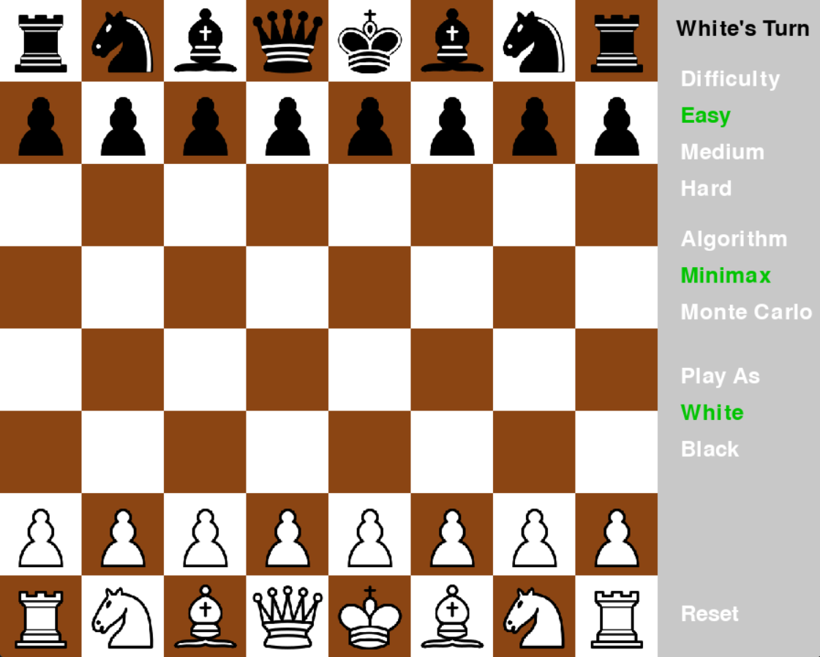
Introduction
Player vs. AI Chess Environment
Player chooses algorithm AI evaluates the board with, including Minimax and Monte Carlo
Algorithms have Easy, Medium, and Hard difficulties
Game flows like a regular game of chess, white plays first, first to checkmate wins

Slide 3
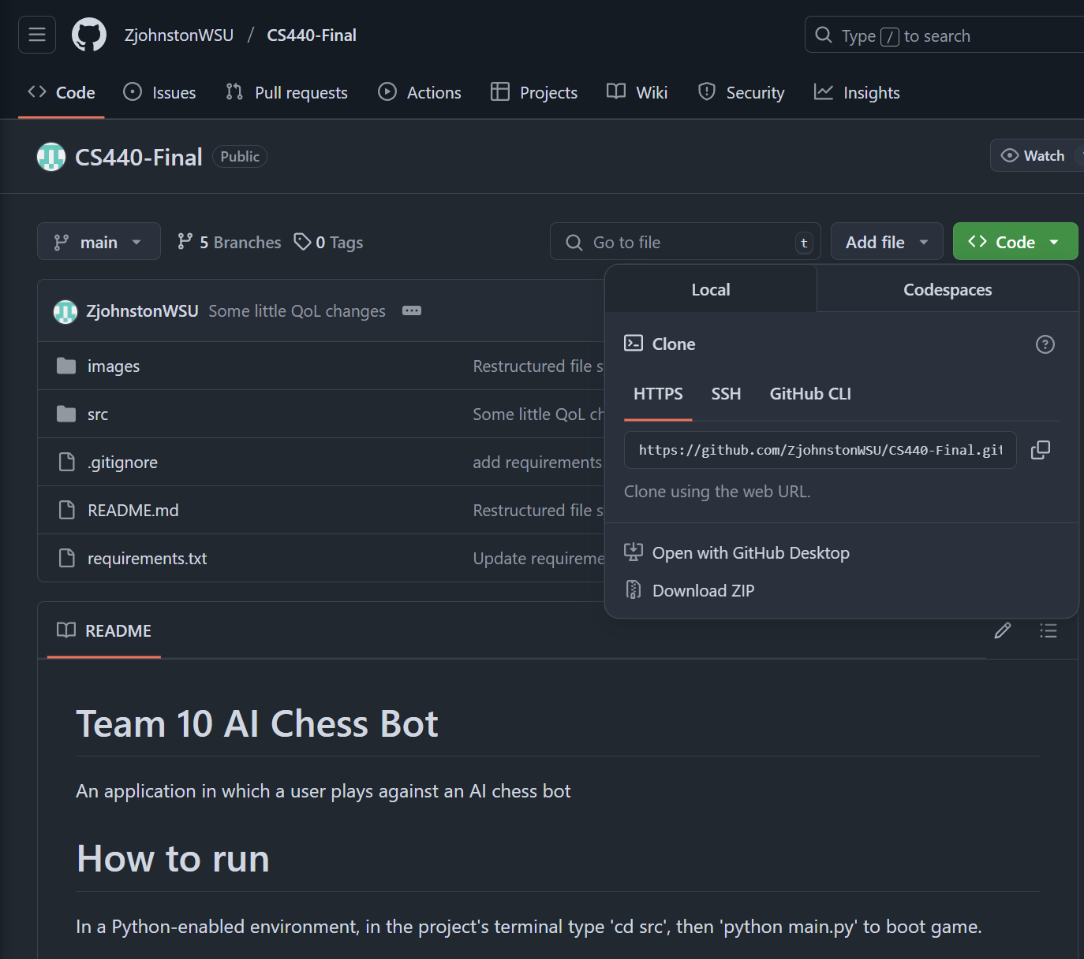
How to Download/Install the Code
Clone the project from GitHub
https://github.com/ZjohnstonWSU/CS440-Final.git
In a Python-enabled environment, in the terminal navigate to the projects "src" directory
Use command "python main.py" to boot game

Slide 4
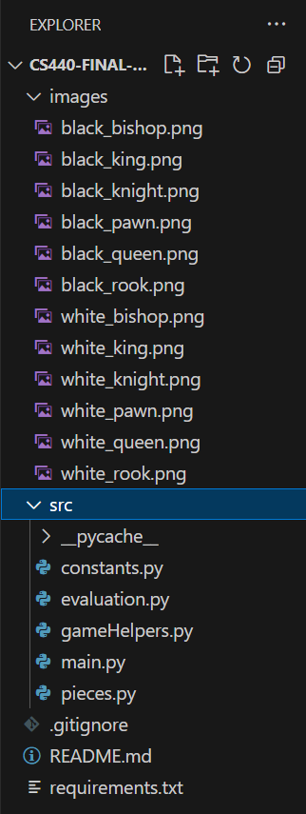
Code Structure Overview
main.py - Game Loop
constants.py - Configuration & Global Values
gameHelpers.py - Game Mechanics & AI
evaluation.py - Board Scoring
pieces.py - Chess Piece Model
Images - Icons for Chess Pieces

Slide 5
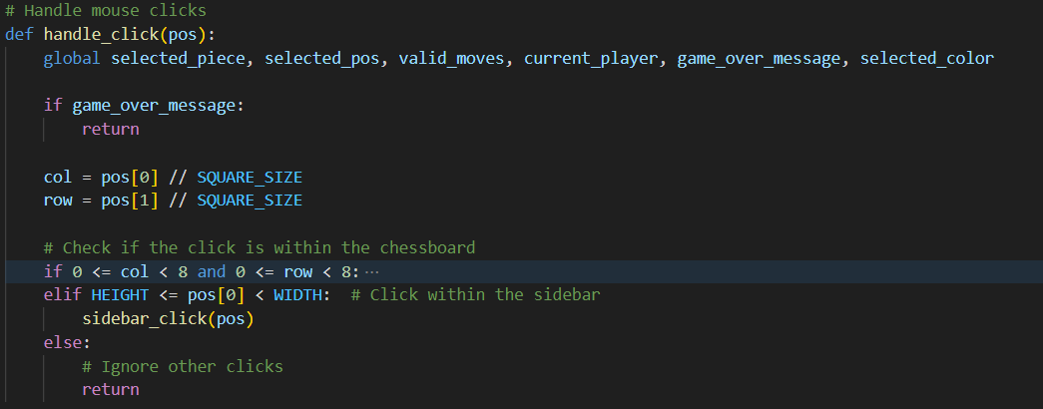
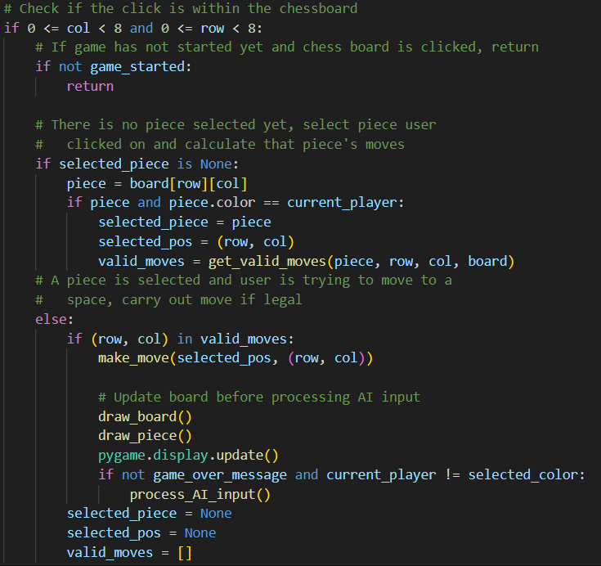
Process Flow
Main loop updates UI while waiting for the player to click
Once clicked, handles player's interactions, breaking into subroutine to handle menu interactions
If player's turn, handles player's move, checks for check/checkmate, handles AI's move, check for check/checkmate again then waits again in main

Slide 6
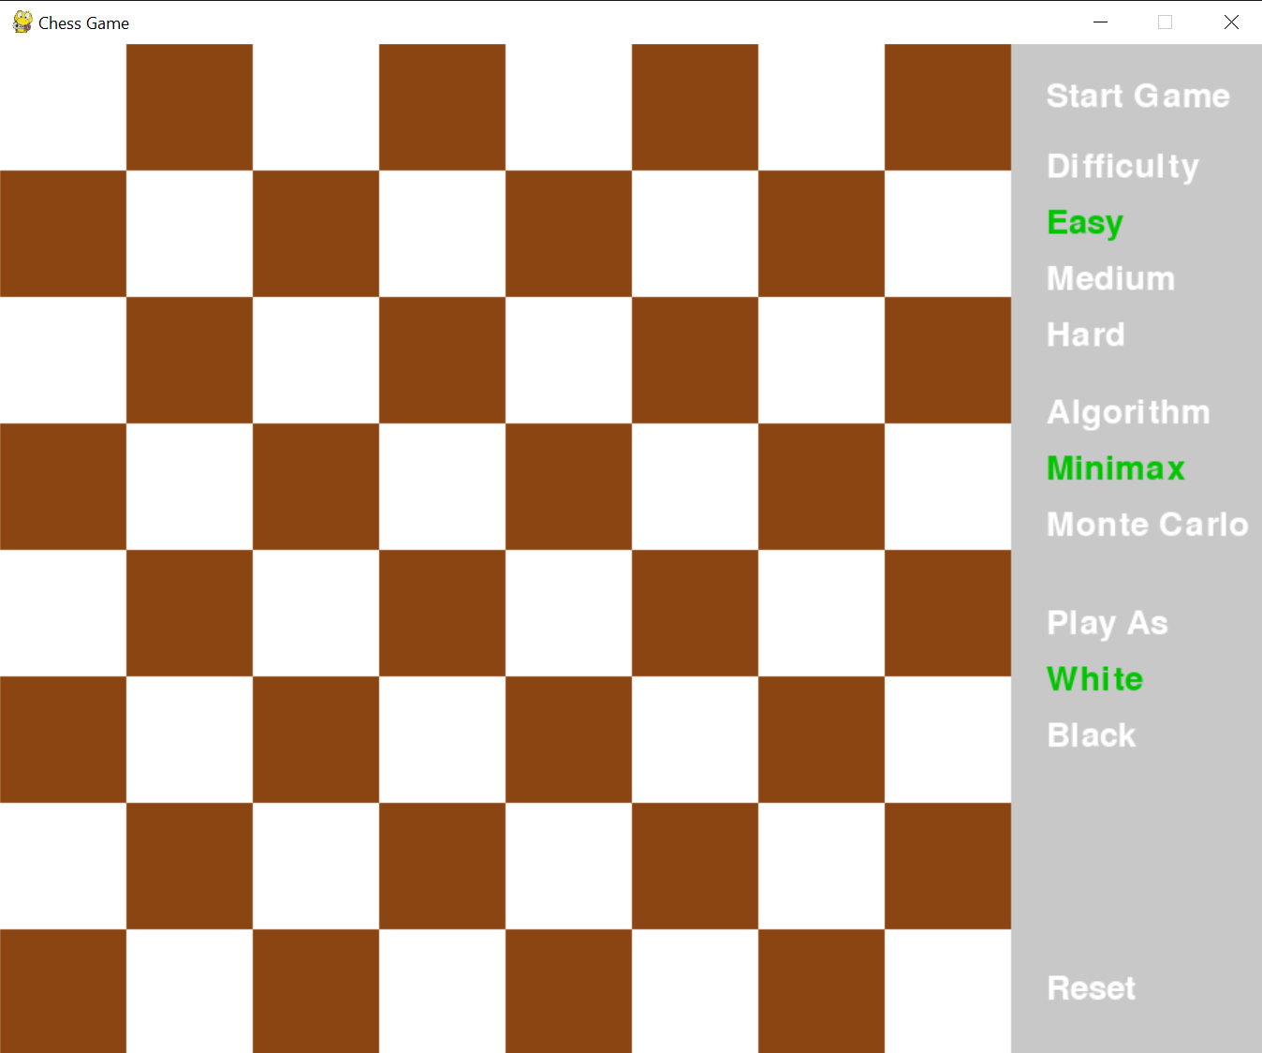
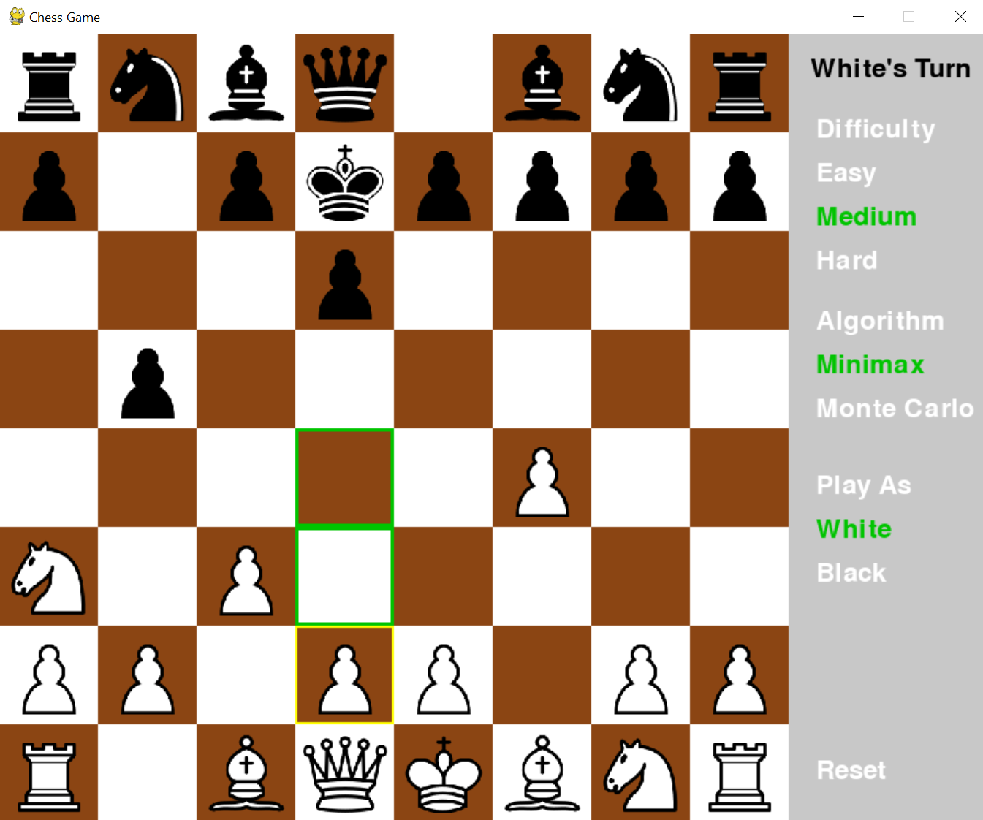
User Interface
Options for Selecting
Difficulty (Easy / Medium / Hard)
Algorithm (Minimax / Monte Carlo)
Color to play as (White / Black)
Start Game and Reset
Game Flow
Empty Board until game has started
Pieces will populate in respective area
Selecting a chess piece will show available move

Slide 7
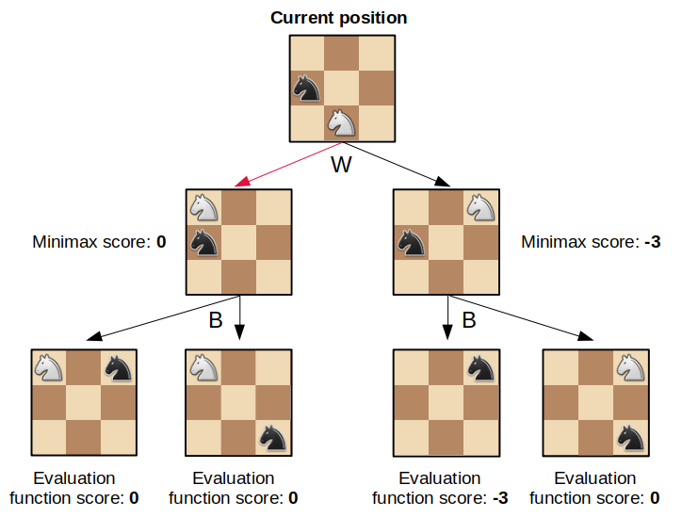
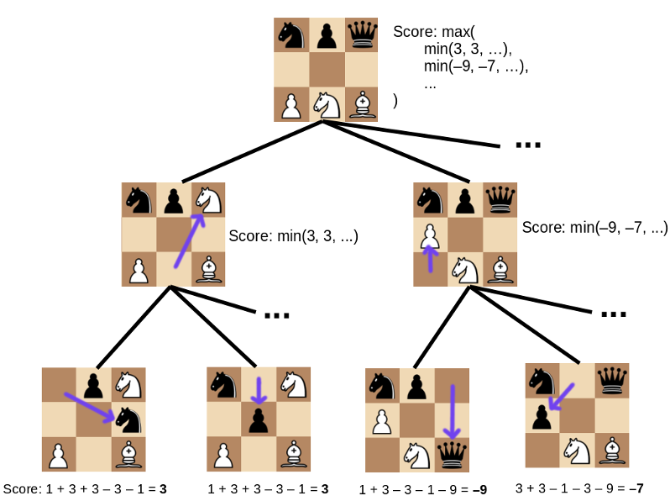
Minimax Algorithm
Minimax and Alpha Beta Pruning
Complexity:
Easy vs Medium vs Hard
Heuristic Function:
Fixed Heuristic Function (Current Board Chess Piece Weight + Pieces Advantage Locations)
Weak evaluation = weak play
Alpha Beta Pruning :
Type A

Slide 8
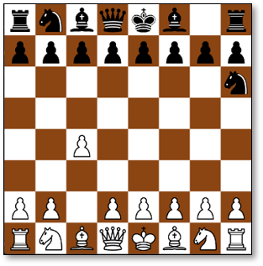
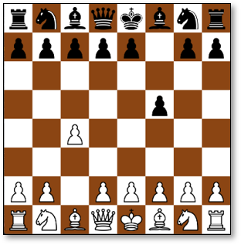
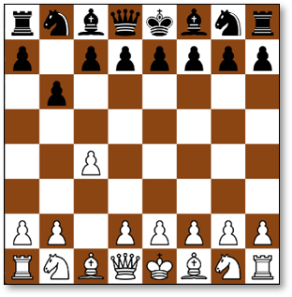
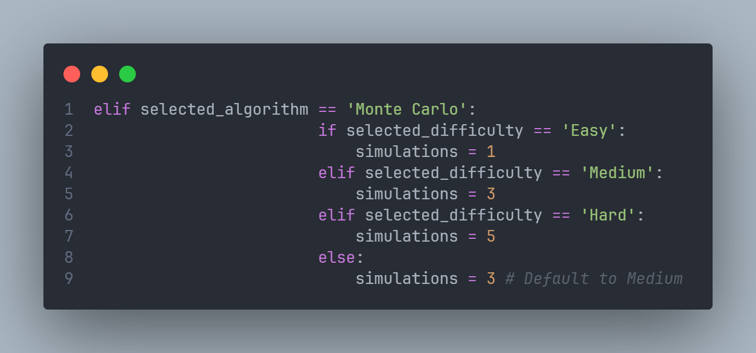
Monte Carlo Algorithm
Implementation
Simulates multiple games
Randomized move selection
Evaluation-based decision making
Difficulty Changing Logic
Number of simulations changes based on
the selected difficulty.
Higher difficulty → more simulations → better AI decisions.
Notes:
Move ordering is the process of sorting or prioritizing the moves to be explored at each node in the game tree so that the most promising moves are evaluated first.
Search Depth Limitation: The Minimax algorithm evaluates positions up to a fixed depth (e.g., 4 plies). Beyond this depth, it relies on a static evaluation function (Type A heuristics) to estimate the position's value.

Slide 9

Future Work
Faster move generation
Parallelization
Move-ordering
Transposition table
Opening book integration
Faster and more strategic opening moves
Improved difficulty settings
Blunder chance
Endgame knowledge

Slide 10

Demo

Slide 11

Questions?

