Slide 1
Finally,
Operating Systems!
01
Notes:
Hello, everyone.
Thank you for studying

Slide 2
Finally,
Operating Systems!
Notes:
this very challenging CS course with me.
First, let me ask you some questions.
Which hardware courses did you complete?
What did you learn in those courses?
How about software courses?
It’s great to know that you have already built a solid background of computer science.
But as you may or may not have noticed, when you learn the software courses, you usually follow a top-down approach

Slide 3



Finally,
Operating Systems!
program
Notes:
At first, you started with various programming languages, like C and Java.
Through those courses, you might have developed some fancy programs/applications and become very much amazed by how awesome our computers can be.
And hopefully, you might’ve also accumulated a strong interest in computer science.

Slide 4

Finally,
Operating Systems!
program
digital logic
Notes:
When you study the hardware courses, you followed a bottom up approach instead.
You probably started with Digital Logic, which models computer computation at a very low level.
For example, how information is modeled by signals in a binary fashion,
how a single transistor represents a bit,
how a gate achieves simple operations over a combination of transistors;

Slide 5
Finally,
Operating Systems!
program
organization
digital logic
Notes:
apparently, it is challenging to always break up a complex computation into sub-computations supported by digital logic
That’s why you get to know more computation units like arithmetic logic unit (ALU) in the course of computer organization.

Slide 6
Finally,
Operating Systems!
program
architecture
organization
digital logic
Notes:
It is computer architecture, a layer between software and hardware, that coordinates computer components to complete a computation.
So far, there is still one major question left unresolved: which is
how exactly are programs handed over to hardware components for execution?

Slide 7

Finally,
Operating Systems!
program
architecture
organization
digital logic
Notes:
In the course of operating systems, you will reveal this missing piece.
Operating system is a special program that manages computer hardware and software resources
and provides common services for other computer programs.
For example, many tasks may be running on our computers. It is the operating system that decides which task accesses which resources at which time instance.

Slide 8
Finally,
Operating Systems!
?
Notes:
So, what will be covered in this course?
To answer this question, let’s first walk through how our computers solve a problem
and see where operating system fits in.

Slide 9

problem
electrons
Notes:
Given a problem, eventually it’ll be the electrons that drive our computers to generate the result.

Slide 10
problem
algorithm
electrons
Notes:
But first, we need to design a method to solve the problem.
In computer science, such methods are called algorithms.

Slide 11
problem
algorithm
program
electrons
Notes:
Then based on your algorithm design, you use a certain programming language to implement it into an executable program.

Slide 12
problem
algorithm
program
runtime system
(VM, OS, MM)
electrons
Notes:
As we mentioned, program execution depends on operating system.

Slide 13
problem
algorithm
program
runtime system
(VM, OS, MM)
ISA (architecture)
electrons
Notes:
Also, in hardware courses, we know that program written in high-level programming languages cannot be understood by computer hardware.
Instead, programs need to be compiled into instructions.
An Instruction Set Architecture (ISA) defines how to encode an instruction and how underlying hardware decodes it.

Slide 14
problem
algorithm
program
runtime system
(VM, OS, MM)
ISA (architecture)
microarchitecture
electrons
Notes:
How an instruction is processed depends on specific architecture design.
For example, at any time instance, only one instruction can be executed
or different instructions can be co-executed with each instruction using a different component.

Slide 15
problem
algorithm
program
runtime system
(VM, OS, MM)
ISA (architecture)
microarchitecture
logic
electrons
Notes:
Each component in use is composed by a number of digital logics,

Slide 16
problem
algorithm
program
runtime system
(VM, OS, MM)
ISA (architecture)
microarchitecture
logic
circuits
electrons
Notes:
which are constructed by integrated circuits driven by electrons.
So among all of these layers, which will be covered in operating systems?

Slide 17
Operating Systems!
problem
algorithm
program
runtime system
(VM, OS, MM)
ISA (architecture)
microarchitecture
logic
circuits
electrons
Notes:
And this will be the parts to be covered in this course
Meanwhile, operating system highly couples with some background knowledge in previous courses,
Such as programming and architecture.

Slide 18
Operating Systems!
challenging
program
runtime system
(VM, OS, MM)
ISA (architecture)
Notes:
So obviously it’s gonna be very challenging,

Slide 19
Operating Systems!
challenging
program
for me as well…
runtime system
(VM, OS, MM)
ISA (architecture)
Notes:
even for me as an instructor.

Slide 20
for me?
Notes:
Well

Slide 21
Instructor
Kai Bu 卜凯
Visiting Professor, SFU
Assistant Professor, Zhejiang University
Ph.D. from Hong Kong PolyU, 2013
Research Interests: networking, security
(e.g., software-defined networking, RFID)
undergrads wanted
http://list.zju.edu.cn/kaibu
Notes:
I’m Kai Bu, a Visiting Professor at SFU and an Assistant Professor at Zhejiang University.
I graduated from Hong Kong PolyU in 2013.
Besides teaching, I also conduct research in networking and security.
If you happen to be interested in my research, I’ll be more than happy to work with you.
You can also know more about me and my research via my webpage.

Slide 22
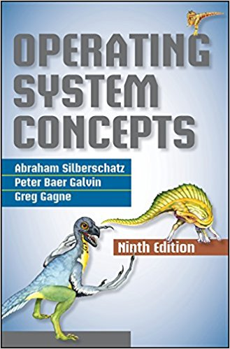
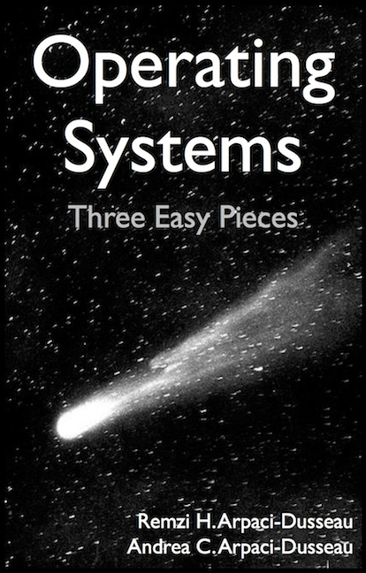

How I Prepared
(and am still preparing)
read textbooks
Notes:
Now back to the course, since it’s very challenging;
You might wonder that, as the instructor, how I prepared for teaching this course.
First, I read related textbooks, for many times.

Slide 23
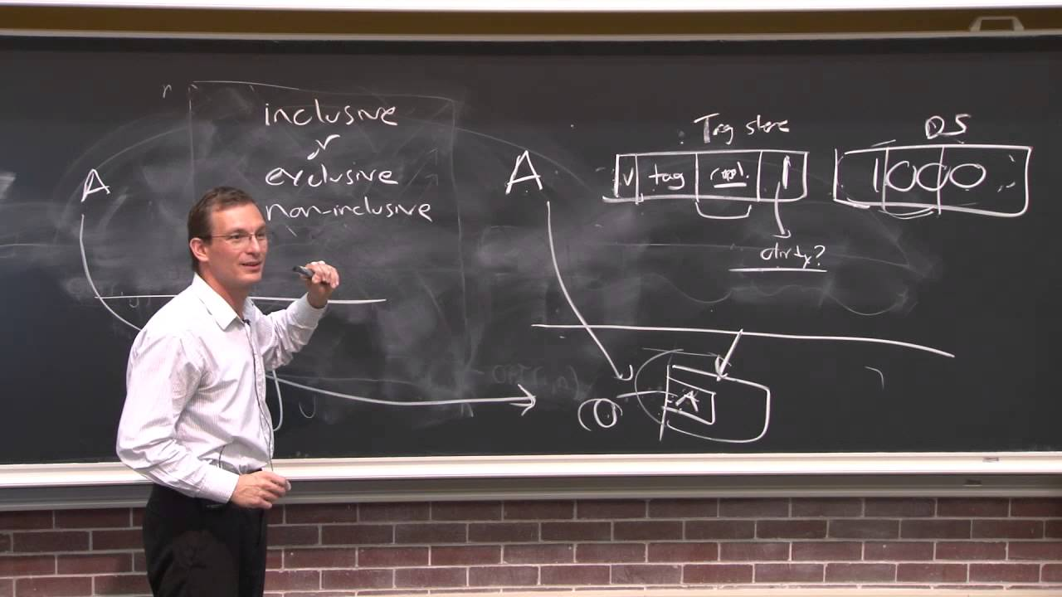
How I Prepared
(and am still preparing)
watch video lectures
Notes:
Watch online video lectures

Slide 24

How I Prepared
(and am still preparing)
practice English
Notes:
Practice English

Slide 25
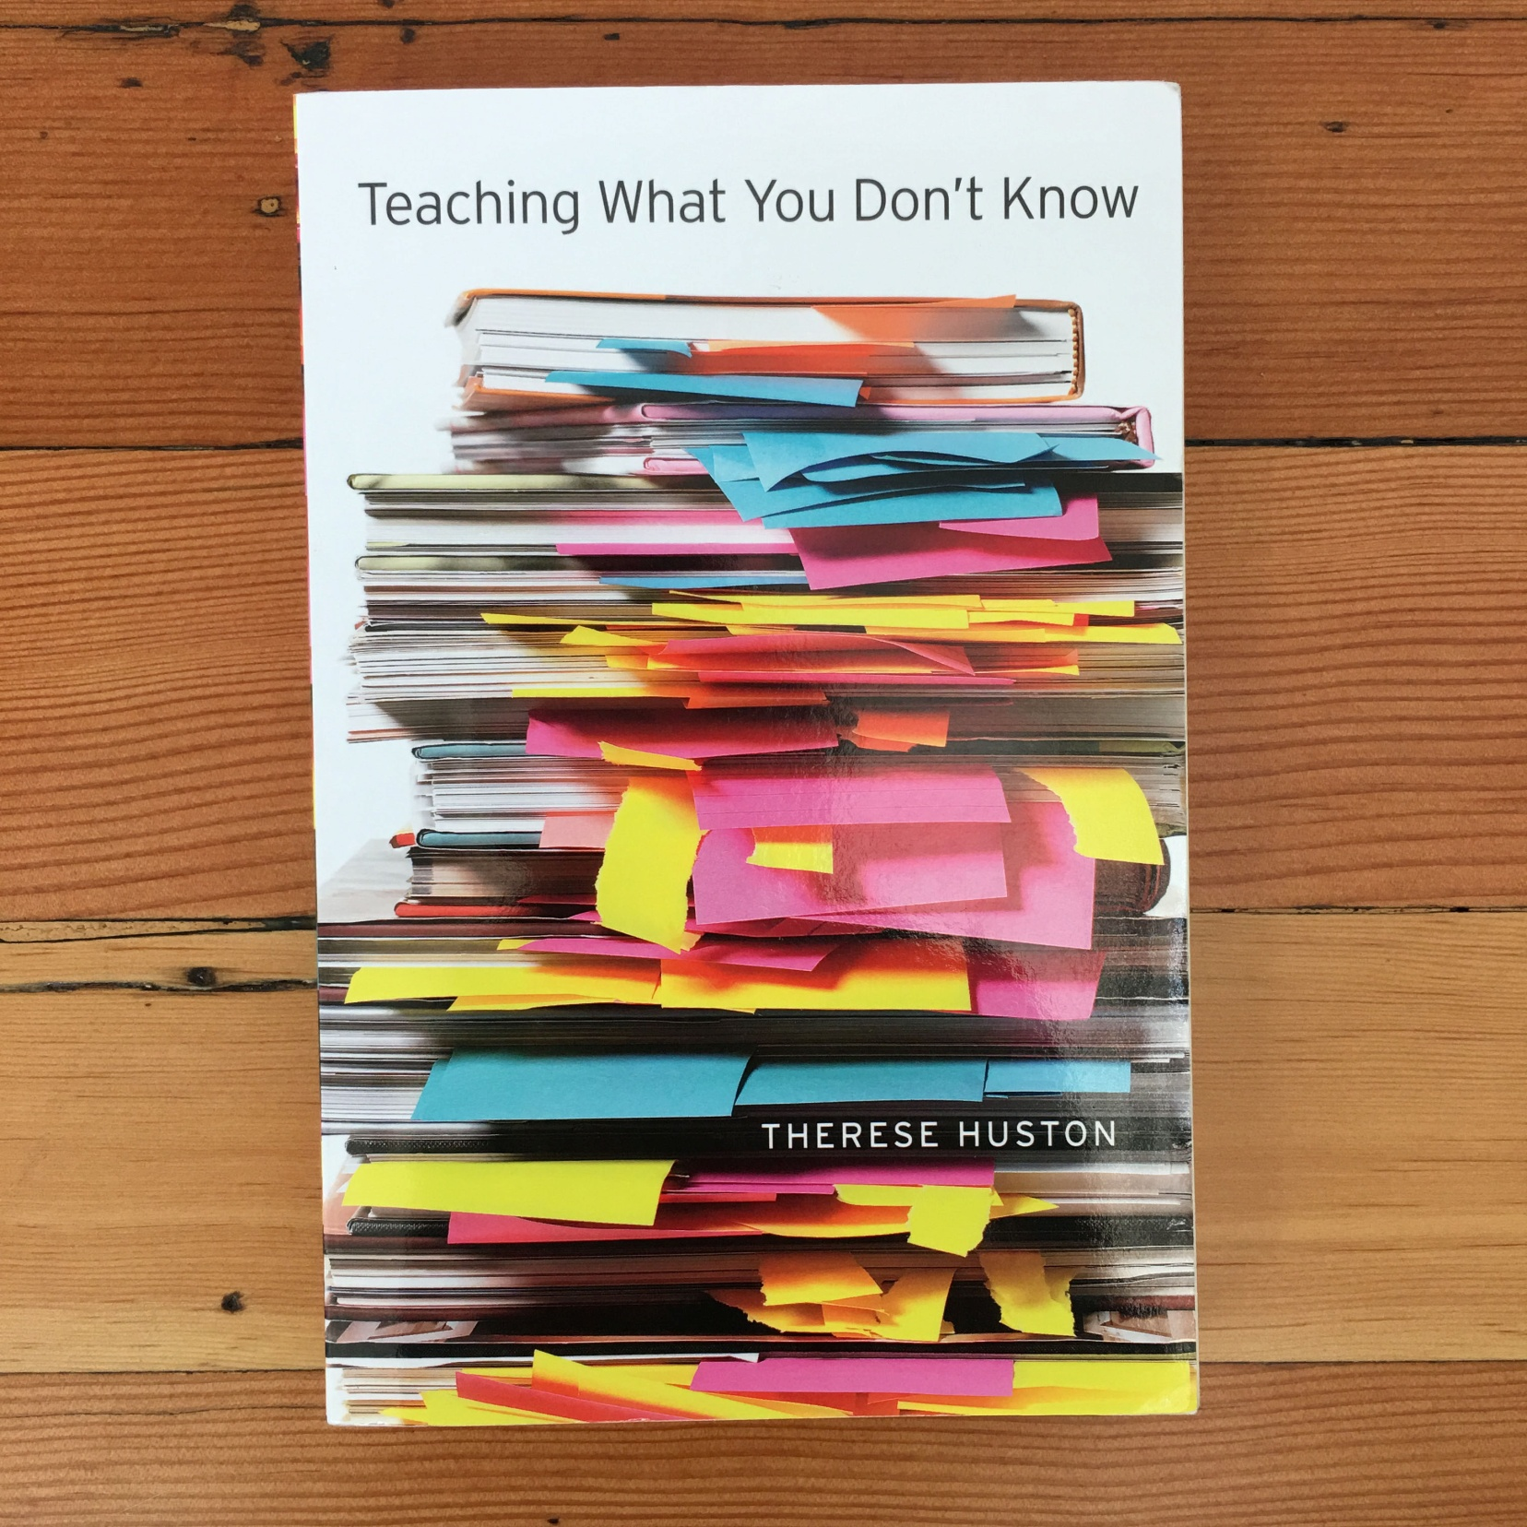

Notes:
And, I even read a book that is literally called Teaching What You Don’t Know

Slide 26
What’s to deliver?
Notes:
So, after these much preparation, what can I offer to students in my class?

Slide 27

How an OS works?
Notes:
After this course, you are expected to understand how an operating system works;

Slide 28
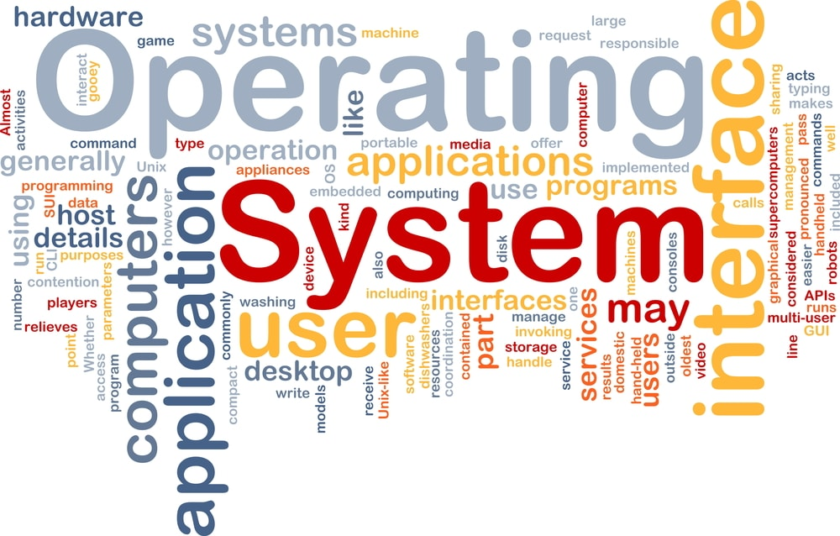
How an OS works?
Notes:
Toward that goal, you need to understand various working principles like process management, CPU scheduling, and memory management.

Slide 29
Know not only how
but also why
Notes:
You’ll start paying attention to not only how something works but also why it works in that way.

Slide 30
Know not only how
but also why
Know not only how
not
Notes:
You may also start wondering why it doesn’t work in some other ways.

Slide 31
Understand the principles
Notes:
Through such comparison, you can better understand the working principles of things.

Slide 32
Explore the tradeoffs of
different designs and ideas
Notes:
You’ll more and more get used to seeing things from different perspectives.
At most cases, a solution cannot be the best at every perspective.
Sometimes, you have to find a tradeoff among all the desired perspectives.

Slide 33
Thought-provoking!
Notes:
Probably it’ll be one of the most thought-provoking courses you’ve even taken.

Slide 34
Textbook
Notes:
The textbook we use is Operating System Concepts, the 9th edition.

Slide 35
Why This Book?
SFU Professors choose it ☺
Recommended reference:
Operating Systems: Three Easy Pieces
Notes:
This simply follows SFU Professors’ choices.
You are also strongly encouraged to read the book Operating Systems: Three Easy Pieces as well.

Slide 36
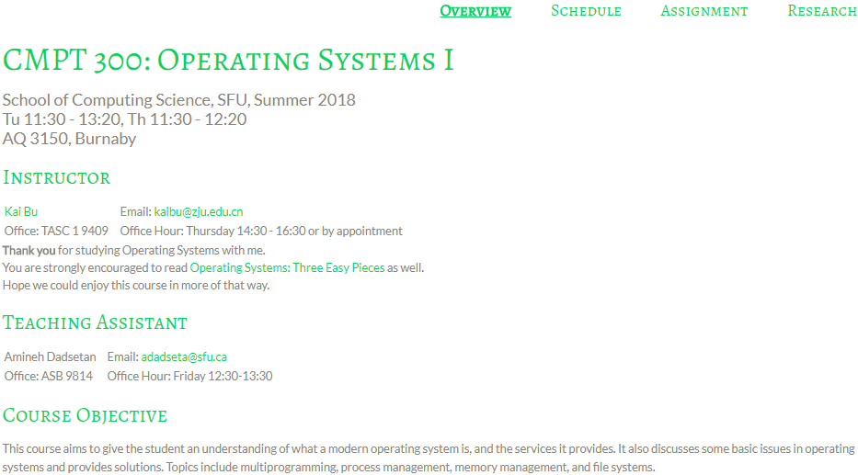
Course Website
http://list.zju.edu.cn/kaibu/cmpt300
Notes:
all announcements and materials like slides and assignments will be posted on this website.

Slide 37
Teaching Components
Lectures
Assignments OR Research Practice
Notes:
Teaching content will feature lectures, and assignments OR research projects.

Slide 38
Teaching Components
Lectures: Chapters 1-11, 14, 17
Assignments OR Research Practice
Notes:
Lectures will cover chapters 1 through 11, 14, and 17

Slide 39
Topics
Operating System Structures
Processes & Threads
CPU Scheduling & Process Coordination
Memory Management
Storage Management & File Systems
I/O Systems
Security & Protection
Notes:
Major topics include

Slide 40
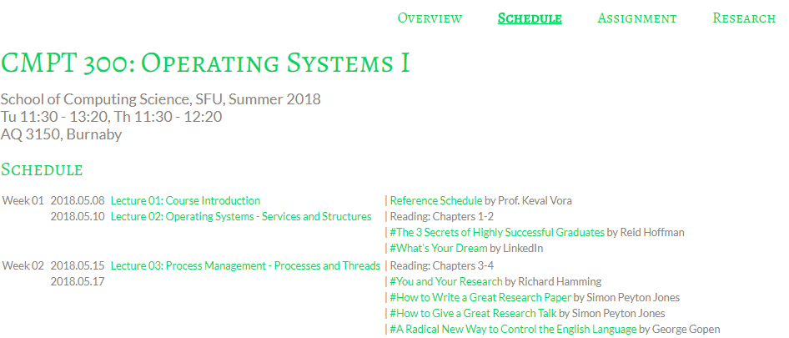
Reference Schedule
by Prof. Keval Vora
http://list.zju.edu.cn/kaibu/cmpt300/ref-schedule.pdf
Notes:
Here’s a reference schedule by Professor Vora.

Slide 41
Teaching Components
Lectures
Assignments OR Research Practice
Notes:
For assignments

Slide 42
Assignments
Problem sets
Projects
Notes:
you can either choose traditional problem sets and projects

Slide 43
OR Research Practice
http://list.zju.edu.cn/kaibu/cmpt300/research.html
Report: research paper oriented
Prototype
Presentation
Notes:
Or challenge yourself with the research practice

Slide 44
Why do you care?
Notes:
So why do u care about the research part?

Slide 45
Waive other assignments
Notes:
First, it can help you waive other assignments

Slide 46
More than that?
Notes:
But what’s more than that is, if you really go deep into the research practice,

Slide 47
Learn to
learn things differently
Notes:
You’ll learn to learn things differently

Slide 48
Know not only how
but also why
Know not only how
(not)
Notes:
You’ll start paying attention to not only how something works but also why it works in that way, and why it doesn’t work in some other ways.

Slide 49
Read this book and you’ll see
Operating Systems: Three Easy Pieces
http://pages.cs.wisc.edu/~remzi/OSTEP/
Notes:
Again, I’m recommending the book Operating Systems: three easy pieces;
It’ll help to build background knowledge for operating systems as well as shape your research mind.

Slide 50
Grade?
Notes:
Finally, the grading policy

Slide 51
Grading (tentative)
40% | Assignments OR Research
20% | Midterm Exam
40% | Final Exam
Students must attain an overall passing grade on the weighted average of exams in the course in order to obtain a clear pass (C- or better).
Violation of academic honesty may result in a penalty more severe than zero credit for an assignment, a test, and/or an exam.
Notes:
We’ve talked about several components this course requires, here’s how they contribute to the final grade.

Slide 52
Respect SFU Policies on
Academic Honesty and Student Conduct
Notes:
You are expected to respect SFU Academic Honesty and Student Conduct Policies: http://www.sfu.ca/policies/gazette/student.html

Slide 53
How will I teach?
Notes:
Then, how will I teach?

Slide 54
What Students Expect from Instructors
Fun
Humor
Expertise
Easy exam
High grades
…
Notes:
For most of us, an ideal instructor should be fun and humorous, meanwhile, and be an expert for what is taught.
More important, exams should be easy and grades should be high.

Slide 55
I wish I knew someone like this, too…
Notes:
Well…

Slide 56
Teaching Plan
Keep it Simple
Focus on the core concepts
Try to help you more easily understand
Notes:
So here’s how I teach.
For every teaching component, I’ll try to keep it simple and focus on the core concepts.
The ultimate goal of my teaching is to help you more easily understand what the textbook delivers.

Slide 57
#What’s More to Share
helpful/inspiring resources
#The 3 Secrets of Highly Successful Graduates by Reid Hoffman
Notes:
I’ll also share with you some helpful or inspiring videos and articles.

Slide 58
How will you contribute?
Notes:
Besides my efforts, your contributions will also be highly appreciated.

Slide 59
Thanks In Advance
Study group
Class participation
…
AT LEAST
submit assignments
show up to midterm&final exams
Notes:
For example, you can start study groups for peer discussion,
You can actively participate in class discussion to make the class more interactive,
At least, please submit assignments in time and show up to exams.

Slide 60
Acknowledgement
SFU-ZJU DDP Coordinators:
Danyu Zhao, Xiaolan Xiang
Janice Regan, Qianping Gu, Keval Vora
Many more
Notes:
Now we have introduced course logistics and contents.
I would also like to thank SFU-ZJU DDP coordinators Danyu and Xiaolan, Professor Janice, Qianping, and Keval, and many other colleagues and students.
They provide generous help throughout my preparation for teaching this course.

Slide 61
?
Notes:
So far, any questions?

Slide 62

Who’s Who
Notes:
Roster;
Now it’s time for the class to get the first impression of each of you.
Please briefly introduce yourself if you like when I call ur name.

Slide 63
Ready?
Notes:
Great to know u all,
Now, Ready for an adventure to operating systems?

Slide 64

#The 3 Secrets of Highly Successful Graduates
Notes:
Cause if not now, when?

